Slide 1
GrantTracker Enhancements
MRAM
June 11, 2020
Austin Campbell, Grant Analyst
Grant and Contract Accounting (GCA)

Slide 2
Agenda
View Open GrantTracker Notes for Parent and Sub Budgets in Central Location
Reports on Parent and Sub Budgets
Revised Reports on Purged budgets

Slide 3
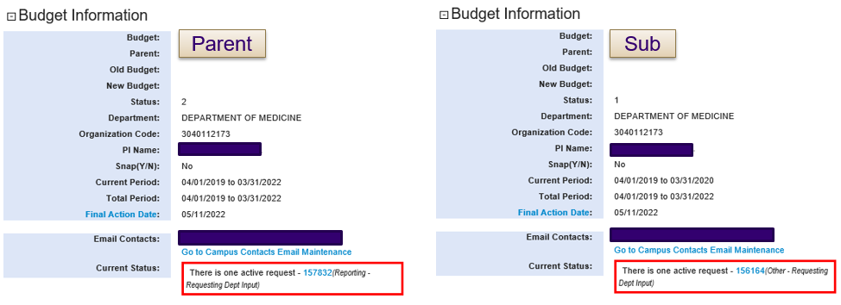
View Open GrantTracker Notes
for Parent and Sub Budgets in Central Location
Previous view – “Current Status”
Only showed open GrantTracker notes for the specific budget you were viewing
Not easy to identify all outstanding requests for one award

Slide 4
View Open GrantTracker Notes
for Parent and Sub Budgets in Central Location
Updated view – “Open GT Notes”
Parent budget view shows open notes for all budgets
Sub budget view shows open notes only for that sub budget
Ability to collapse or expand section

Slide 5
Reports on Parent and Sub Budgets
Awards requiring separate period accountability are sometimes set up with sub budgets to track expenditures for each period
Financial report schedule only visible on the parent budget GrantTracker summary page
Burdensome to navigate if a report was for a period covered only by a specific sub budget
Going forward, these sub budgets will have their own list of reports (established budgets will not be updated)
Parent budget reporting schedule will show all reports for the entire award (parent and subs)
Sub budget reporting schedule will show reports
for that specific budget

Slide 6
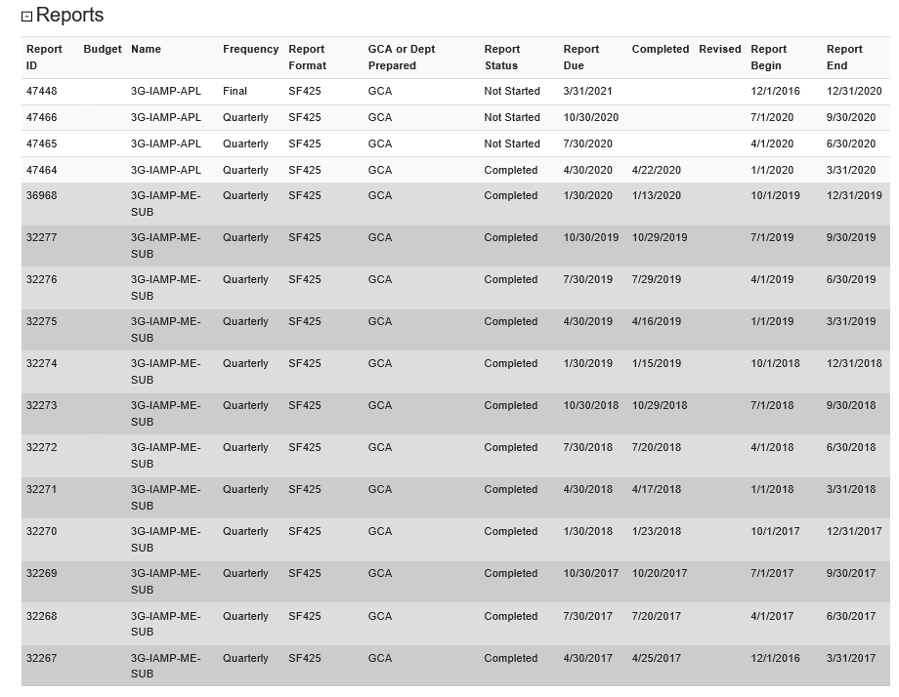
Reports on Parent and Sub Budgets
Parent
Parent view
Budget number and name now show
Sub

Slide 7
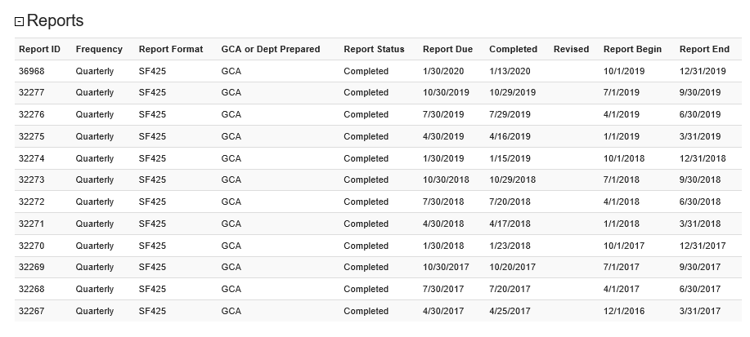
Reports on Parent and Sub Budgets
Sub budget view
Only this sub budget’s reports are listed

Slide 8
Revised Reports on Purged Budgets
Previously we couldn’t update anything in GrantTracker after a budget was purged from the Financial Accounting System (FAS)
Reports on purged budgets need to be revised occasionally
GCA can now add a revised date to reports on purged budgets in GrantTracker

Slide 9
Additional Information
Curious about other updates that have been made?
Check out the GrantTracker Release Information
https://gcaserver.finance.washington.edu/gca/GT/Release
Also accessible from any GrantTracker page if you scroll down and click on the hyperlink in the right of the footer
It should look like “ver. 4.10 6/5/2020”
This is just an example of the most recent version/update
If you have any questions or feedback regarding these updates, please contact us at gcahelp@uw.edu.

