Slide 1
SAGE BUDGET REDESIGN
A LOOK AT WHAT’S COMING SOON
Judy Chung (jachung@uw.edu)

Slide 2
SAGE BUDGET REDESIGN RELEASE
June 25, 2020
5:30 pm

Slide 3
GOALS FOR TODAY
Familiarize you with the project drivers, goals, and user engagement
Preview the new layout & highlights
Share the support/change management plan
Answer questions

Slide 4
DRIVERS
Usability concerns raised by users
Overly complex
Not PI friendly
Inefficient (Excel preferred)
Gaps, needs not met
Many shadow systems and different formats
Challenging for reviewers
Calculation errors, cross-checking needed
Not leveraging institutional data
Notes:
Create a more streamlined, efficient, intuitive design
Address gaps
Upgrade infrastructure to support system integrations in the future

Slide 5
CAMPUS ENGAGEMENT
Survey - over 200 responses
Focus Groups - 3 sessions
SAGE Budget Advisory Group - met monthly
Usability Testing - 3 sessions
RAPIT, RAPN - preview & input
Notes:
Create a more streamlined, efficient, intuitive design
Address gaps
Upgrade infrastructure to support system integrations in the future

Slide 6
NEW DESIGN FEATURES

Slide 7
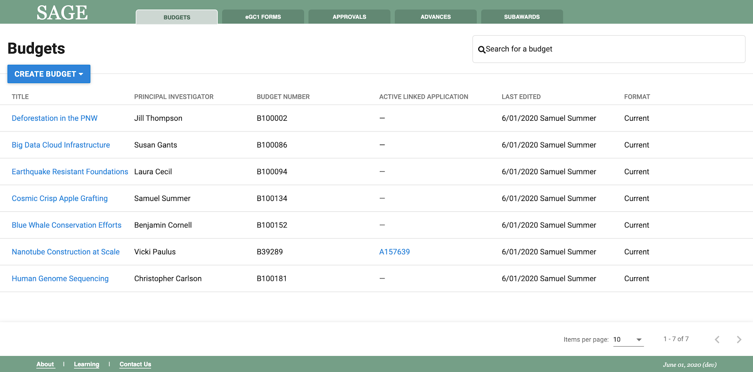
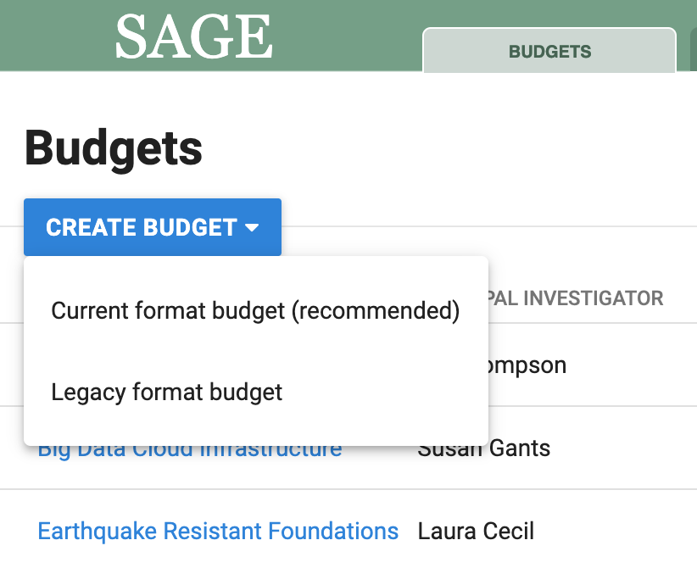
BUDGET LIST REVISIONS
For initial release, users can choose to create new budgets in “Legacy” (old SAGE) format, or use the redesigned “Current” format.
Search
Create
New Budgets
(current or
legacy)

Slide 8
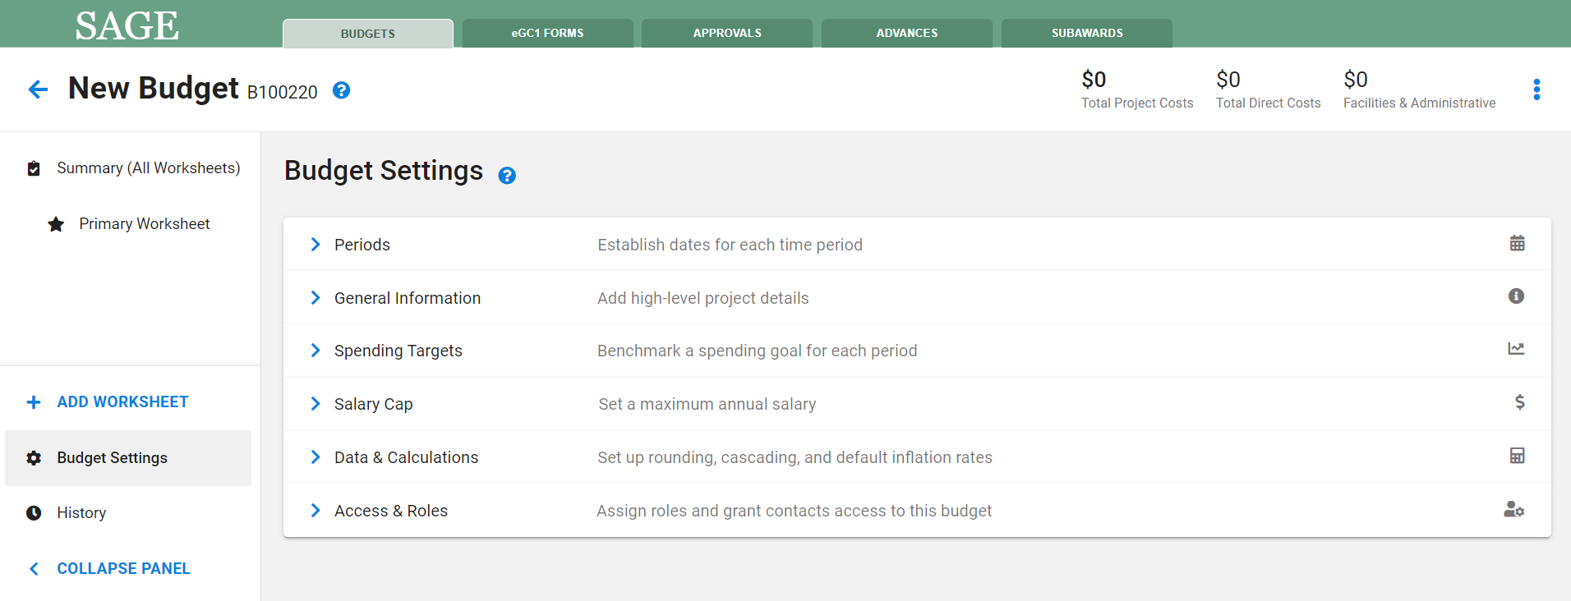
NEW BUDGET - SETTINGS
Notes:
Streamlining by only requiring entry of periods at time of create. By default, will auto-create a new Primary worksheet.

Slide 9
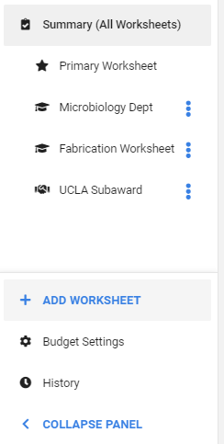
LEFT NAVIGATION WITH MULTIPLE WORKSHEETS
New more intuitive left navigation
Better view of all worksheets included in the overall project budget
Unique icons indicate type of worksheet/sub-budget
Budget Settings and History at bottom
Ability to collapse navigation panel for wider view of budget detail

Slide 10
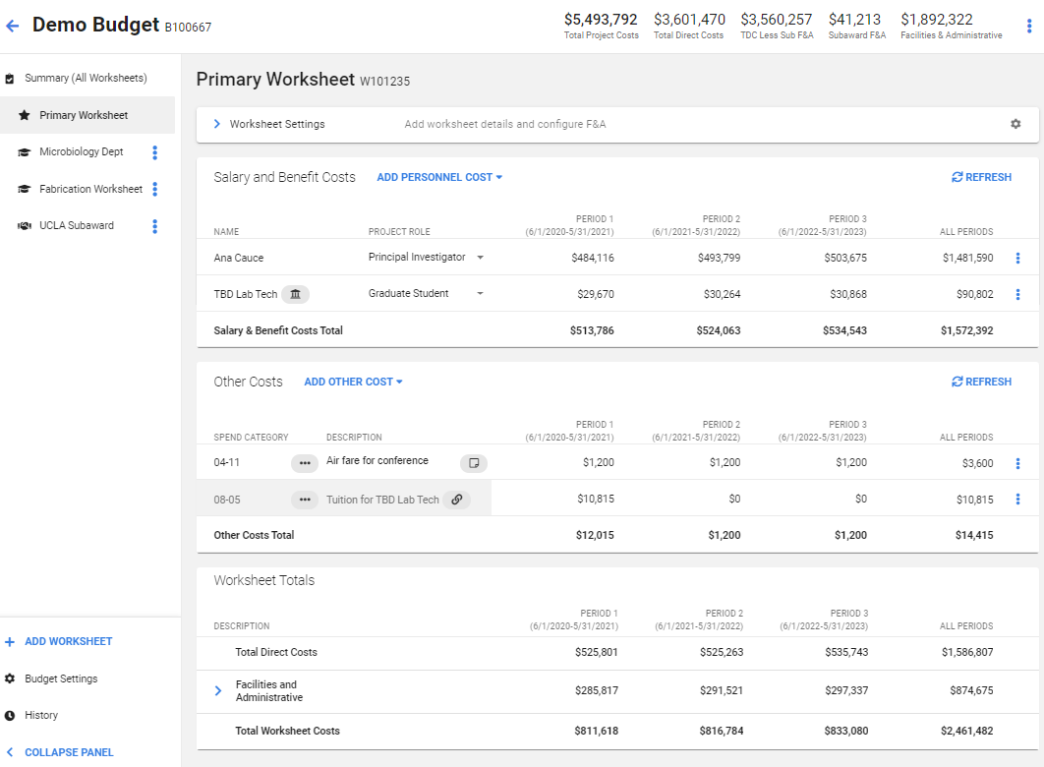
BUDGET WORKSHEETS
Project Totals
Worksheet Settings
More Actions Menu

Slide 11
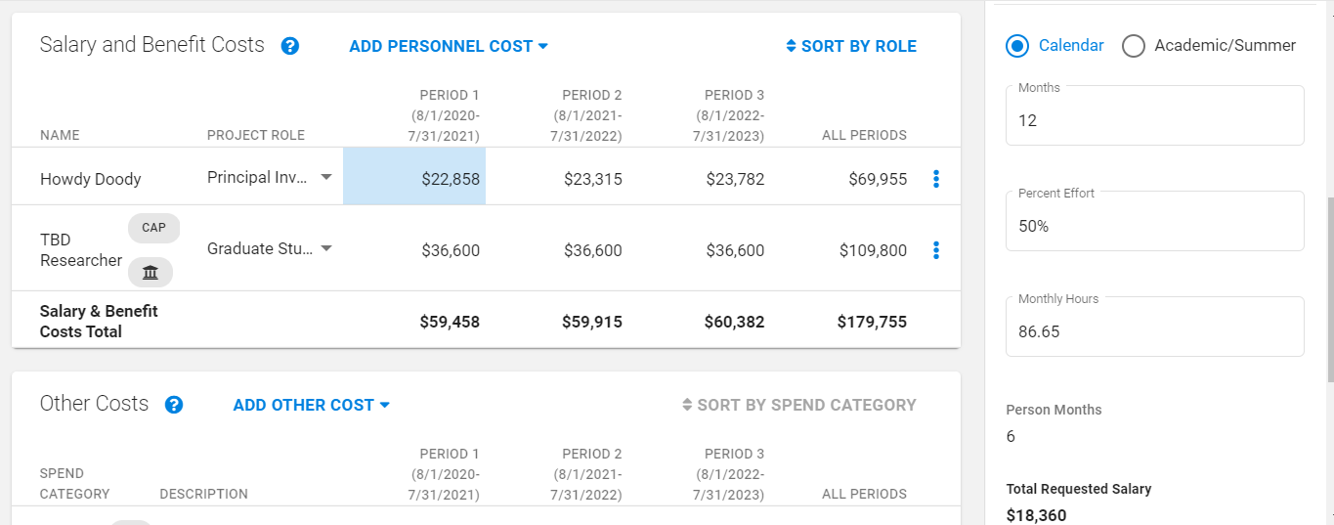
PERSONNEL ENTRY
Enter percent effort or total hours
Customize benefit rate if sponsor restricted
Salary Cap icon displays when over the cap
Click to Open
Details Panel

Slide 12
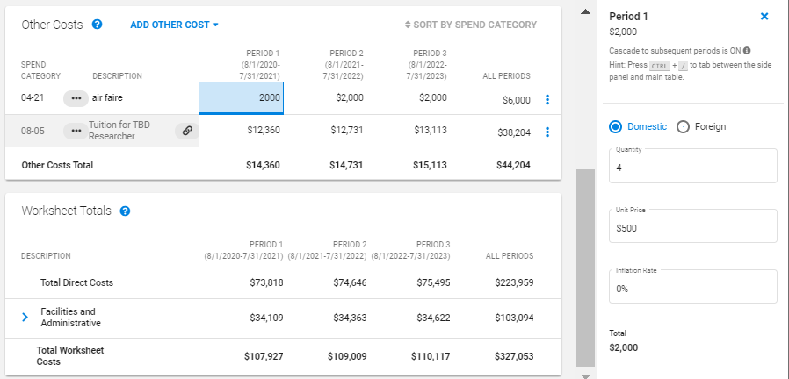
FLEXIBLE ENTRY - INLINE AMOUNT OR QTY X PRICE
Custom Entry Allows Quantity x Price and Inflation
Quick and Easy Inline Entry

Slide 13
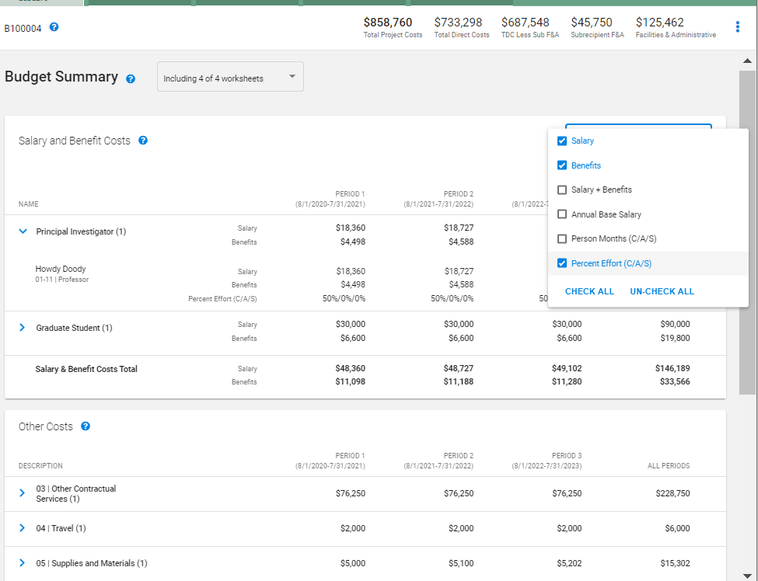
BUDGET SUMMARY
(READ ONLY ROLLUP)
Project
Totals at Top
Expand/Collapse Detailed Expense Rows
Customizable Display of Personnel Details
Notes:
This is what the reviewers would mostly work with during routing.

Slide 14
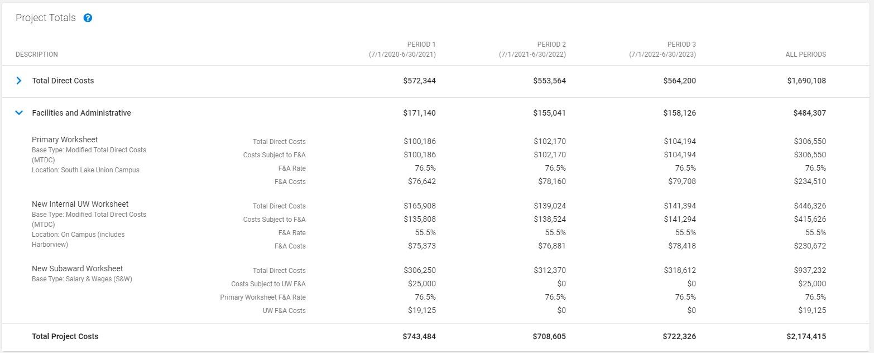
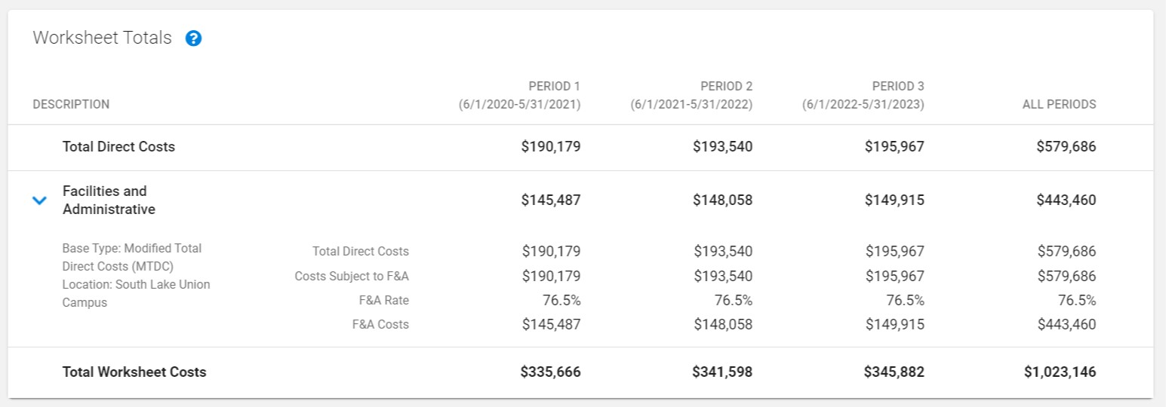
BUDGET F&A TOTALS
Add a slide focused on the Worksheet Totals, with F&A detail expanded

Slide 15
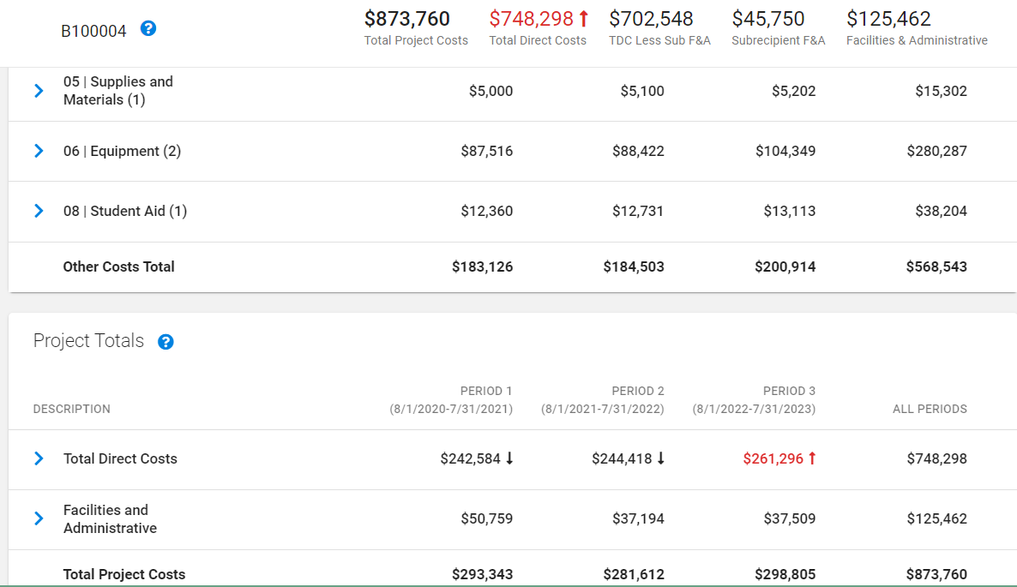
BUDGET TARGETS & LIMITS
Sample: Limit of $250,000 per period in TDC exceeded
Total Direct Costs Exceeds Limit
Period Limit Exceeded
Notes:
Can set targets & limit by period, and apply it to overall costs, TDC, or TDC less subrecipient F&A

Slide 16
EXPORT BUDGET
Export the Following to Excel (.xlsx)
> Budget Summary
> R&R Detailed Budget Format
> Individual Budget Worksheets

Slide 17
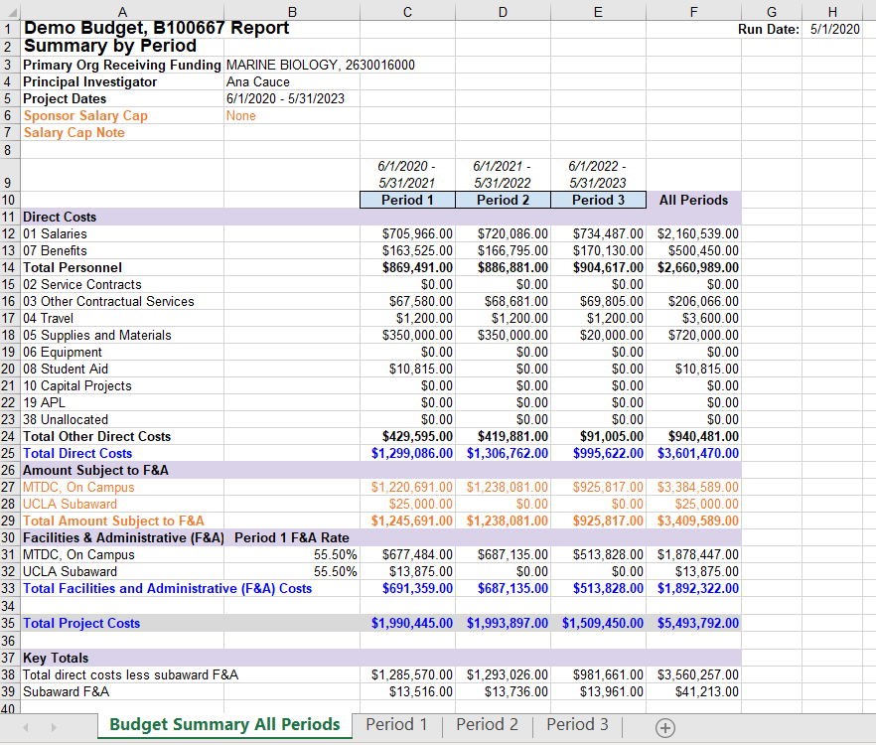
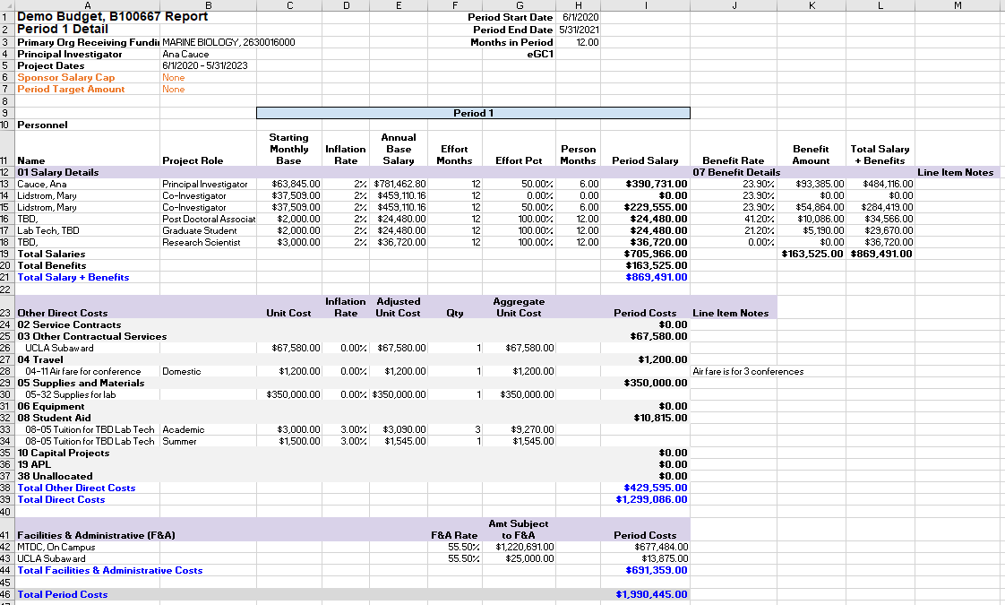
IMPROVED EXPORT LAYOUT
Budget Summary (all periods)
and period breakdown (tabs)
Notes:
Note the tabs at bottom

Slide 18
LEGACY VS CURRENT FORMAT
> Newly Created Budgets (for a limited time)
Can choose to use “legacy” (old) SAGE format or “current” (new) SAGE format
This is for the transition period only; we’ll announce in advance when full cutover will take place
> Existing Budgets
Can keep in legacy format, or upgrade to “current” (new) format
Once you upgrade a budget, you cannot revert back to legacy format

Slide 19
RESOURCES

Slide 20
RESOURCES
Date: Friday, June 26
Time: 10 am - noon AND 1 - 3 pm
Location: Zoom
https://washington.zoom.us/j/98959052578
(10 - noon) https://washington.zoom.us/j/93961983622
(1- 3)
Join us on Friday, June 26 to share your thoughts and ask questions about the redesigned SAGE Budget.
Virtual Office Hours
Demo
Date: Monday, June 29
Time: 10 - 11 am
Location: Zoom
https://washington.zoom.us/j/92856737507
Join us on Monday, June 29 for a virtual demo of the redesigned SAGE Budget.
Notes:
Links to join via Zoom will be shared in an email to MRAM next week.

Slide 21
RESOURCES
> Department Presentations
If your department is interested in a demo or focused discussion, contact us
at oris@uw.edu
SAGE Budget User Guide
New information will be published as we release the new design at the end
of June: http://www.washington.edu/research/tools/sage/guide/sage-budget/
SAGE Budget Class
Attend a SAGE Budget class offered quarterly through CORE: https://www.washington.edu/research/research-administration-learning/sage-budget/
Notes:
July 8 Budget class is currently full - looking into opening this up so more participants can attend but TBD.

Slide 22
SAGE BUDGET REDESIGN RELEASE
June 25, 2020
5:30 pm
Notes:
Reminder that this is not live yet - release date is June 25 at 5:30 pm.

Slide 23
QUESTIONS? FEEDBACK?
We encourage you to give the new
SAGE Budget revisions a try!
Send us feedback and help shape and evolve the tool further. (sagehelp@uw.edu)

