Slide 1
MRAM | Monthly Research Administration Meeting
July 9, 2020 9:00 AM – 10:00 AM HOSTED REMOTELY Join the LIVE Webinar: https://washington.zoom.us/j/346891888
TOPIC | PRESENTER | EMAIL | MIN
Welcome | Kirsten DeFries Research Compliance & Operations | kirsten5@uw.edu | 2
Upcoming DHHS Changes | Jackie Paule Grant & Contract Accounting | gcahelp@uw.edu | 5
Office of Research Misconduct Proceedings | Julie Severson Office of Research | severson@uw.edu | 15
Extension & Expiration of Covid-19 Flexibilities on Sponsored Awards | Andra Sawyer Post Award Fiscal Compliance Carol Rhodes Office of Sponsored Programs | gcafco@uw.edu carhodes@uw.edu | 10
Department of Defense: Cybersecurity Maturity Model Certification (CMMC) requirement | Carol Rhodes Office of Sponsored Programs | carhodes@uw.edu | 5
NIH Reminders & Updates | Ariadna Santander Office of Sponsored Programs | filimus@uw.edu | 5
Compliance Corner | Matt Gardner Post Award Fiscal Compliance | gcafco@uw.edu | 10
CORE Update | Collaborative On Research Education (CORE) | corehelp@uw.edu | 2
NEXT MEETING August 13, 2020 9:00 AM - 10:00 AM

Slide 2
Upcoming DHHS Changes
MRAM
July, 2020
Jackie Paule, Grant Manager
GCA

Slide 3
Upcoming DHHS Changes
SF425 Reports transition to Payment Management System (PMS) Submission
Standardized Notice of Award (NOA)
Possible elimination of FCTR
FCTR = Federal Cash Transaction Report submitted quarterly by RCA
Report of cash receipts verified against expenditures on SF425 reports
Does not involve campus
Receiving emails with FCTR literature? Please forward them to me at jmatend@uw.edu
MRAM – Jackie Paule - GCA

Slide 4
SF425 Reports > PMS Submission
HRSA transitioning to PMS submission effective 10/01/2020
NIH transitioning to PMS submission effective 1/01/2021
Benefits
Improve consistency with one source reporting
Financial data across HHS will make it easy to research and find reports in PMS
Consolidated report submission
MRAM – Jackie Paule - GCA

Slide 5
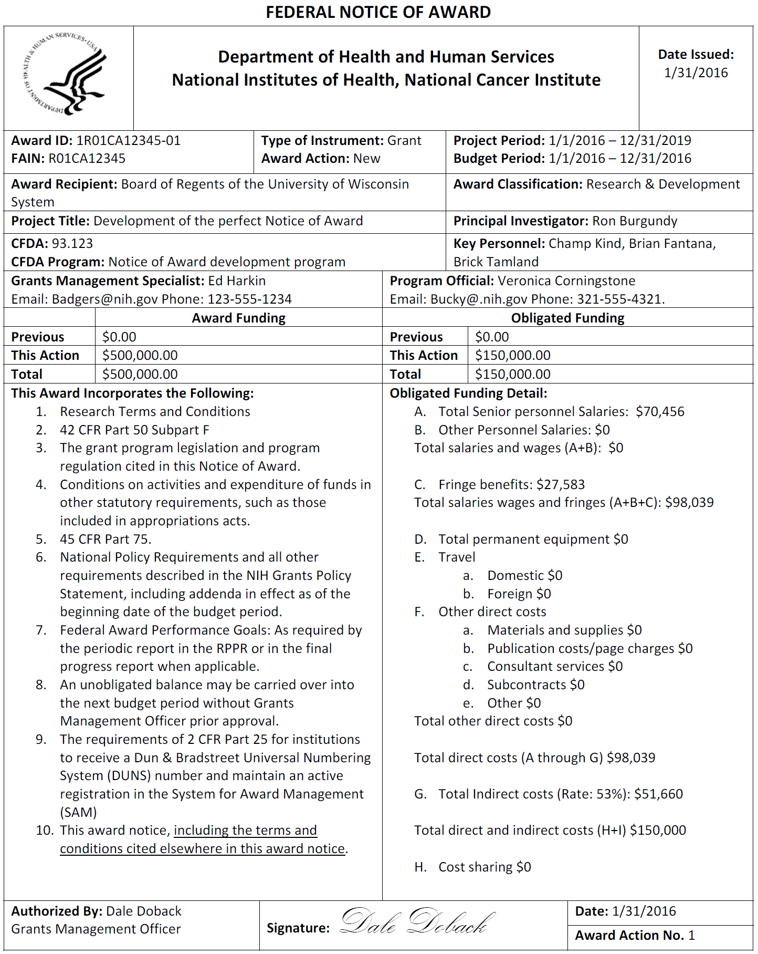
Standardized Notice of Award (NOA)
Will be adopted by all DHHS Operating
Divisions
Administration for Children and Families (ACF)
Administration for Community Living (ACL)
Agency for Healthcare Research and Quality (AHRQ)
Agency for Toxic Substance and Disease Registry (ATSDR)
Centers for Disease Control and Prevention (CDC)
Centers for Medicare and Medicaid Services (CMS)
Food and Drug Administration (FDA)
Health Resources and Services Administration (HRSA)
National Institutes of Health (NIH)
Substance Abuse and Mental Health Services Administration (SAMHSA)
Benefits
Consistency
Faster budget setup process
Straightforward and easy to analyze
MRAM – Jackie Paule - GCA

Slide 6
Questions?
GCA Email: gcahelp@uw.edu
Jackie: jmatend@uw.edu
MRAM – Jackie Paule - GCA

Slide 7
Research Integrity
& the ORMP
MRAM | July 2020
Julie R. Severson, PhD, JD
Director, Office of Research Misconduct Proceedings

Slide 8
Today’s Overview & Objectives
Overview
(Re)Introduce Office of Research Misconduct Proceedings
ORMP’s role in upholding research integrity & handling misconduct proceedings at UW
Objectives
Refresh your understanding of foundational concepts and requirements
UW’s research integrity objectives
UW’s responsibility to address research misconduct claims
Become familiar with your resources
ORMP
Research integrity at UW
Federal and commercial sources
MRAM | Research Integrity & Misconduct

Slide 9
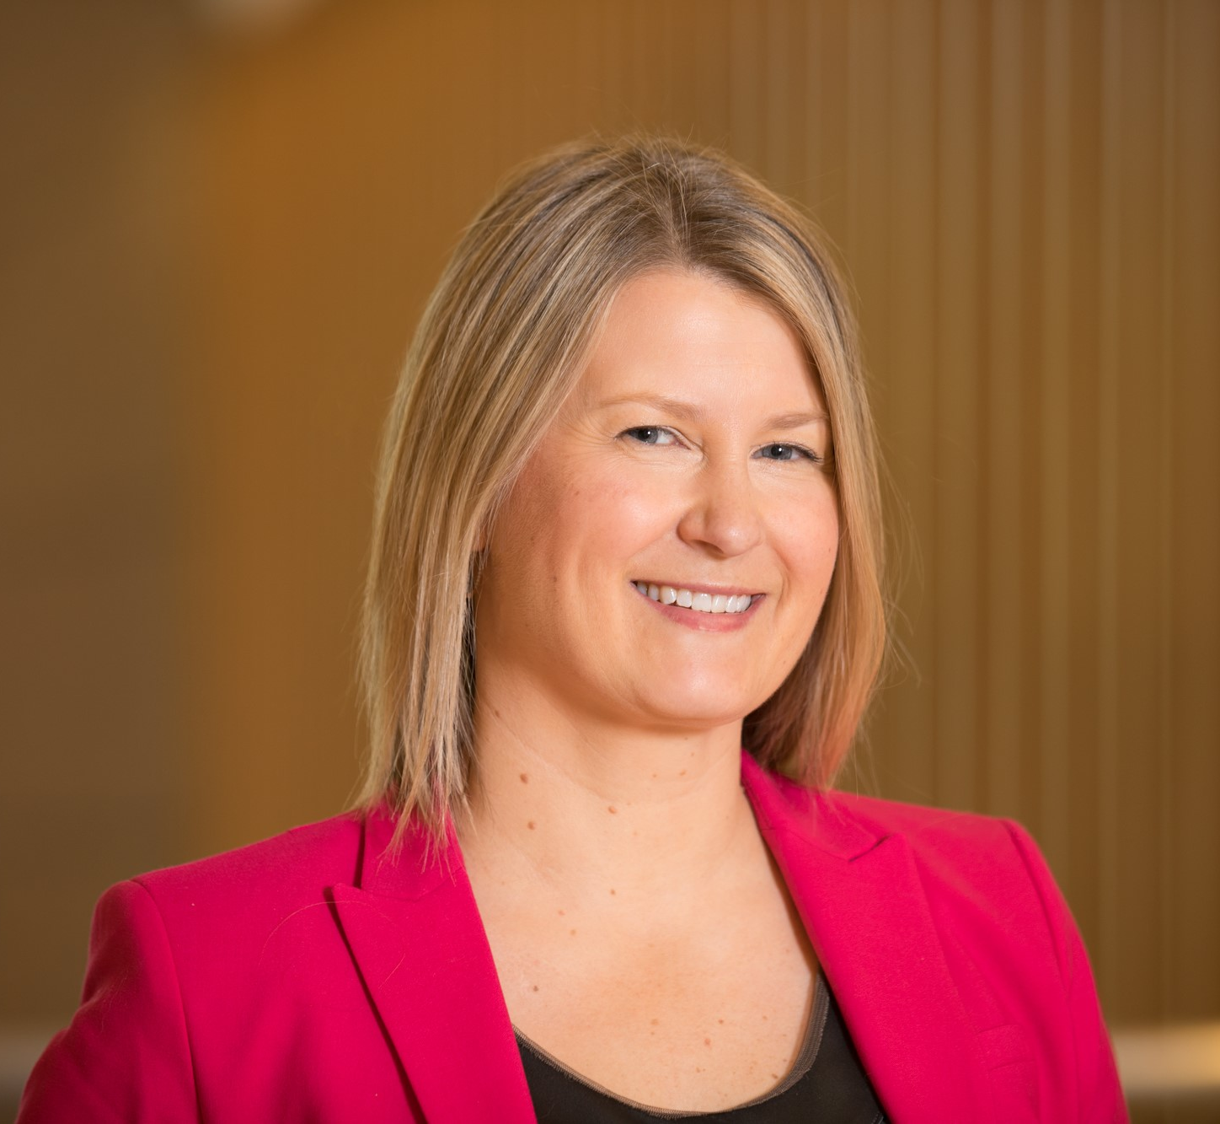
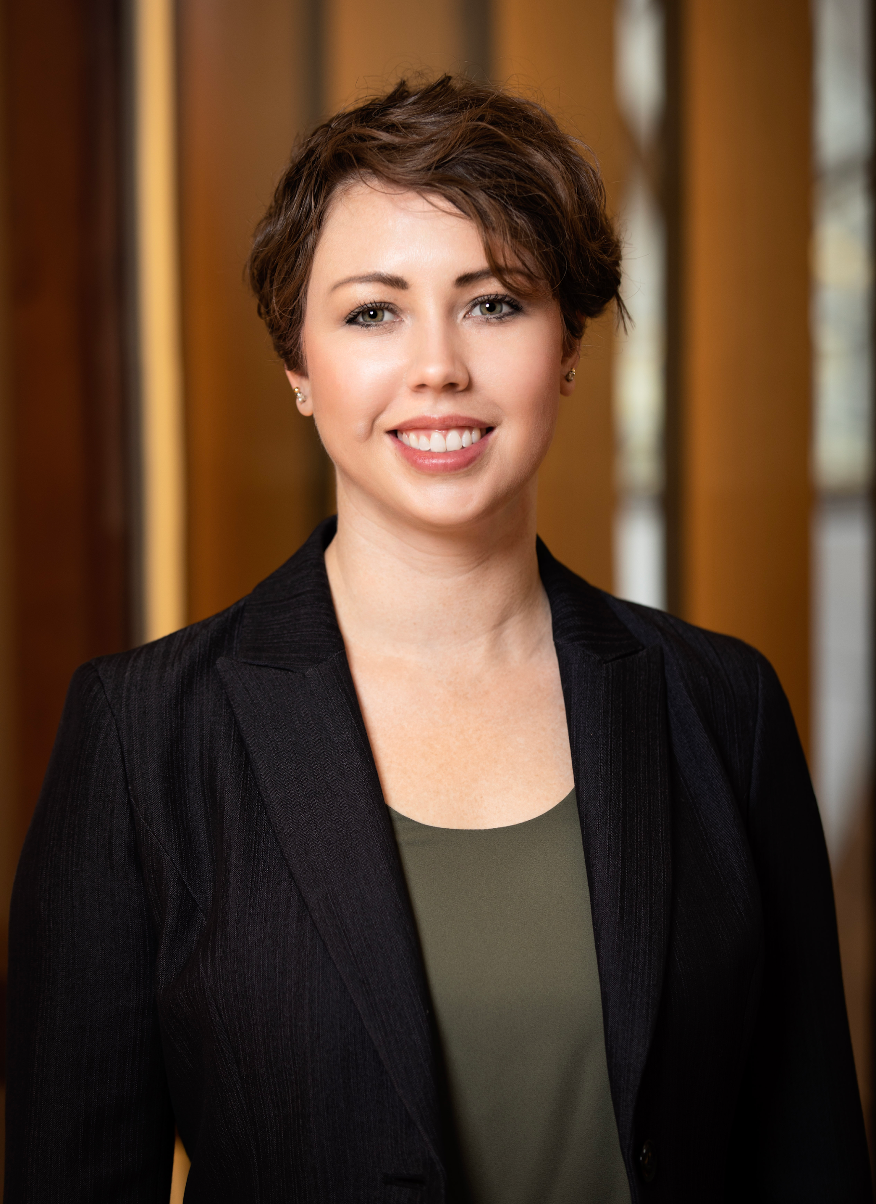
Office of Research Misconduct Proceedings
What is ORMP?
ORMP initiates and coordinates UW’s handling of research misconduct allegations and supports UW’s broader research integrity goals.
ORMP recently moved under the Office of Research
Gerberding Hall (via our living rooms)
Who is ORMP?
Julie Severson, PhD, JD | Director
Background
bioethics and health policy
research and research administrative services
Brynne Street | Research Integrity Analyst
Beginning late-July 2020
MRAM | Research Integrity & Misconduct

Slide 10
Research Integrity at UW
NIH definition
the use of honest and verifiable methods in proposing, performing, and evaluating research;
reporting research results with particular attention to adherence to rules, regulations, guidelines, and;
following commonly accepted professional codes or norms.
UW Executive Order 61
UW strives for and expects integrity in research
UW places the responsibility to uphold this integrity on anyone who is
directly involved in research at the University,
in a position to ensure the integrity of research, including collaborators, principal investigators, and supervisors.
UW is required to adopt and follow procedures for addressing allegations of research misconduct that comport with federal regulations.
MRAM | Research Integrity & Misconduct

Slide 11
Research Misconduct is…
The fabrication, falsification, or plagiarism in proposing, performing, or reviewing research, or in reporting research results.
Fabrication - making up data or results and recording or reporting them.
Falsification – manipulating research materials, equipment, or processes, or changing or omitting data or results such that the research is not accurately represented in the research record.
Plagiarism - the appropriation of another person’s ideas, processes, results or words without giving appropriate credit.
MRAM | Research Integrity & Misconduct

Slide 12
Research Misconduct is not…
Honest error or difference of opinion
Misconduct relating to work undertaken in the fulfillment of class assignments
The following issues may arise from a research misconduct allegation, but they are not research misconduct:
Fiscal impropriety
Violation of human or animal subject regulations
Intentional misrepresentation of credentials
Abuse of confidentiality
Violation of other regulations applicable to research
Conflicts of interest
Authorship disputes among research collaborators
MRAM | Research Integrity & Misconduct

Slide 13
Research Misconduct Proceedings occur when…
A complainant shares information about potential research misconduct conducted by faculty, other academic personnel, students, and/or staff.
COMPLAINT
ORMP assesses the complaint to determine whether the facts appear to align with the research misconduct definition.
PRELIMINARY ASSESSMENT
When they do, in collaboration with the appropriate dean, ORMP proceeds with an inquiry: an initial review of the allegation, the research record, and the respondent’s response.
INQUIRY
When warranted, cases result in a formal investigation conducted by an Advisory Committee appointed by the appropriate dean. These cases can result in either findings or non-findings of research misconduct.
INVESTIGATION
MRAM | Research Integrity & Misconduct

Slide 14
Research Misconduct Findings occur when…
An Advisory Committee and dean conclude:
That fabrication, falsification and/or plagiarism in proposing, performing, or reviewing research, or in reporting research results has occurred.
A significant departure from accepted practices of the relevant research community has occurred.
The misconduct was committed intentionally, knowingly, or recklessly.
The allegation is proven by a preponderance of the evidence.
MRAM | Research Integrity & Misconduct

Slide 15
When a finding occurs ORMP…
Notifies the appropriate regulatory authority, which can conduct its own review. For example:
Office of Research Integrity, HHS, which oversees research integrity activities on behalf of 10 federal offices and agencies, including:
National Institutes of Health
The Food and drug Administration
The Centers for Disease Control and Prevention
The Agency for Healthcare Research and Quality
6 others
Office of Inspector General, National Science Foundation
Works with the Office of Sponsored Programs (OSP) to notify a private sponsor when required and/or prudent.
MRAM | Research Integrity & Misconduct

Slide 16
What happens next?
If the UW and/or the governing regulatory authority makes a research misconduct finding, any (or a combination) of the following can
Correction of the research record
Letters of reprimand
Certifications or assurance requirements
for future research
Increased oversight
Remedial education
Suspension/debarment
Recovery of funds
Other disciplinary actions
If privately sponsored, the institution and/or grant contract typically determines next steps. These can vary.
If the UW and/or the governing regulatory authority makes a research misconduct finding, any (or a combination) of the following can occur:
MRAM | Research Integrity & Misconduct

Slide 17
What can a participant expect?
Confidentiality (for claimants, respondents, and witnesses)
Discrete, separate phases: preliminary assessment, inquiry, investigation, federal or private sponsor action (the former can entail an opportunity for an appeal)
Reliance on community-based, discipline-specific standards (including expert reviewers)
ORMP expertise in the responsible conduct of research, regulatory analysis, interview and conflict management, skillful (and discrete) sequestration of the research record
Fair, accurate, and timely proceedings
MRAM | Research Integrity & Misconduct

Slide 18
Resources
ORMP
ormp@uw.edu
206.616.8212
Other UW Research Integrity sources
Biomedical Research Integrity Program, Department of Bioethics and Humanities
Responsible Conduct of Research training, Office of Research
The Collaborative for Research Education (CORE)
Federal and commercial resources
Office of Research Integrity, HHS
CITI RCR training
MRAM | Research Integrity & Misconduct

Slide 19
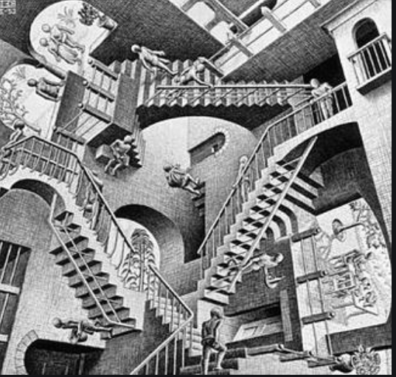
COVID: Federal Regulation Update
MRAM July 2020
Andra Sawyer
Post Award Fiscal Compliance
gcafco@uw.edu

Slide 20
Reminder: How Federal Notifications Work
Office of Management and Budget (OMB) issues notifications (guidance) to federal agencies
Federal agencies determine if they want to allow their recipients (the UW) to follow the guidance
Federal agencies can always be more restrictive, or add additional requirements, to the OMB guidance

Slide 21
OMB Notifications on COVID
March 19: OMB 20-17 provided for flexibilities for Awards impacted by COVID
Most federal agencies allowed for these flexibilities
April 9: OMB 20-20 allowed for repurposing of funds to support COVID research
June 18 : OMB 20-26 did two things:
Rescinded the flexibilities & repurposing effective June 17
Allowed for the continuation of the salary flexibilities and costs necessary to resume research but with additional requirements….

Slide 22
So What does that Mean?
Flexibilities only available March 16 – June 16 2020
Timing makes this tricky, see PAFC’s FAQs
Salary Flexibilities means some latitude with charging effort to an Award when the research is impacted by COVID
Flexibilities on salaries and costs to resume research are only available after June 16 if:
The federal sponsor has adopted OMB 20-26 & so far it has only been NSF & NIH; AND
New requirements are met…

Slide 23
So About those New Requirements..
If your Award is impacted by COVID and if your Sponsor allows for the flexibilities under OMB 20-26, you must do and maintain records of the following:
“Utilize offsets (e.g., reduction in training and travel)”
“Substantiate the charging of any salaries and other costs related to the interruption”
“Exhaust other available funding sources to sustain workforce”
“Implement necessary steps to save overall operational costs”

Slide 24
Suggested Next Steps if Federal Award is Impacted by COVID
TALK TO YOUR SPONSOR
Review administrative flexibilities and ensure they are within the March 19 – June 16 window
Review federal agency requirements to see if implemented OMB 20-26 (hint: look for updates after June 18)
TALK TO YOUR SPONSOR

Slide 25
Best and Worst Case Scenarios of Awards Impacted by COVID
Worst Case Scenario: Award funds are expended, Award objectives have not been met, and Sponsor is surprised. Sponsor then has every right to review for requirements outlined in OMB 20-26.
Best Case Scenario: documented communication with Sponsor, any necessary Award approvals or modifications are in place.

Slide 26
Resources
COGR webpage with listing of OMB notifications and federal agency responses:
https://www.cogr.edu/institutional-and-agency-responses-covid-19-and-additional-resources
PAFC main COVID webpage with new requirements:
https://finance.uw.edu/pafc/covid19-information-sponsored-awards
Flexibility Timing FAQs
https://finance.uw.edu/pafc/covid19-information-sponsored-awards#FAQ_flex_timing
Salary Flexibility
https://finance.uw.edu/pafc/Salary_Expenses_COVID
Help! Post Award Fiscal Compliance (Andra Sawyer & Matt Gardner)
gcafco@uw.edu

Slide 27
Expiration of Covid-19 Flexibilities on Sponsored Awards
July 2020 MRAM
Carol Rhodes
Office of Sponsored Programs

Slide 28
Federal Office of Management and Budget (OMB) memo M-20-26
This memo (M 20-26 ) to federal agencies:
Rescinded flexibilities for research impacted by COVID-19 in memos M-20-17 and M-20-20.
those memos have expired & flexibilities provided are only valid March 16 – June 16 2020.
M-20-11 expires 7.26.2020
Impacts awards made directly for emergency support in response to COVID-19
Extended flexibilities were covered by Post-Award Fiscal Compliance, PAFC.
Notes:
Federal agencies must document that they are allowing this flexibility in order for awardees to use it.
Departments need to review individual federal agency regulations to determine if they have been allowed to continue use of the salary and other cost flexibility and how certain conditions are imposed.
This is a complex and evolving situation. Updated information, as it becomes available, can be found on the PAFC COVID-19 web page.

Slide 29
M-20-17 Rescission, Effective 6/16
Flexibility with application deadlines: Agencies continue to have independent authority to extend deadlines for other non-C19 reasons (see the FOA).
Publish emergency Notice of Funding Opportunities for less than required sixty (60) days: UG requires agencies to provide sixty days. Shorter time frame no longer allowed.

Slide 30
M-20-17 Rescission: Reporting, Closeout, and No-Cost Extensions, Prior Approvals
Reporting, Closeout, and No-Cost Extensions: Agencies no longer allowed to extend due to C19. If you were already granted an extension, it is still in effect.
Prior approval waiver requirement: Agencies who allowed now resuming regular requirements.

Slide 31
M-20-20 Rescission - PPE Donations
Agencies no longer able to allow, as a broad flexibility, donation of PPE or other medical supplies, equipment or resources from award to C19 response.
If you wish to donate PPE on an award, please request permission from the Grant officer.
See steps under “Award Changes” and explain need.

Slide 32
Questions?

Slide 33
Department of Defense: Cybersecurity Maturity Model Certification (CMMC) Requirement
July 2020 MRAM
Carol Rhodes
Office of Sponsored Programs

Slide 34
Cybersecurity Maturity Model Certification What is it?
Controlled Unclassified Information (CUI) is information the Government creates or possesses, or that an entity creates or possesses for or on behalf of the Government, that a law, regulation, or Government-wide policy requires or permits an agency to handle using safeguarding or dissemination controls.
As of Nov 1, 2020, DoD is requiring Cybersecurity Maturity Model Certification to reflect adequate protection of CUI.
The CMMC will encompass multiple maturity levels that range from “Basic Cybersecurity Hygiene” to “Advanced/Progressive”. The intent is to incorporate CMMC into Defense Federal Acquisition Regulation Supplement (DFARS) and use it as a requirement for contract award.
DoD Cybersecurity Maturity Model Certification FAQs
Notes:
Cybersecurity Maturity Model Certification (CMMC) is the first step in a program to establish basic cybersecurity and enhance protections for Controlled Unclassified Information (CUI) in DoD-funded research.

Slide 35
What does this mean for responding to a DOD Request for Proposal (RFP) or Information (RFI)?
Adequate cybersecurity measures in place at the Level imposed by DoD in the Request for Proposal (RFP) or Request for Information (RFI)
Implementation of these measures must be certified by an accredited third-party (external to UW) in order for UW to accept contract terms.

Slide 36
How Do I Achieve this?
If you have or plan to respond to a DoD RRFI or RFP:
Understand: You will need help from your unit’s IT manager along with the help of UW-IT/CISO.
Cost: Include costs to implement CMMC as a direct cost in your proposal budget along with substantiation of costs.
Implement: You will need to have requirements in place AND third-party certification for UW to accept terms of a resulting contract.
Notes:
CISO working on general estimate resources>>>stay tuned for general estimate resources from CISO being published soon
DFARs clause expected in contracts> requires the certification

Slide 37
Questions
Where do I find out more about CMMC?
Who can help me to understand whether UW Provided IT resources meet the standards imposed by the DoD CMMC Level?
Can a UW group certify my Cybersecurity Measures?
Can the UW submit my proposal even if I don’t have the Level needed in place?
Can the UW accept a DoD contract if I haven’t had
my system certified?
Notes:
https://www.acq.osd.mil/cmmc/faq.html

Slide 38
Resource List
UW General Information: Information, Privacy, and Security
System Gap Analysis (help@uw.edu)
General Estimate of Costs for Levels 1-3 (help@uw.edu)
List of Accredited Third-party Certifiers

Slide 39
NIH: Updates & Reminders
July 2020 MRAM
Ariadna Santander
Office of Sponsored Programs

Slide 40
PARs & PASs May Include Non-Responsive Criteria
PARs: Program Announcements with special receipt, referral, and/or review considerations
PASs: Program Announcements with set-aside funds
NOT-OD-20-114: PARs & PASs may now include a new subheading in the funding opportunity section: “Applications Not Responsive to this FOA” which may include explicit non-responsive criteria.
Read the full description carefully. Applications that are deemed non-responsive will be withdrawn.

Slide 41
Inclusion Reporting in Human Subjects System (HSS) Required
Participant-level data on sex/gender, race, ethnicity, and age at enrollment are required in progress reports. Effective for due dates January 25, 2019 or later.
Include the data in the HSS using this template. This populates cumulative enrollment tables.
As of June 13, 2020 all post-submission updates in HSS must use the FORMS-F version.
Study records also now require an Inclusion Enrollment Report title and clinical trials must indicate whether they are an Applicable Clinical Trial (ACT).
Review NIH’s short video and the data template.
NOT-OD-20-125

Slide 42
Administrative Supplements Require Electronic Submission
Effective immediately: Submit administrative supplement applications for multi-project awards electronically.
Effective July 25, 2020:
The streamlined submission method through the eRA Commons will be replaced with the option to initiate the administrative supplement application within eRA Commons and ability to complete submission in ASSIST.
All supplement applications to existing single and multi-project awards must be submitted electronically.
NOT-OD-20-128
As usual these are always prepared on an eGC1
in SAGE for OSP review and approval.
Notes:
Electronically = through Grants.gov using NIH ASSIST, Grants.gov Workspace, or institutional system-to-system (S2S) solutions.
1> Since the administrative supplement applies to the parent award as a whole, the single-project application form package used for research grants and cooperative agreements will be used for these submissions (e.g., Competition ID= “FORMS-F-ADMINSUPP-RESEARCH.”)

Slide 43
Rolling Submission Dates
Most funding opportunity announcements (FOAs) and notices of special interest (NOSIs) provide specific due dates or point to the standard due dates.
Recently, NIH has issued more FOAs indicating “applications will be accepted on a rolling basis.”
With “rolling” submission dates, NIH defines the first and last days that applications will be accepted and you pick the day between them to submit your application.
NIH Rolling Submission Announcement 7.01.2020
Notes:
Sponsor due date entered on the eGC1 is the date from which OSP will calculate the GIM 19 deadline.
This is common with “emergency” or “urgent” funding to address a critical need (e.g., COVID-19 Funding).

Slide 44
COVID-19 FAQs
NIH continually updates their C19 FAQs and has specifically made changes in response to OMB Memo M-20-26.
We recommend referencing them frequently.

Slide 45
COMPLIANCE CORNER
MRAM
July, 2020
Matt Gardner
Post Award Fiscal Compliance

Slide 46
Revised GIM 21: Cost Share
Nothing new; updates to clarify current practices and complex topics:
Revised term definitions (Cost Share, Mandatory, Voluntary, Commitments, etc.) to match current practice and align with GCA webpage
Revised system terminology to reflect current systems and system names
Clarification on the Cost Share F&A Rate
Updated processes to reflect current practice
Eliminated processes that are covered on the GCA Cost Share webpage
MRAM – Matt Gardner – PAFC

Slide 47
Revised GIM 21: Cost Share (cont’d)
Third Party and Subaward Cost Share:
Third Party and Subaward Cost Share are different
Different definitions
Different processes for documenting contributions
Clarification added on the differences between Third Party and Subaward Cost Share
MRAM – Matt Gardner – PAFC

Slide 48
Cost Share References
GIM 21: Cost Share on Sponsored Programs
https://www.washington.edu/research/policies/gim-21-cost-share-on-sponsored-programs/
GCA Cost Share Webpage
https://finance.uw.edu/gca/cost-share
MRAM – Matt Gardner – PAFC

Slide 49
NSF Update to Research Terms & Conditions (RTCs)
Minor updates:
Must use negotiated F&A rates (unless otherwise directed by NSF in the Program Solicitation)
Recipients are responsible for ensuring documentation for each subawardee is “maintained for the same retention period as the grantee’s.”
Translation: If the UW’s retention policy is six years for Sponsored Award documentation, the subawardee must also retain for six years.
Updates effective October 5, 2020
MRAM – Matt Gardner – PAFC

Slide 50
RTS References
NSF RTCs:
https://www.nsf.gov/bfa/dias/policy/fedrtc/agencyspecifics/nsf_1020.pdf
Summary of Significant Changes:
https://www.nsf.gov/bfa/dias/policy/fedrtc/agencyspecifics/nsf_sigchg1020.pdf
MRAM – Matt Gardner – PAFC

Slide 51
Questions
Post Award Fiscal Compliance (PAFC)
gcafco@uw.edu
https://finance.uw.edu/pafc/
Andra Sawyer
andra2@uw.edu
Matt Gardner
mgard4@uw.edu
MRAM – Matt Gardner – PAFC

Slide 52
Updates
Changes coming to Faculty Grants Management Required Training for Investigators
POD Registration:
https://hr.uw.edu/pod/courses-and-workshops/faculty-grants-management/
Two changes effective July 1, 2020
changing the name of the session to “Grants Management for Investigators” to reflect the fact that not all investigators are faculty
GMI Required Training page: https://www.washington.edu/research/required-training/faculty-grants-management/
investigators now required to take this training the time of their first proposal in SAGE (previously required at time of award). This allows us to give first time investigators this crucial information earlier in their research career at the UW.
The next session will be a live Zoom session on October 21st (register through POD)

