Slide 1
Upcoming DHHS Changes
MRAM
July, 2020
Jackie Paule, Grant Manager
GCA

Slide 2
Upcoming DHHS Changes
SF425 Reports transition to Payment Management System (PMS) Submission
Standardized Notice of Award (NOA)
Possible elimination of FCTR
FCTR = Federal Cash Transaction Report submitted quarterly by RCA
Report of cash receipts verified against expenditures on SF425 reports
Does not involve campus
Receiving emails with FCTR literature? Please forward them to me at jmatend@uw.edu
MRAM – Jackie Paule - GCA

Slide 3
SF425 Reports > PMS Submission
HRSA transitioning to PMS submission effective 10/01/2020
NIH transitioning to PMS submission effective 1/01/2021
Benefits
Improve consistency with one source reporting
Financial data across HHS will make it easy to research and find reports in PMS
Consolidated report submission
MRAM – Jackie Paule - GCA

Slide 4
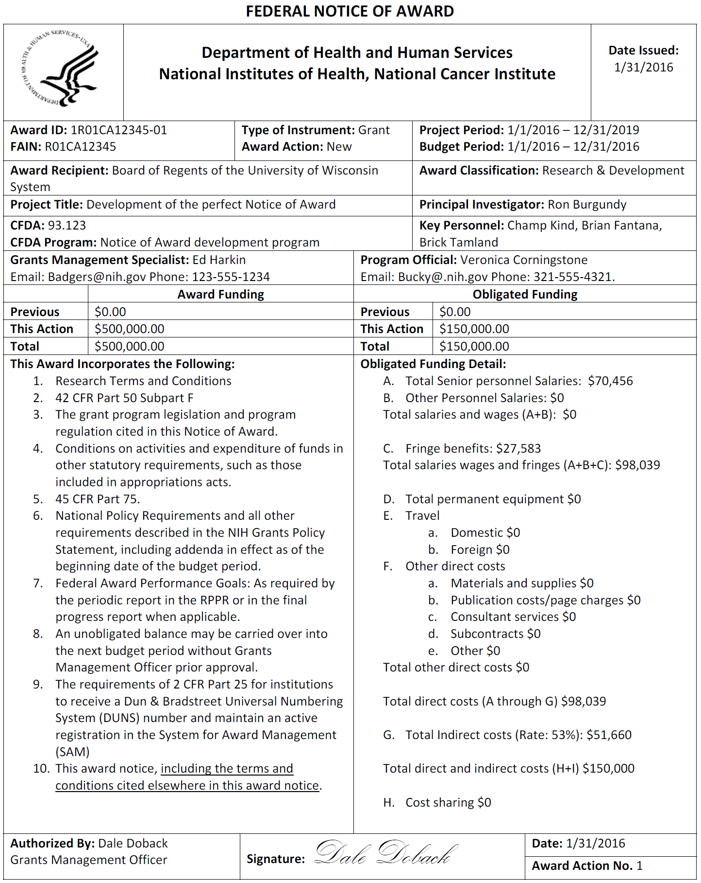
Standardized Notice of Award (NOA)
Will be adopted by all DHHS Operating
Divisions
Administration for Children and Families (ACF)
Administration for Community Living (ACL)
Agency for Healthcare Research and Quality (AHRQ)
Agency for Toxic Substance and Disease Registry (ATSDR)
Centers for Disease Control and Prevention (CDC)
Centers for Medicare and Medicaid Services (CMS)
Food and Drug Administration (FDA)
Health Resources and Services Administration (HRSA)
National Institutes of Health (NIH)
Substance Abuse and Mental Health Services Administration (SAMHSA)
Benefits
Consistency
Faster budget setup process
Straightforward and easy to analyze
MRAM – Jackie Paule - GCA

Slide 5
Questions?
GCA Email: gcahelp@uw.edu
Jackie: jmatend@uw.edu
MRAM – Jackie Paule - GCA

