Slide 1
Research Integrity
& the ORMP
MRAM | July 2020
Julie R. Severson, PhD, JD
Director, Office of Research Misconduct Proceedings

Slide 2
Today’s Overview & Objectives
Overview
(Re)Introduce Office of Research Misconduct Proceedings
ORMP’s role in upholding research integrity & handling misconduct proceedings at UW
Objectives
Refresh your understanding of foundational concepts and requirements
UW’s research integrity objectives
UW’s responsibility to address research misconduct claims
Become familiar with your resources
ORMP
Research integrity at UW
Federal and commercial sources
MRAM | Research Integrity & Misconduct

Slide 3
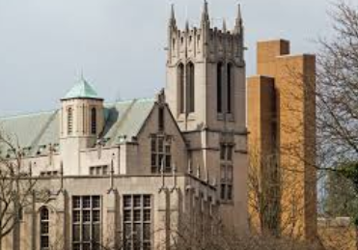
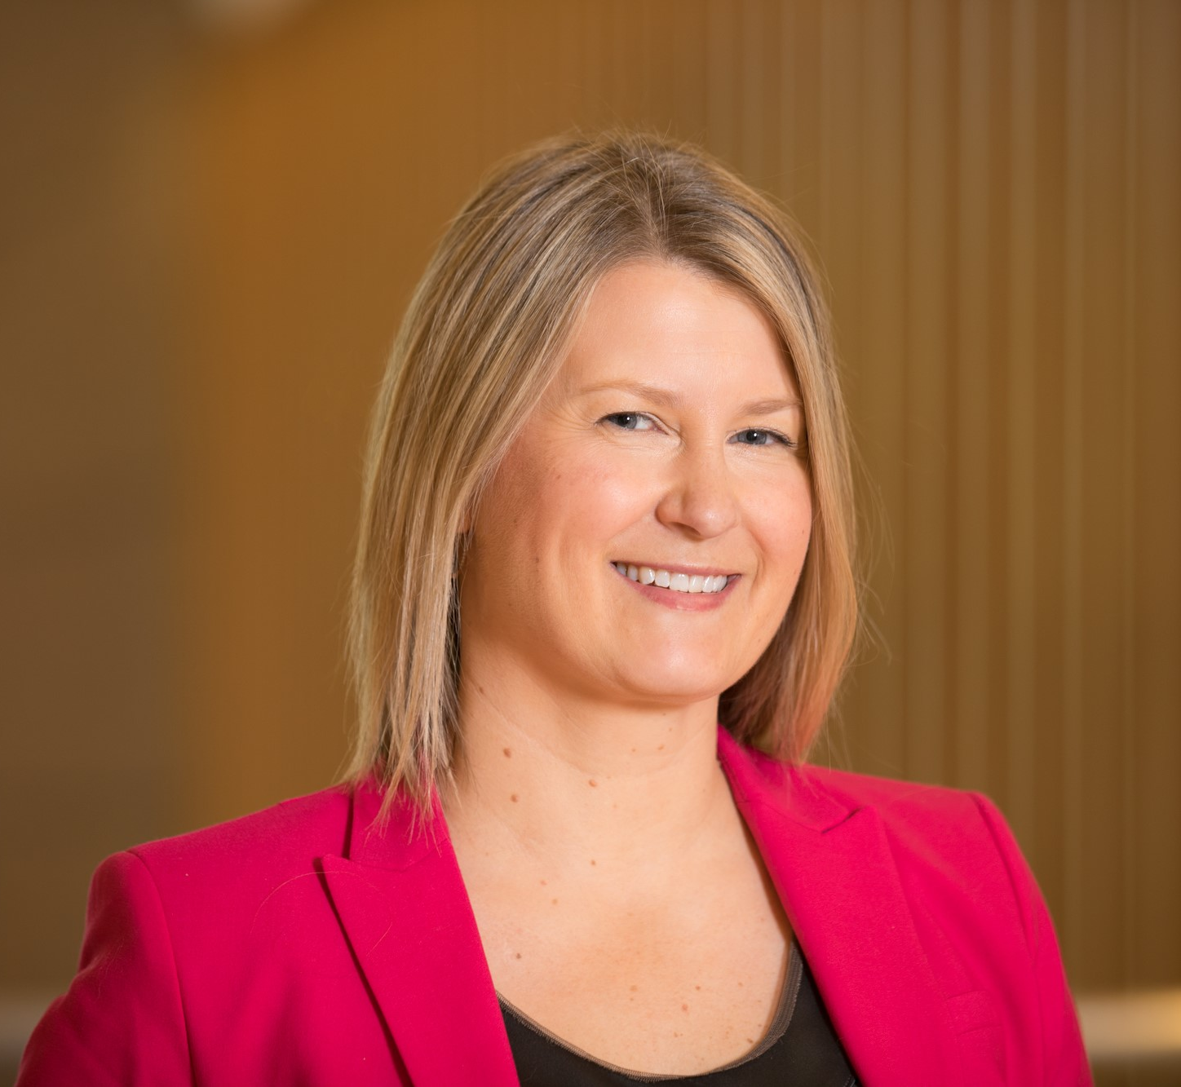
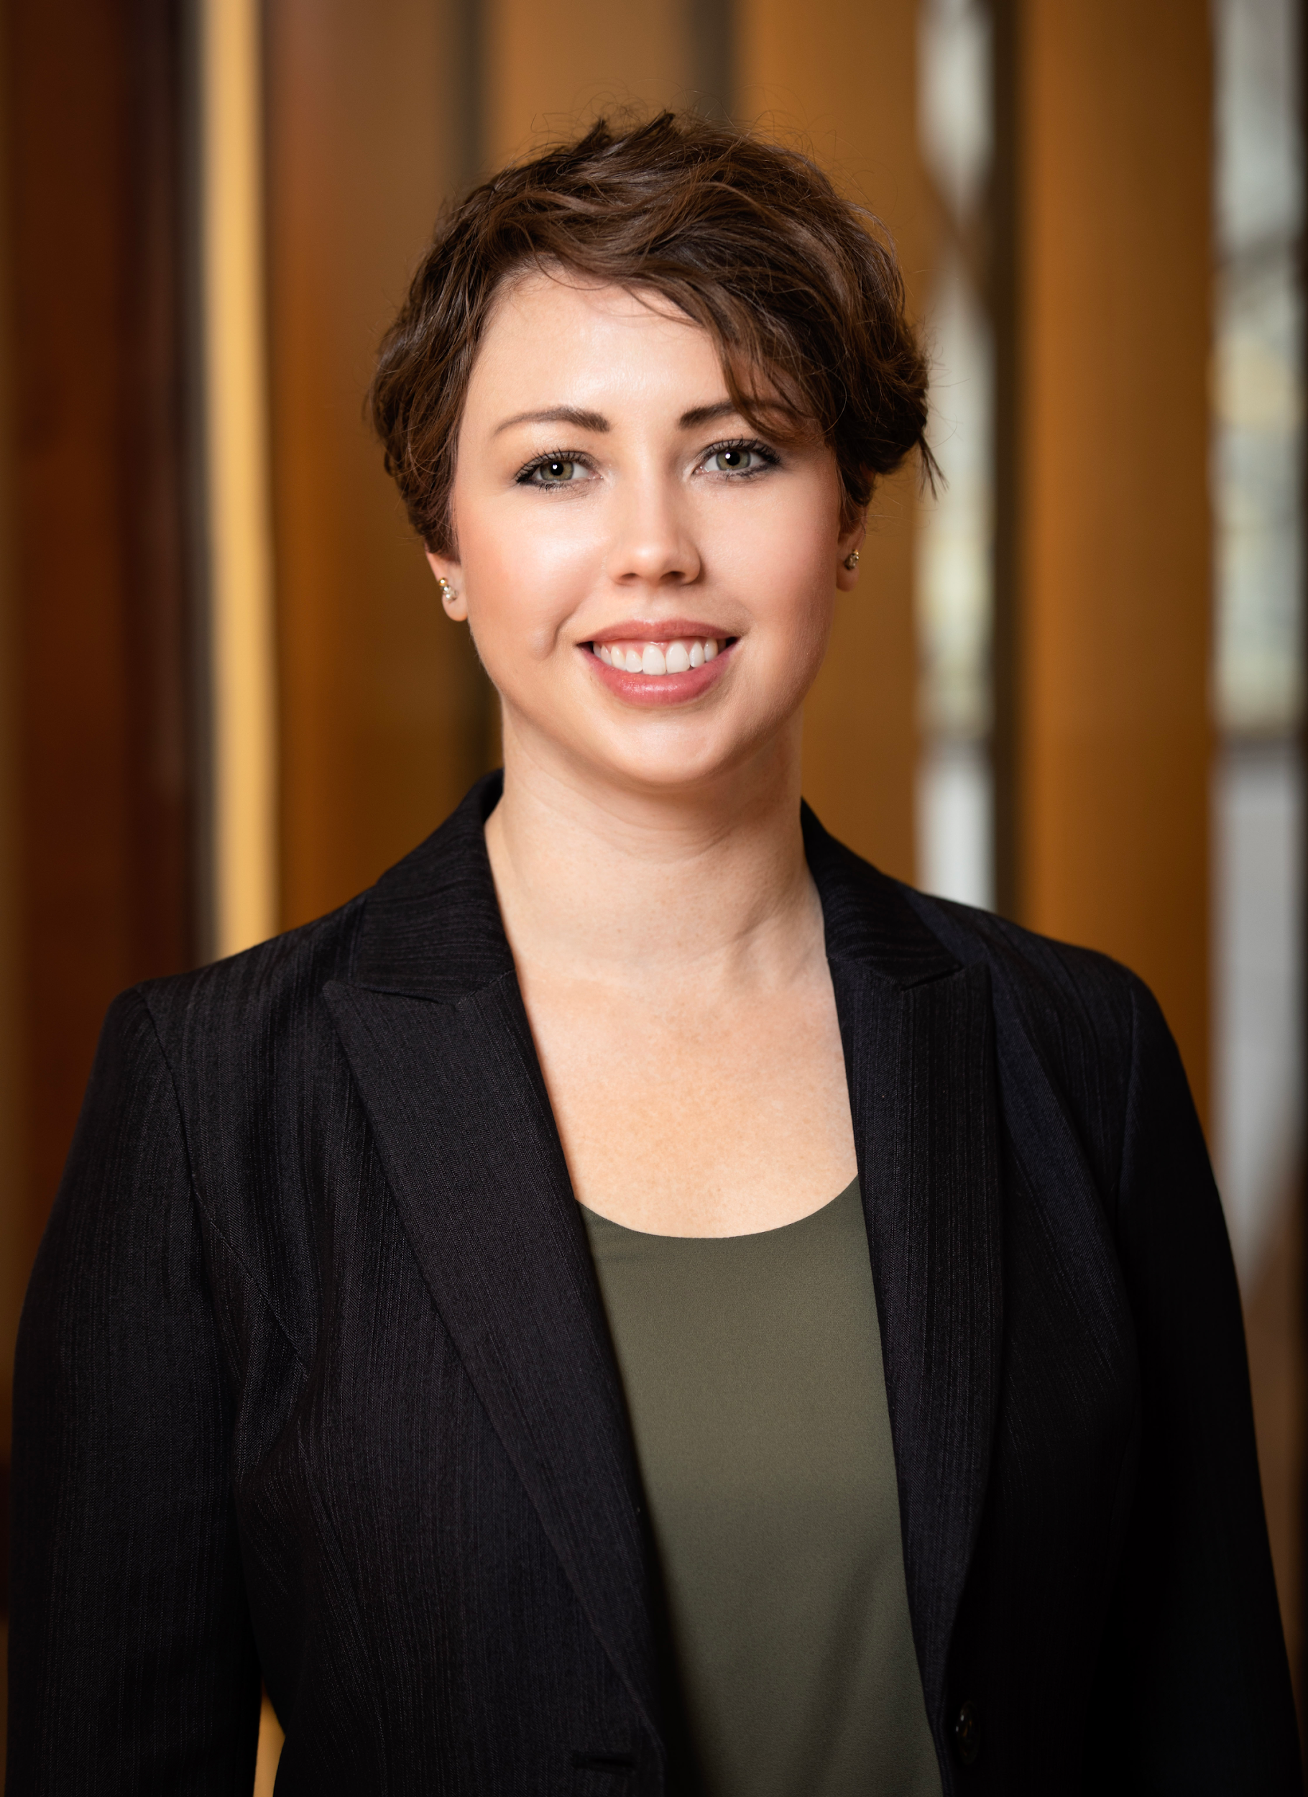
Office of Research Misconduct Proceedings
What is ORMP?
ORMP initiates and coordinates UW’s handling of research misconduct allegations and supports UW’s broader research integrity goals.
ORMP recently moved under the Office of Research
Gerberding Hall (via our living rooms)
Who is ORMP?
Julie Severson, PhD, JD | Director
Background
bioethics and health policy
research and research administrative services
Brynne Street | Research Integrity Analyst
Beginning late-July 2020
MRAM | Research Integrity & Misconduct

Slide 4
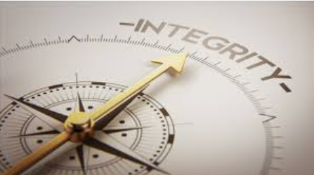
Research Integrity at UW
NIH definition
the use of honest and verifiable methods in proposing, performing, and evaluating research;
reporting research results with particular attention to adherence to rules, regulations, guidelines, and;
following commonly accepted professional codes or norms.
UW Executive Order 61
UW strives for and expects integrity in research
UW places the responsibility to uphold this integrity on anyone who is
directly involved in research at the University,
in a position to ensure the integrity of research, including collaborators, principal investigators, and supervisors.
UW is required to adopt and follow procedures for addressing allegations of research misconduct that comport with federal regulations.
MRAM | Research Integrity & Misconduct

Slide 5
Research Misconduct is…
The fabrication, falsification, or plagiarism in proposing, performing, or reviewing research, or in reporting research results.
Fabrication - making up data or results and recording or reporting them.
Falsification – manipulating research materials, equipment, or processes, or changing or omitting data or results such that the research is not accurately represented in the research record.
Plagiarism - the appropriation of another person’s ideas, processes, results or words without giving appropriate credit.
MRAM | Research Integrity & Misconduct

Slide 6
Research Misconduct is not…
Honest error or difference of opinion
Misconduct relating to work undertaken in the fulfillment of class assignments
The following issues may arise from a research misconduct allegation, but they are not research misconduct:
Fiscal impropriety
Violation of human or animal subject regulations
Intentional misrepresentation of credentials
Abuse of confidentiality
Violation of other regulations applicable to research
Conflicts of interest
Authorship disputes among research collaborators
MRAM | Research Integrity & Misconduct

Slide 7
Research Misconduct Proceedings occur when…
A complainant shares information about potential research misconduct conducted by faculty, other academic personnel, students, and/or staff.
COMPLAINT
ORMP assesses the complaint to determine whether the facts appear to align with the research misconduct definition.
PRELIMINARY ASSESSMENT
When they do, in collaboration with the appropriate dean, ORMP proceeds with an inquiry: an initial review of the allegation, the research record, and the respondent’s response.
INQUIRY
When warranted, cases result in a formal investigation conducted by an Advisory Committee appointed by the appropriate dean. These cases can result in either findings or non-findings of research misconduct.
INVESTIGATION
MRAM | Research Integrity & Misconduct

Slide 8
Research Misconduct Findings occur when…
An Advisory Committee and dean conclude:
That fabrication, falsification and/or plagiarism in proposing, performing, or reviewing research, or in reporting research results has occurred.
A significant departure from accepted practices of the relevant research community has occurred.
The misconduct was committed intentionally, knowingly, or recklessly.
The allegation is proven by a preponderance of the evidence.
MRAM | Research Integrity & Misconduct

Slide 9
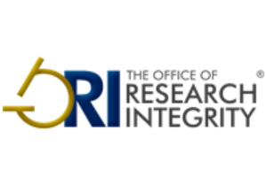
When a finding occurs ORMP…
Notifies the appropriate regulatory authority, which can conduct its own review. For example:
Office of Research Integrity, HHS, which oversees research integrity activities on behalf of 10 federal offices and agencies, including:
National Institutes of Health
The Food and drug Administration
The Centers for Disease Control and Prevention
The Agency for Healthcare Research and Quality
6 others
Office of Inspector General, National Science Foundation
Works with the Office of Sponsored Programs (OSP) to notify a private sponsor when required and/or prudent.
MRAM | Research Integrity & Misconduct

Slide 10
What happens next?
If the UW and/or the governing regulatory authority makes a research misconduct finding, any (or a combination) of the following can
Correction of the research record
Letters of reprimand
Certifications or assurance requirements
for future research
Increased oversight
Remedial education
Suspension/debarment
Recovery of funds
Other disciplinary actions
If privately sponsored, the institution and/or grant contract typically determines next steps. These can vary.
If the UW and/or the governing regulatory authority makes a research misconduct finding, any (or a combination) of the following can occur:
MRAM | Research Integrity & Misconduct

Slide 11
What can a participant expect?
Confidentiality (for claimants, respondents, and witnesses)
Discrete, separate phases: preliminary assessment, inquiry, investigation, federal or private sponsor action (the former can entail an opportunity for an appeal)
Reliance on community-based, discipline-specific standards (including expert reviewers)
ORMP expertise in the responsible conduct of research, regulatory analysis, interview and conflict management, skillful (and discrete) sequestration of the research record
Fair, accurate, and timely proceedings
MRAM | Research Integrity & Misconduct

Slide 12
Resources
ORMP
ormp@uw.edu
206.616.8212
Other UW Research Integrity sources
Biomedical Research Integrity Program, Department of Bioethics and Humanities
Responsible Conduct of Research training, Office of Research
The Collaborative for Research Education (CORE)
Federal and commercial resources
Office of Research Integrity, HHS
CITI RCR training
MRAM | Research Integrity & Misconduct

