Slide 1
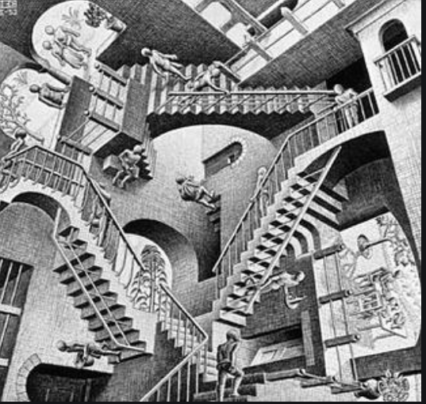
COVID: Federal Regulation Update
MRAM July 2020
Andra Sawyer
Post Award Fiscal Compliance
gcafco@uw.edu

Slide 2
Reminder: How Federal Notifications Work
Office of Management and Budget (OMB) issues notifications (guidance) to federal agencies
Federal agencies determine if they want to allow their recipients (the UW) to follow the guidance
Federal agencies can always be more restrictive, or add additional requirements, to the OMB guidance

Slide 3
OMB Notifications on COVID
March 19: OMB 20-17 provided for flexibilities for Awards impacted by COVID
Most federal agencies allowed for these flexibilities
April 9: OMB 20-20 allowed for repurposing of funds to support COVID research
June 18 : OMB 20-26 did two things:
Rescinded the flexibilities & repurposing effective June 17
Allowed for the continuation of the salary flexibilities and costs necessary to resume research but with additional requirements….

Slide 4
So What does that Mean?
Flexibilities only available March 16 – June 16 2020
Timing makes this tricky, see PAFC’s FAQs
Salary Flexibilities means some latitude with charging effort to an Award when the research is impacted by COVID
Flexibilities on salaries and costs to resume research are only available after June 16 if:
The federal sponsor has adopted OMB 20-26 & so far it has only been NSF & NIH; AND
New requirements are met…

Slide 5
So About those New Requirements..
If your Award is impacted by COVID and if your Sponsor allows for the flexibilities under OMB 20-26, you must do and maintain records of the following:
“Utilize offsets (e.g., reduction in training and travel)”
“Substantiate the charging of any salaries and other costs related to the interruption”
“Exhaust other available funding sources to sustain workforce”
“Implement necessary steps to save overall operational costs”

Slide 6
Suggested Next Steps if Federal Award is Impacted by COVID
TALK TO YOUR SPONSOR
Review administrative flexibilities and ensure they are within the March 19 – June 16 window
Review federal agency requirements to see if implemented OMB 20-26 (hint: look for updates after June 18)
TALK TO YOUR SPONSOR

Slide 7
Best and Worst Case Scenarios of Awards Impacted by COVID
Worst Case Scenario: Award funds are expended, Award objectives have not been met, and Sponsor is surprised. Sponsor then has every right to review for requirements outlined in OMB 20-26.
Best Case Scenario: documented communication with Sponsor, any necessary Award approvals or modifications are in place.

Slide 8
Resources
COGR webpage with listing of OMB notifications and federal agency responses:
https://www.cogr.edu/institutional-and-agency-responses-covid-19-and-additional-resources
PAFC main COVID webpage with new requirements:
https://finance.uw.edu/pafc/covid19-information-sponsored-awards
Flexibility Timing FAQs
https://finance.uw.edu/pafc/covid19-information-sponsored-awards#FAQ_flex_timing
Salary Flexibility
https://finance.uw.edu/pafc/Salary_Expenses_COVID
Help! Post Award Fiscal Compliance (Andra Sawyer & Matt Gardner)
gcafco@uw.edu

Slide 9
Expiration of Covid-19 Flexibilities on Sponsored Awards
July 2020 MRAM
Carol Rhodes
Office of Sponsored Programs

Slide 10
Federal Office of Management and Budget (OMB) memo M-20-26
This memo (M 20-26 ) to federal agencies:
Rescinded flexibilities for research impacted by COVID-19 in memos M-20-17 and M-20-20.
those memos have expired & flexibilities provided are only valid March 16 – June 16 2020.
M-20-11 expires 7.26.2020
Impacts awards made directly for emergency support in response to COVID-19
Extended flexibilities were covered by Post-Award Fiscal Compliance, PAFC.
Notes:
Federal agencies must document that they are allowing this flexibility in order for awardees to use it.
Departments need to review individual federal agency regulations to determine if they have been allowed to continue use of the salary and other cost flexibility and how certain conditions are imposed.
This is a complex and evolving situation. Updated information, as it becomes available, can be found on the PAFC COVID-19 web page.

Slide 11
M-20-17 Rescission, Effective 6/16
Flexibility with application deadlines: Agencies continue to have independent authority to extend deadlines for other non-C19 reasons (see the FOA).
Publish emergency Notice of Funding Opportunities for less than required sixty (60) days: UG requires agencies to provide sixty days. Shorter time frame no longer allowed.

Slide 12
M-20-17 Rescission: Reporting, Closeout, and No-Cost Extensions, Prior Approvals
Reporting, Closeout, and No-Cost Extensions: Agencies no longer allowed to extend due to C19. If you were already granted an extension, it is still in effect.
Prior approval waiver requirement: Agencies who allowed now resuming regular requirements.

Slide 13
M-20-20 Rescission - PPE Donations
Agencies no longer able to allow, as a broad flexibility, donation of PPE or other medical supplies, equipment or resources from award to C19 response.
If you wish to donate PPE on an award, please request permission from the Grant officer.
See steps under “Award Changes” and explain need.

Slide 14
Questions?

