Slide 1
MRAM | Monthly Research Administration Meeting
September 10, 2020 -- 9:00 AM – 10:00 AM HOSTED REMOTELY Join the LIVE Webinar: https://washington.zoom.us/j/346891888
TOPIC | PRESENTER | EMAIL | MIN
Welcome | Kirsten DeFries Research Compliance & Operations | kirsten5@uw.edu | 2
COVID-19 Relative Risk Tool for Human Subjects Research | Karen Moe Human Subjects Division | kemoe@uw.edu | 15
Foreign Talent Recruitment Programs | Joe Giffels Office of Research | jgiffels@uw.edu | 10
Updated Guidance: Current and Pending or Other Support + a Foreign Components Reminder | Carol Rhodes Office of Sponsored Programs | carhodes@uw.edu | 5
Updated Guidance: Personnel Roles on a Project | Carol Rhodes Office of Sponsored Programs Melissa Petersen Office of Research | carhodes@uw.edu petermm@uw.edu | 5
New NSF PAPPG FAQs | Tim Mhyre Office of Sponsored Programs | tmhyre@uw.edu | 5
Compliance Corner | Matt Gardner, Andra Sawyer Post Award Fiscal Compliance | gcafco@uw.edu | 10
CORE Update | Laurie Stephan Collaborative On Research Education (CORE) | corehelp@uw.edu | 2
NEXT MEETING October 15, 2020 9:00 AM - 10:00 AM

Slide 2
COVID-19 and Human Subjects Research
MRAM Meeting September 10, 2020

Slide 3
Summary of Changes Implemented August 12, 2020
NEW expectations for all research involving in-person interactions
ARCHIVE (eliminate) the CHECKLIST Human Subjects Research During the COVID-19 Pandemic
NEW risk-based identification of allowed research

Slide 4
Expectations for ALL research involving in-person interactions (ongoing & new)
Common-sense infection & severity controls:
All in-person interactions must be essential
Face coverings worn by all
Symptom screening of participants & study staff
No subjects over age 85 exceptions possible

Slide 5
These are common-sense infection & severity controls
They are also UW & UW Medicine policies for all staff, not just for research.
We ask researchers to confirm compliance when they apply for IRB approval
Question 1.10 on IRB Protocol form

Slide 7
CHECKLIST Human Subjects Research During the COVID-19 Pandemic
Now removed. Why?
Almost universally confusing
A well-intentioned attempt to make things easier for researchers by bringing together requirements from multiple places
Researchers need fewer COVID documents, not more

Slide 8
Identification of Allowed Research
Goal: Manage the impact of COVID-19 on the risks and benefits, based on limited knowledge of COVID and sense of which methods/types of research might be most risky.
Previous approach was based on categorizing research according to intent, benefit to subjects, and method

Slide 9
How to make the categories more workable & up-to-date?
Categories 1, 2, and 3 still make sense but not the others.
1 – no in-person interactions
2 – COVID research
3 – Most clinical trials

Slide 10
A more direct risk assessment is now possible

Slide 11
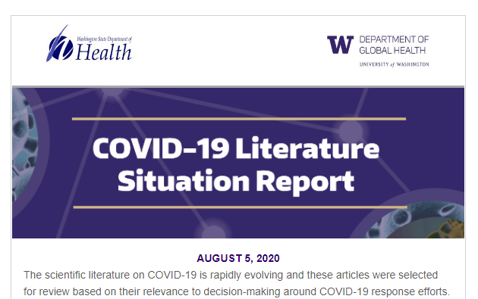
Solid, reliable scientific information
Minimizing the risk of infection
People/circumstances associated with severity

Slide 12
The Change
Keep Categories 1, 2, and 3 as they are.
If the research fits into one of these, go ahead.
If the research doesn’t fit into one of the categories: the researcher assesses with the COVID-19 Relative Risk self-assessment tool

Slide 13
COVID-19 Relative Risk Self-Assessment Tool
Use this new tool to assess new or halted research that doesn’t fit into Categories 1,2, 3
For new or currently halted research that doesn’t fit into Category 1, 2, or 3.
Who uses it
Researchers
Is it a required part of the IRB application?
No, don’t send it to the IRB. It is for researcher use only.

Slide 14
How it works
Score the research on 5 COVID risk factors
State of the pandemic in geographic area
Participant age
Subject medical conditions & need for research trip
Physical distancing
# people interacting with subjects
Add the 5 scores, for a Total Relative Risk Score.
Compare Total Score to allowable range.

Slide 15
Advantages of this approach
Directly based on major risks for COVID infection & severity
Evidence-based & reviewed by several experts
Easier for researchers to apply
Researchers can see what changes might significantly lower the COVID risk profile of a study
Can be easily adjusted/revised as new information about COVID 19 becomes known
There is a process for requesting an exception
It will be revised only when there is significant, reliable new information that is affecting University-wide operations i.e., infrequently

Slide 16
Revisions to the Risk Tool
Example scenarios
The pandemic becomes very bad in our area.
A major new risk factor is discovered.
How revisions will be communicated
Usual ways for very broad/redundant messaging
Might some ongoing research might have to halt?
Yes, but this was true of previous approach too, and all COVID-related policies generally

Slide 17
Lots of information is embedded in the tool
The actual scoring system is set within lots of text.
Purpose:
Provide details and interpretation
Address specific situations (e.g., international research, review by external IRBs)
Anticipate as many questions as possible

Slide 18
Vetted for accuracy and sensibility
Office of Research
UW Advisory Committee on Communicable Diseases
Faculty infectious disease experts
UW Risk Management
School of Medicine leaders

Slide 19
Why Allow Exceptions?
Exception = allowing research that has a Total Relative Risk Score above the allowable range.

Slide 20
Exceptions Allowed When…
Extraordinary benefit of a study whose score is just above the allowable range.
Participant protections that aren’t captured by the Risk tool – example, additional Personal Protective Equipment such as N95 masks, face shields, full gear

Slide 21
Questions About the Tool
Answers will usually be in the footnotes
Send all other questions and requests for exceptions to hsdinfo@uw.edu

Slide 22
Foreign Talent Recruitment Programs
MRAM
September, 2020
Joe Giffels
Office of Research

Slide 23
From: "Lilian Nie" <lilian.n@ifuture.ai>
Date: August 5, 2020 at 10:49:59 PM PDT
To: “XXX" <XXX@uw.edu>
Subject: International Scholar Projects
Dear Dr. XXX,
It’s my pleasure to connect with you, I’m Lilian Nie, we are partnering with EOL (www.eol.cn), who has been dedicating for many years to recruit top Researchers all over the world, building up a bridge between overseas scholars and the domestic Chinese academic community.
MRAM – Joe Giffels – Office of Research

Slide 24
There are top industry leaders, research institutions and universities, who are keen to form joint research collaboration projects with Global Experts like you by providing superior rewarding funds in 4 categories (FYR: some high-level info below). It is our honor to invite you to join in the race with respect to your professional fields to help their scientific /academic researches and/or commercialization.
If you have interest in exploring the opportunities, please kindly reply to us. Once your offer or rewards package has been approved, you can carry on your professional journey on full-time or part-time basis.
Yours, cordially
Lilian Nie
CNHR Project Director
I-Future Data Technology Inc.
an executive searching firm focusing on high-caliber talents
MRAM – Joe Giffels – Office of Research

Slide 25
P.S.
Top booming provinces have launched superior Global Experts Rewards Programs for 2020.
Rewards funding programs for eligible world-class talents to lead or work on joint research projects full-time or part-time or establish own businesses in China:
The following rewards funding and other rewards are provided to the talents on top of their compensation package –
a. 1 Million to 5 Million RMB for each individual who has been selected to provincial (or city-level) or federal talent programs;
b. 5 Million to 20 Million RMB for top talent-teams;
c. Compensation package includes salary, benefits and housing allowance, etc.
d. Research funds are provided for joint research projects;
e. Max. 20 Million RMB for winning start-up projects;
f. More…
MRAM – Joe Giffels – Office of Research

Slide 26
Eligibilities A (High- caliber Global Experts):
a. Born after July 31, 1955; Ph.D. degree;
b. Has rich experience in academic fields (including universities or research institutions) or fortune 1000 enterprises or well-known financial institutions;
Eligibilities B (High- caliber Young Scholars):
a. Born after July 31, 1980; Ph.D. degree;
b. Has minimum 3 years work experience aboard in academic fields (including universities or research institutions) or fortune 1000 enterprises or well-known financial institutions (*full-time is mandatory)
MRAM – Joe Giffels – Office of Research

Slide 27
Our Services:
Our project specialist provides one-on-one and one-stop professional services to assist you in applying for the government rewarding funds from beginning until you receive these funds. We only charge 10% service fee upon the government funds have been deposited to your account and/or a headhunting fee of 15% of your annual salary package after you accept the offer.
We have successfully recruited world-class talents in various professional industries, such as life science, biochemistry, finance, investment banking, communications, AI, new materials, chemical, etc. for provincial/federal talent programs / joint research programs / large enterprises.
Our references are available upon request.
Especially for the worldwide outbreak period, your chance to be entered these rewards programs is extremely high (due to the limited applicants), and all the application procedures can be completed online (no travel required).
MRAM – Joe Giffels – Office of Research

Slide 28
Foreign National Term and Condition
On Federal Awards - Examples
Foreign National as PI or PD
Foreign National in a Critical Position
Foreign National as Business POC
Foreign National frequent contact with Agency personnel
Foreign National from T4 country
Iran, N Korea, Sudan, Syria
T4 approval process takes up to 12 months to process
MRAM – Joe Giffels – Office of Research
Notes:
DoEnergy

Slide 29
Current and Pending, or Other Support
September, 2020 MRAM
Carol Rhodes
Office of Sponsored Programs

Slide 30
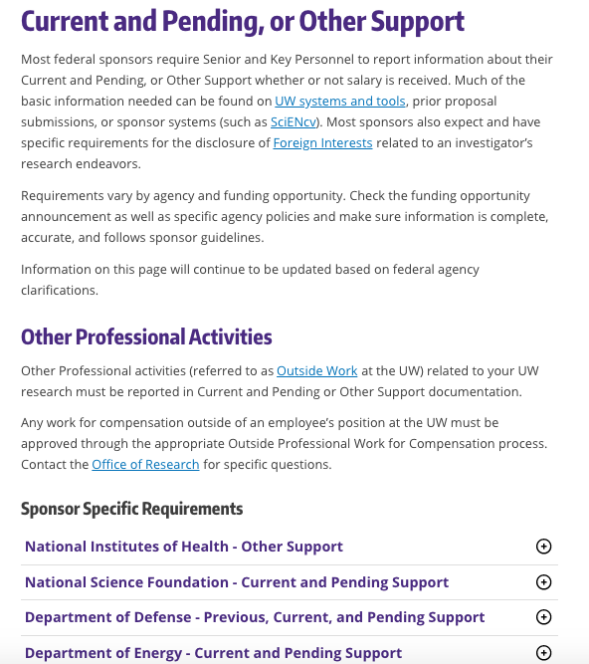
Key information on requirements from some federal sponsors.
Variations for NIH & NSF requirements such as in-kind support, and appointments
Inconsistencies in NIH guidance - hopefully will be cleared up with NIH Oct. updates
Notes:
https://www.washington.edu/research/myresearch-lifecycle/plan-and-propose/sponsor-requirements/federal/cpos/
Note differences between NIH & NSF requirements such as in-kind support, and appointments
NIH is making updates in October - including to their OS template

Slide 31
Rules on listing In-kind Support
NSF:
List in Current & Pending Support when in-kind support is involves a time commitment (not related to proposed project)
List in Facilities, Equipment and Other Resources when in-kind support is related to proposed project.
Don’t list in both places.
See NSF FAQs
NIH: List all In-kind support in Other Support
See NIH NOT-OD-19-114

Slide 32
NIH and Appointments
NOT OD-19-114 states to list all appointments relevant to an application in Other Support.
NIH new guidance, “Protecting U.S. Biomedical Intellectual Innovation” indicates to list in Biosketch only.
Which is it?
We are telling campus to err on side of disclosure and list in both locations, unless/until we have further clarification.

Slide 33
Foreign Components and Other Support - Reminder
NIH Definition for Foreign Components: Any “significant scientific element or segment of a project” outside of the U.S.:
performance of work by a researcher or recipient in a foreign location, whether or not NIH grant funds are expended and/or
performance of work by a researcher in a foreign location employed or paid for by a foreign organization, whether or not NIH grant funds are expended.
Activity that does not meet the definition of foreign component because all research is being conducted within the U.S., but there is a non-U.S. resource supporting the research of an investigator and/or researcher, must be reported as other support.
NOT-OD-19-114
FAQ: Other Support and Foreign Component
Notes:
Human Fetal Tissue from elective abortions
HFT Sample IRB Consent Form:HSD will post an IRB-approved consent form that can be used for this purpose, by September 19th.
Search for consent in Forms and Templates. The new consent form will be called TEMPLATE: Consent Form, Fetal Tissue Research.
HFT Compliance Assurance: letter signed by PI attesting to compliance w/specific consent-related requirements outlined in NIH policy.

Slide 34
Questions

Slide 35
Updated Guidance for Personnel Roles on a Project
September, 2020 MRAM
Carol Rhodes, Office of Sponsored Programs
Melissa Petersen, Office of Research

Slide 36
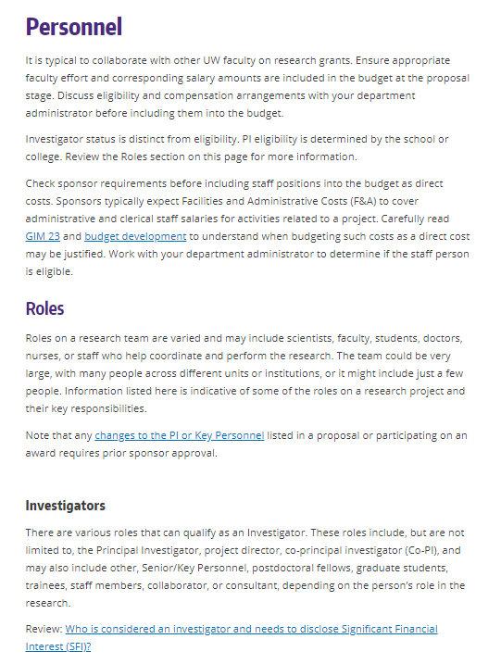
Personnel Roles
Provides guidance on PI eligibility, other Investigator types, and other roles on a project and related responsibilities, including SFI disclosure.
https://www.washington.edu/research/myresearch-lifecycle/plan-and-propose/recruit-team/personnel/
Notes:
s

Slide 37
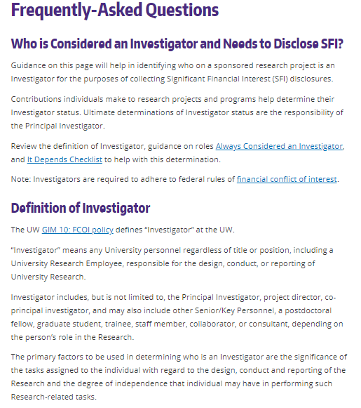
Who is considered an investigator & needs to disclose SFI?
https://www.washington.edu/research/faq/who-is-considered-an-investigator-and-needs-to-disclose-sfi/
Notes:
s

Slide 38
Questions

Slide 39
New NSF FAQs
September MRAM
Tim Mhyre
Office of Sponsored Programs

Slide 40
2020 NSF PAPPG (NSF 20-1) & Previous MRAMs
NSF 20-1 became effective June 1, 2020
Previous MRAMs
February 2020 - Matt Gardner (PAFC) covered Participant Support Costs
March MRAM - Carol Rhodes (OSP) covered SciENcv for Biosketches and Current & Pending Support
April MRAM - Carol covered both NSF and NIH Current & Pending Support
Frequently Asked Questions (FAQs) on proposal preparation and award administration
Proposal & Award Policies & Procedures Guide (PAPPG) (NSF 20-1)

Slide 41
NSF FAQs Related to 2020 PAPPG
Issued on August 28, 2020
Not new policy, but provides clarification and examples
FAQs from A - Assistance Listing (formerly CFDA Numbers) to T - Tuition Remission
Focus today - few highlights & areas that tend to be discussion points
Frequently Asked Questions (FAQs) on proposal preparation and award administration
Proposal & Award Policies & Procedures Guide (PAPPG) (NSF 20-1)

Slide 42
Biosketches and Current & Pending Support
NSF-Approved Formats Required October 1, 2020, onward
NSF-Approved Formats for the Biographical Sketch
SciENcv, NSF Fillable PDF
NSF-Approved Formats for Current and Pending Support
SciENcv, NSF Fillable PDF
Frequently Asked Questions (FAQs) on proposal preparation and award administration
Proposal & Award Policies & Procedures Guide (PAPPG) (NSF 20-1)

Slide 43
Highlighted FAQs
Collaborative Proposals
Lead and non-lead collaborative proposal(s) do not need to be submitted on the same day
All components must still meet any established deadline date
Cost Sharing
Unless required by NSF solicitation, must use current NICRA in computing F&A costs (or else it’s considered voluntary committed CS)
Frequently Asked Questions (FAQs) on proposal preparation and award administration
Proposal & Award Policies & Procedures Guide (PAPPG) (NSF 20-1)

Slide 44
Highlighted FAQs
Postdoctoral Researcher Mentoring Plan
Cannot be corrected thru Proposal File Update module
Proposal must be withdrawn, resubmitted by deadline
Proposal Preparation
Research.gov automatically paginates (FastLane does not)
URLs must not be included with the Project Description
Frequently Asked Questions (FAQs) on proposal preparation and award administration
Proposal & Award Policies & Procedures Guide (PAPPG) (NSF 20-1)

Slide 45
Highlighted FAQs
Synergistic Activities
“NSF policy (PAPPG Chapter II.C.2.f(i)(d)) allows for up to five distinct examples of synergistic activities. Each item must be one activity and must not be followed by a listing of additional sub-activities. As an example, the PI may summarize that he/she served on ten review panels, however, the PI must not list the specific panels for that distinct example.”
Frequently Asked Questions (FAQs) on proposal preparation and award administration
Proposal & Award Policies & Procedures Guide (PAPPG) (NSF 20-1)

Slide 46
Questions
Tim Mhyre
Office of Sponsored Programs
tmhyre@uw.edu
(206) 221-1057
Frequently Asked Questions (FAQs) on proposal preparation and award administration
Proposal & Award Policies & Procedures Guide (PAPPG) (NSF 20-1)

Slide 47
COMPLIANCE CORNER
MRAM
September, 2020
Matt Gardner
Post Award Fiscal Compliance

Slide 48
OMB Compliance Supplement
Supplement released on August 14, 2020
Effective for audits of fiscal years beginning after June 30, 2019
No major changes from the 2019 Supplement
MRAM – Matt Gardner – PAFC

Slide 49
OMB Compliance Supplement: COVID-19
Supplement didn’t address audit guidance for:
COVID-19 related programs/funding
Existing Awards with compliance requirement changes due to COVID-19
Addendum to the Supplement will be released in “the fall of 2020” that will cover funding and guidance related to COVID-19
MRAM – Matt Gardner – PAFC

Slide 50
OMB Compliance Supplement - Resources
2020 Compliance Supplement – 2 CFR Part 200 Appendix XI
https://www.whitehouse.gov/omb/management/office-federal-financial-management/
MRAM – Matt Gardner – PAFC

Slide 51
NSF Frequently Asked Questions
NSF 20-1
NSF updated FAQs on August 28th
FAQs address a variety of pre- and post-Award questions and issues
Provides information and clarifications on existing policies; no new policies introduced
MRAM – Matt Gardner – PAFC

Slide 52
NSF Frequently Asked Questions
NSF 20-1
Provides links to where to find NSF policies related to specific topics (ex. NSF’s Cost Share policy)
Many helpful examples covering topics such as PI Effort on No-Cost Extensions, Participant Support, and Prior Approval Requirements
NSF 20-1 Link:
https://www.nsf.gov/bfa/dias/policy/papp/pappg20_1/faqs20_1.pdf
MRAM – Matt Gardner – PAFC

Slide 53
Questions
Post Award Fiscal Compliance (PAFC)
gcafco@uw.edu
https://finance.uw.edu/pafc/
Andra Sawyer
andra2@uw.edu
Matt Gardner
mgard4@uw.edu
MRAM – Matt Gardner – PAFC

Slide 54
Compliance Corner
MRAM September 10, 2020
Andra Sawyer
Post Award Fiscal Compliance (PAFC)
gcafco@uw.edu

Slide 55
PAFC’s CORE Classes
All classes scheduled for in-person (via Zoom) for Fall 2020
Converting most from in-person to on-demand (recorded)
Some recorded modules meet two needs:
Component of a CORE class
General information, explanation

Slide 56
Example: Cost Share F&A Rate
PAFC Webpage:
GCA Webpage:

Slide 57
Updates
Fall quarter schedule
All courses scheduled
All offered via Zoom
Certificate program
295 enrolled in the certificate program
16 graduates—CONGRATULATIONS!
CORE Registration:
https://uwresearch.gosignmeup.com/public/course/browse
CORE Home: https://www.washington.edu/research/required-training/faculty-grants-management/

