Slide 1
COVID-19 and Human Subjects Research
MRAM Meeting September 10, 2020

Slide 2
Summary of Changes Implemented August 12, 2020
NEW expectations for all research involving in-person interactions
ARCHIVE (eliminate) the CHECKLIST Human Subjects Research During the COVID-19 Pandemic
NEW risk-based identification of allowed research

Slide 3
Expectations for ALL research involving in-person interactions (ongoing & new)
Common-sense infection & severity controls:
All in-person interactions must be essential
Face coverings worn by all
Symptom screening of participants & study staff
No subjects over age 85 exceptions possible

Slide 4
These are common-sense infection & severity controls
They are also UW & UW Medicine policies for all staff, not just for research.
We ask researchers to confirm compliance when they apply for IRB approval
Question 1.10 on IRB Protocol form

Slide 6
CHECKLIST Human Subjects Research During the COVID-19 Pandemic
Now removed. Why?
Almost universally confusing
A well-intentioned attempt to make things easier for researchers by bringing together requirements from multiple places
Researchers need fewer COVID documents, not more

Slide 7
Identification of Allowed Research
Goal: Manage the impact of COVID-19 on the risks and benefits, based on limited knowledge of COVID and sense of which methods/types of research might be most risky.
Previous approach was based on categorizing research according to intent, benefit to subjects, and method

Slide 8
How to make the categories more workable & up-to-date?
Categories 1, 2, and 3 still make sense but not the others.
1 – no in-person interactions
2 – COVID research
3 – Most clinical trials

Slide 9
A more direct risk assessment is now possible

Slide 10
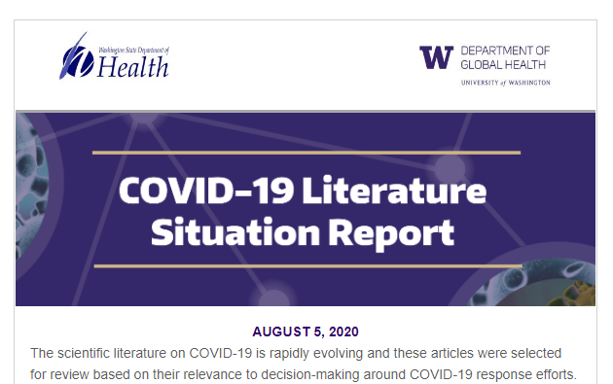
Solid, reliable scientific information
Minimizing the risk of infection
People/circumstances associated with severity

Slide 11
The Change
Keep Categories 1, 2, and 3 as they are.
If the research fits into one of these, go ahead.
If the research doesn’t fit into one of the categories: the researcher assesses with the COVID-19 Relative Risk self-assessment tool

Slide 12
COVID-19 Relative Risk Self-Assessment Tool
Use this new tool to assess new or halted research that doesn’t fit into Categories 1,2, 3
For new or currently halted research that doesn’t fit into Category 1, 2, or 3.
Who uses it
Researchers
Is it a required part of the IRB application?
No, don’t send it to the IRB. It is for researcher use only.

Slide 13
How it works
Score the research on 5 COVID risk factors
State of the pandemic in geographic area
Participant age
Subject medical conditions & need for research trip
Physical distancing
# people interacting with subjects
Add the 5 scores, for a Total Relative Risk Score.
Compare Total Score to allowable range.

Slide 14
Advantages of this approach
Directly based on major risks for COVID infection & severity
Evidence-based & reviewed by several experts
Easier for researchers to apply
Researchers can see what changes might significantly lower the COVID risk profile of a study
Can be easily adjusted/revised as new information about COVID 19 becomes known
There is a process for requesting an exception
It will be revised only when there is significant, reliable new information that is affecting University-wide operations i.e., infrequently

Slide 15
Revisions to the Risk Tool
Example scenarios
The pandemic becomes very bad in our area.
A major new risk factor is discovered.
How revisions will be communicated
Usual ways for very broad/redundant messaging
Might some ongoing research might have to halt?
Yes, but this was true of previous approach too, and all COVID-related policies generally

Slide 16
Lots of information is embedded in the tool
The actual scoring system is set within lots of text.
Purpose:
Provide details and interpretation
Address specific situations (e.g., international research, review by external IRBs)
Anticipate as many questions as possible

Slide 17
Vetted for accuracy and sensibility
Office of Research
UW Advisory Committee on Communicable Diseases
Faculty infectious disease experts
UW Risk Management
School of Medicine leaders

Slide 18
Why Allow Exceptions?
Exception = allowing research that has a Total Relative Risk Score above the allowable range.

Slide 19
Exceptions Allowed When…
Extraordinary benefit of a study whose score is just above the allowable range.
Participant protections that aren’t captured by the Risk tool – example, additional Personal Protective Equipment such as N95 masks, face shields, full gear

Slide 20
Questions About the Tool
Answers will usually be in the footnotes
Send all other questions and requests for exceptions to hsdinfo@uw.edu

