Slide 1
Current and Pending, or Other Support
September, 2020 MRAM
Carol Rhodes
Office of Sponsored Programs

Slide 2
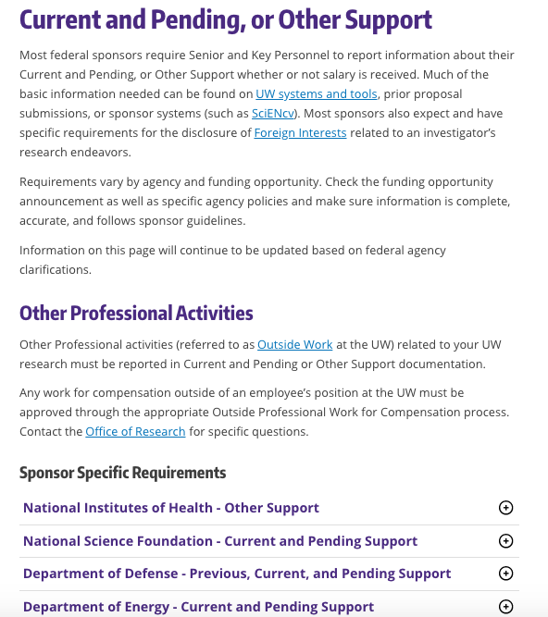
Key information on requirements from some federal sponsors.
Variations for NIH & NSF requirements such as in-kind support, and appointments
Inconsistencies in NIH guidance - hopefully will be cleared up with NIH Oct. updates
Notes:
https://www.washington.edu/research/myresearch-lifecycle/plan-and-propose/sponsor-requirements/federal/cpos/
Note differences between NIH & NSF requirements such as in-kind support, and appointments
NIH is making updates in October - including to their OS template

Slide 3
Rules on listing In-kind Support
NSF:
List in Current & Pending Support when in-kind support involves a time commitment (not related to proposed project)
List in Facilities, Equipment and Other Resources when in-kind support is related to proposed project.
Don’t list in both places.
See NSF FAQs
NIH: List all In-kind support in Other Support
See NIH NOT-OD-19-114

Slide 4
NIH and Appointments
NOT OD-19-114 states to list all appointments relevant to an application in Other Support.
NIH new guidance, “Protecting U.S. Biomedical Intellectual Innovation” indicates to list in Biosketch only.
Which is it?
We are telling campus to err on side of disclosure and list in both locations, unless/until we have further clarification.

Slide 5
Foreign Components and Other Support - Reminder
NIH Definition for Foreign Components: Any “significant scientific element or segment of a project” outside of the U.S.:
performance of work by a researcher or recipient in a foreign location, whether or not NIH grant funds are expended and/or
performance of work by a researcher in a foreign location employed or paid for by a foreign organization, whether or not NIH grant funds are expended.
Activity that does not meet the definition of foreign component because all research is being conducted within the U.S., but there is a non-U.S. resource supporting the research of an investigator and/or researcher, must be reported as other support.
NOT-OD-19-114
FAQ: Other Support and Foreign Component

Slide 6
Questions

