Slide 1
Updated Guidance for Personnel Roles on a Project
September, 2020 MRAM
Carol Rhodes, Office of Sponsored Programs
Melissa Petersen, Office of Research

Slide 2
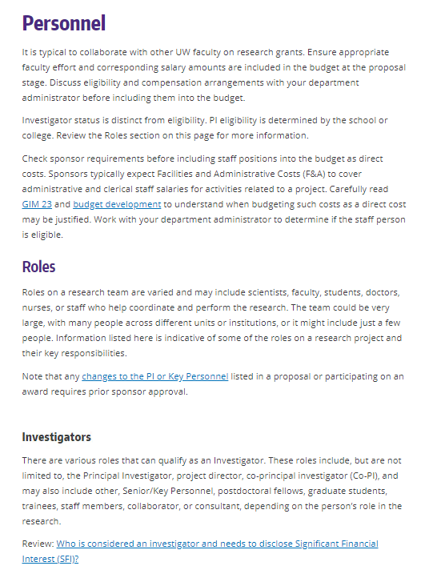
Personnel Roles
Provides guidance on PI eligibility, other Investigator types, and other roles on a project and related responsibilities, including SFI disclosure.
https://www.washington.edu/research/myresearch-lifecycle/plan-and-propose/recruit-team/personnel/
Notes:
s

Slide 3
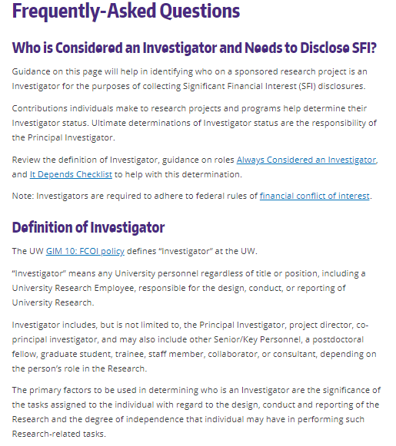
Who is considered an investigator & needs to disclose SFI?
https://www.washington.edu/research/faq/who-is-considered-an-investigator-and-needs-to-disclose-sfi/
Notes:
s

Slide 4
Questions

