Slide 1
Compliance Corner
MRAM September 10, 2020
Andra Sawyer
Post Award Fiscal Compliance (PAFC)
gcafco@uw.edu

Slide 2
PAFC’s CORE Classes
All classes scheduled for in-person (via Zoom) for Fall 2020
Converting most from in-person to on-demand (recorded)
Some recorded modules meet two needs:
Component of a CORE class
General information, explanation

Slide 3
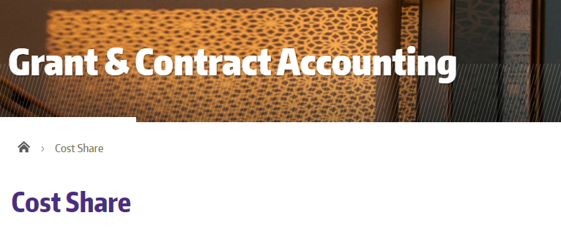
Example: Cost Share F&A Rate
PAFC Webpage:
GCA Webpage:

