Slide 1
MRAM | Monthly Research Administration Meeting
October 15, 2020 9:00 AM – 10:30 AM HOSTED REMOTELY Join the LIVE Webinar: https://washington.zoom.us/j/346891888
TOPIC | PRESENTER | EMAIL | MIN
Welcome | Kirsten DeFries Research Compliance & Operations | kirsten5@uw.edu | 2
GCA Budget Set Up Turnaround Time | Lily Gebrenegus Grant & Contract Accounting | lgebren@uw.edu | 2
Uniform Guidance Update | Carol Rhodes & Bo Park Office of Sponsored Programs Matt Gardner Post Award Fiscal Compliance | carhodes@uw.edu bohyune@uw.edu gcafco@uw.edu | 20
National Defense Authorization Act: Specific prohibition on covered telecommunications products/services | Carol Rhodes Office of Sponsored Programs | carhodes@uw.edu | 10
White House Race and Sex Stereotyping Executive Order | Joe Giffels Office of Research | jgiffels@uw.edu | 10
Foreign Nationals on Sponsored Projects | Mark Stomski Office of Research | stomski@uw.edu | 10
National Biosafety Month/COVID-19 Biological Research and Biosafety Requirements | Lesley Decker Biosafety Officer, Environmental Health & Safety | lldecker@uw.edu | 15
Compliance Corner | Andra Sawyer, Matt Gardner Post Award Fiscal Compliance | gcafco@uw.edu | 10
Recognition of Recipients of the CORE Certificate in Research Administration | Laurie Stephan Collaborative On Research Education (CORE) | corehelp@uw.edu | 10
NEXT MEETING November 5, 2020 9:00 AM - 10:00 AM

Slide 2
GCA Budget Set Up Turnaround Time
MRAM
October 2020
Lily Gebrenegus
Grant & Contract Accounting

Slide 3
CURRENT PROCESS
GCA has a daily goal to process all budget set-up related items within 1 business day of receipt
TAP survey respondents said that they value the accuracy of the data more than the 1 day turnaround
Completing high volumes of complex items in recent months has been a challenge (e.g. CARES Act, etc.)

Slide 4
NEW PROCESS
Starting next week, GCA’s goal for processing budget set-up items will change from 1 business day to 2 business days of receipt
We’ll still prioritize high impact items (e.g. assigning new budget numbers, extensions)
We’ll continue to monitor for urgent requests and items impacted by payroll deadlines

Slide 5
QUESTIONS?
Contact Lily Gebrenegus
lgebren@uw.edu

Slide 6
Uniform Guidance Update
October 2020 MRAM
Carol Rhodes: Office of Sponsored Programs
Bo Park: Office of Sponsored Programs

Slide 7
UG Revisions - Why?
President’s Management Agenda, Results-Oriented Accountability for Grants Cross-Agency Priority Goal (Grants CAP Goal)
CAP finding: Too much time using antiquated processes to monitor compliance. Efficiencies from modernization, grants managers shift time to analyze data to improve results
Purpose of revisions: Enhanced results-oriented accountability for grants and aligns with other regulations (e.g. NDAA, FFATA, DATA Act)
Carol Rhodes, Office of Sponsored Programs

Slide 8
When are the Revisions Effective?
Most revisions effective November 12th, 2020
Items related to National Defense Authorization Act (NDAA) effective as of August 13, 2020
covered in separate MRAM presentation
Carol Rhodes, Office of Sponsored Programs

Slide 9
Scope of UG: Federal Awards
Federal Awards that are Sponsored Programs
UG covers all Federal Awards. Not all Federal Awards are Sponsored Programs.
Federal Award categories for Sponsored Programs:
Federal Financial Assistance funding that is:
Grant
Cooperative Agreement
Federal Contract that is a Cost Reimbursable basis for R&D
Can be hybrid fixed price and Cost reimbursable to qualify as a sponsored program
Other Transaction Authority (OTA) – not covered today
Carol Rhodes, Office of Sponsored Programs

Slide 10
Scope of UG: Federal Agency Adoption
Individual agencies adopt the UG in separate Code of Federal Regulations (CFRs)
DHHS (e.g. NIH, CDC, SAMHSA), NSF, NASA, DOE and others have not yet adopted but we expect they will implement their own regulations to mirror these provisions
Carol Rhodes, Office of Sponsored Programs

Slide 11
PART 25—UNIVERSAL IDENTIFIER AND SYSTEM FOR AWARD MANAGEMENT
Unique Entity Identifier – currently DUNS #
The federal government is in the process of transitioning to issuing a UEI instead of DUNS #
Transition was supposed to be complete by the end of this calendar year but it has been put on hold indefinitely
You will see both the terms UEI and DUNS # used across forms, documents, websites, and policy guidance
Until you hear otherwise, continue to use the DUNS #
Carol Rhodes, Office of Sponsored Programs

Slide 12
Terminology Change:
CFDA = Assistance Listing
Grants and Cooperative agreements come from a category of funding currently listed in the Catalog of Federal Domestic Assistance (CFDA).
This term is now going to be called Assistance Listing. We will start seeing this term in our awards.
Carol Rhodes, Office of Sponsored Programs

Slide 13
Part 200: COST PRINCIPLES, AND AUDIT REQUIREMENTS FOR FEDERAL AWARDS
Fixed Amount Awards 1/3
Fixed amount awards are defined as:
A type of agreement under which the Federal awarding agency or pass-through entity provides a specific level of support without regard to actual costs incurred under the Federal award. This type of Federal award reduces some of the administrative burden and record-keeping requirements for both the non-Federal entity and Federal awarding agency or pass-through entity. Accountability is based primarily on performance and results.
Agency will indicate in the funding opportunity if the award will result in fixed amount award.
Carol Rhodes, Office of Sponsored Programs
Notes:
Pricing data helps establish a reasonable estimate of actual cost.
Cost principles are still used to formulate your fixed pricing.

Slide 14
Part 200: COST PRINCIPLES, AND AUDIT REQUIREMENTS FOR FEDERAL AWARDS
Fixed Amount Awards 2/3
Fixed Amount Awards are:
used if project scope has measurable goals and objectives
When adequate cost, historical, or unit pricing data is available
Not used when there is mandatory cost sharing or matching
Cost principles apply? Yes, the award amount is “negotiated” using the cost principles (or other pricing information) as a guide.

Slide 15
Part 200: COST PRINCIPLES, AND AUDIT REQUIREMENTS FOR FEDERAL AWARDS
Fixed Amount Awards 3/3
Accountability is based on performance and results
There isn’t a govt. review of the actual costs incurred in award performance
The UW must certify that the project or activity was completed or the level of effort was expended at closeout.
Carol Rhodes, Office of Sponsored Programs
Notes:
We presume certification is done by UW as the grantee rather than the PI individually, but we will need to capture that information from the PI before certification.

Slide 16
PART 25—UEI, SAM, and Subawards
Subrecipients must have a UEI (DUNS#) to receive a subaward.
UG says that subrecipients do not have to do the full SAM registration to receive a UEI (DUNS).
Some agencies may flow down this requirement, which means they will have to do it anyway...
Bo Park, Office of Sponsored Programs

Slide 17
PART 170—REPORTING SUBAWARD AND EXECUTIVE COMPENSATION INFORMATION
As PI/dept, you do not need to take any additional steps to fulfill this requirement
OSP Subawards team handles all FFATA reporting for subawards as required by UG
FFATA reporting: Largely the same requirements but the threshold has raised to $30K for outgoing subawards
Bo Park, Office of Sponsored Programs

Slide 18
PART 200.414 & 200.332 - INDIRECT (F&A) COST RATE USED BY SUBAWARDS
Expansion of 10% MTDC de minimus rate, it can be used indefinitely
No documentation required to justify using de minimus rate or to prove they have never had a rate
If the subrecipient has a subaward with another pass-through entity (PTE), that same rate used can be accepted for current subaward with UW as PTE
No documentation needed but we can ask
Bo Park, Office of Sponsored Programs

Slide 19
Part 200.215 NEVER CONTRACT WITH THE ENEMY
Who is the enemy:
Outside the United States, a person or entity that is actively opposing United States or coalition forces involved in a contingency operation in which members of the Armed Forces are actively engaged in hostilities. (Per Part 183)
What does that mean?
When issuing subawards, OSP checks SAM for “enemies”
Flow-down clause in outgoing subaward
Bo Park, Office of Sponsored Programs

Slide 20
Questions

Slide 21
UNIFORM GUIDANCE UPDATE
MRAM
October 2020
Matt Gardner
Post Award Fiscal Compliance

Slide 22
REVISED UNIFORM GUIDANCE - CLOSEOUT
200.344 Closeout
OMB has increased the maximum time to closeout an Award from 90 to “no later than 120” days. This includes:
Financial Reports
Performance Reports
Any other reports required by the Terms & Conditions
Subrecipient closeout “no later than 90” days
MRAM – Matt Gardner – PAFC

Slide 23
REVISED UNIFORM GUIDANCE - CLOSEOUT
200.344 Closeout
These are maximum closeout dates, not minimums.
An agency may, at their discretion, require earlier closeout dates.
Always read your Notice of Award (and sponsor Terms & Conditions) for the closeout and deliverable dates applicable to your Award.
MRAM – Matt Gardner – PAFC

Slide 24
REVISED UNIFORM GUIDANCE – CLOSEOUT CONSEQUENCES
200.344(h) The Federal agency will close the Award, regardless of the status of required reports, within one year of the end date
200.344(i) The Federal agency “must” report the failure to comply to the OMB-designated integrity and performance system.
Failure to closeout an Award in a timely manner has consequences
MRAM – Matt Gardner – PAFC

Slide 25
REVISED UNIFORM GUIDANCE –
TELECOMMUNICATIONS
New Sections:
200.216 Prohibition on certain telecommunications and video surveillance services or equipment
200.471 Telecommunications and video surveillance costs
Definition of “Telecommunications Cost”
These new sections apply to current Federal awards, as well as any subrecipients.
MRAM – Matt Gardner – PAFC
Notes:
Telecommunications cost means the cost of using communication and telephony technologies such as mobile phones, land lines, and internet.

Slide 26
Questions
Post Award Fiscal Compliance (PAFC)
gcafco@uw.edu
https://finance.uw.edu/pafc/
Andra Sawyer
andra2@uw.edu
Matt Gardner
mgard4@uw.edu
We are available for Teams voice calls!
MRAM – Matt Gardner – PAFC

Slide 27
National Defense Authorization Act: Prohibition on covered telecommunications products/services
October 2020 MRAM
Carol Rhodes
Office of Sponsored Programs

Slide 28
National Defense Authorization Act (NDAA)
Section 889:
Prohibits agencies from entering into contracts with entities (such as the UW) that use equipment, systems, or services that integrate “covered” telecommunications equipment or services deemed to be a “substantial or essential component of any system” or “critical technology as part of any system.”
e.g. covered entity =Huawei and others
Prohibits use of federal funding to procure or obtain “covered” telecommunications equipment or services
Effective August 13, 2020
Notes:
s

Slide 29
How does this look in Federal Awards?
Federal Contracts will include new FAR clause 52.204-26: Does UW represent that it □ does, □ does not provide covered telecommunications equipment or services as a part of its offered products or services . . .
Federal Grants and Cooperative agreements will include similar language as a term and condition, but further:
Grantees are prohibited from using government funds “to enter into contracts (or extend or renew contracts) with entities that use covered telecommunications equipment or services.” (language from revised UG)
Notes:
We can bypass reps under 52.204-24 if we state “does not” provide covered telecommunications equipment/services as part of the offered products or services to the Government

Slide 30
How is the UW Handling?
UWIT:
Confirmed UWIT environment does not violate this clause
Incorporate into its vendor contracts as needed
UW Procurement:
Reviewed P-card transactions to date
Additional procedures under development
Subawards:
New subrecipients are checked against SAM
Foreign entities also receive Restricted Party Screening (RPS)
Incorporate as flow-down as needed
OSP:
Makes PI aware of limitation and have them acknowledge in writing
Notes:
Claudia and Ray can elaborate further on Procurement steps

Slide 31
Questions

Slide 32
EO 13950 - Combating Race and Sex Stereotyping
MRAM
October 2020
Joe Giffels
Office of Research

Slide 33
Effects on Recipients of Federal Funding
Grants – additional requirements may be imposed (Section 5), including requiring certifications
Contracts – Every new federal contract will have specific, new terms and conditions (Section 4)
Contracts for providing diversity training to federal employees – violations may lead to debarment (Section 7b)
General UW diversity training – may affect UW as a federal contractor (Section 4)
MRAM – Joe Giffels – Office of Research

Slide 34
Advice to PIs
Review their portfolio of grants and contracts
Await notice from federal agency sponsors regarding grants or programs
Await new terms to appear in new contracts
Let the Office of Research know (research@uw.edu) if they lead a program that provides diversity training to federal employees
MRAM – Joe Giffels – Office of Research

Slide 35
Foreign Nationals and the
Fundamental Research Exclusion
MRAM
October 2020
Mark Stomski
Office of Research

Slide 36
Fundamental Research Exclusion
Exempt from export controls: Research results that are generated with the hope of being published and there are no restrictions or approvals required by the sponsor on the publication or use of foreign nationals. FREE PUBLICATION
Publication approval example: DFARS 252.204-7000
PI agrees to publication approval process
Reviews of publications are OK for I.P. purposes
Does not include physical items (esp. military or space)
Does not include Sponsor or proprietary data
Does this impact remote international work/collaboration?
MRAM – Mark Stomski – Office of Research

Slide 37
Export Controlled vs Fundamental Research
Fundamental Research RESULTS
Controlled Information & Equipment
Sponsor
US!
Open research
Gov’t
Awareness
Foreign national participation OK
Proprietary Data
CONTROLLED DATA
PUBLIC DOMAIN
MRAM – Mark Stomski – Office of Research

Slide 38
Keep in Mind
Remind PIs of the fundamental research exclusion, especially PIs who may indicate that there is a publication or foreign national approval process
Sanctioned country nationals
Cuba, Iran, North Korea, Syria
US Permanent Residents are “US persons,” not foreign nationals
UW faculty, staff, and students from sanctioned countries are OK
International Visitors – Alert exports@uw.edu
Debarred entities
Potential nefarious goals
Report any suspicious behavior
MRAM – Mark Stomski – Office of Research

Slide 39
Keep in Mind
Alert us to potential international collaboration talks or opportunities
Saves time if the collaboration has legal complications
Export licenses may be needed to share some data with foreign nationals, wherever located
Agreements with Russia, China, or the sanctioned countries will require a foreign influence review
Imports of high-value equipment/items
Early notice will help exponentially
Public Domain material and the results of fundamental research are free of export controls
MRAM – Mark Stomski – Office of Research

Slide 40
Contact Anytime
Feel free to contact exports@uw.edu for any of your import/export/foreign national needs
For faster service, contact me:
Mark Stomski
stomski@uw.edu

Slide 41
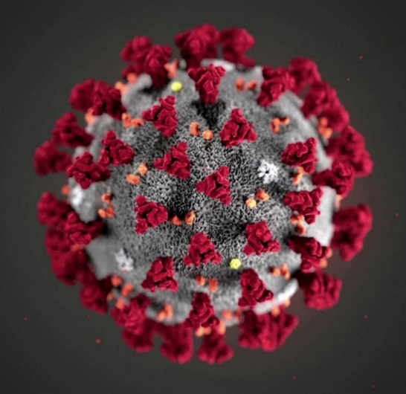
BIOSAFETY MONTH &
COVID-19 BIOLOGICAL RESEARCH AT UW
Lesley Decker
October 15, 2020
MRAM

Slide 42
NATIONAL BIOSAFETY MONTH

Slide 43
WHAT IS BIOSAFETY?
Framework for containment of biohazards
Includes safe practices, safety equipment, facilities and training
Protects the worker, community and environment
Protects the research product

Slide 44
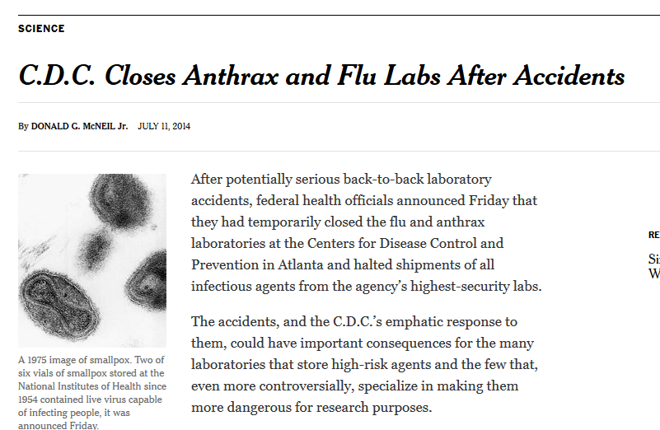
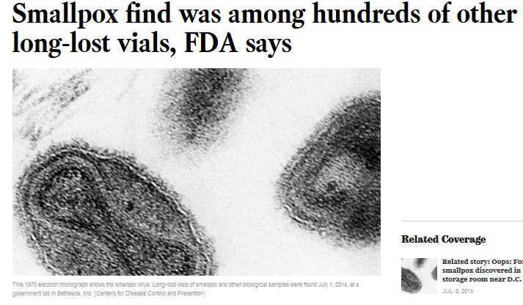
NATIONAL BIOSAFETY MONTH
Started in 2014 by the NIH Office of Science Policy
Time to focus attention to biosafety practices, policies, procedures and inventory

Slide 45
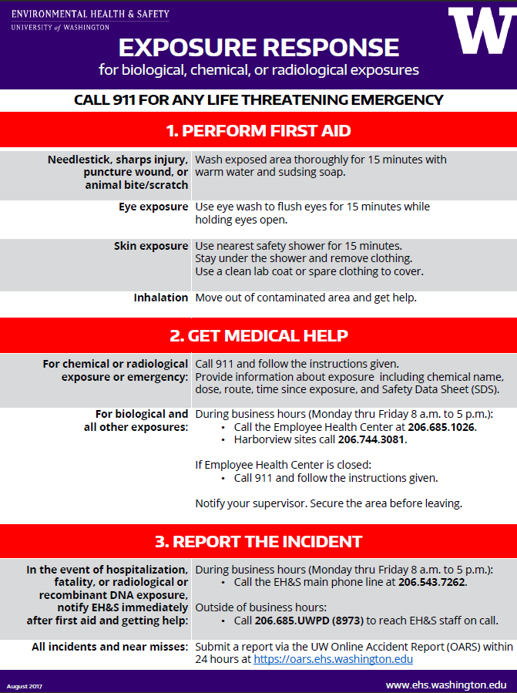
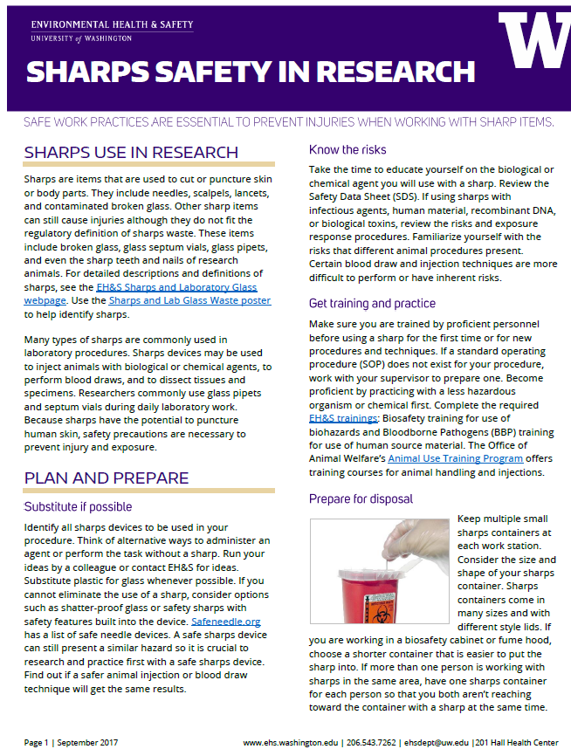
NATIONAL BIOSAFETY MONTH AT UW

Slide 46
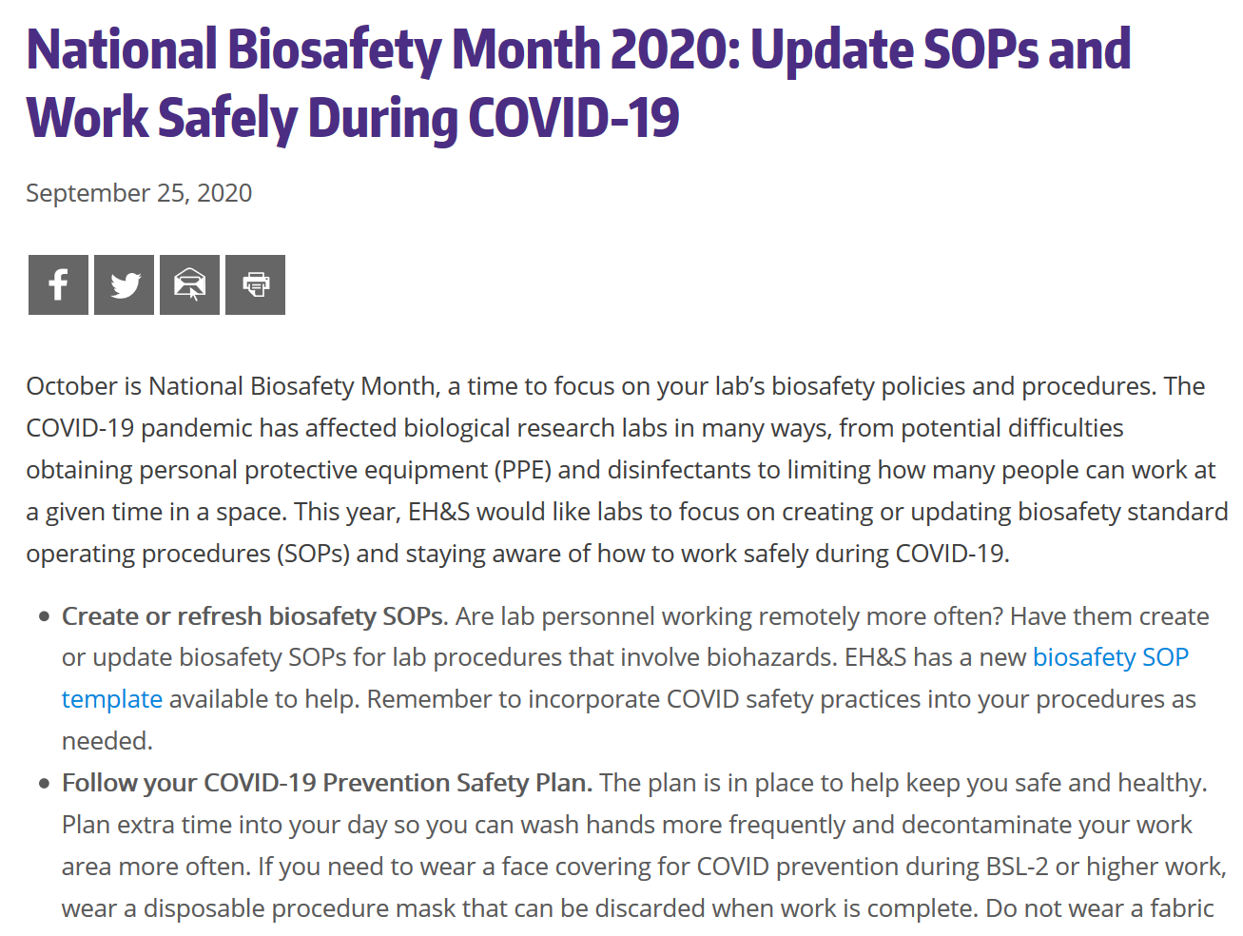
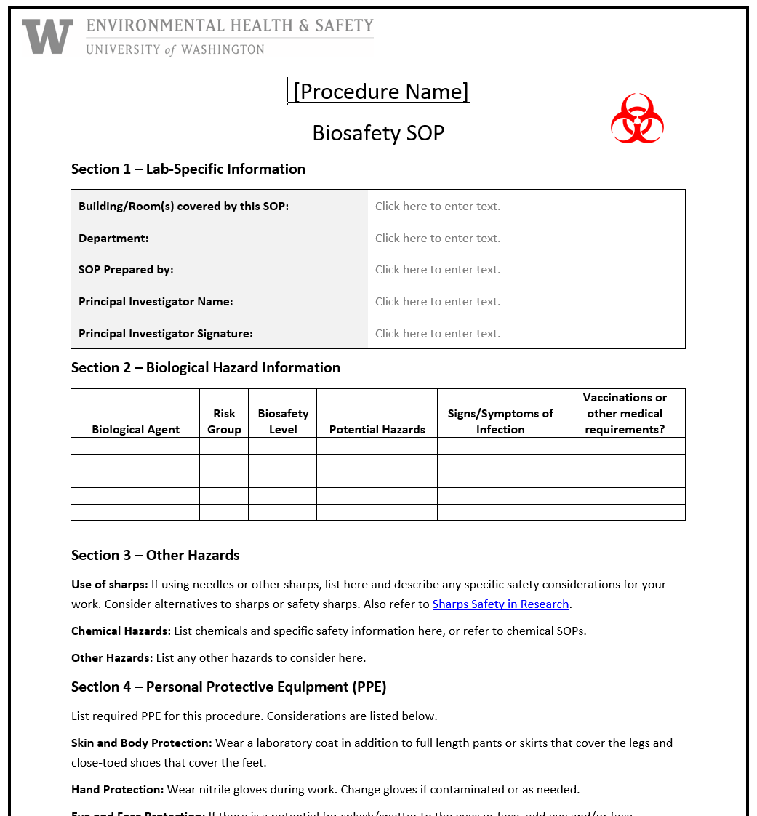
2020 BIOSAFETY MONTH AT UW

Slide 47
BIOSAFETY MONTH OUTREACH
Email to principal investigators and lab managers with BUAs
EH&S newsletter article
Article featured on EH&S homepage
Office of Research web
Presentation to MRAM and U-WIDE Health and Safety Committee

Slide 48
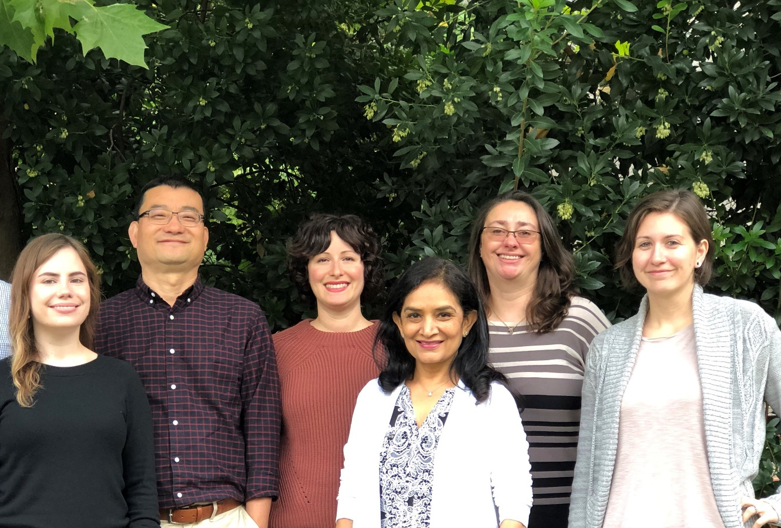
HAPPY BIOSAFETY MONTH!
Plus one brand new biosafety officer!

Slide 49
COVID-19 BIOLOGICAL RESEARCH AT UW

Slide 50
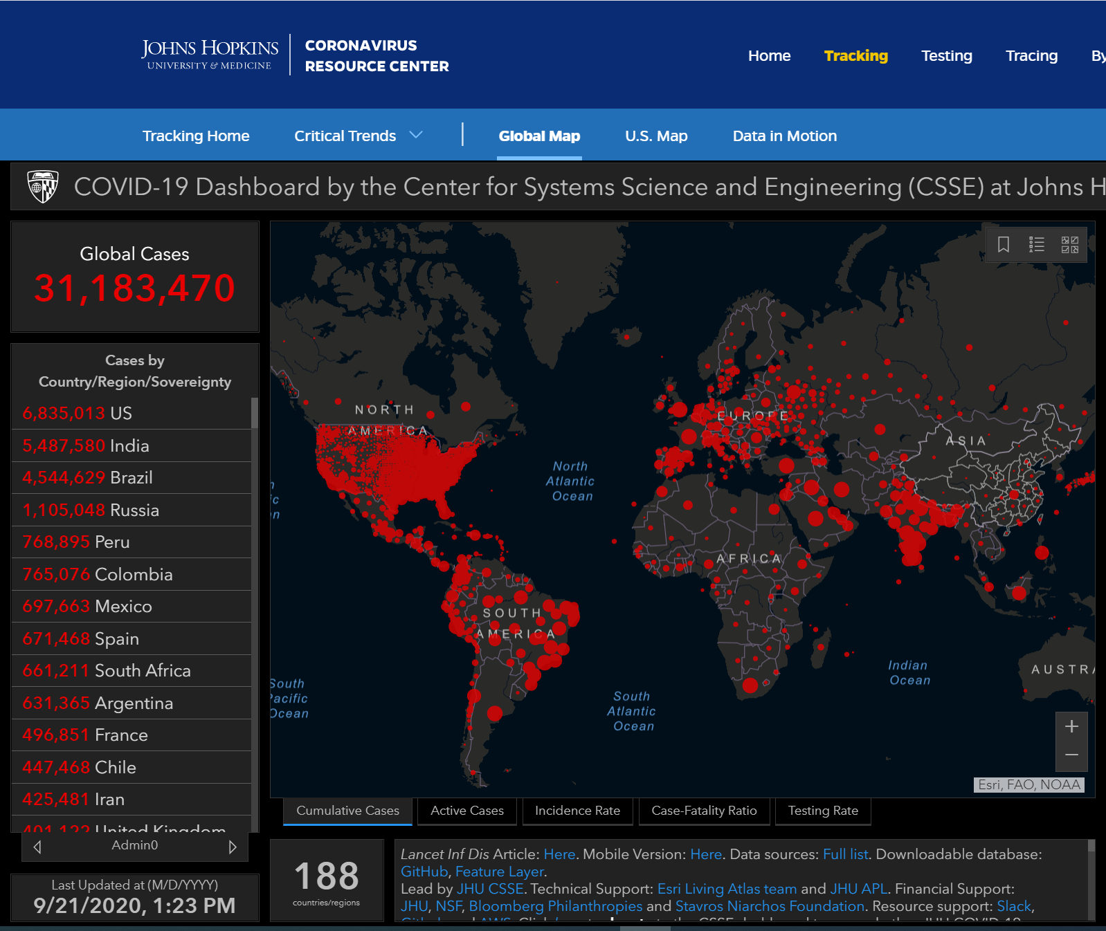
OUTLINE
Overview of SARS-CoV-2
Biosafety requirements at UW
UW COVID-19 biosafety metrics
UW COVID-19 research

Slide 51
OVERVIEW OF SARS-COV-2
Severe acute respiratory syndrome virus 2 aka COVID-19
Positive stranded enveloped RNA virus
Crown-like appearance due to spike glycoproteins on envelope
Human-to-human transmission via respiratory droplets from coughs/sneezes
Close contact (within 6 feet) important for transmission
Not known to exist in humans prior to 2019
Probably zoonotic
Notes:
EnvRNA - it stores its genetic information as RNA packaged inside an envelope, which is made of the host cell’s membrane.
The spike protein serves to recognize and attach to the host cell’s receptors and facilitates entry into the cell.
Once inside the cell, the virus propagates by recruiting the host cell’s enzymes to produce numerous viral precursors.
Mature virions are then released from the host cell’s surface by exocytosis.

Slide 52
SARS-CoV-2 BIOSAFETY REQUIREMENTS AT UW
Informed by:
CDC Interim Laboratory Biosafety Guidelines for COVID-19
National Institutes of Health (NIH)
Institutional Biosafety Committee (IBC)
EH&S Biological Safety
Biological Use Authorization (BUA) required for all work
Genetic modifications to virus could require NIH approval

Slide 53
SARS-CoV-2 BIOSAFETY REQUIREMENTS AT UW
Research activity / Sample or specimen type | Biosafety level (BSL)
SARS-CoV-2 in vitro and in vivo experiments | BSL-3
Clinical specimens from COVID-19 patients | BSL-2 with enhancements
Fixed or inactivated SARS-CoV-2 samples or tissue | BSL-2

Slide 54
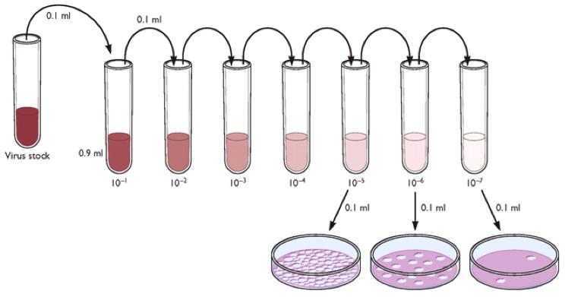
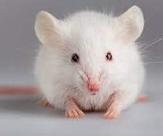
BSL-3: IN VITRO AND IN VIVO EXPERIMENTS
Biosafety level 3 (BSL-3) is required for:
Virus isolation, culture and amplification
Animal experiments

Slide 55
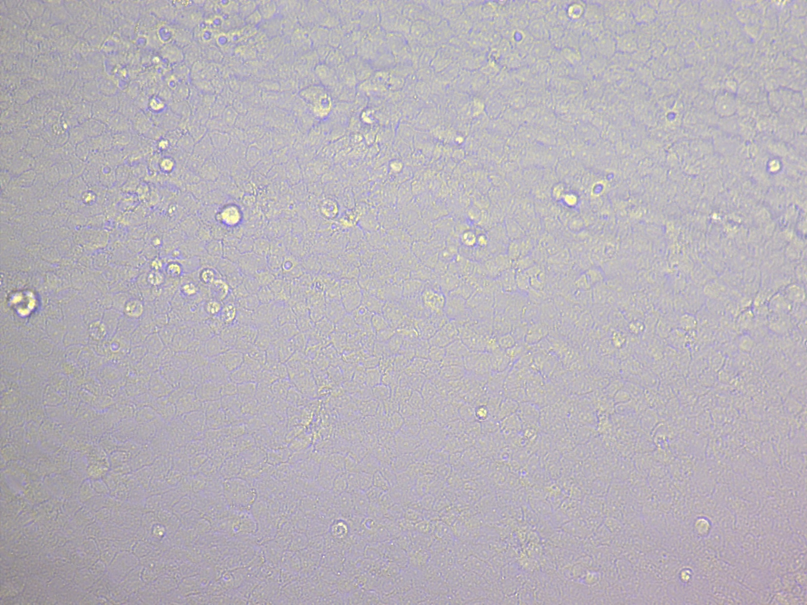
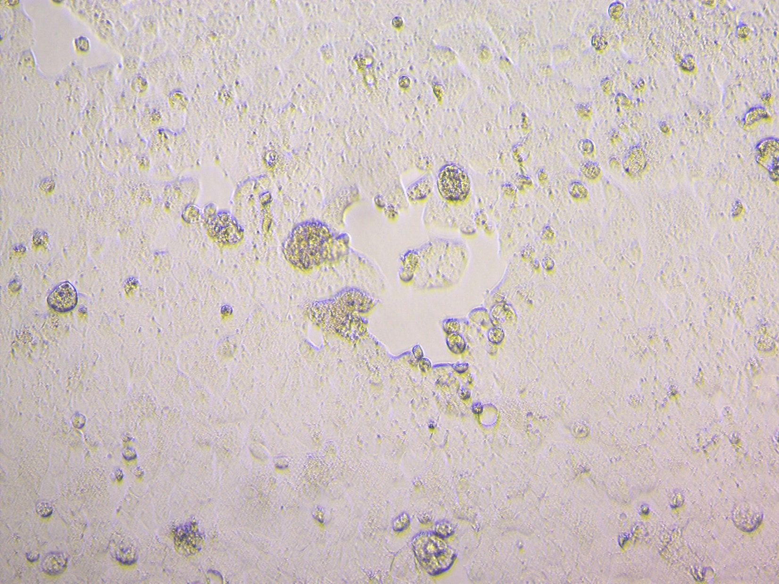

Slide 56
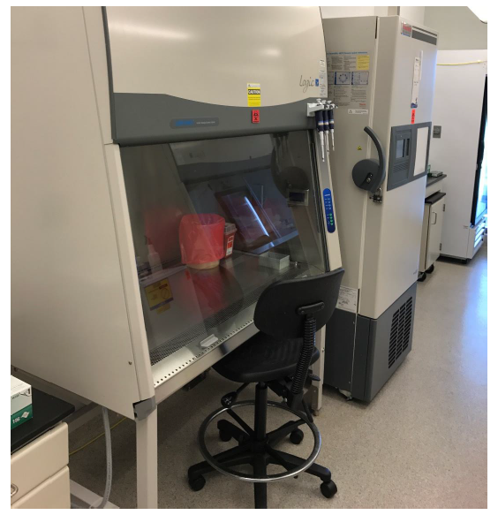
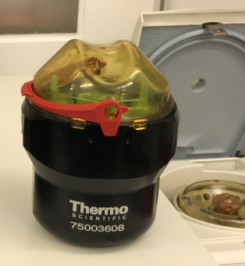
BSL-3: IN VITRO AND IN VIVO EXPERIMENTS
Directional airflow to contain infectious agents
from “clean” to potentially contaminated
HEPA filtered exhaust air
No re-circulated exhaust air
All work conducted inside biosafety cabinet
No glass or sharps unless absolutely necessary
Approved SOPs required

Slide 57
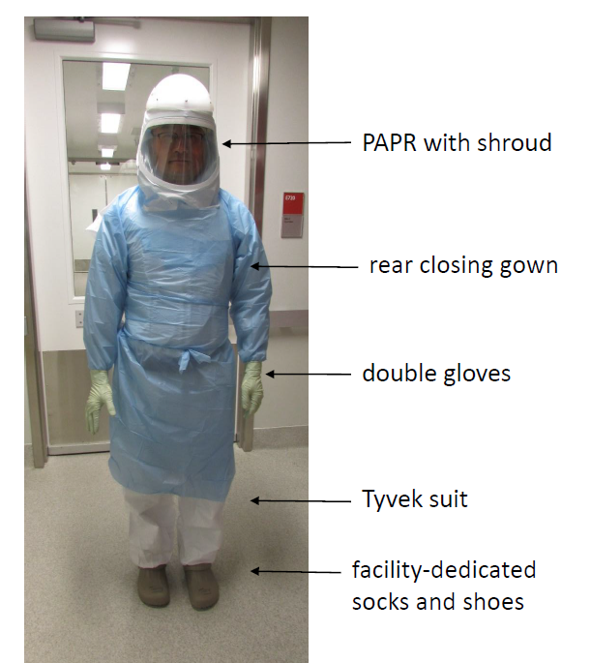
BSL-3 Personal Protective Equipment (PPE)

Slide 58
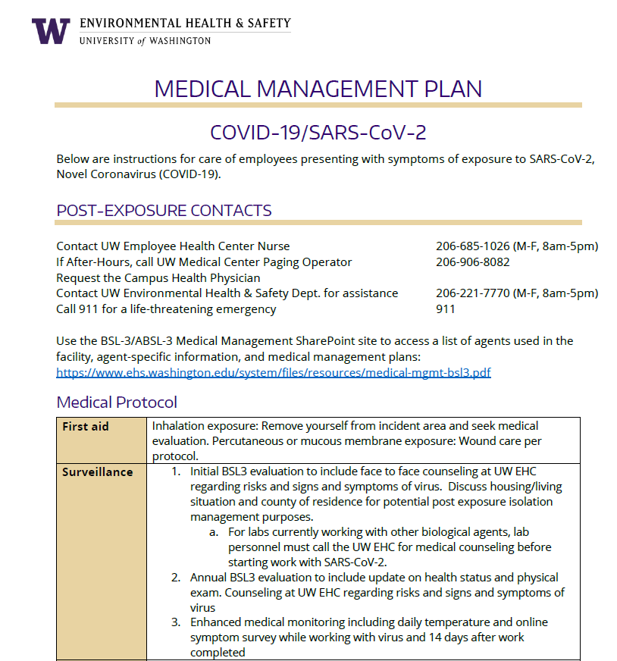
BSL-3: IN VITRO AND IN VIVO EXPERIMENTS
Specific medical management requirements for BSL-3 program
Medical counseling required
Reporting protocol for exposures or symptom development
Annual influenza vaccine required
Specific daily symptom attestation for facility entry

Slide 59
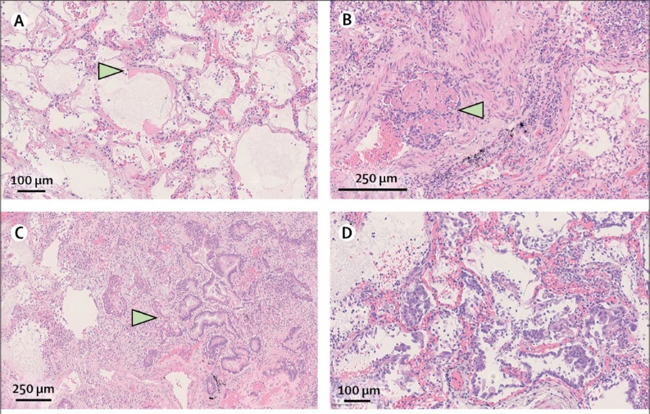
BSL-2 WITH ENHANCEMENTS: CLINICAL SPECIMENS
Biological samples or tissue from COVID-19 patients or potentially infected patients
Notes:
Diagnostic platforms for rapid detection, point-of-care detection, molecular biology assays, RNA extraction, biomarkers, etc.
Host response factors, genetics factors, etc.

Slide 60
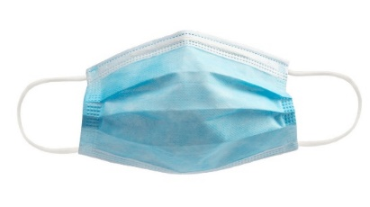
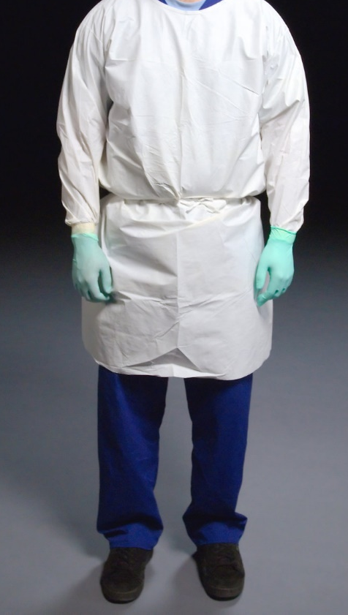
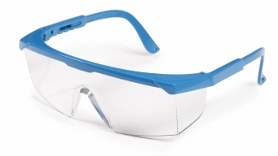
BSL-2 WITH ENHANCEMENTS: CLINICAL SPECIMENS
PPE enhancements include:
Procedure mask plus either face shield, safety goggles, or safety glasses with solid side shields
Gloves
Closed-front gown

Slide 61
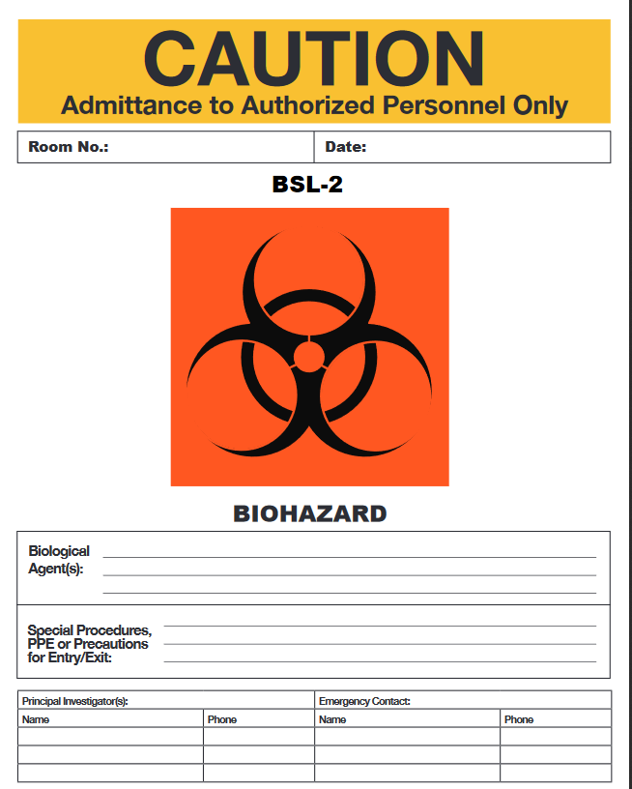
BSL-2 WITH ENHANCEMENTS: CLINICAL SPECIMENS
Other enhancements include:
All work performed inside biosafety cabinet
Site-specific SOP for work
Documented training
Additional COVID-19 warning sign
Medical counseling required
COVID-19 clinical samples in use

Slide 62
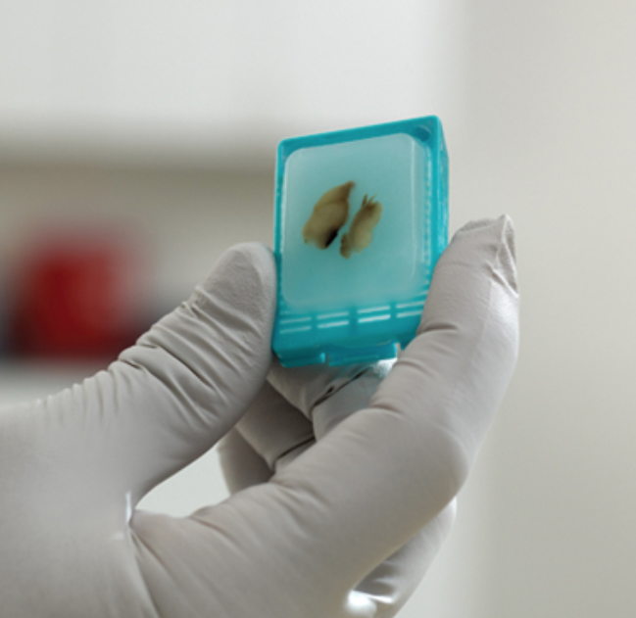
BSL-2 : FIXED OR INACTIVATED SAMPLES/TISSUE
BSL-2 is required for:
Flow cytometry
Staining and microscopy
Pathologic examination and processing
Extracted nucleic acid preparations
Use biosafety cabinet for aerosol-generating activities
Medical counseling required

Slide 63
UW COVID-19 BIOSAFETY METRICS
49 approved BUAs for work with SARS-CoV-2 materials
1 approved BUA for COVID-19 vaccine clinical trial
43 principal investigators (PIs) working with SARS-CoV-2 materials
4 special IBC meetings outside of normal monthly meeting
BSL-3/Select Agent Program:
38 total members pre-COVID
72 total members post-COVID
38 COVID-19 researchers

Slide 64
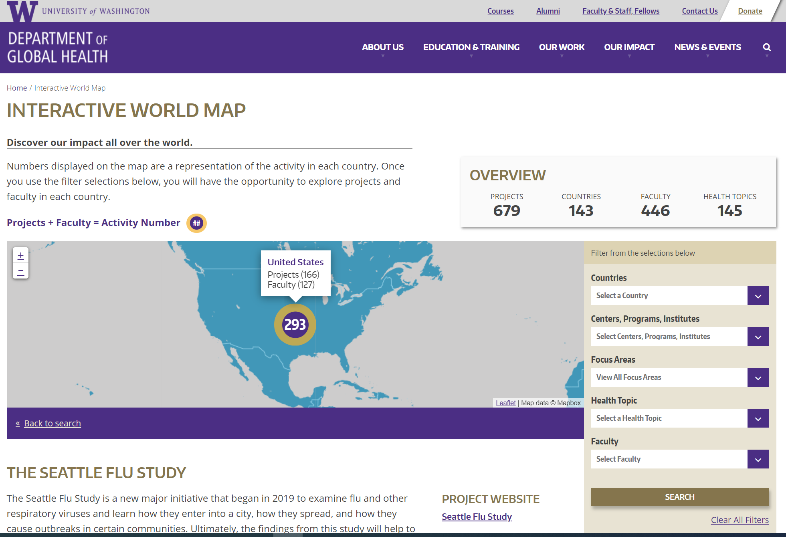
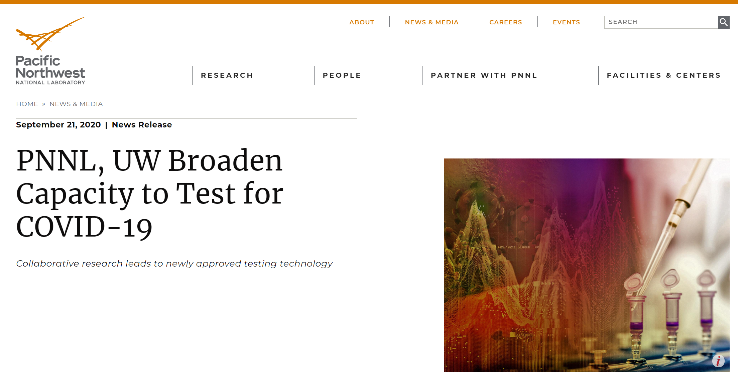
UW COVID-19 RESEARCH
Virology
Virus-host cell interactions
Systems biology (genomics, metabolomics, proteomics)
Immunology
Immune responses to infection
Viral pathogenesis
Clinical samples testing
Serology and PCR
Environmental sampling
Sewage, swabs

Slide 65
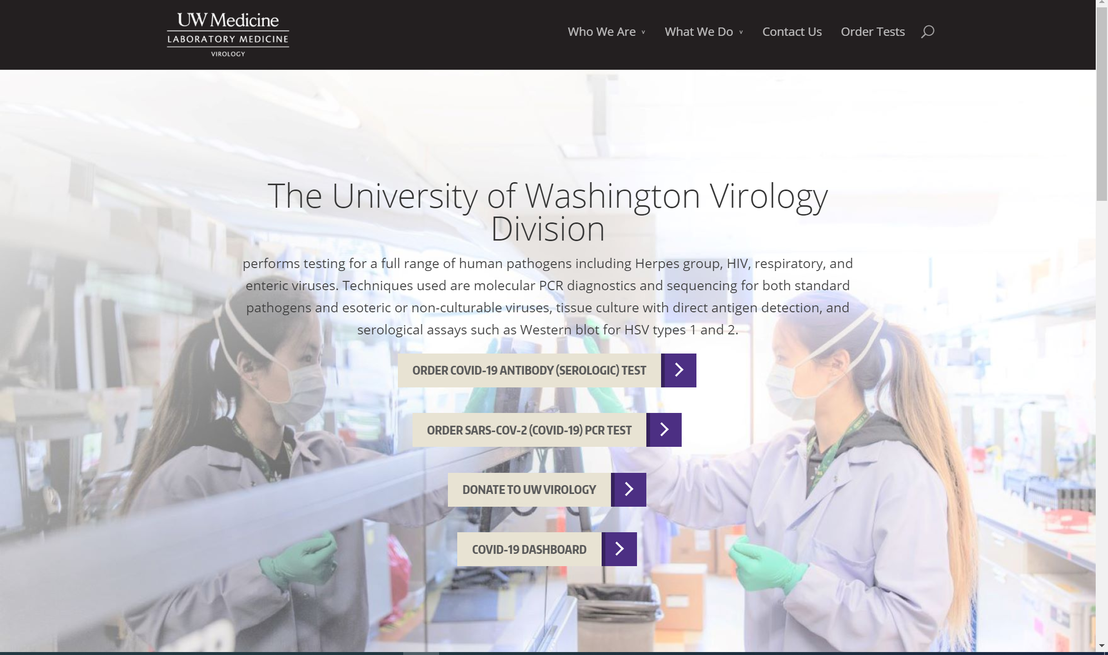
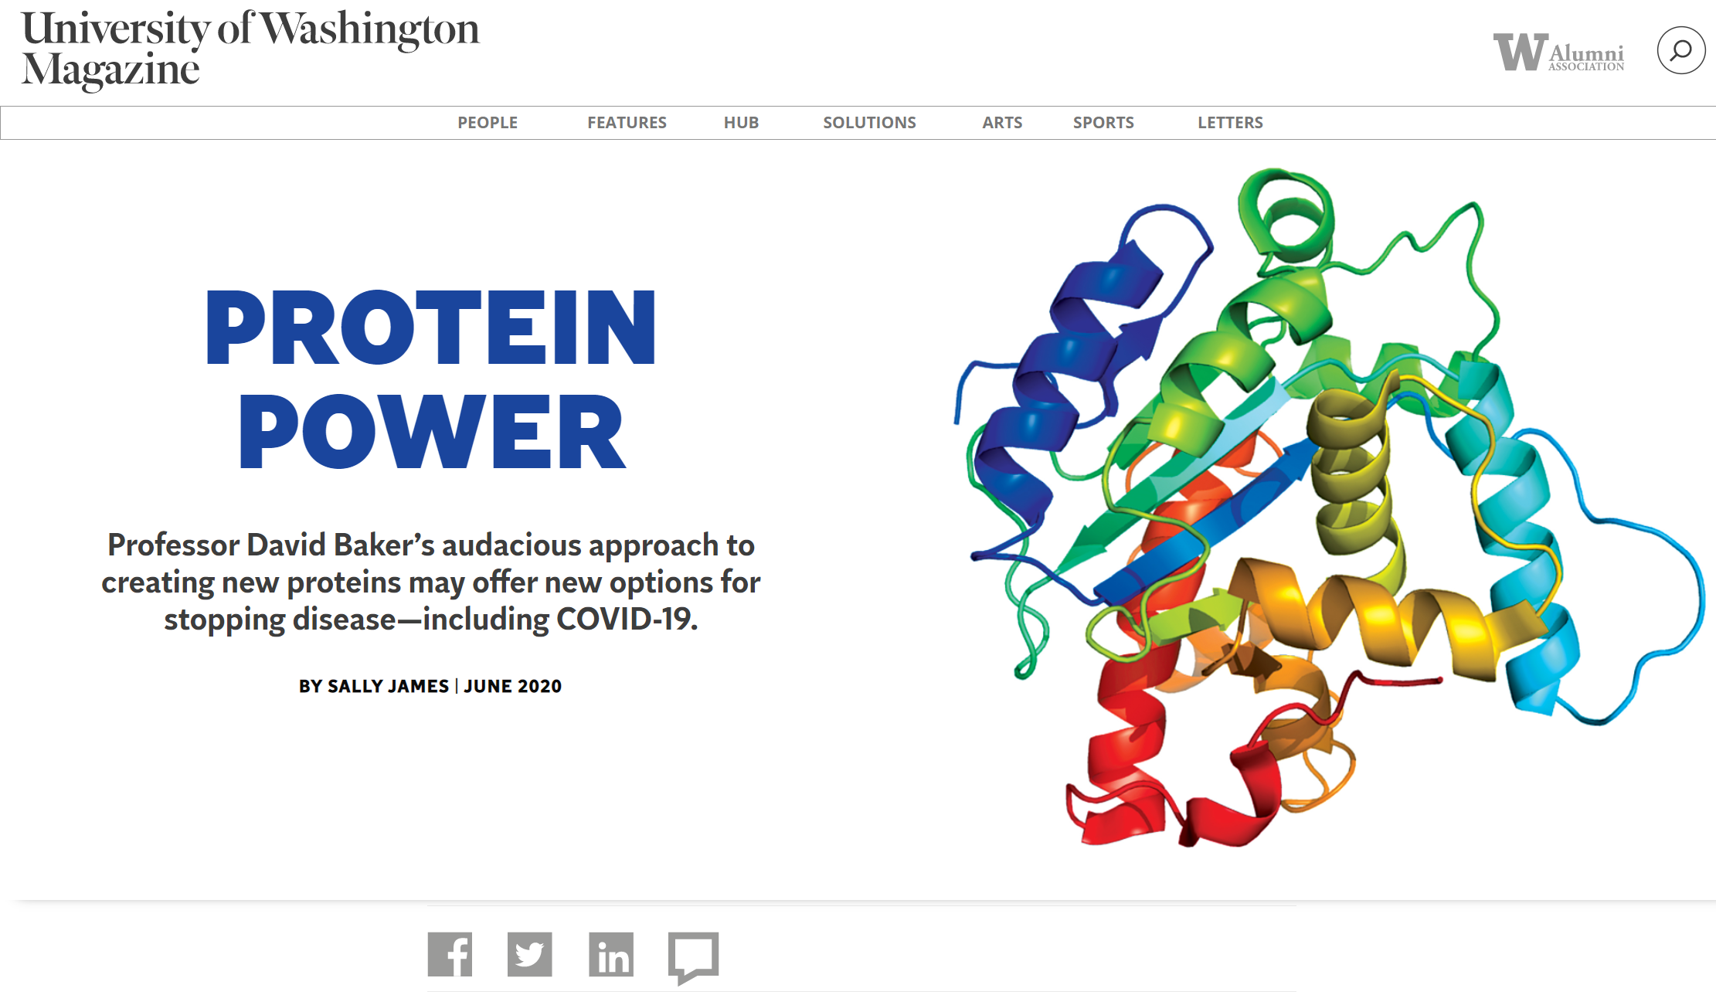
UW COVID-19 RESEARCH
Diagnostic development
UW Virology lab
Vaccine development
Antiviral targets
Protein design

Slide 66
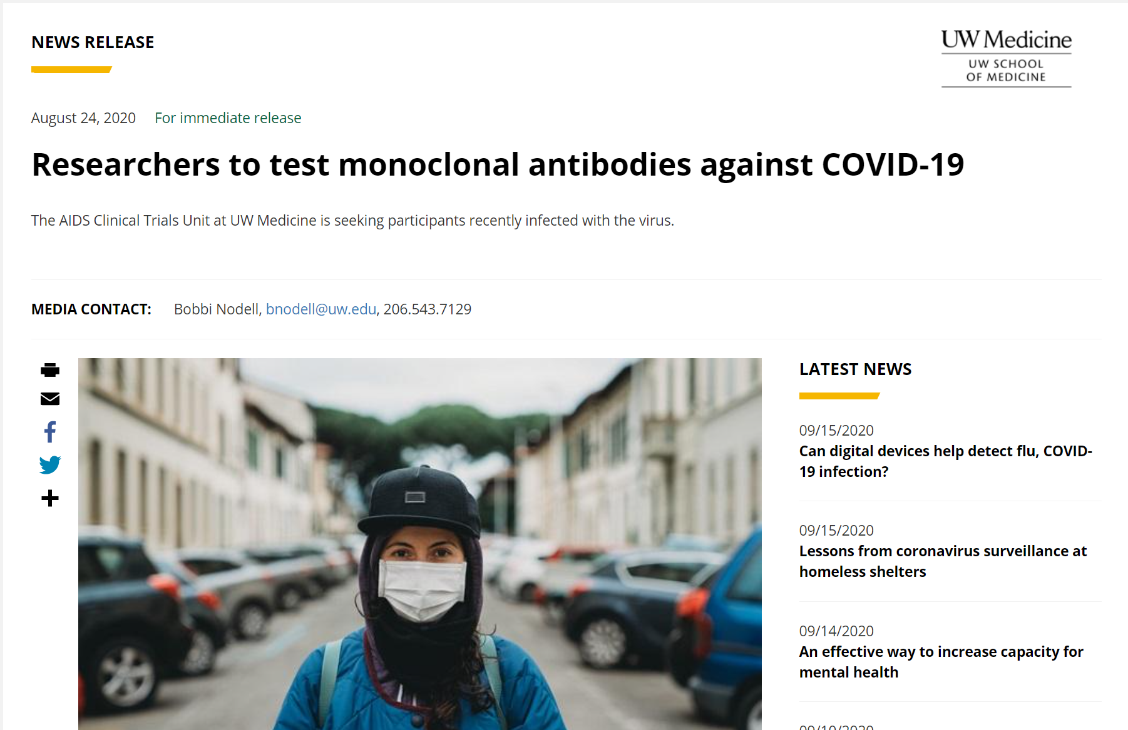
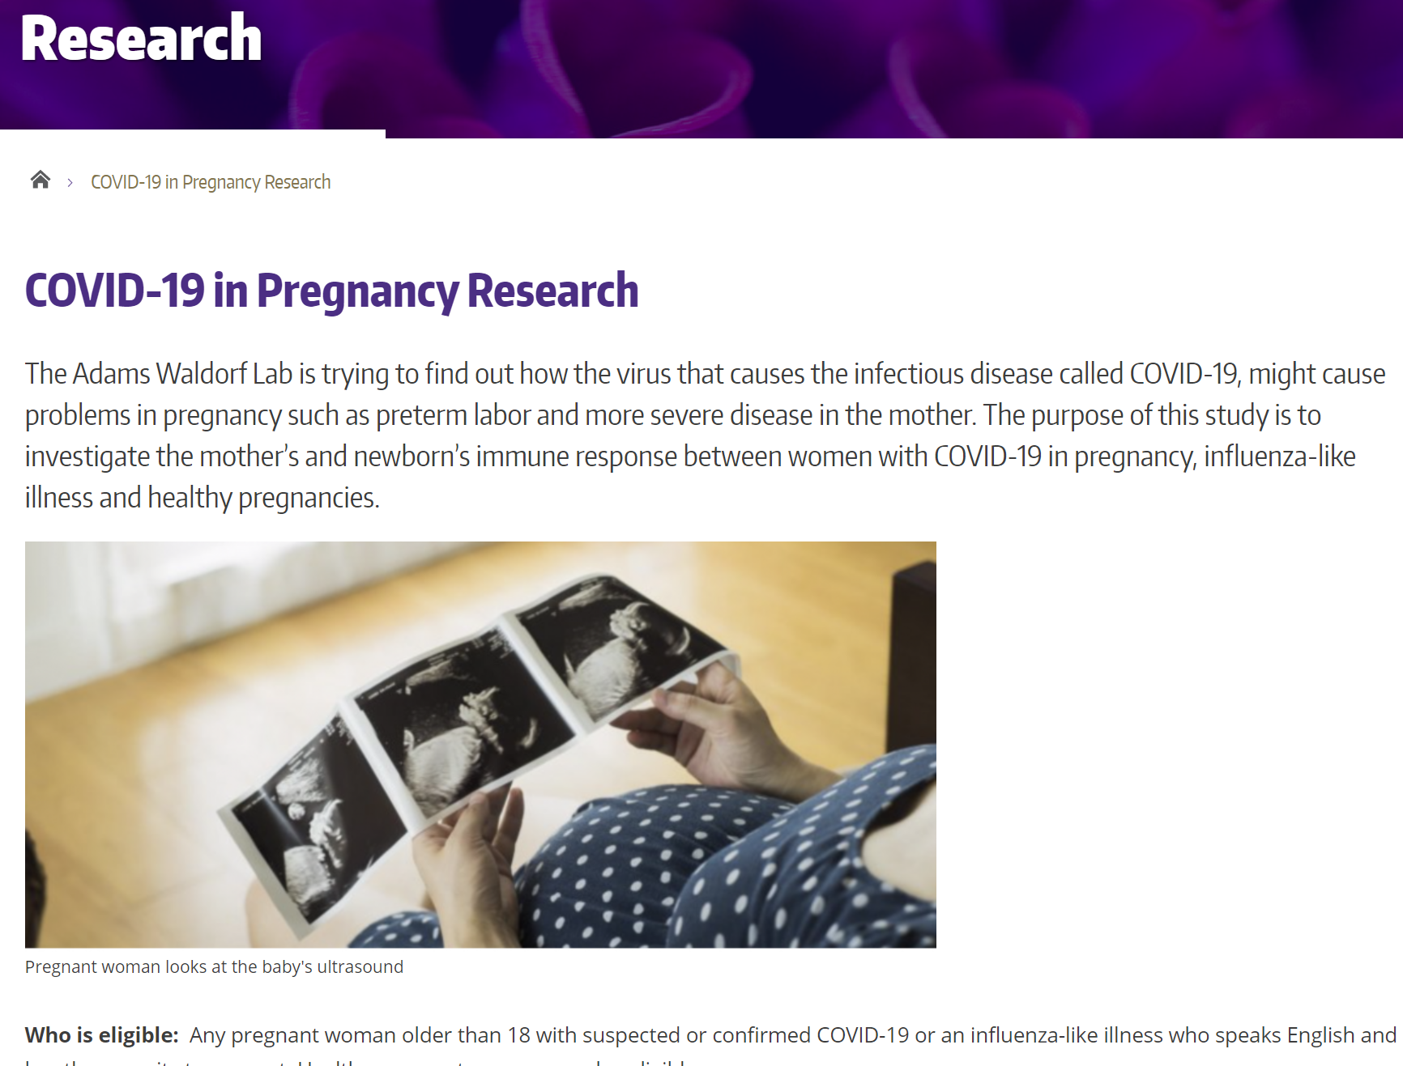
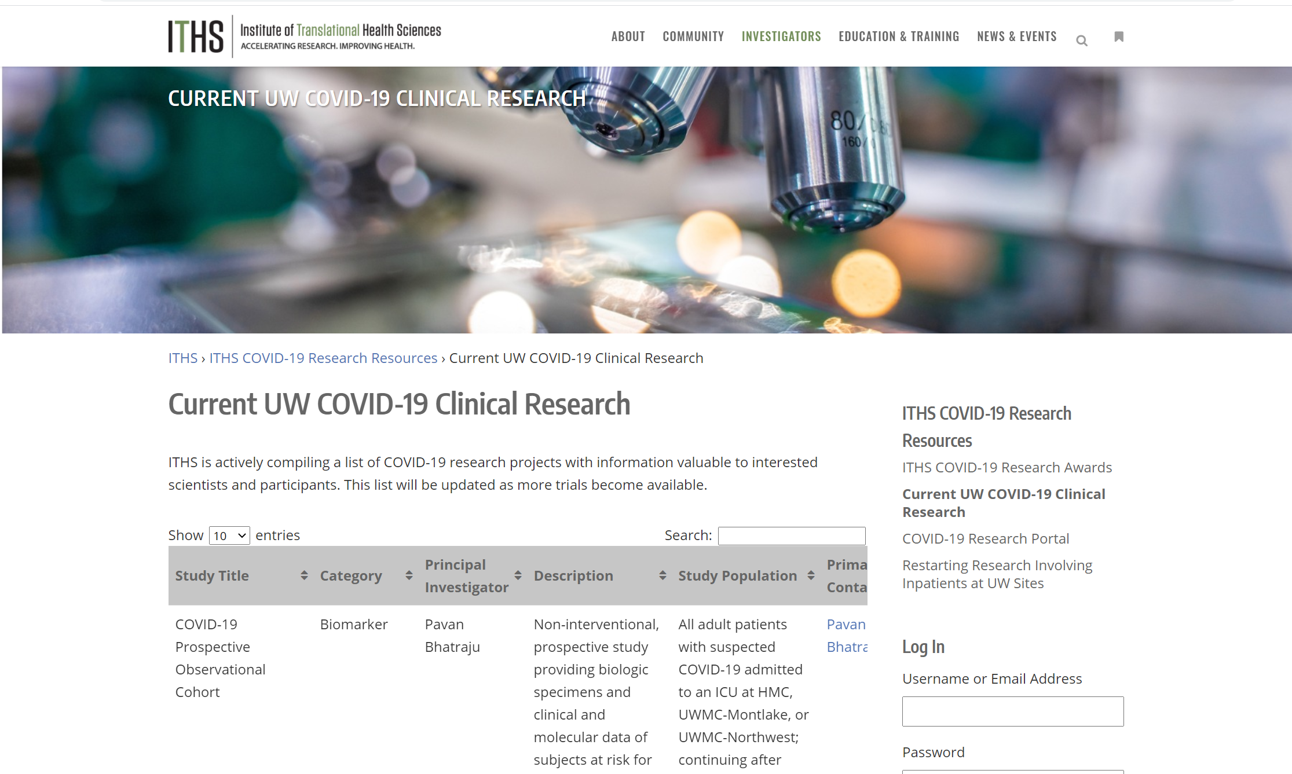
UW COVID-19 RESEARCH
Clinical trials
Pregnancy research

Slide 67
Questions?

Slide 68
COMPLIANCE CORNER
MRAM October 2020
Andra Sawyer
Post Award Fiscal Compliance
gcafco@uw.edu

Slide 69
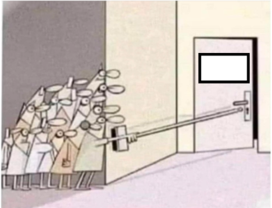
COVID Flexibilities
Where we are now: All COVID flexibilities have been rescinded or expired
Up Next
2021

Slide 70
Reminder: OMB Notifications
Office of Management and Budget (OMB) issues notifications (guidance) to federal agencies
Federal agencies determine if they want to allow their recipients (the UW) to follow the OMB guidance
Federal agencies can always be more restrictive, or add additional requirements, to the OMB guidance
COGR webpage on federal agency actions:
https://www.cogr.edu/institutional-and-agency-responses-covid-19-and-additional-resources

Slide 71
COVID Flexibilities: 19 March to 17 June
Types of Costs, Actions
Costs incurred due to COVID disruptions (cancellations, replacements)
https://finance.uw.edu/pafc/OMB_Memo_Admin_COVID-19
Travel Cancellations
https://finance.uw.edu/pafc/Travel_COVID-19
Prior Approval Waivers
https://finance.uw.edu/pafc/Prior_Approval_Waivers_COVID-19
Mind the Timing!
https://finance.uw.edu/pafc/covid19-information-sponsored-awards#FAQ_flex_timing

Slide 72
COVID Flexibilities: 19 March – 30 September
Types of Costs
Salaries
Costs to resume research
Be sure to meet and document the federal requirements:
https://finance.uw.edu/pafc/covid19-information-sponsored-awards#expired

Slide 73
Federal Awards Impacted by COVID
If your federal awarding agency implemented any of the flexibilities:
PLEASE TALK TO YOUR SPONSOR
Make sure any flexibilities exercised were
Allowed by your federal agency
Within the allowable time frame
Make sure you complied with and documented all requirements
NO REALLY, TALK TO YOUR SPONSOR & DOCUMENT IT

Slide 74
What Happens Next
Audit? Yes
Flexibilities have complex requirements + timing restrictions
CARES Act Funding – lots of $$
Waiting for OMB to issue COVID Addendum (Audit guidelines) to the Compliance Supplement
Election….
Questions? Contact PAFC at gcafco@uw.edu

Slide 75
Recognition!
Certificate in Research Administration
305 enrolled in the certificate
28 graduates—CONGRATULATIONS!
CORE Registration:
https://uwresearch.gosignmeup.com/public/course/browse
CORE Home: https://www.washington.edu/research/required-training/faculty-grants-management/
Notes:
Good morning! Today we would like to recognize the first ever group of graduates from the CORE Certificate in Research Administration. As you may remember CORE launched this certificate a year ago this fall. Since launch over 300 people have enrolled int the certificate program and as of Friday, October 9, 28 of them have met all requirements to receive the certificate. We had originally scheduled a recognition event for this week to occur in the HUB, but times being what they are, that is not possible. So, let’s take a moment today to recognize their achievements with this meeting.

Slide 76
Certificate in Research Administration Program Graduates
Notes:
Here’s who they are—let’s give them a hand!

Slide 77
Jullien Berzuela Grants & Finance Specialist College of Education
Congratulations!

Slide 78
Michelle Chan Grants Manager ABC Shared Services, School of Medicine
Congratulations!

Slide 79
Kimberlee Choe Grants Manager Institute for Nuclear Theory
Congratulations!

Slide 80
Gail Colfax Grant Manager School of Social Work
Congratulations!

Slide 81
Virginia Daugherty Program Operations Specialist Office of Regional Affairs, School of Dentistry
Congratulations!

Slide 82
Laura Davis Grants Manager EarthLab
Congratulations!

Slide 83
Dali Grubisa Fiscal Specialist 2 Paul G. Allen School of Computer Science & Engineering
Congratulations!

Slide 84
Haley Hibbs-Roady Administrative Coordinator Office of Research
Congratulations!

Slide 85
Alyson Howser Fiscal Specialist Radiology Grants Administration, School of Medicine
Congratulations!

Slide 86
Than Than Htwe Financial Services Manager Chemical Engineering, College of Engineering
Congratulations!

Slide 87
Scott Kelly Administrator Center for Studies in Demography & Ecology
Congratulations!

Slide 88
Choong Kim Budget Fiscal Analyst Lead College of Education
Congratulations!

Slide 89
Daniel Larsen Program Administrator Astrobiology Program, College of Arts & Sciences
Congratulations!

Slide 90
Samantha Lepidi Grant Coordinator Radiation Oncology, School of Medicine
Congratulations!

Slide 91
Malik Olanrewaju Finance Accounting Associate Global Health, School of Public Health
Congratulations!

Slide 92
Sara Paul Administrator Oral & Maxillofacial Surgery, School of Dentistry
Congratulations!

Slide 93
Jon Sallows Program Assistant Office of Sponsored Programs
Congratulations!

Slide 94
Susan SangredeunAngel Grants Manager Evans School of Public Policy & Governance
Congratulations!
Notes:
Congratulations to all of you!

Slide 95
Thank You!
Thanks to the staff and their supervisors who support this important training to help make the UW an effectively managed research enterprise!
Notes:
And a big thank you to all who support the ongoing professional development of our research administration staff!

