Slide 1
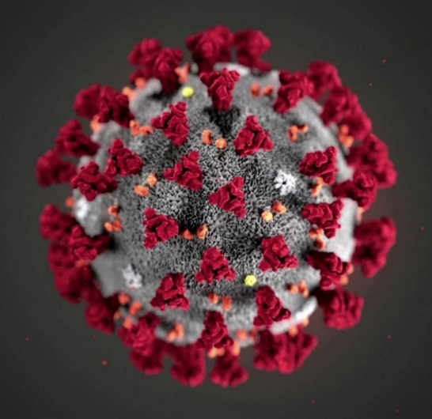
BIOSAFETY MONTH &
COVID-19 BIOLOGICAL RESEARCH AT UW
Lesley Decker
October 15, 2020
MRAM

Slide 2
NATIONAL BIOSAFETY MONTH

Slide 3
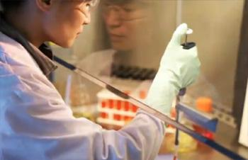
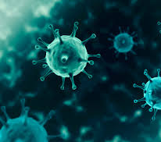
WHAT IS BIOSAFETY?
Framework for containment of biohazards
Includes safe practices, safety equipment, facilities and training
Protects the worker, community and environment
Protects the research product

Slide 4
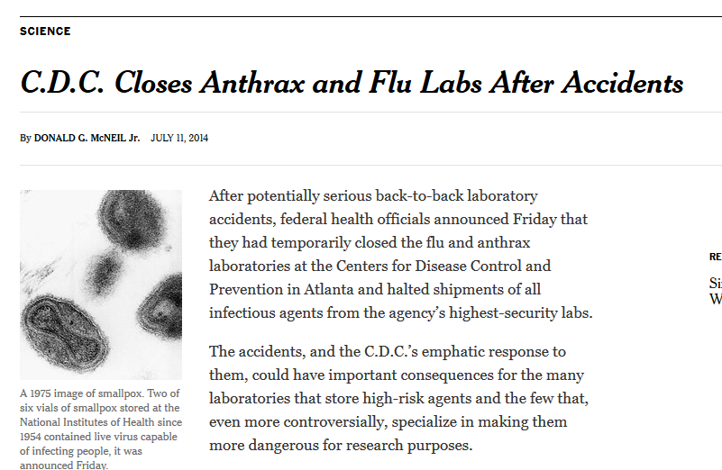
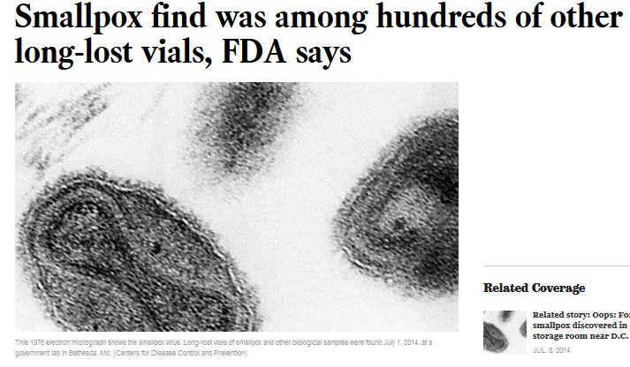
NATIONAL BIOSAFETY MONTH
Started in 2014 by the NIH Office of Science Policy
Time to focus attention to biosafety practices, policies, procedures and inventory

Slide 5
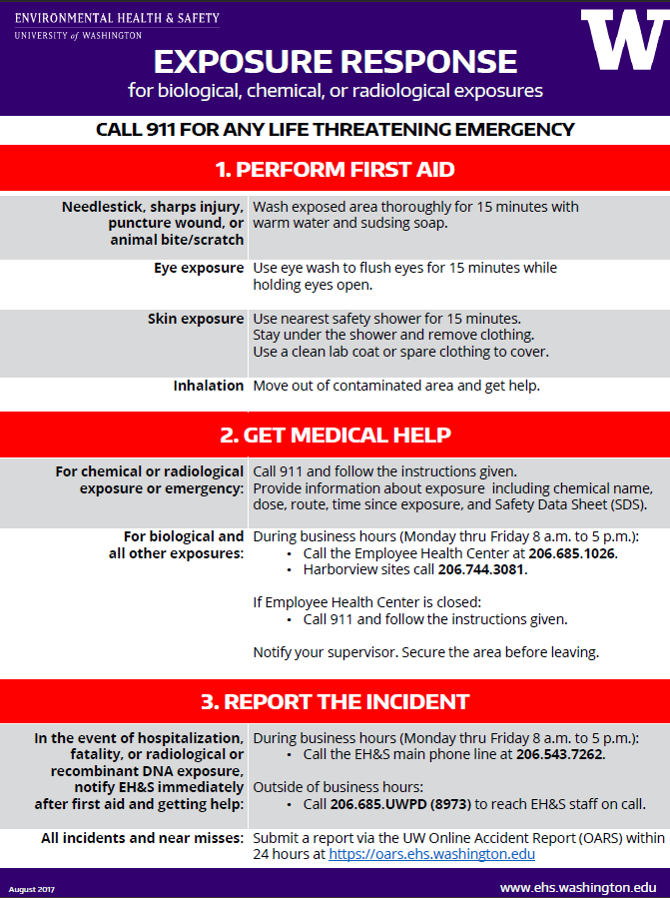
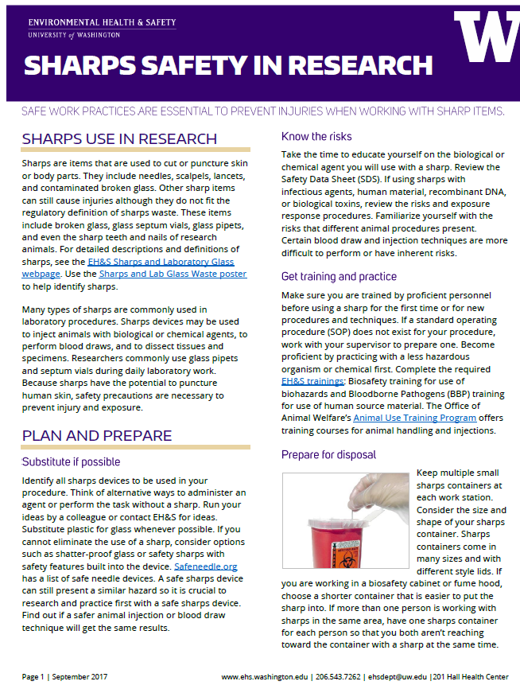
NATIONAL BIOSAFETY MONTH AT UW

Slide 6
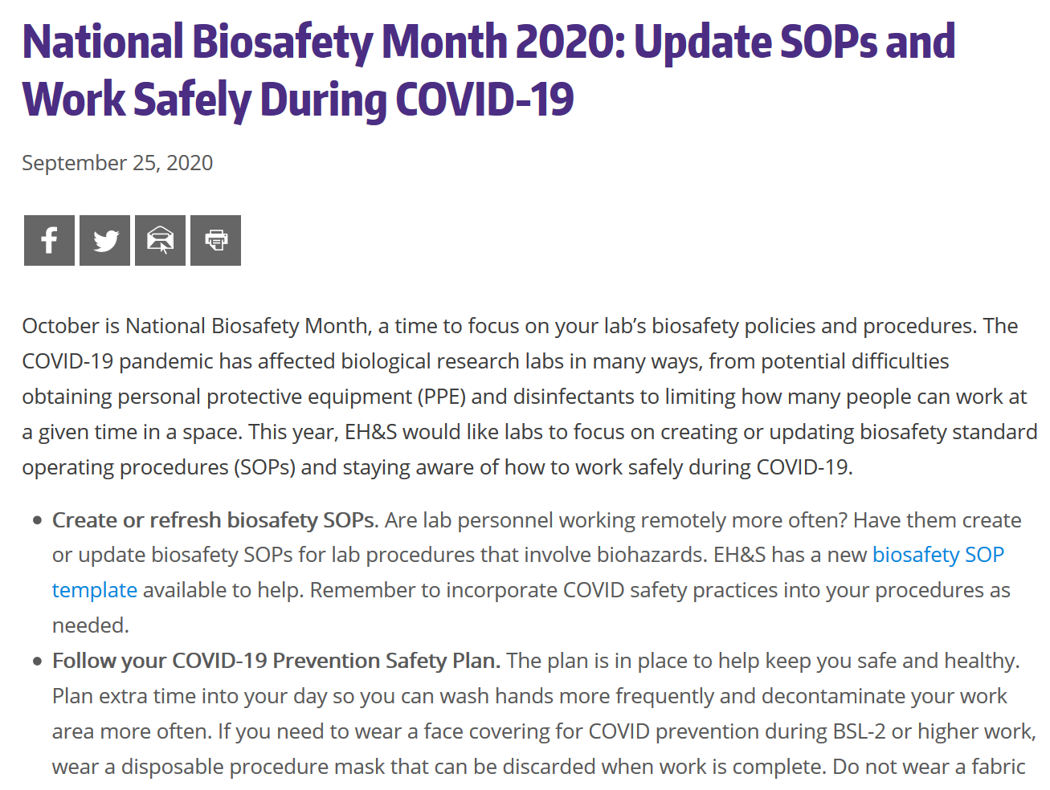
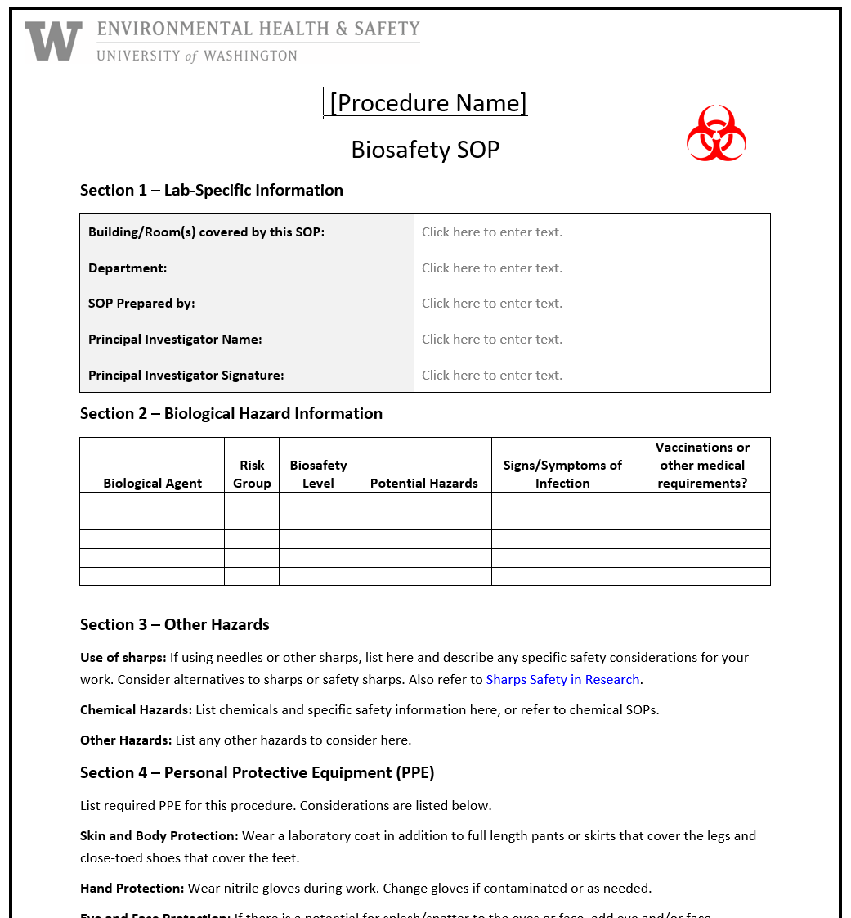
2020 BIOSAFETY MONTH AT UW

Slide 7
BIOSAFETY MONTH OUTREACH
Email to principal investigators and lab managers with BUAs
EH&S newsletter article
Article featured on EH&S homepage
Office of Research web
Presentation to MRAM and U-WIDE Health and Safety Committee

Slide 8
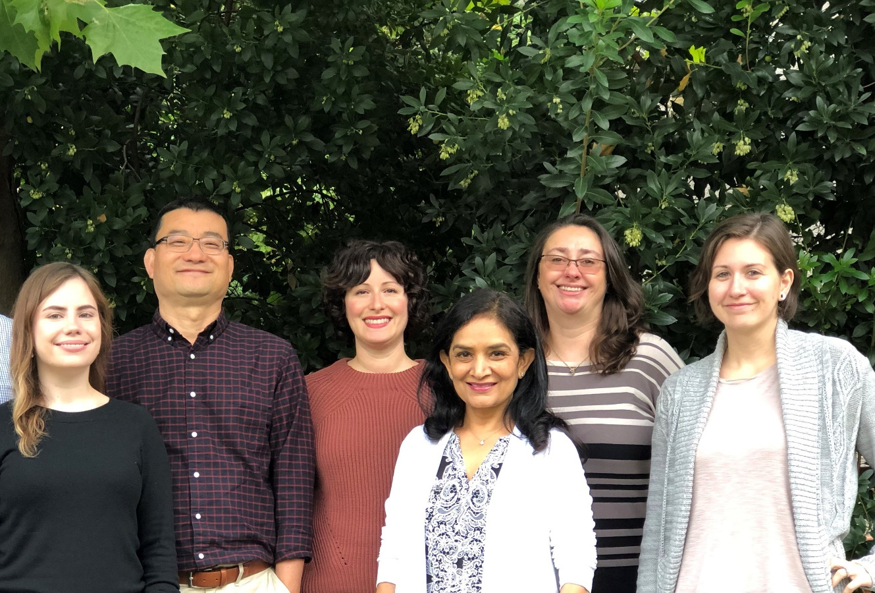
HAPPY BIOSAFETY MONTH!
Plus one brand new biosafety officer!

Slide 9
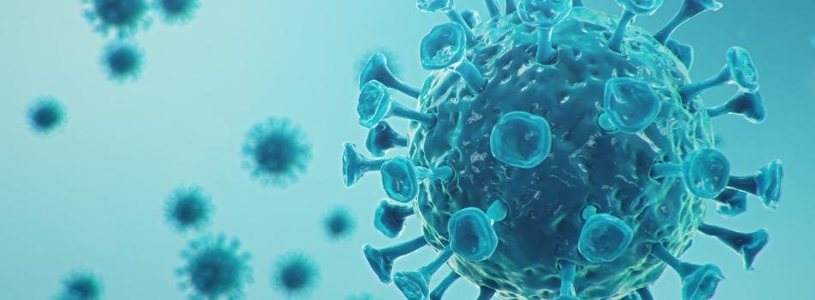
COVID-19 BIOLOGICAL RESEARCH AT UW

Slide 10
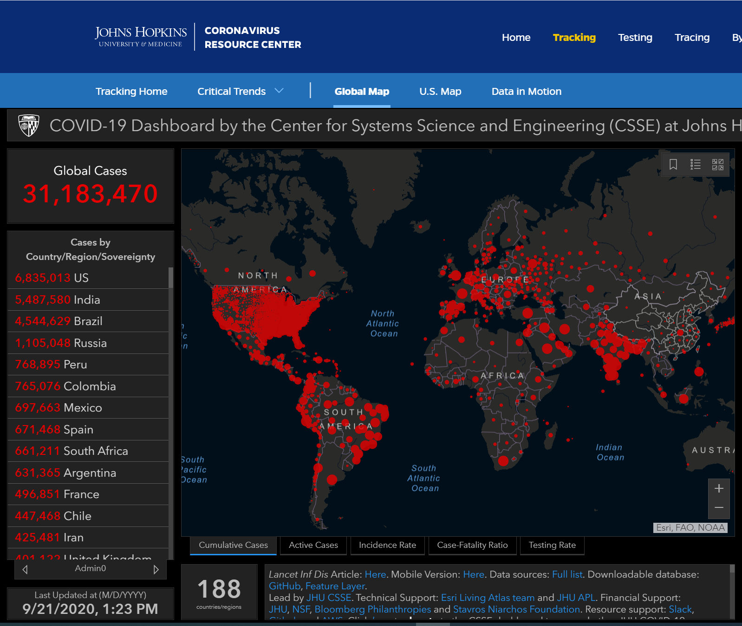
OUTLINE
Overview of SARS-CoV-2
Biosafety requirements at UW
UW COVID-19 biosafety metrics
UW COVID-19 research

Slide 11
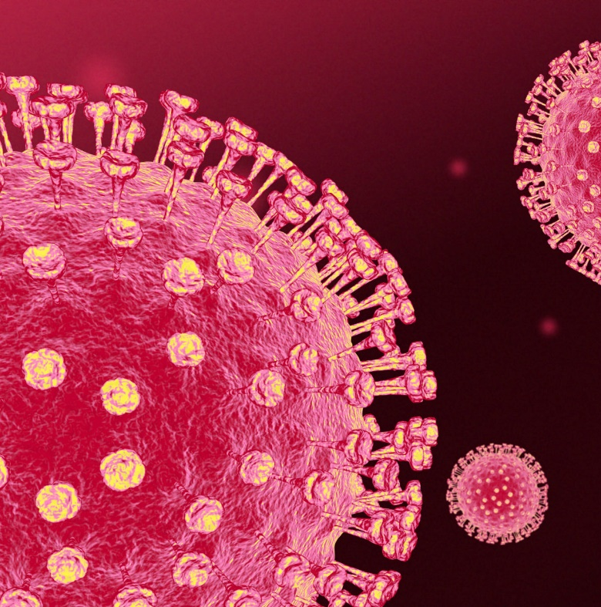
OVERVIEW OF SARS-COV-2
Severe acute respiratory syndrome virus 2 aka COVID-19
Positive stranded enveloped RNA virus
Crown-like appearance due to spike glycoproteins on envelope
Human-to-human transmission via respiratory droplets from coughs/sneezes
Close contact (within 6 feet) important for transmission
Not known to exist in humans prior to 2019
Probably zoonotic
Notes:
EnvRNA - it stores its genetic information as RNA packaged inside an envelope, which is made of the host cell’s membrane.
The spike protein serves to recognize and attach to the host cell’s receptors and facilitates entry into the cell.
Once inside the cell, the virus propagates by recruiting the host cell’s enzymes to produce numerous viral precursors.
Mature virions are then released from the host cell’s surface by exocytosis.

Slide 12
SARS-CoV-2 BIOSAFETY REQUIREMENTS AT UW
Informed by:
CDC Interim Laboratory Biosafety Guidelines for COVID-19
National Institutes of Health (NIH)
Institutional Biosafety Committee (IBC)
EH&S Biological Safety
Biological Use Authorization (BUA) required for all work
Genetic modifications to virus could require NIH approval

Slide 13
SARS-CoV-2 BIOSAFETY REQUIREMENTS AT UW
Research activity / Sample or specimen type | Biosafety level (BSL)
SARS-CoV-2 in vitro and in vivo experiments | BSL-3
Clinical specimens from COVID-19 patients | BSL-2 with enhancements
Fixed or inactivated SARS-CoV-2 samples or tissue | BSL-2

Slide 14
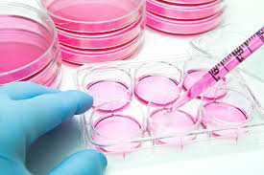
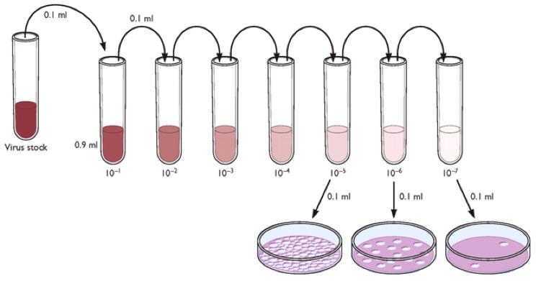
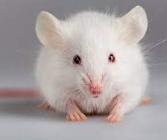
BSL-3: IN VITRO AND IN VIVO EXPERIMENTS
Biosafety level 3 (BSL-3) is required for:
Virus isolation, culture and amplification
Animal experiments

Slide 15
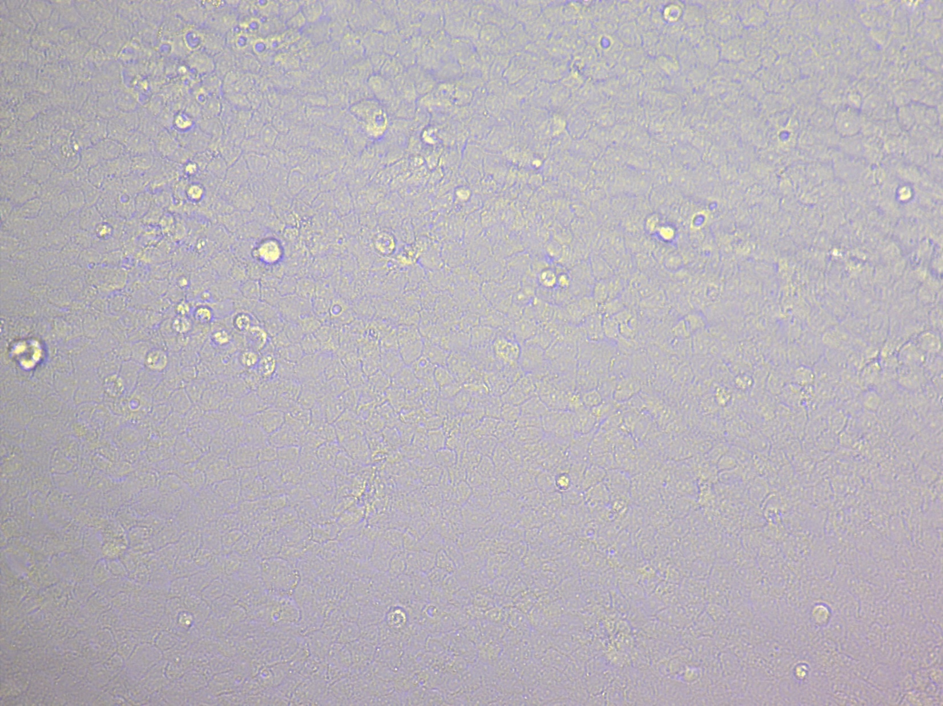
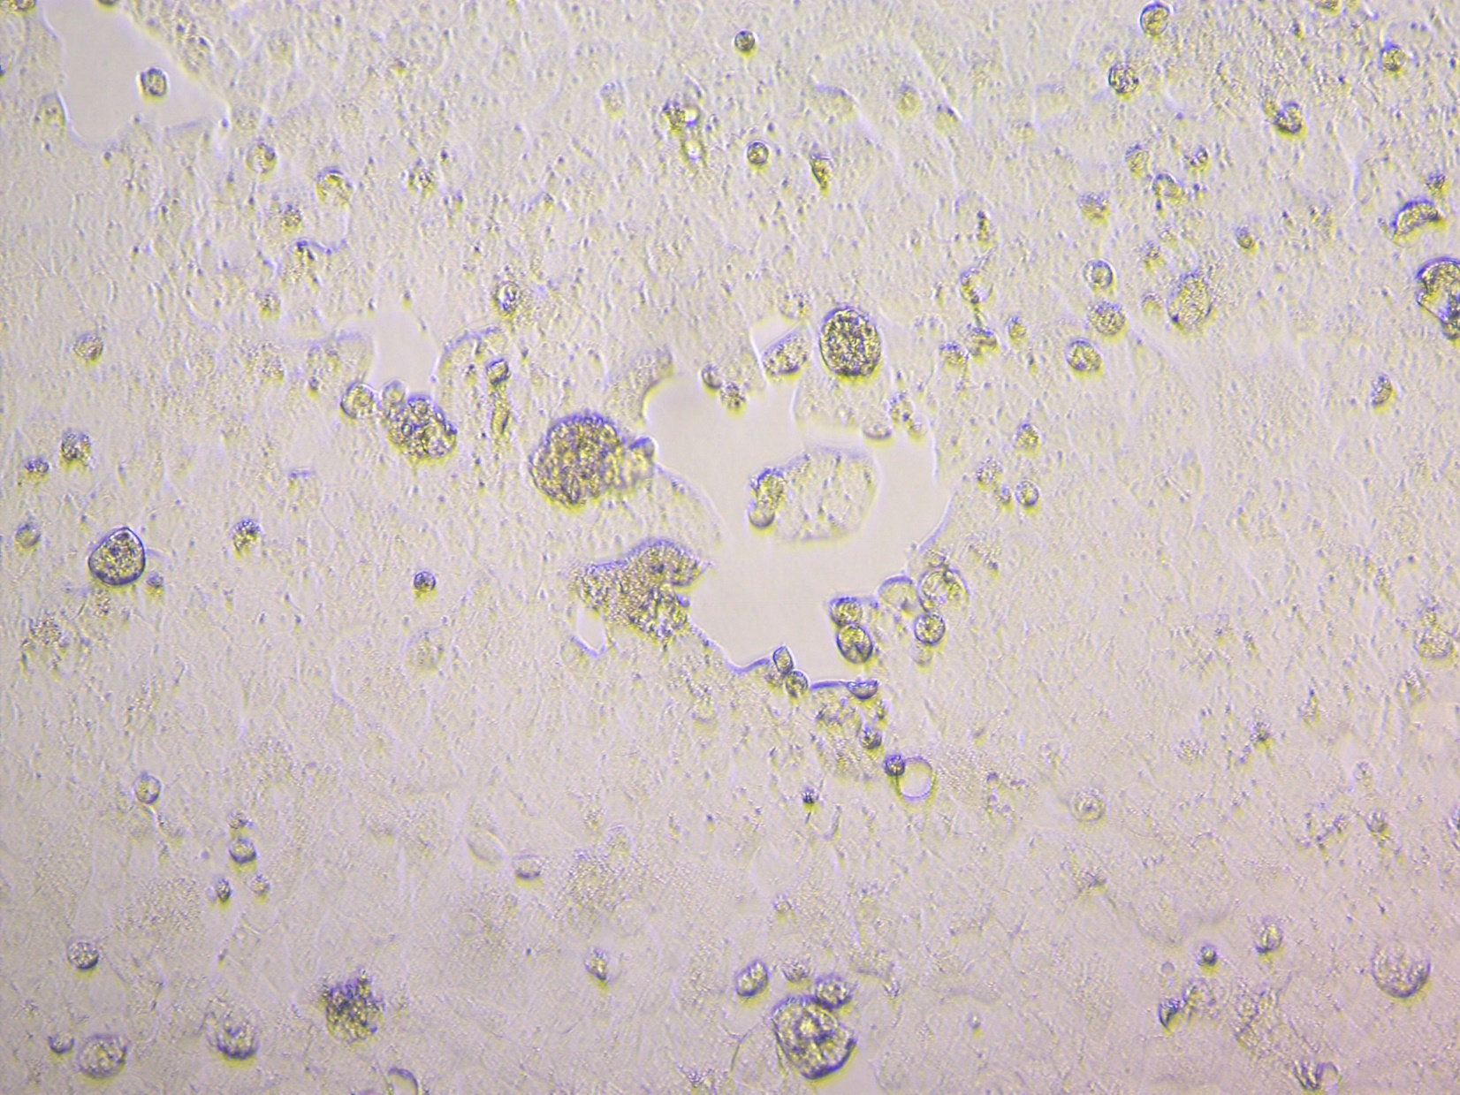

Slide 16
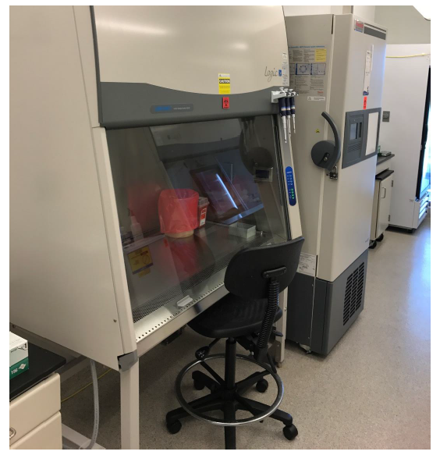
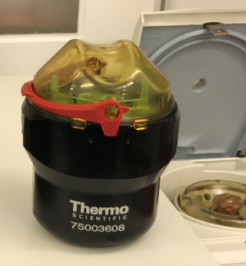
BSL-3: IN VITRO AND IN VIVO EXPERIMENTS
Directional airflow to contain infectious agents
from “clean” to potentially contaminated
HEPA filtered exhaust air
No re-circulated exhaust air
All work conducted inside biosafety cabinet
No glass or sharps unless absolutely necessary
Approved SOPs required

Slide 17
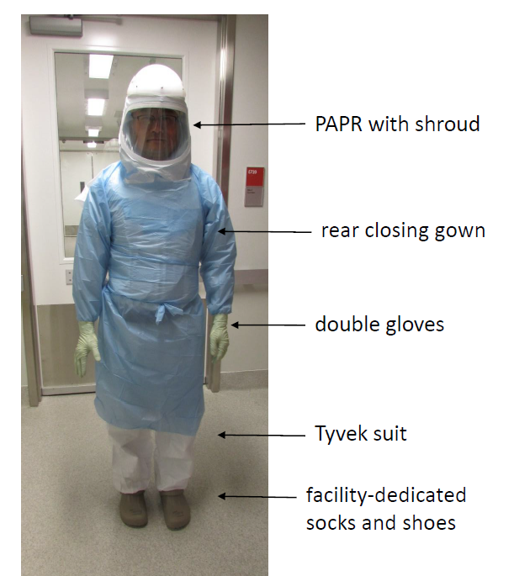
BSL-3 Personal Protective Equipment (PPE)

Slide 18
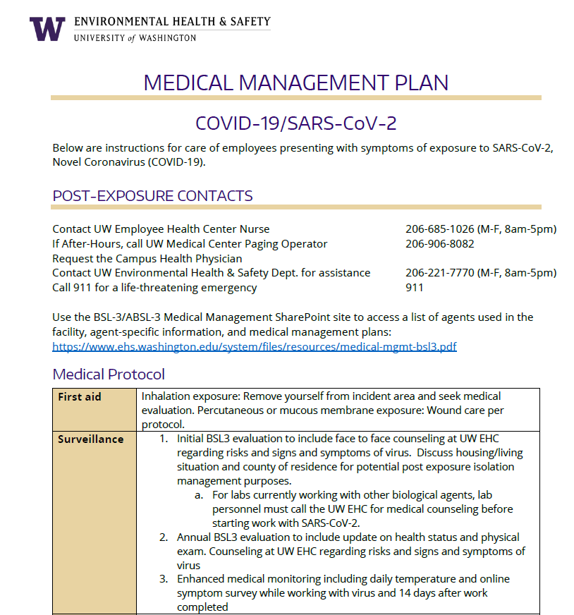
BSL-3: IN VITRO AND IN VIVO EXPERIMENTS
Specific medical management requirements for BSL-3 program
Medical counseling required
Reporting protocol for exposures or symptom development
Annual influenza vaccine required
Specific daily symptom attestation for facility entry

Slide 19
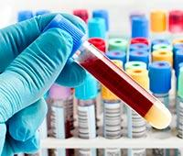
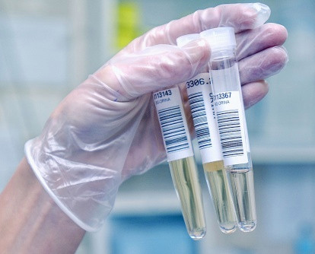
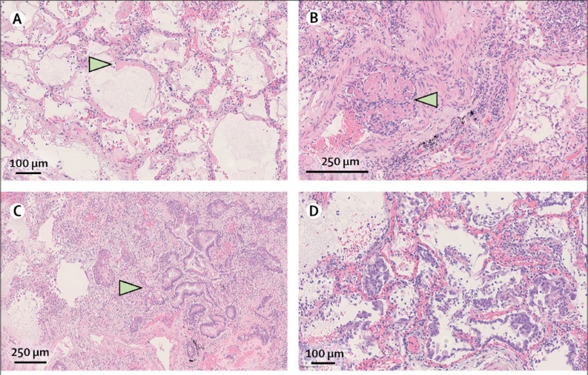
BSL-2 WITH ENHANCEMENTS: CLINICAL SPECIMENS
Biological samples or tissue from COVID-19 patients or potentially infected patients
Notes:
Diagnostic platforms for rapid detection, point-of-care detection, molecular biology assays, RNA extraction, biomarkers, etc.
Host response factors, genetics factors, etc.

Slide 20
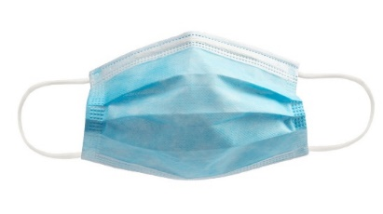
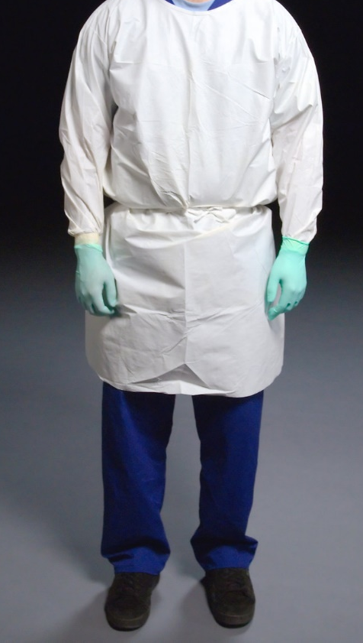
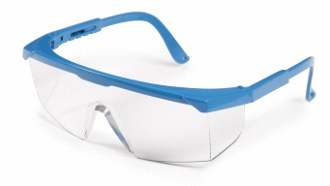
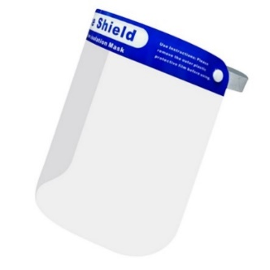
BSL-2 WITH ENHANCEMENTS: CLINICAL SPECIMENS
PPE enhancements include:
Procedure mask plus either face shield, safety goggles, or safety glasses with solid side shields
Gloves
Closed-front gown

Slide 21
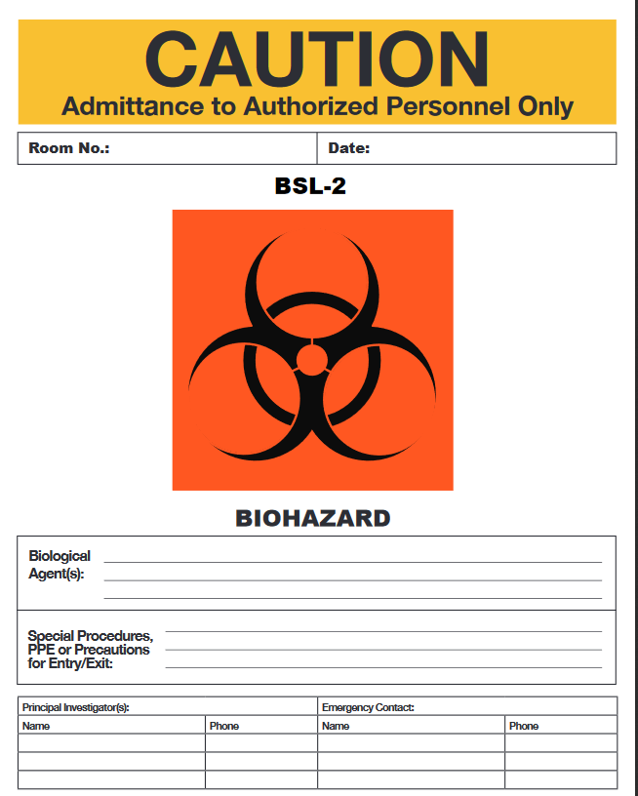
BSL-2 WITH ENHANCEMENTS: CLINICAL SPECIMENS
Other enhancements include:
All work performed inside biosafety cabinet
Site-specific SOP for work
Documented training
Additional COVID-19 warning sign
Medical counseling required
COVID-19 clinical samples in use

Slide 22
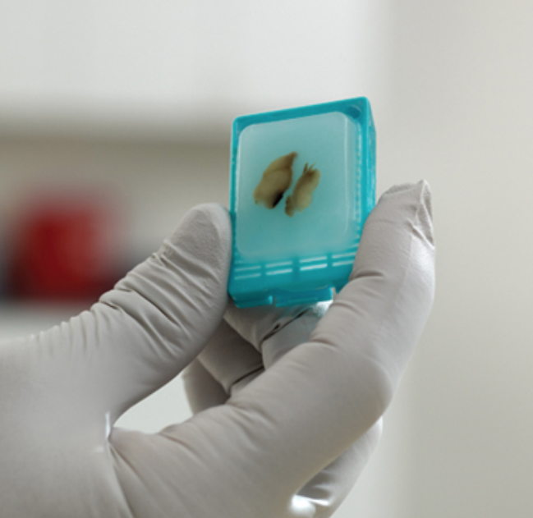
BSL-2 : FIXED OR INACTIVATED SAMPLES/TISSUE
BSL-2 is required for:
Flow cytometry
Staining and microscopy
Pathologic examination and processing
Extracted nucleic acid preparations
Use biosafety cabinet for aerosol-generating activities
Medical counseling required

Slide 23
UW COVID-19 BIOSAFETY METRICS
49 approved BUAs for work with SARS-CoV-2 materials
1 approved BUA for COVID-19 vaccine clinical trial
43 principal investigators (PIs) working with SARS-CoV-2 materials
4 special IBC meetings outside of normal monthly meeting
BSL-3/Select Agent Program:
38 total members pre-COVID
72 total members post-COVID
38 COVID-19 researchers

Slide 24
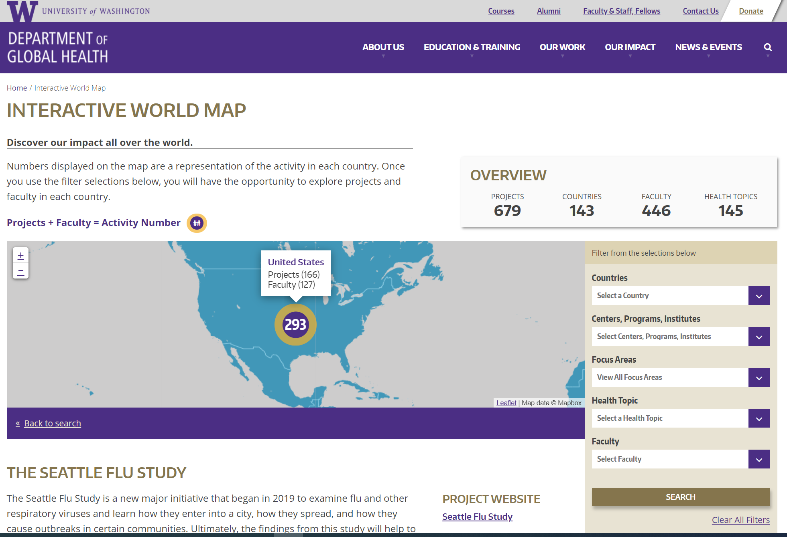
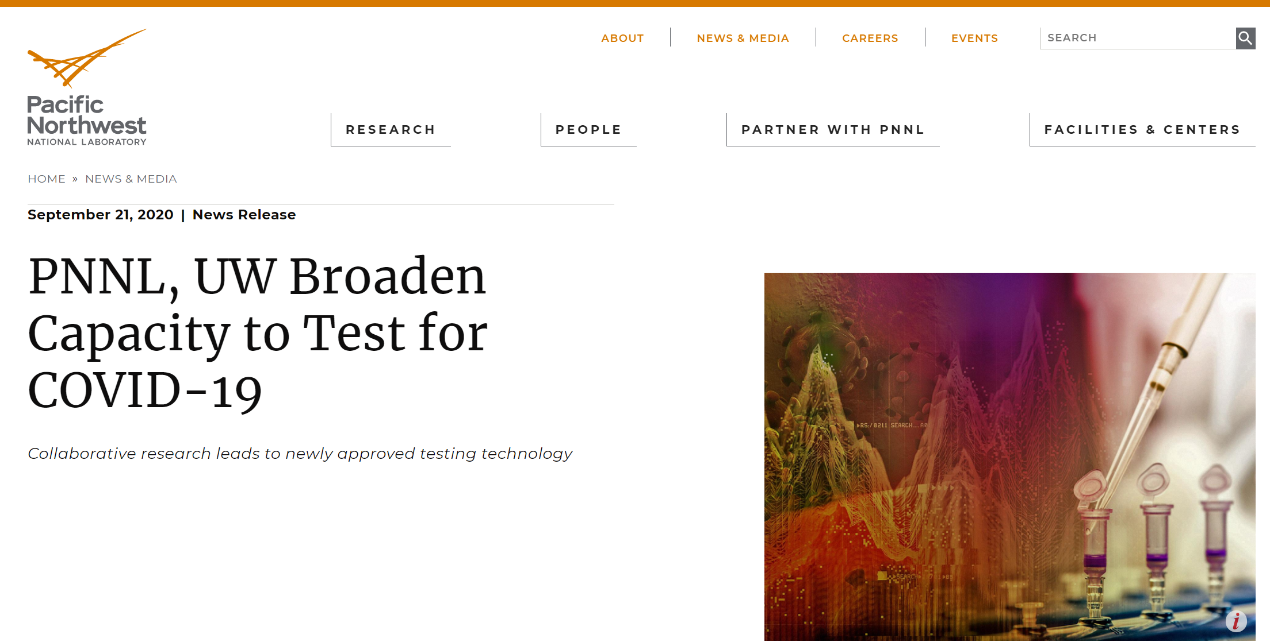
UW COVID-19 RESEARCH
Virology
Virus-host cell interactions
Systems biology (genomics, metabolomics, proteomics)
Immunology
Immune responses to infection
Viral pathogenesis
Clinical samples testing
Serology and PCR
Environmental sampling
Sewage, swabs

Slide 25
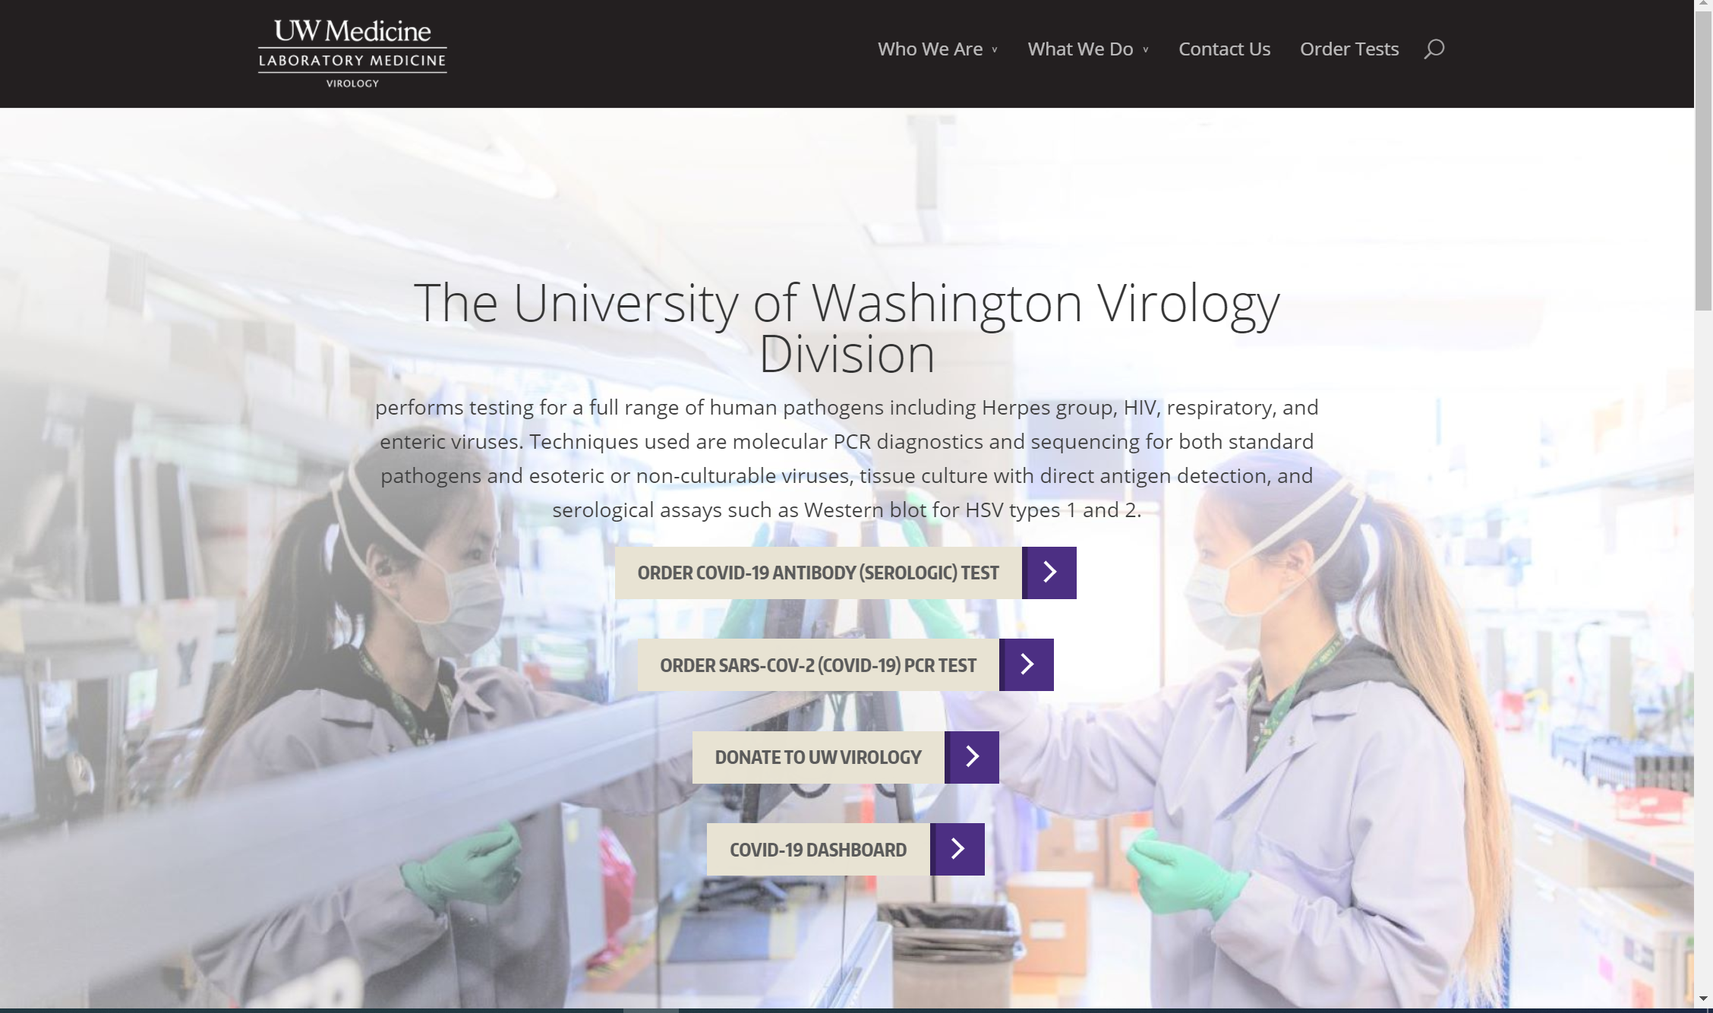
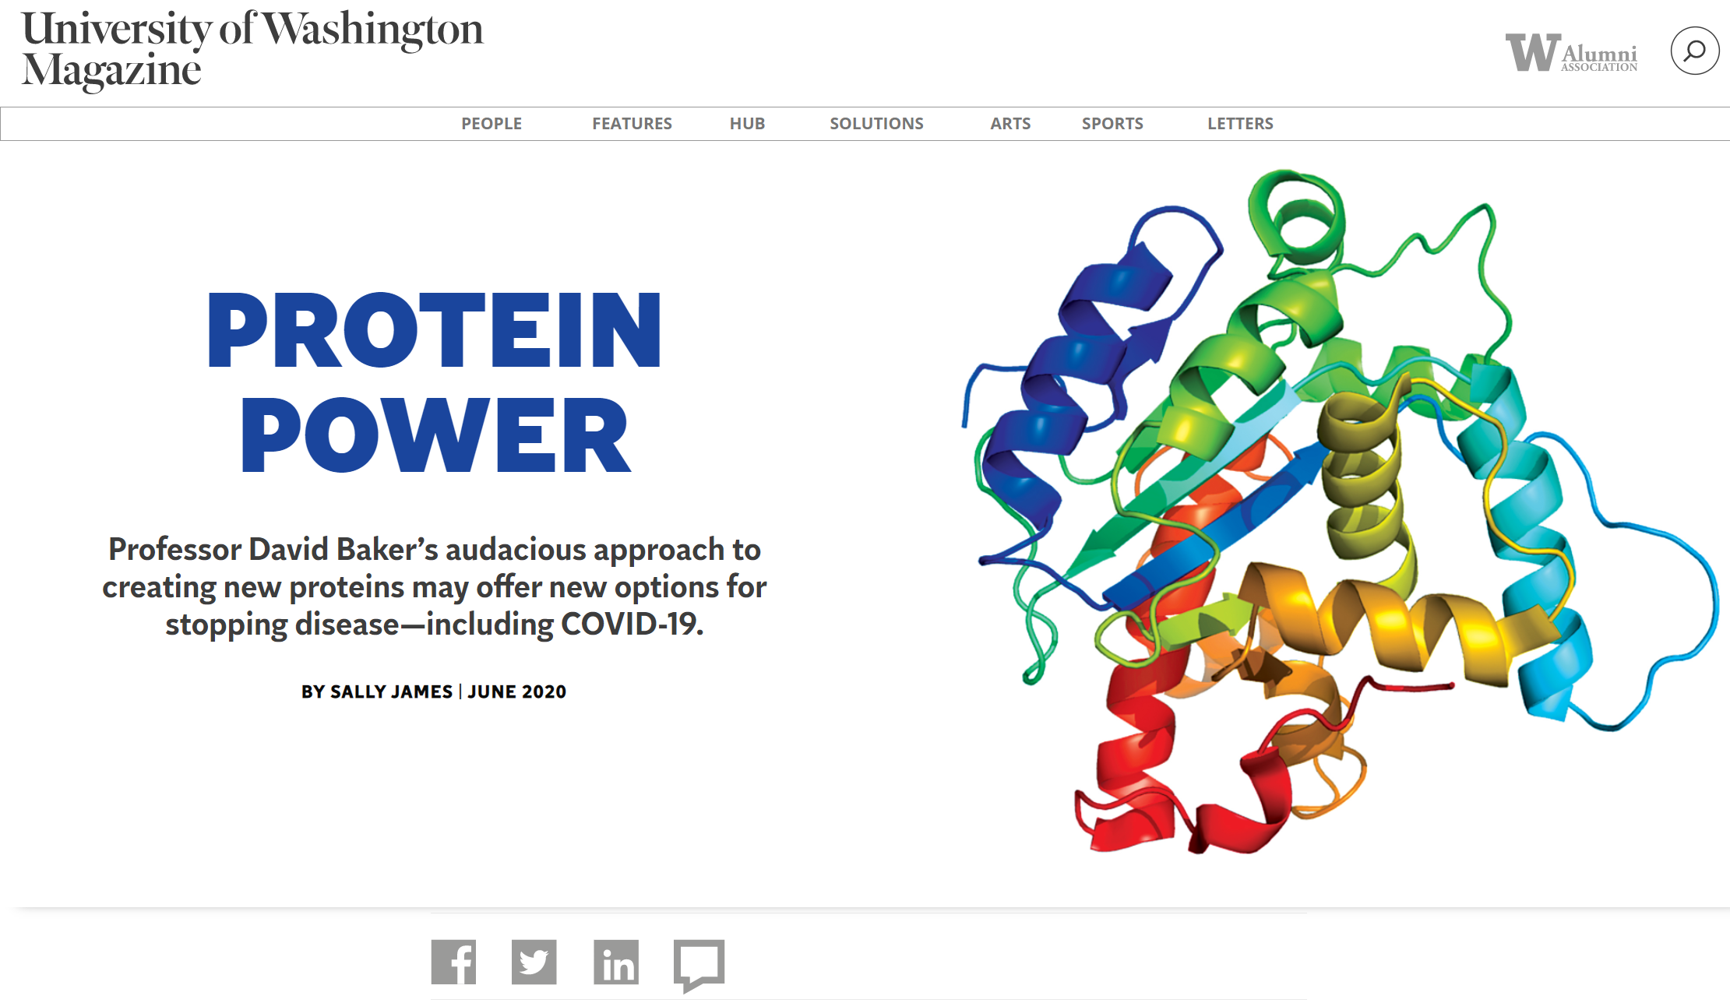
UW COVID-19 RESEARCH
Diagnostic development
UW Virology lab
Vaccine development
Antiviral targets
Protein design

Slide 26
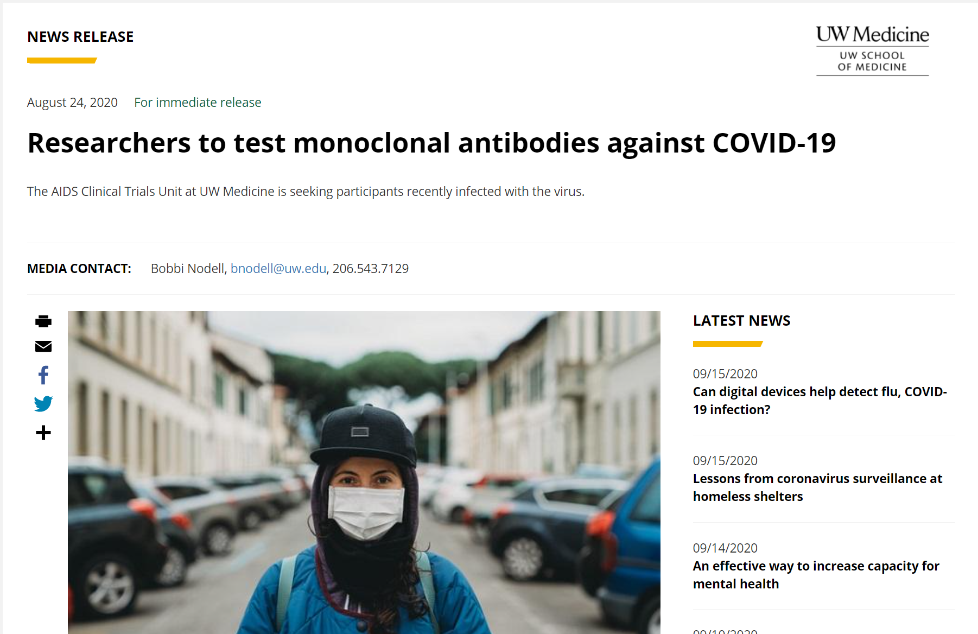
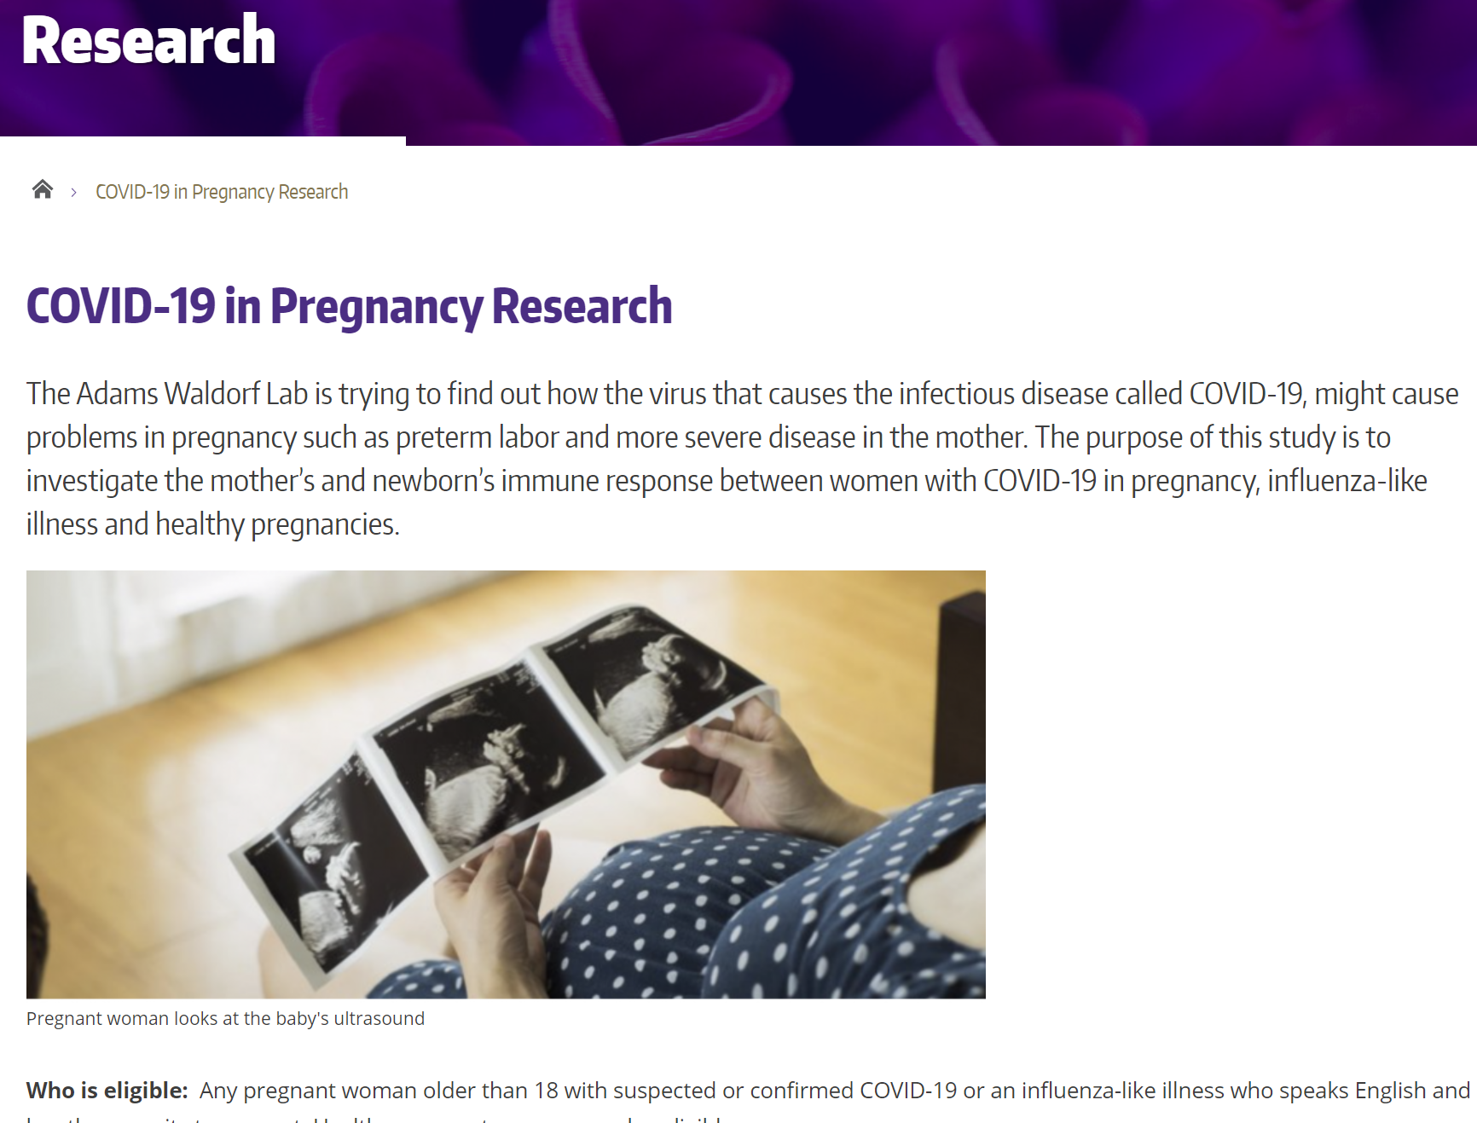
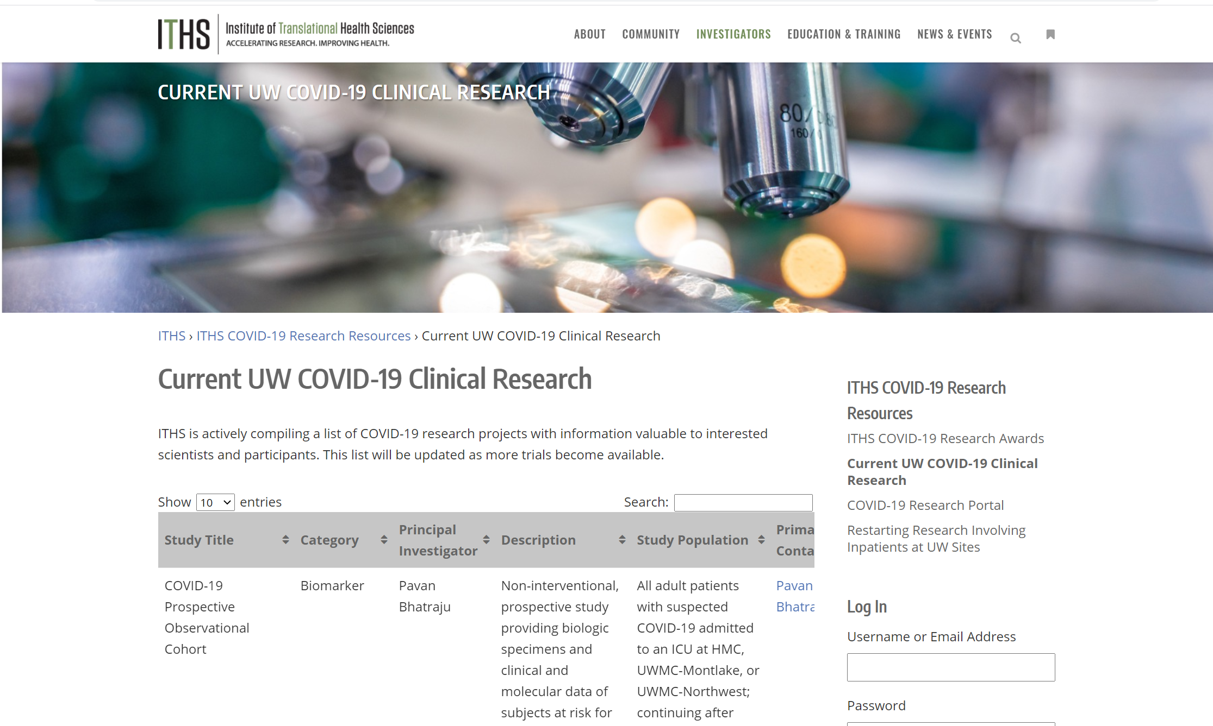
UW COVID-19 RESEARCH
Clinical trials
Pregnancy research

Slide 27
Questions?

