Slide 1
COMPLIANCE CORNER
MRAM October 2020
Andra Sawyer
Post Award Fiscal Compliance
gcafco@uw.edu

Slide 2
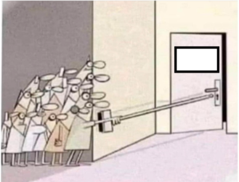
COVID Flexibilities
Where we are now: All COVID flexibilities have been rescinded or expired
Up Next
2021

Slide 3
Reminder: OMB Notifications
Office of Management and Budget (OMB) issues notifications (guidance) to federal agencies
Federal agencies determine if they want to allow their recipients (the UW) to follow the OMB guidance
Federal agencies can always be more restrictive, or add additional requirements, to the OMB guidance
COGR webpage on federal agency actions:
https://www.cogr.edu/institutional-and-agency-responses-covid-19-and-additional-resources

Slide 4
COVID Flexibilities: 19 March to 17 June
Types of Costs, Actions
Costs incurred due to COVID disruptions (cancellations, replacements)
https://finance.uw.edu/pafc/OMB_Memo_Admin_COVID-19
Travel Cancellations
https://finance.uw.edu/pafc/Travel_COVID-19
Prior Approval Waivers
https://finance.uw.edu/pafc/Prior_Approval_Waivers_COVID-19
Mind the Timing!
https://finance.uw.edu/pafc/covid19-information-sponsored-awards#FAQ_flex_timing

Slide 5
COVID Flexibilities: 19 March – 30 September
Types of Costs
Salaries
Costs to resume research
Be sure to meet and document the federal requirements:
https://finance.uw.edu/pafc/covid19-information-sponsored-awards#expired

Slide 6
Federal Awards Impacted by COVID
If your federal awarding agency implemented any of the flexibilities:
PLEASE TALK TO YOUR SPONSOR
Make sure any flexibilities exercised were
Allowed by your federal agency
Within the allowable time frame
Make sure you complied with and documented all requirements
NO REALLY, TALK TO YOUR SPONSOR & DOCUMENT IT

Slide 7
What Happens Next
Audit? Yes
Flexibilities have complex requirements + timing restrictions
CARES Act Funding – lots of $$
Waiting for OMB to issue COVID Addendum (Audit guidelines) to the Compliance Supplement
Election….
Questions? Contact PAFC at gcafco@uw.edu

