Slide 1
MRAM | Monthly Research Administration Meeting
November 5, 2020 9:00 AM – 10:00 AM HOSTED REMOTELY Join the LIVE Webinar: https://washington.zoom.us/j/346891888
TOPIC | PRESENTER | EMAIL | MIN
Welcome | Kirsten DeFries Research Compliance & Operations | kirsten5@uw.edu | 2
Cybersecurity Federal Regulations | Jim Poland Office of the Chief Information Security Officer | jwpoland@uw.edu | 15
Sponsored Programs Annual Data - FY20 | Carol Rhodes Office of Sponsored Programs | carhodes@uw.edu | 10
Research Administration Data (RAD): Visualizations and Reports | Anatoliy Klots Office of Research Information Services | klots@uw.edu | 15
Compliance Corner | Andra Sawyer, Matt Gardner Post Award Fiscal Compliance | gcafco@uw.edu | 10
CORE Update | Laurie Stephan Collaborative On Research Education (CORE) | corehelp@uw.edu | 2
NEXT MEETING December 10, 2020 9:00 AM - 10:00 AM

Slide 2
Information Security in Federal Awards
November MRAM
2020

Slide 3
FISMA
Federal Information Security Management Act
Requires federal risk management framework
OMB Circulars, FIPS Publications, NIST Special Publication 800 series
Applies to
Federal agencies, subject to agency policies
Organizations providing a service on behalf of federal government
Applied via contract or service agreement
Subject to agency policies
Notes:
FISMA - Federal Information Security Management Act, passed in 2002
FIPS Pubs - Federal Information Processing Standards Publications
OMB Circulars - Office of Management and Budget
NIST SP - National Institute of Standards and Technology Special Publication

Slide 4
FISMA
May be included in any federal award
Often agencies under U.S. Department of Health and Human Services
Prescribes safeguarding, process requirements for confidentiality, integrity and availability in three levels
May involve self assessment, certification statement
Requires flowdown
Notes:
HHS - CDC, FDA, NIH

Slide 5
FISMA trigger terms
Federal Information Processing Standard Publication 199
FIPS Pub 199
Federal Information Processing Standard Publication 200
FIPS Pub 200
National Institute of Standards and Technology Special Publication 800-53
NIST SP 800-53

Slide 6
Federal acquisition regulations
FAR 52.204-21, Basic Safeguarding of Covered Contractor Information Systems
Defines Federal Contract Information (FCI)
Prescribes 15 safeguarding requirements for protecting FCI
Requires flowdown
DFARS 252.204-7012, Safeguarding Covered Defense Information and Cyber Incident Reporting
Defines controlled technical information, Controlled Unclassified Information (CUI)
Prescribes 110 safeguarding requirements for protecting controlled technical information, CUI
Requires incident investigation and reporting
Requires flowdown
Notes:
FCI - Federal Contract Information, information, not intended for public release, that is provided by or generated for the Government under a contract to develop or deliver a product or service to the Government, but not including information provided by the Government to the public (such as on public websites) or simple transactional information, such as necessary to process payments.
CUI - Controlled Unclassified Information,

Slide 7
Cybersecurity maturity model certification
Applies to DoD awards only
Few if any currently
All by 10/1/2025
Prescribes safeguarding, process requirements for confidentiality at the FISMA Moderate level in five Maturity Levels
Maturity Level 1 for FCI (equivalent to 15 FAR 52.204-21 safeguarding requirements)
Maturity Level 3 (minimum) for CUI (equivalent to 110 DFARS 252.204-7012 plus minimum 20 additional requirements)
Involves compliance self-assessment, third party assessment
Requires flowdown

Slide 8
Cybersecurity maturity model certification triggers
DFARS 252.204-7012, Safeguarding Covered Defense Information and Cyber Incident Reporting (now)
DFARS 252.204-7019, Notice of NIST SP 800-171 DoD Assessment Requirements (as of 11/30/2020)
DFARS 252.204-7020, NIST SP 800-171 DoD Assessment Requirements (as of 11/30/2020)
DFARS 252.204-7021, Cybersecurity Maturity Model Certification Requirements (11/30/2020 to 9/30/2025)

Slide 9
Trigger terms for less formal information security programs
Certificate of Confidentiality is issued/required...
A data security plan is required...
Identify and provide contact information for personnel responsible for securing information systems...
Describe information system baseline hardening procedures used...

Slide 10
Questions?
ciso@uw.edu

Slide 11
Sponsored Programs
Annual Data FY20
November 2020 MRAM
Carol Rhodes
Office of Sponsored Programs

Slide 12
UW Statistics: Sponsored Program Funding
Since 1972 the UW:
has received more federal research funding than any other U.S. public university
consistently places among the top 5 for total externally-sponsored research funding for all public and private universities in the country
FY18 the UW ranked #2
We are one of the few universities in the U.S. with sponsored program funding over $1Billion
State FY20 Total: $1.63 Billion

Slide 13
Recent World Rankings
Academic Ranking of World Universities (formerly Shanghai Jiao Tong World University) (2020) | 16
The Times Higher Education World Rankings (2020) | 26
The Times Higher Education National (Public) Rankings (2020) | 4
US News & World Report Global Rankings (2021) | 8
Forbes Best Value National Rankings (2019) | 10
Reuters Most Innovative (2018) | 5
UpShot College Rankings Index National (2017) (does the most for low-income students) | 18
Notes:
These are current as of 10/21/2020.
Link is to OR site that reflects YOY rankings since 2003

Slide 14
Proposals – Fiscal Years 2016-2020
State FY | FY16 | FY17 | FY18 | FY19 | FY20
Total Requested | $5.16B | $4.90B | $4.48B | $5.05B | $4.98B
Proposal Count | 5,861 | 5,893 | 5,826 | 5,631 | 5,873
Proposal Count-
Includes only: Approved, Awarded, Denied by Sponsor
Proposal Types-
Excludes: Non-Competing, Pre-Applications, Non-Award Agreements

Slide 15
Awards – Fiscal Years 2016-2020
FY Type | FY16 | FY17* | FY18 | FY19 | FY20
State FY | $1.36B | $1.63B | $1.35B | $1.58B | $1.63B
Federal FY | $1.32B | $1.68B | $1.34B | $1.71B | $1.68B
* Note: A ten-year, $280M Foundation award accounts for the higher level of funding in FY 2017

Slide 16
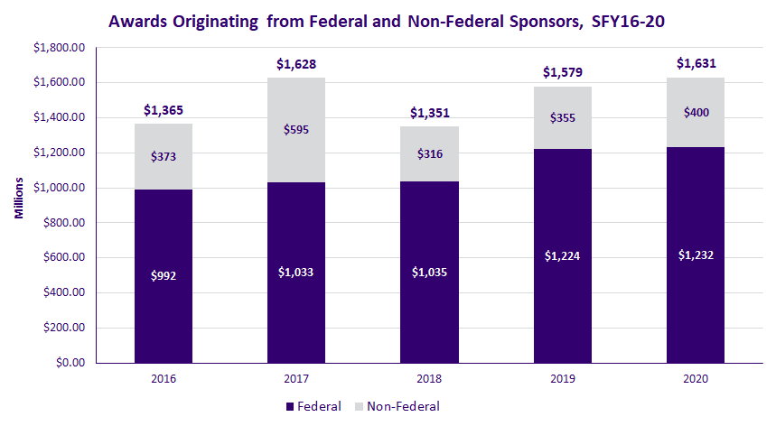
Awards Originating from Federal & Non-Federal Sponsors FY16-FY2020
* Note: A ten-year, $280M Foundation award accounts for the higher level of funding in FY 2017

Slide 17
Awards Originating from Federal & Non-Federal Sponsors FY16-FY2020
Awards by originating sponsor; Bold=increased in FY20
Federal Sponsor Type | FY19 | FY2020
Department of Agriculture | $5,707,183 | $11,216,958
Department of Commerce | $43,259,926 | $30,290,554
Department of Defense | $105,171,472 | $119,449,696
Department of Education | $27,602,077 | $25,631,525
Department of Energy | $48,192,615 | $40,240,794
Department of Health and Human Services | $801,081,665 | $784,242,515
Department of the Interior | $7,677,673 | $9,602,495
Department of Transportation | $4,891,953 | $5,473,579
Department of Veterans Affairs | $7,482,299 | $8,581,395
Environmental Protection Agency | $1,960,800 | $3,105,729
National Aeronautics And Space Administration | $23,919,135 | $27,847,194
National Science Foundation | $133,390,066 | $125,420,918
Other Federal | $13,667,624 | $40,576,012
Total Federal Awards | $1,224,004,489 | $1,231,679,364

Slide 18
Awards – Fiscal Years 2019-2020
Awards by originating sponsor; Bold=increased in FY20
Non-Federal Sponsors Type | 2019 | 2020
Associations and Non-Profits | $79,672,280 | $87,405,693
Foundations | $149,030,117 | $131,819,703
Industry | $86,603,699 | $142,913,896
Institutes of Higher Learning | $3,812,775 | $1,496,702
Local Government | $6,658,922 | $5,158,274
Other Government | $4,317,161 | $4,948,973
State of Washington | $24,905,973 | $25,844,499
Total Non-Federal Awards | $355,000,927 | $399,587,741

Slide 19
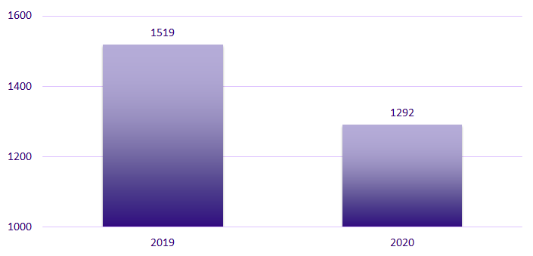
Pre-Award Notifications (PANs) by FY
Notes:
Reduction can be attributed to C19 but also process change. JIT, revised budget, and other support content down.
Process change: OSP no longer creates a PAN upon receipt of automatic JIT notice. PAN created for JIT only once department initiates a response to a JIT notice.

Slide 20
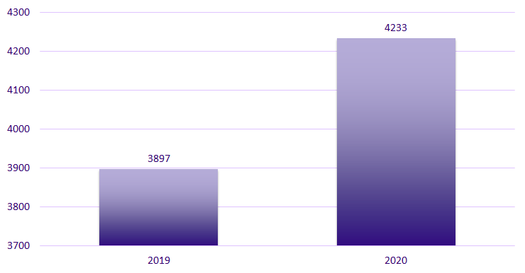
Post Award Change (PACs)
Notes:
PACs up. Largest increase: Extensions up by 174 from last year. (Likely due to C19)
Others that are up: Rebudgeting approval, Change in Key Personnel, and Work Scope Change

Slide 21
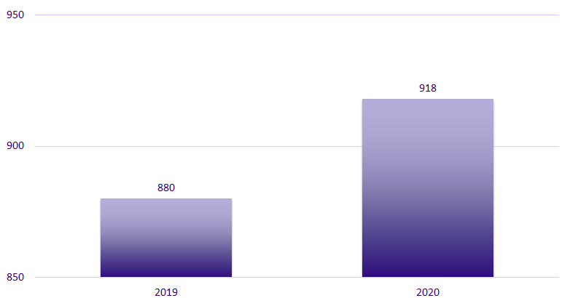
Nonaward Agreements (NAAs) - by FY
NAA: Data Use Agreements, Confidentiality Agreement/Nondisclosure Agreements, Material Transfer Agreements, Master Agreements, Collaboration Agreements
Notes:
Based on “approved date”
NAA: Agreements between UW and another party, related to a sponsored program, that obligates UW resources or otherwise makes legal obligations on behalf of the University and does not include external funding.

Slide 22
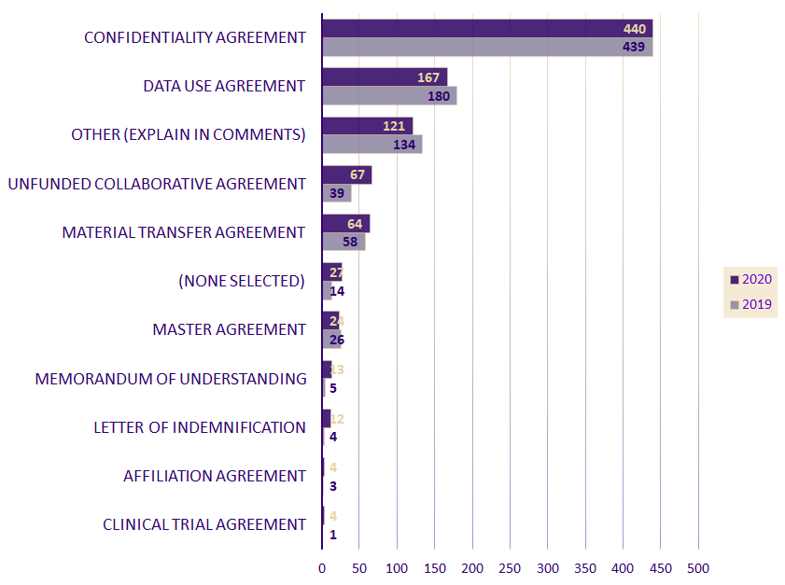
NAAs by Subtype FY19-2020

Slide 23
NAAs by Sponsor Type, FY19-2020
Bold=increased in FY20
2019
2020
Associations/Non-Profits Foundations and Foreign Non-Profit | 103 | 132
Industry Corporate Foundation, Corporate Business, Industry Foreign | 518 | 545
Federal Government | 146 | 127
Foreign Government | 6 | 4
Institutes of Higher Ed WA, Foreign, Other State Universities, Private Universities | 82 | 92
State of WA State Agencies, School Districts | 15 | 7
Other State | 1 | 3
Local Government Cities, Counties, etc | 9 | 8
Total | 880 | 918

Slide 24
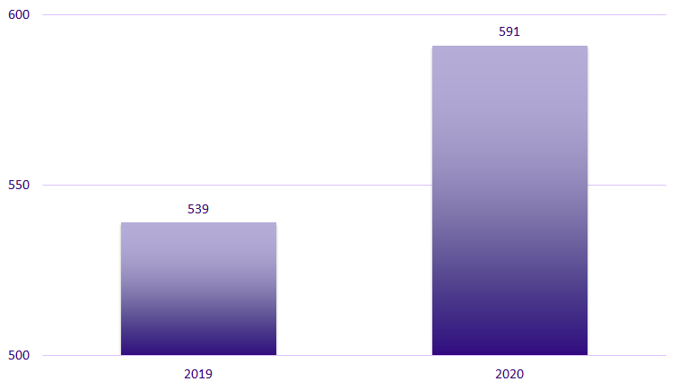
Subawards by FY - Outgoing
Notes:
Biggest increase: Other institutions of higher education (64 increase from last year)
Not accounted for in overall #s are closeout actions.

Slide 25
Questions

Slide 26
RESEARCH ADMINISTRATION DATA (RAD) REPORTS & VISUALIZATIONS

Slide 27
AGENDA
The Research Administration Data (RAD) ‘ecosystem’
An introduction to RAD tools
Resources

Slide 28
RESEARCH ADMINISTRATION DATA ECOSYSTEM
Data Analysis Tools
UW Profiles
uwprofiles.uw.edu
Research Administration Data Sources
SAGE
Enterprise Data Warehouse (EDW)
Dashboards
Finance Systems
B.I. Portal
biportal.uw.edu
Visualizations
Reports
Cubes
Notes:
Research Administration Data, or RAD, is not one database, nor one report, it’s a collection of tools that let you access a combination of databases. - take a look at this image that (greatly) simplifies that ‘ecosystem’ - Starting with the box on the left
RAD is compiled from multiple UW institutional data sources (example: SAGE, managed by ORIS and Finance data, managed by UW Finance)
That compilation of data is collected into UW-IT’s EDW - Enterprise Data Warehouse
All of that data is then made available to you through a number of different EDW data analysis tools
Which data analysis tools? (slide) - different ways to look at data. A separate class is dedicated to Cubes.
UW Profiles (Dashboards)
B.I. Portal (Visualizations - ready made, Reports - details in spreadsheet, Cubes - a lot of data accessible via excel pivot table)

Slide 29
WHICH TOOL?
Easy to use
Less Flexible
More Flexible
More Difficult to use
UW Profiles
B.I. Portal
Dashboards
Visualizations
Reports
Reports
Report Download
Cube
Ready made views of RAD
Ready made summarized views with filters
More details in a spreadsheet format
Export Reports for manipulation in Excel
More flexible data than Viz or Reports, manipulated via Pivot Table
Notes:
When do I use what?
Research Administration Data, or RAD, is not one database, nor one report, it’s a collection of tools that let you access a combination of databases. - take a look at this image that (greatly) simplifies that ‘ecosystem’ - Starting with the box on the left
RAD is compiled from multiple UW institutional data sources (example: SAGE, managed by ORIS and Finance data, managed by UW Finance)
That compilation of data is collected into UW-IT’s EDW - Enterprise Data Warehouse
All of that data is then made available to you through a number of different EDW data analysis tools
Which data analysis tools? (slide) - different ways to look at data. A separate class is dedicated to Cubes.
UW Profiles (Dashboards)
B.I. Portal (Visualizations - ready made, Reports - details in spreadsheet, Cubes - a lot of data accessible via excel pivot table)

Slide 30
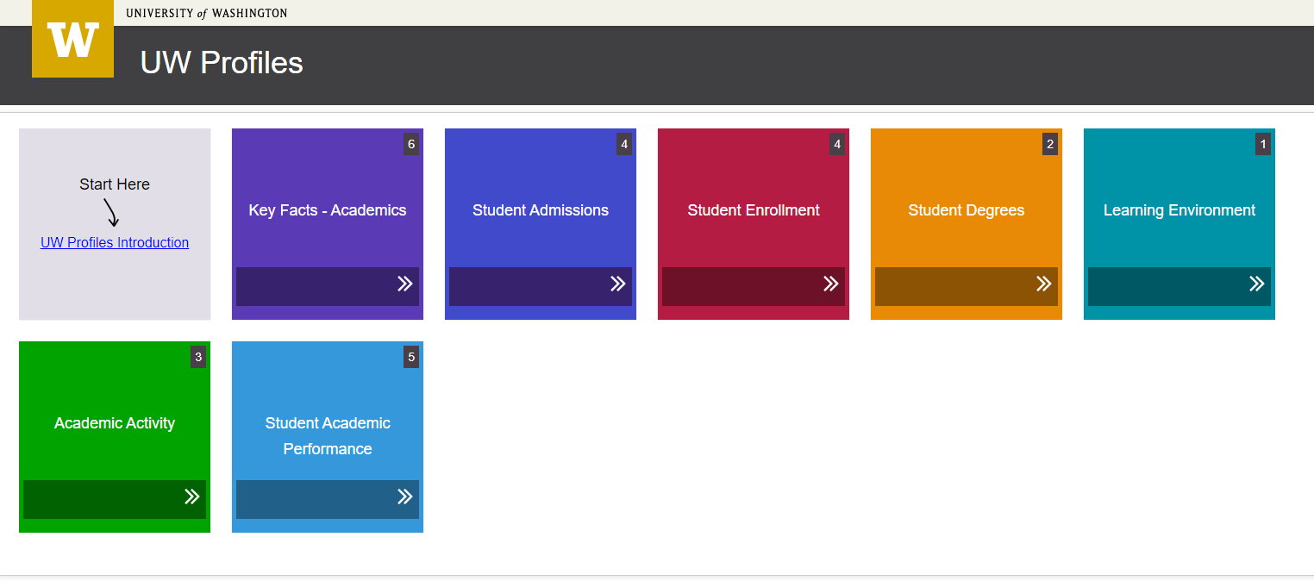
UW PROFILES
UW PROFILES
https://uwprofiles.uw.edu
High-level trend data about university activities “that strives to be easy to use and understand”
UW NetID and EDW access required
Same Visualizations available in BI Portal with more up-to-date data
UW PUBLIC PROFILES
http://opb.washington.edu/uw-profiles-information
Notes:
“[...]a display of high-level trend data about university activities that strives to be easy to use and understand[...] The goal of UW Profiles is to inform, to foster discussion [...] and to encourage further analysis and exploration”
Access to UW Profiles
Requires an active UW NetID + password
Requires EDW access
Requires being logged on to the UW network
UW Public Profiles
An effort lead by the Office of Planning & Budgeting (OPB)
Presents a number of interactive dashboards accessible by the public (no UW NetID required)

Slide 31
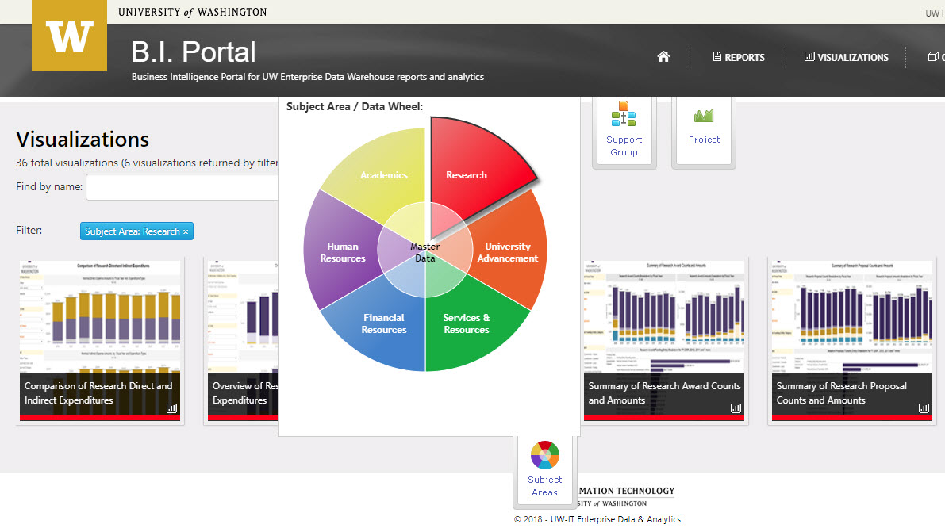
BI PORTAL: WHAT IS IT?
A business intelligence portal developed and maintained by EIIA, a division of UW-IT
65 Billion Records Stored in the Enterprise Data Warehouse (EDW)
200+ Reports, Visualizations and Cubes in the BI Portal
Data from all over the UW, but we’ll be focusing on RAD
https://biportal.uw.edu
Notes:
Enterprise Information, Integration and Analytics, a division of UW-IT
Need UW netID as some data is sensible

Slide 32
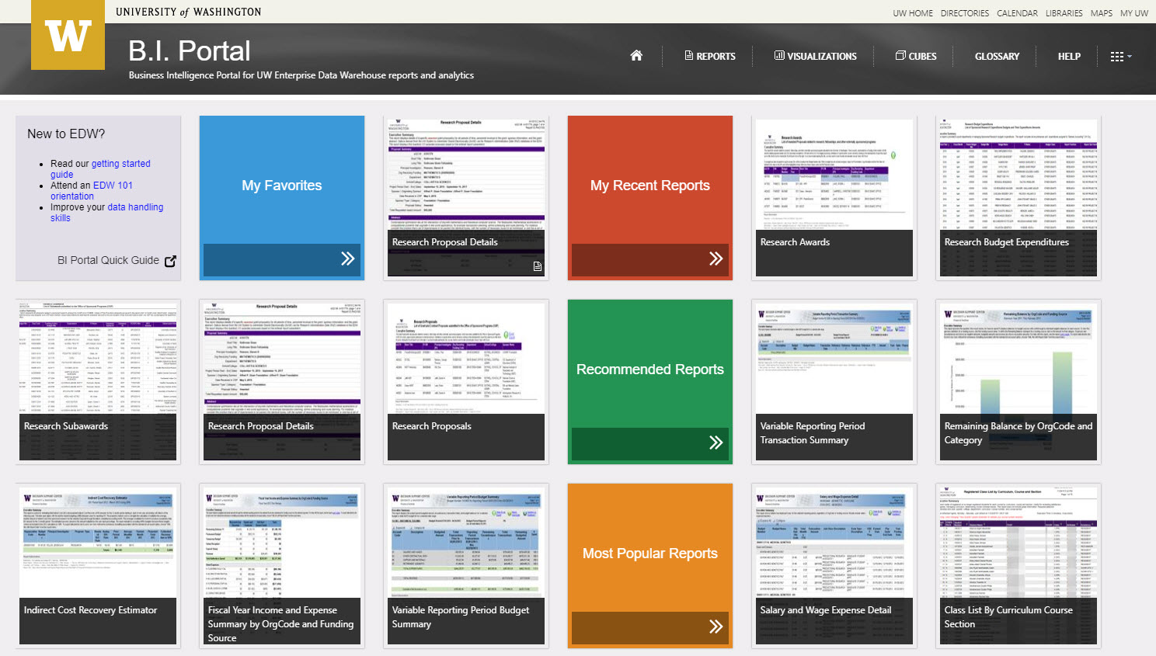
BI PORTAL: ACCESS
https://biportal.uw.edu/Viz
Requires an active UW NetID + password
Requires EDW access rights - go here to identify who could authorize you https://itconnect.uw.edu/work/data/data-security/request-access/
Requires being logged on to the UW network or VPN
Note: VPN (e.g. Husky OnNet) is required for Visualizations, but not for Reports.
Notes:
We’ll cover Visualizations first (NEXT SLIDE)

Slide 33
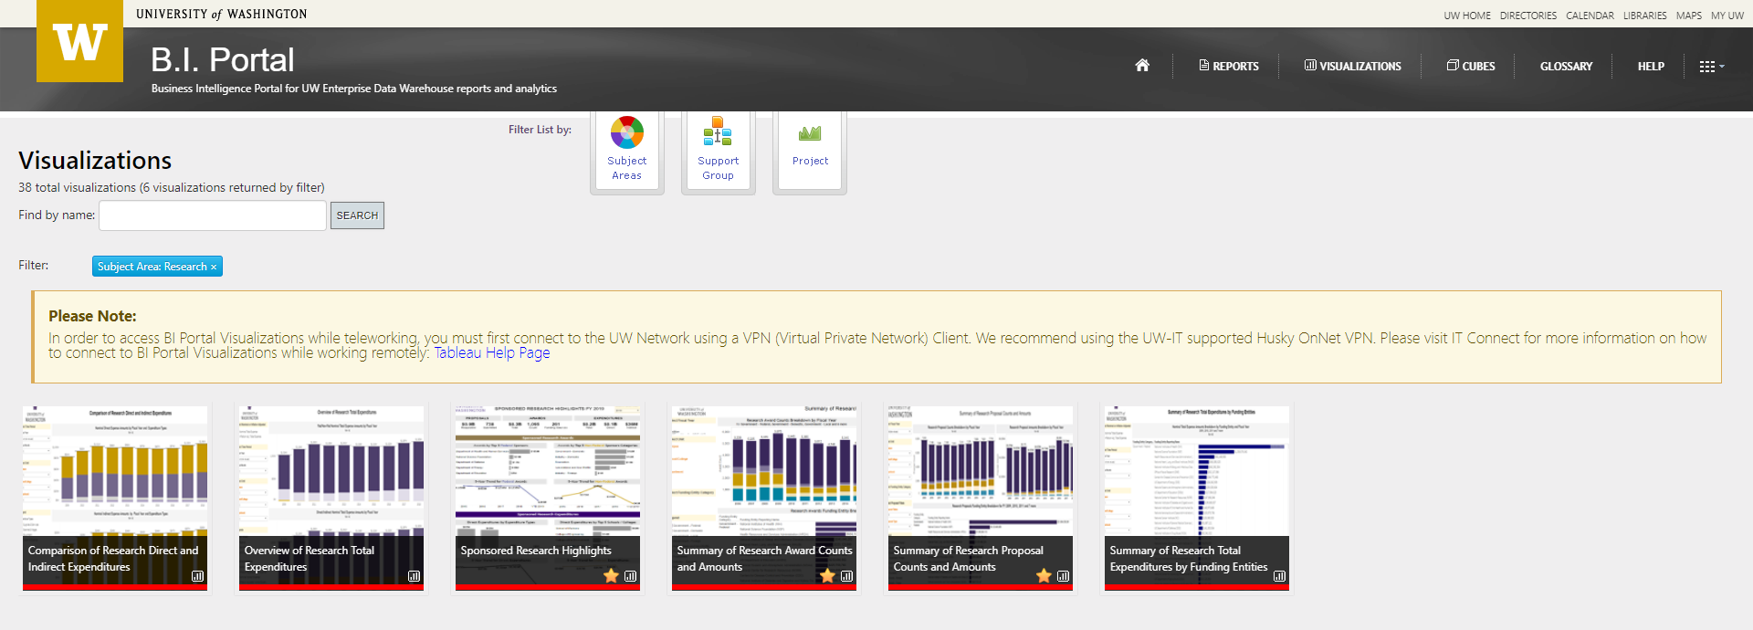
VISUALIZATIONS
Notes:
Visualizations - the easiest way to consume data!
Class Hands-On
Note: Slide packet will include information on all of the RAD Visualizations covered during the hands-on session

Slide 34
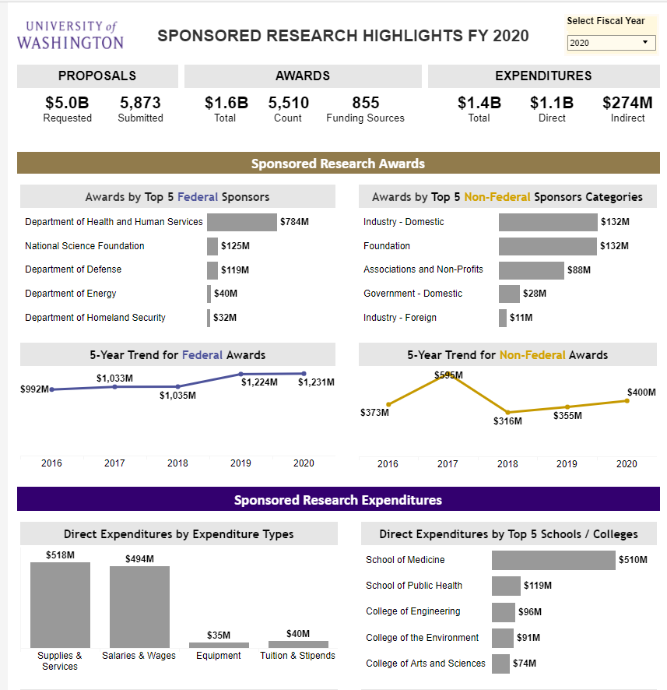
VISUALIZATIONS
SPONSORED RESEARCH HIGHLIGHTS
Each visualization has an overview tab explaining how to interpret data and be aware of limitations
This visualization is like a high-level view of the Annual Report
Data is updated nightly
Filters data by fiscal year
Notes:
Put in context; high level university use, no department or college level details

Slide 35
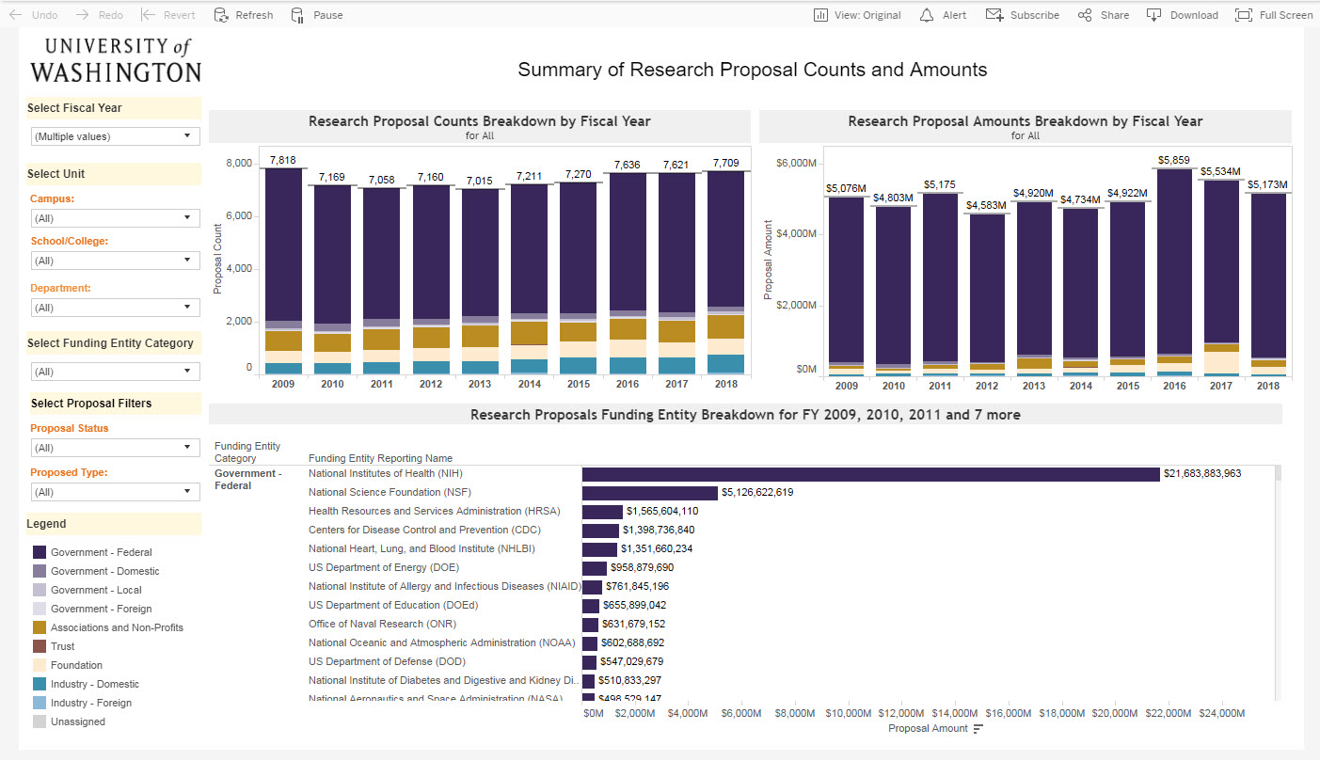
VISUALIZATIONS
SUMMARY OF RESEARCH PROPOSAL COUNTS & AMOUNTS
A Proposal is not an Award
Proposal Count: a count of eGC1s that have reached at least “In OSP” status
Date of Proposal: the date that the eGC1 reached “In OSP” status the first time.
Filters: fiscal year, campus, school, department, but not Division, proposal status, proposal type, and funding entity

Slide 36
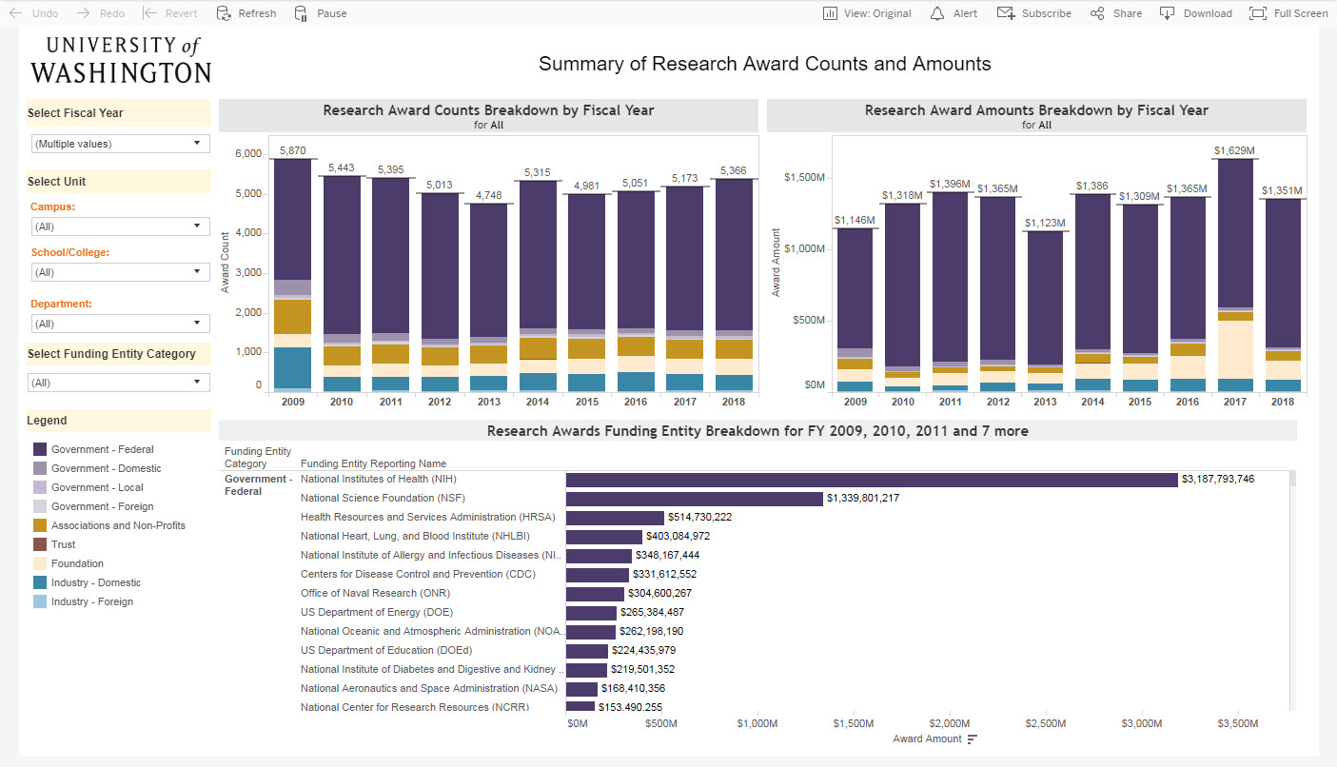
VISUALIZATIONS
SUMMARY OF RESEARCH AWARD COUNTS & AMOUNTS
The Award Count is a count of the Funding Actions on an awarded Proposal
It looks a lot like the previous one! They could be compared side by side
Filters: fiscal year, campus, school/college, department, funding entity category

Slide 37
VISUALIZATIONS
Why use visualizations?
Easy to read and interactive dashboards of RAD
Each visualization has overview with a description and functionality info
Simple filters like date range and college and/or department
Easy to customize, share a copy of your filtered dashboard, download as image, PDF, or PPT a slide
CURRENT RAD VISUALIZATIONS:
Sponsored Research Highlights
Proposal counts and amounts
Award counts and amounts
Comparison of Research Direct and Indirect Expenditures
Summary of Research Total Expenditures by Funding Entities
Overview of Research Total Expenditures

Slide 38
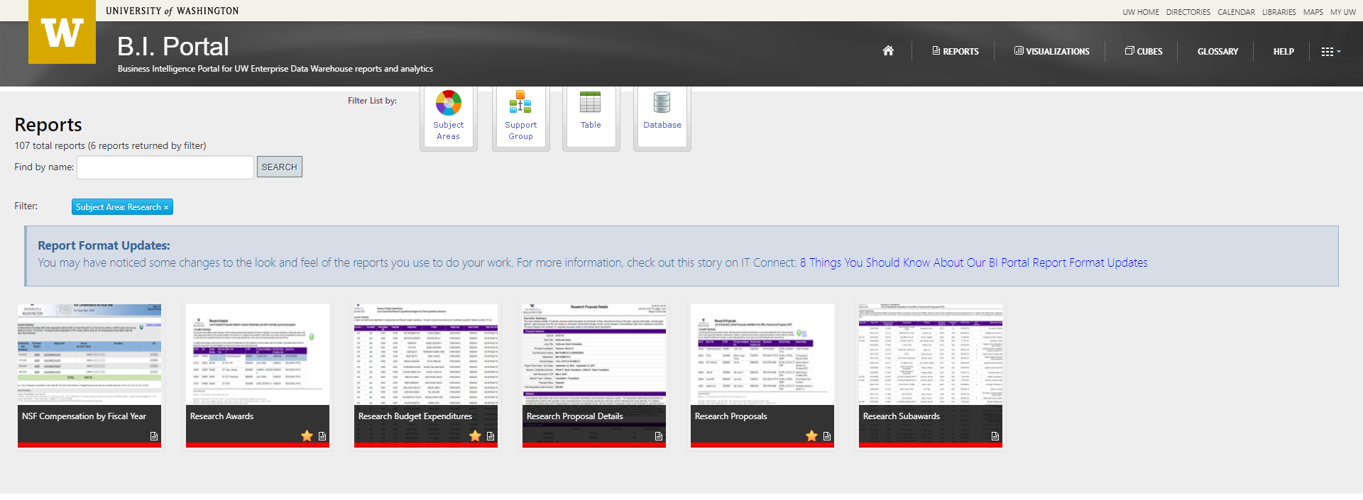
REPORTS
Notes:
Reports - less constructed data views, but more details
Class Hands-On
Note: Slide packet will include information on all of the RAD Reports covered during the hands-on session

Slide 39
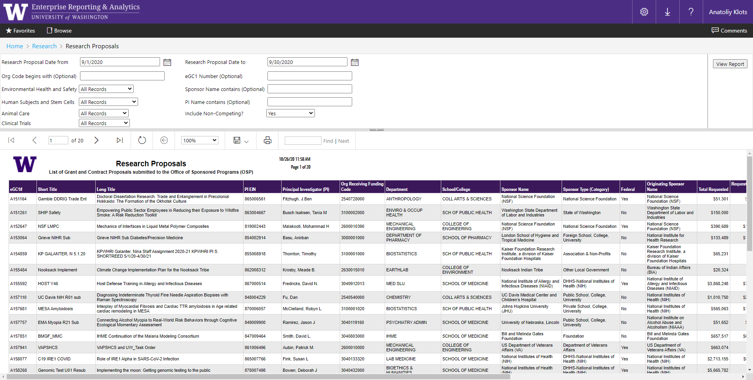
REPORTS
RESEARCH PROPOSALS
A list of all the proposals (SAGE eGC1s) that were submitted within (filtered) date range and reached at least the “In OSP” status

Slide 40
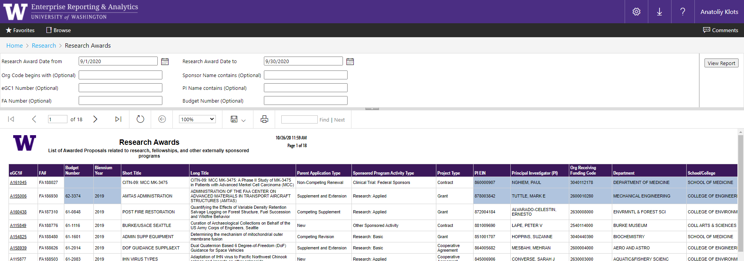
REPORTS
RESEARCH AWARDS
This report is a list of FAs enacted during the selected (filtered) date range

Slide 41
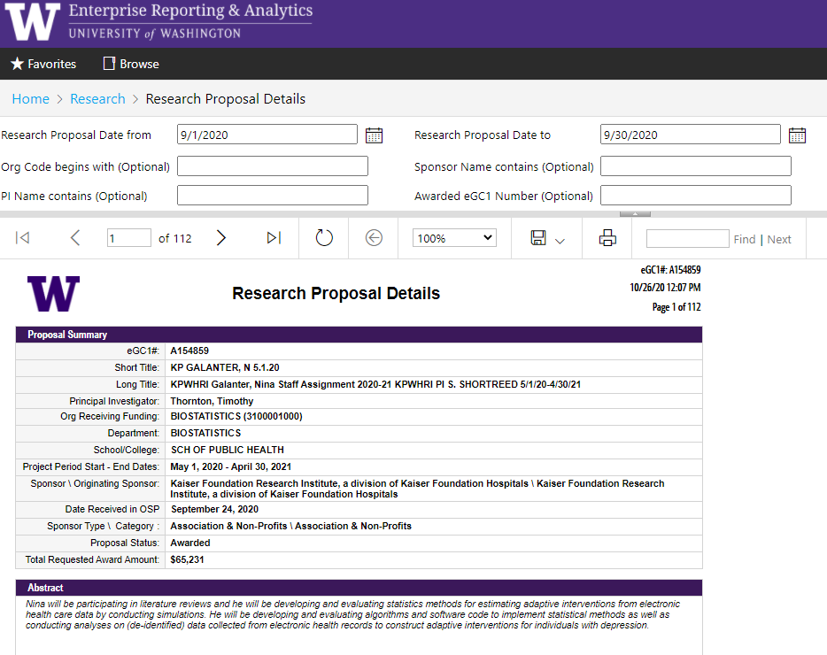
REPORTS
RESEARCH PROPOSAL DETAILS
This report is ideal as a snapshot of a proposal, particularly when first awarded
Each “page” of the report is a proposal, with associated details and FAs

Slide 42
REPORT DOWNLOADS to Excel
Notes:
This is a demo - NOT hands-on for the class
Demonstrates Report Downloads
Introduces what it will be like to work with the RAD Cube

Slide 43
REPORTS
RECAP
Detailed data in a spreadsheet format
Powerful filters including org code, PI name, and eGC1 number
Remember: each report has unique data limitations
REPORT AREAS:
Proposals
Awards
Subawards
Expenditures

Slide 44
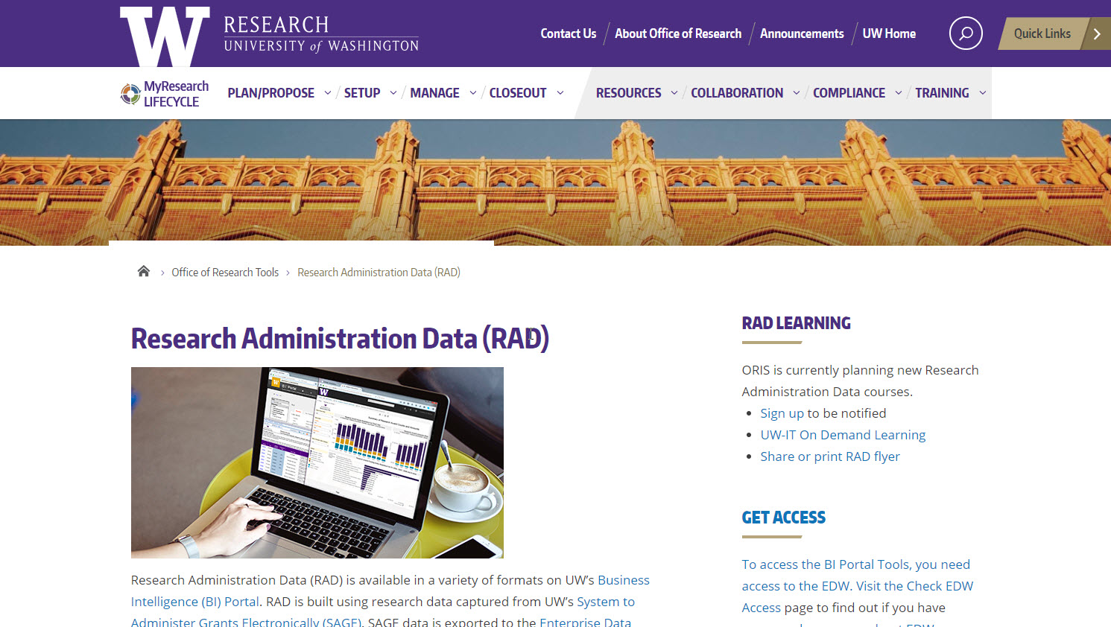
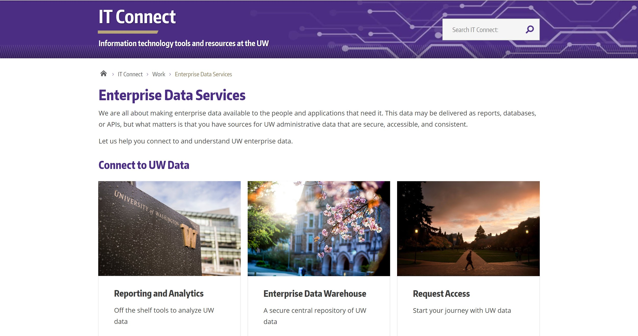
RESOURCES: WEBPAGES
Research Administration Data
Enterprise Information, Integration & Analytics
https://www.washington.edu/research/tools/research-administration-data-rad/
https://itconnect.uw.edu/work/decision-support/

Slide 45
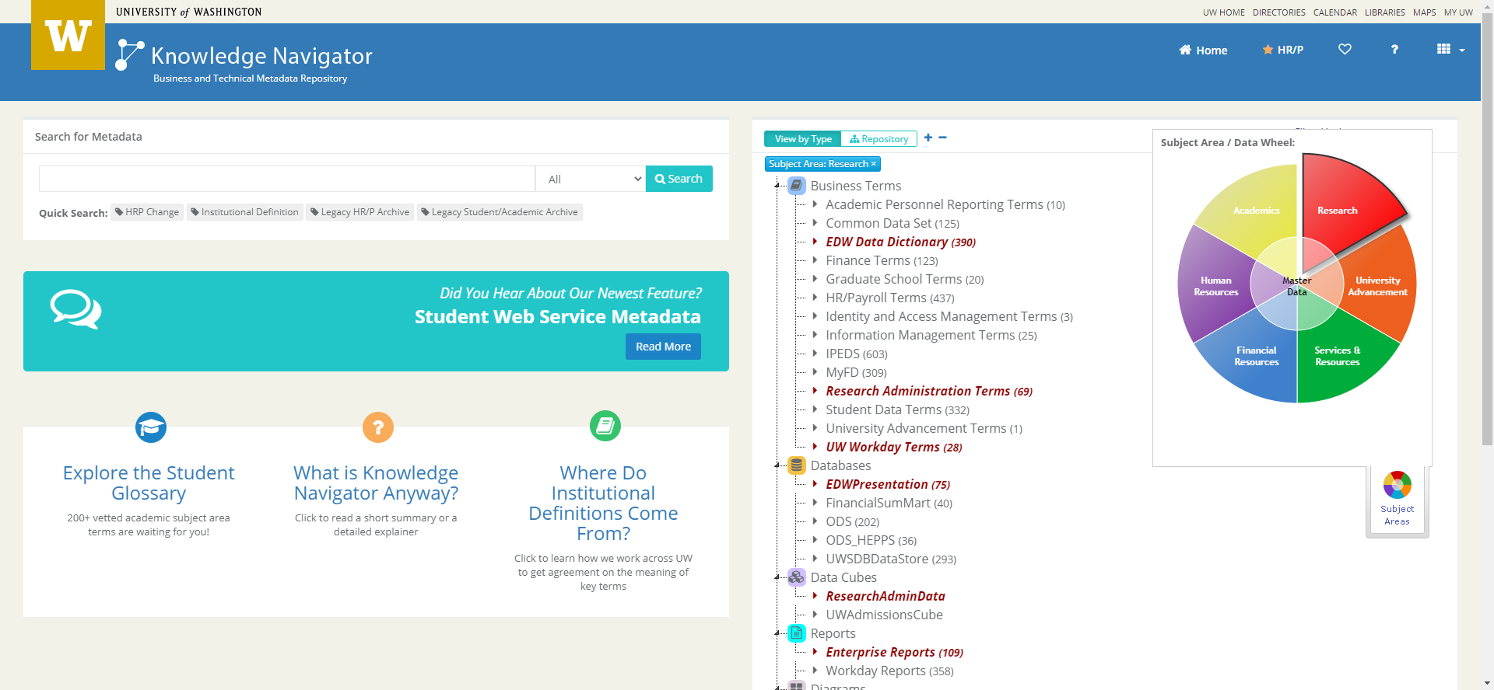
RESOURCES: EIIA and UW-IT
Knowledge Navigator
UW Data Definitions
Represents business terms visually and textually, highlighting linkages between old and new systems
Definitions are vetted and approved by data custodians
https://metadata.uw.edu/
Notes:
Knowledge Navigator displays business terms
and data relationships both visually and textually,
highlighting linkages between old and new systems.
Definitions are vetted and approved by data custodians

Slide 46
RESOURCES: HELP
Research Administration Data questions: grantrpt@uw.edu
Will go to ORIS Decision Support Services (DSS) team
Technical BI Portal questions, including how to connect: help@uw.edu
Put “EDW Question” in subject line
Will be forwarded to Enterprise Information, Integration and Analytics (EIIA) team

Slide 47
RESOURCES: UPCOMING TRAINING
CORE Training: Calendar & Course Descriptions
https://www.washington.edu/research/training/core/
Research Administration Data Cube Class
11/19/2020 (hybrid course)
Jeff Babauta, Director of Finance and Reporting

Slide 48
QUESTIONS?
Thank you!

Slide 49
COMPLIANCE CORNER
MRAM November 2020
Andra Sawyer & Matt Gardner
Post Award Fiscal Compliance
gcafco@uw.edu

Slide 50
CARES Act Funding and COVID Research

Slide 51
Federal Appropriations/Aid Related to COVID
Three Acts of Congress relating to funding due to the impacts from COVID:
Coronavirus Preparedness and Response Supplemental Appropriations Act, 2020 (PL 116-123)
Coronavirus Aid, Relief, and Economic Security (CARES) Act (PL 116-136)
Paycheck Protection Program and Health Care Enhancement Act (PL 116-139)
MRAM – Matt Gardner – PAFC

Slide 52
Federal Appropriations Related to COVID
OMB has instructed federal agencies to track and report funding from the “Three Acts”.
UW will also track funds from the “Three Acts” because:
If federal agencies are tracking funds separately, it is prudent for UW to follow their lead.
High probability these funds are audited in the future; separate accountability is critical to preparing for an audit.
MRAM – Matt Gardner – PAFC

Slide 53
COVID Research Not Funded by the “Three Acts”
There may (will) be Awards which are classified as “COVID Research” that are not funded by the “Three Acts”
Example: COVID research funded via a non-federal sponsor/non-federal funds
UW will also track overall research related to COVID
MRAM – Matt Gardner – PAFC

Slide 54
Tracking the “Three Acts” and COVID Research
GCA will activate two Grant Control Flags in the financial system for Awards which represent:
Funding issued under the “Three Acts” or
Funding where the purpose of the Award is COVID research
GCA will review the Notice of Award and applicable award documentation in order to determine which flag to activate, if applicable.
MRAM – Matt Gardner – PAFC

Slide 55
Supplemental Funding Issued Under the “Three Acts”
Active awards in which supplemental funding was issued under the “Three Acts” will require a sub budget. (example on next slide)
Separate accounting is required even if the sponsor does not require separate financial reporting or invoicing.
GCA will create the sub budget and allocate funding when the supplemental funding is processed.
MRAM – Matt Gardner – PAFC

Slide 56
Supplemental Funding Issued Under the “Three Acts” - Example
Federal Award A
Original Funding from normal appropriations: $100,000 Supplemental Funding via “Three Acts”: $50,000
In this scenario, GCA will create a sub budget to track the $50,000 in supplemental funding issued under the “Three Acts”.
Expenditures related to the supplemental funding must be charged to the sub budget.
MRAM – Matt Gardner – PAFC

Slide 57
Timeline
GCA will begin reviewing current and new funding within the next couple of weeks.
Estimated date of the end of November to complete review of the Notice of Awards, activation of the Grant Control Flags, and creation of required sub budgets, when applicable.
If a new sub budget is needed, GCA will send a notification in Grant Tracker and request that appropriate expenses be transferred to it.
MRAM – Matt Gardner – PAFC

Slide 58
Questions
Post Award Fiscal Compliance (PAFC)
gcafco@uw.edu
https://finance.uw.edu/pafc/
Andra Sawyer
andra2@uw.edu
Matt Gardner
mgard4@uw.edu
We are available for voice/video calls on Teams and Zoom!
MRAM – Matt Gardner – PAFC

Slide 59
Registration open for the *VIRTUAL* 2020 NCURA Region VI & VII Fall Meeting (RM2020)
Tuesday, November 17 through Thursday, November 19, 2020
11 am-4 pm Pacific
Registration
$75 for members and non-members October 24, 2020 – November 10, 2020
Program, Registration and Details
https://www.ncuraregionvi.org/regionalmeeting2020-virtual
Questions?
Vanessa Quiroz Hotz | Region VI Chair | vmqh@uw.edu | www.ncuraregionvi.org
Ashley Stahle | Region VII Chair | ashley.stahle@colostate.edu | www.ncuraregionvii.org
Notes:
There is still time to register for the virtual NCURA Region VI and VII meeting that will be held November 17-19.
Registration is $75 for members and non-members and can be paid via credit card or check.
See our website at https://www.ncuraregionvi.org/ for additional program information.

Slide 60
There is still time to register for the virtual NCURA Region VI and VII meeting that will be held November 17-19.
Registration is $75 for members and non-members and can be paid via credit card or check.
See our website at https://www.ncuraregionvi.org/ for additional program information.

