Slide 1
Sponsored Programs
Annual Data FY20
November, 2020 MRAM
Carol Rhodes
Office of Sponsored Programs

Slide 2
UW Statistics: Sponsored Program Funding
Since 1972 the UW:
has received more federal research funding than any other U.S. public university
consistently places among the top 5 for total externally-sponsored research funding for all public and private universities in the country
FY18 the UW ranked #2
We are one of the few universities in the U.S. with sponsored program funding over $1Billion
State FY20 Total: $1.63 Billion

Slide 3
Recent World Rankings
Academic Ranking of World Universities (formerly Shanghai Jiao Tong World University) (2020) | 16
The Times Higher Education World Rankings (2020) | 26
The Times Higher Education National (Public) Rankings (2020) | 4
US News & World Report Global Rankings (2021) | 8
Forbes Best Value National Rankings (2019) | 10
Reuters Most Innovative (2018) | 5
UpShot College Rankings Index National (2017) (does the most for low-income students) | 18
Notes:
These are current as of 10/21/2020.
Link is to OR site that reflects YOY rankings since 2003

Slide 4
Proposals – Fiscal Years 2016-2020
State FY | FY16 | FY17 | FY18 | FY19 | FY20
Total Requested | $5.16B | $4.90B | $4.48B | $5.05B | $4.98B
Proposal Count | 5,861 | 5,893 | 5,826 | 5,631 | 5,873
Proposal Count-
Includes only: Approved, Awarded, Denied by Sponsor
Proposal Types-
Excludes: Non-Competing, Pre-Applications, Non-Award Agreements

Slide 5
Awards – Fiscal Years 2016-2020
FY Type | FY16 | FY17* | FY18 | FY19 | FY20
State FY | $1.36B | $1.63B | $1.35B | $1.58B | $1.63B
Federal FY | $1.32B | $1.68B | $1.34B | $1.71B | $1.68B
* Note: A ten-year, $280M Foundation award accounts for the higher level of funding in FY 2017

Slide 6
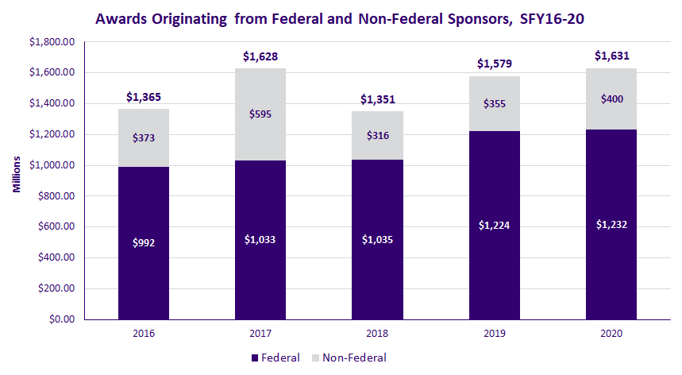
Awards Originating from Federal & Non-Federal Sponsors FY16-FY2020
* Note: A ten-year, $280M Foundation award accounts for the higher level of funding in FY 2017

Slide 7
Awards Originating from Federal & Non-Federal Sponsors FY16-FY2020
Awards by originating sponsor; Bold=increased in FY20
Federal Sponsor Type | FY19 | FY2020
Department of Agriculture | $5,707,183 | $11,216,958
Department of Commerce | $43,259,926 | $30,290,554
Department of Defense | $105,171,472 | $119,449,696
Department of Education | $27,602,077 | $25,631,525
Department of Energy | $48,192,615 | $40,240,794
Department of Health and Human Services | $801,081,665 | $784,242,515
Department of the Interior | $7,677,673 | $9,602,495
Department of Transportation | $4,891,953 | $5,473,579
Department of Veterans Affairs | $7,482,299 | $8,581,395
Environmental Protection Agency | $1,960,800 | $3,105,729
National Aeronautics And Space Administration | $23,919,135 | $27,847,194
National Science Foundation | $133,390,066 | $125,420,918
Other Federal | $13,667,624 | $40,576,012
Total Federal Awards | $1,224,004,489 | $1,231,679,364

Slide 8
Awards – Fiscal Years 2019-2020
Awards by originating sponsor; Bold=increased in FY20
Non-Federal Sponsors Type | 2019 | 2020
Associations and Non-Profits | $79,672,280 | $87,405,693
Foundations | $149,030,117 | $131,819,703
Industry | $86,603,699 | $142,913,896
Institutes of Higher Learning | $3,812,775 | $1,496,702
Local Government | $6,658,922 | $5,158,274
Other Government | $4,317,161 | $4,948,973
State of Washington | $24,905,973 | $25,844,499
Total Non-Federal Awards | $355,000,927 | $399,587,741
Notes:
approx. $55 million increase in clinical trial funding. We’ve experienced a 25% in volume of CTAs

Slide 9
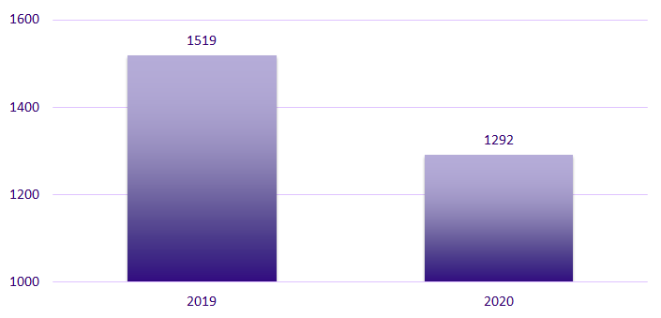
Pre-Award Notifications (PANs) by FY
Notes:
Reduction can be attributed to C19 but also process change. JIT, revised budget, and other support content down.
Process change: OSP no longer creates a PAN upon receipt of automatic JIT notice. PAN created for JIT only once department initiates a response to a JIT notice.

Slide 10
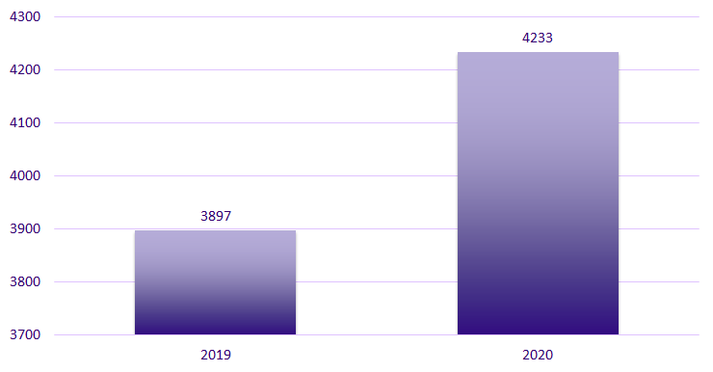
Post Award Change (PACs)
Notes:
PACs up. Largest increase: Extensions up by 174 from last year. (Likely due to C19)
Others that are up: Rebudgeting approval, Change in Key Personnel, and Work Scope Change

Slide 11
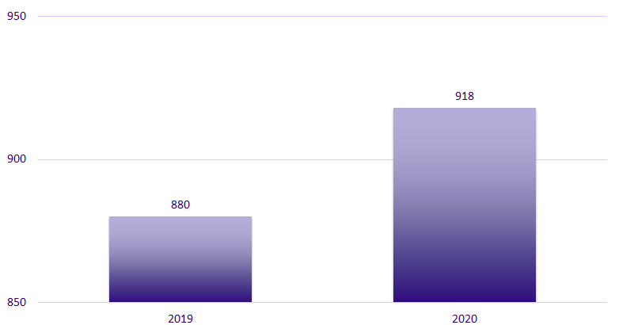
Nonaward Agreements (NAAs) - by FY
NAA: Data Use Agreements, Confidentiality Agreement/Nondisclosure Agreements, Material Transfer Agreements, Master Agreements, Collaboration Agreements
Notes:
Based on “approved date”
NAA: Agreements between UW and another party, related to a sponsored program, that obligates UW resources or otherwise makes legal obligations on behalf of the University and does not include external funding.

Slide 12
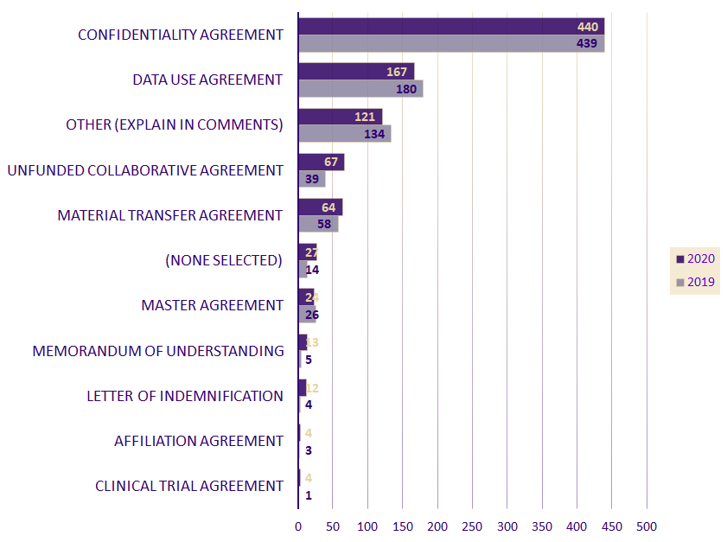
NAAs by Subtype FY19-2020
Notes:
CTA here signifies a compassionate use/emergency use agreement, or a modification to a master CTA

Slide 13
NAAs by Sponsor Type, FY19-2020
Bold=increased in FY20
2019
2020
Associations/Non-Profits Foundations and Foreign Non-Profit | 103 | 132
Industry Corporate Foundation, Corporate Business, Industry Foreign | 518 | 545
Federal Government | 146 | 127
Foreign Government | 6 | 4
Institutes of Higher Ed WA, Foreign, Other State Universities, Private Universities | 82 | 92
State of WA State Agencies, School Districts | 15 | 7
Other State | 1 | 3
Local Government Cities, Counties, etc | 9 | 8
Total | 880 | 918

Slide 14
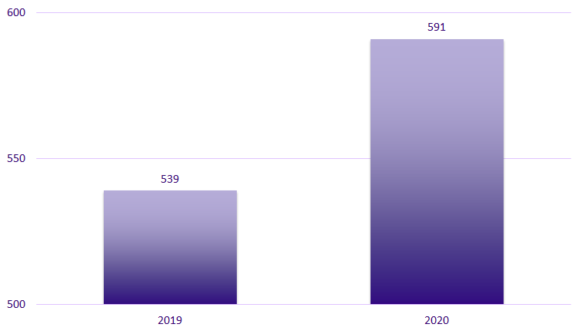
Subawards by FY - Outgoing
Notes:
Biggest increase: Other institutions of higher education (64 increase from last year)
Not accounted for in overall #s are closeout actions.

Slide 15
Questions

