Slide 1
RESEARCH ADMINISTRATION DATA (RAD) REPORTS & VISUALIZATIONS

Slide 2
AGENDA
The Research Administration Data (RAD) ‘ecosystem’
An introduction to RAD tools
Resources

Slide 3
RESEARCH ADMINISTRATION DATA ECOSYSTEM
Data Analysis Tools
UW Profiles
uwprofiles.uw.edu
Research Administration Data Sources
SAGE
Enterprise Data Warehouse (EDW)
Dashboards
Finance Systems
B.I. Portal
biportal.uw.edu
Visualizations
Reports
Cubes
Notes:
Research Administration Data, or RAD, is not one database, nor one report, it’s a collection of tools that let you access a combination of databases. - take a look at this image that (greatly) simplifies that ‘ecosystem’ - Starting with the box on the left
RAD is compiled from multiple UW institutional data sources (example: SAGE, managed by ORIS and Finance data, managed by UW Finance)
That compilation of data is collected into UW-IT’s EDW - Enterprise Data Warehouse
All of that data is then made available to you through a number of different EDW data analysis tools
Which data analysis tools? (slide) - different ways to look at data. A separate class is dedicated to Cubes.
UW Profiles (Dashboards)
B.I. Portal (Visualizations - ready made, Reports - details in spreadsheet, Cubes - a lot of data accessible via excel pivot table)

Slide 4
WHICH TOOL?
Easy to use
Less Flexible
More Flexible
More Difficult to use
UW Profiles
B.I. Portal
Dashboards
Visualizations
Reports
Reports
Report Download
Cube
Ready made views of RAD
Ready made summarized views with filters
More details in a spreadsheet format
Export Reports for manipulation in Excel
More flexible data than Viz or Reports, manipulated via Pivot Table
Notes:
When do I use what?
Research Administration Data, or RAD, is not one database, nor one report, it’s a collection of tools that let you access a combination of databases. - take a look at this image that (greatly) simplifies that ‘ecosystem’ - Starting with the box on the left
RAD is compiled from multiple UW institutional data sources (example: SAGE, managed by ORIS and Finance data, managed by UW Finance)
That compilation of data is collected into UW-IT’s EDW - Enterprise Data Warehouse
All of that data is then made available to you through a number of different EDW data analysis tools
Which data analysis tools? (slide) - different ways to look at data. A separate class is dedicated to Cubes.
UW Profiles (Dashboards)
B.I. Portal (Visualizations - ready made, Reports - details in spreadsheet, Cubes - a lot of data accessible via excel pivot table)

Slide 5
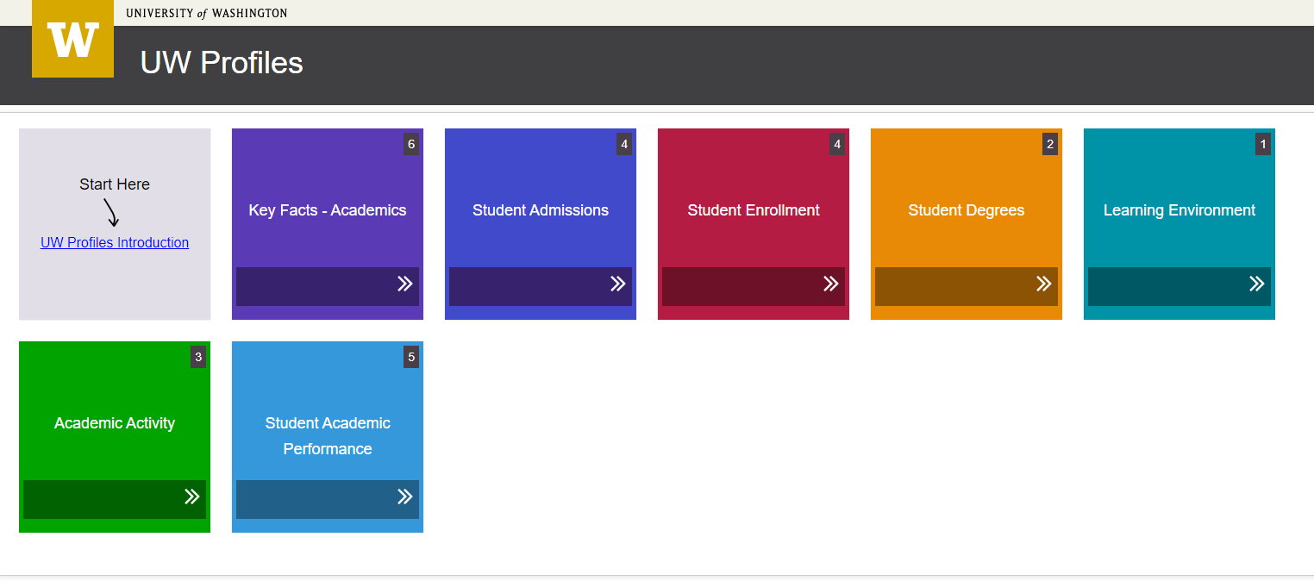
UW PROFILES
UW PROFILES
https://uwprofiles.uw.edu
High-level trend data about university activities “that strives to be easy to use and understand”
UW NetID and EDW access required
Same Visualizations available in BI Portal with more up-to-date data
UW PUBLIC PROFILES
http://opb.washington.edu/uw-profiles-information
Notes:
“[...]a display of high-level trend data about university activities that strives to be easy to use and understand[...] The goal of UW Profiles is to inform, to foster discussion [...] and to encourage further analysis and exploration”
Access to UW Profiles
Requires an active UW NetID + password
Requires EDW access
Requires being logged on to the UW network
UW Public Profiles
An effort lead by the Office of Planning & Budgeting (OPB)
Presents a number of interactive dashboards accessible by the public (no UW NetID required)

Slide 6
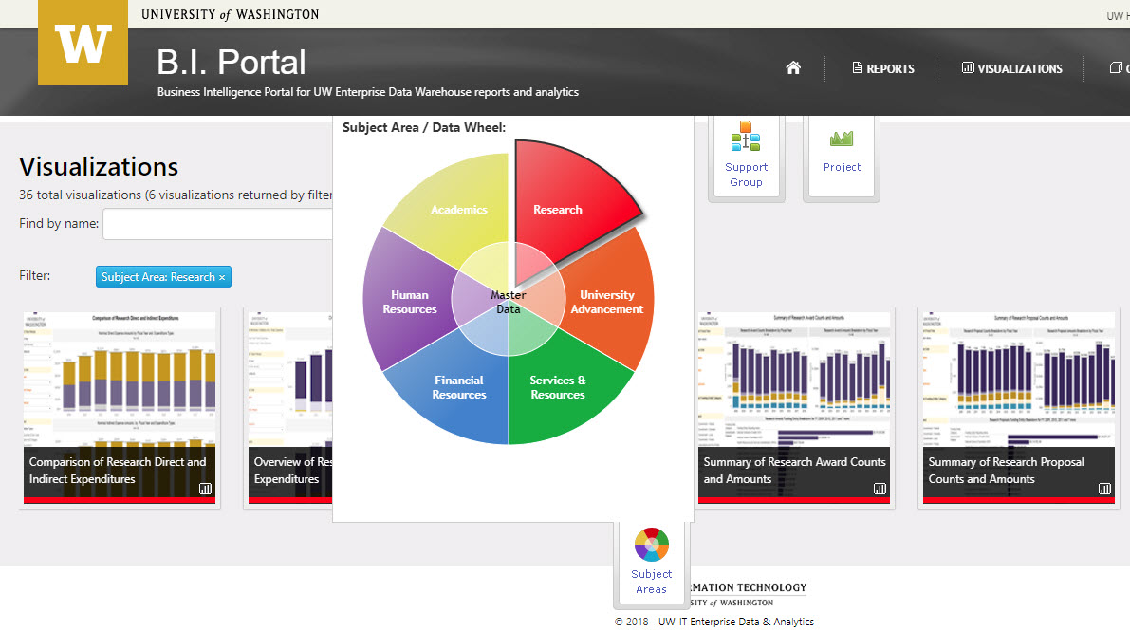
BI PORTAL: WHAT IS IT?
A business intelligence portal developed and maintained by EIIA, a division of UW-IT
65 Billion Records Stored in the Enterprise Data Warehouse (EDW)
200+ Reports, Visualizations and Cubes in the BI Portal
Data from all over the UW, but we’ll be focusing on RAD
https://biportal.uw.edu
Notes:
Enterprise Information, Integration and Analytics, a division of UW-IT
Need UW netID as some data is sensible

Slide 7
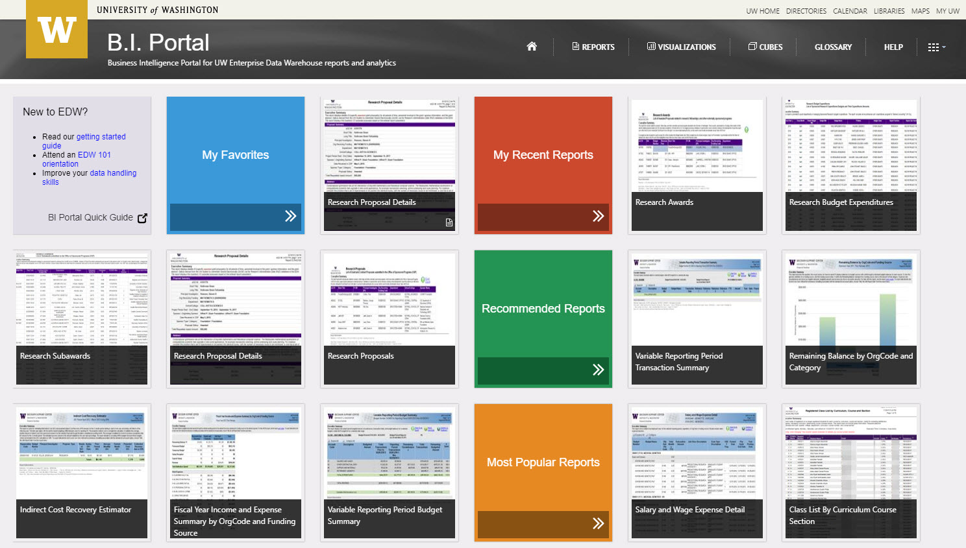
BI PORTAL: ACCESS
https://biportal.uw.edu/Viz
Requires an active UW NetID + password
Requires EDW access rights - go here to identify who could authorize you https://itconnect.uw.edu/work/data/data-security/request-access/
Requires being logged on to the UW network or VPN
Note: VPN (e.g. Husky OnNet) is required for Visualizations, but not for Reports.
Notes:
We’ll cover Visualizations first (NEXT SLIDE)

Slide 8
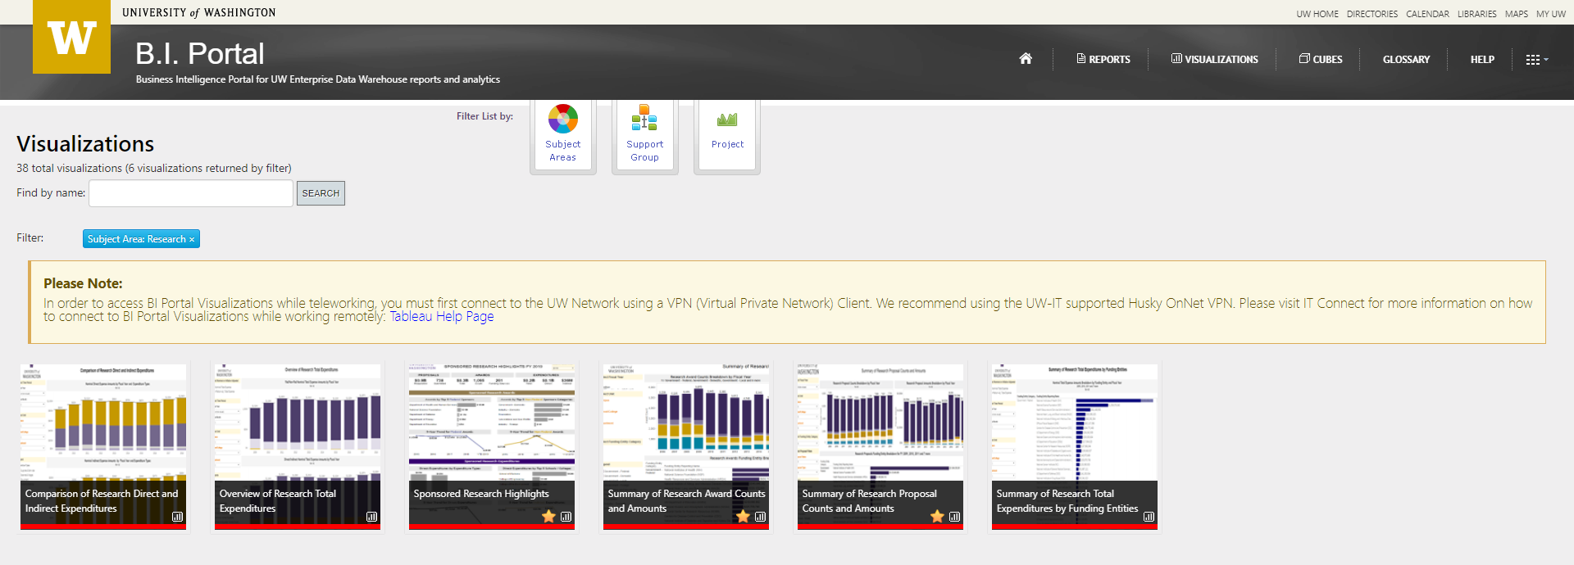
VISUALIZATIONS
Notes:
Visualizations - the easiest way to consume data!
Class Hands-On
Note: Slide packet will include information on all of the RAD Visualizations covered during the hands-on session

Slide 9
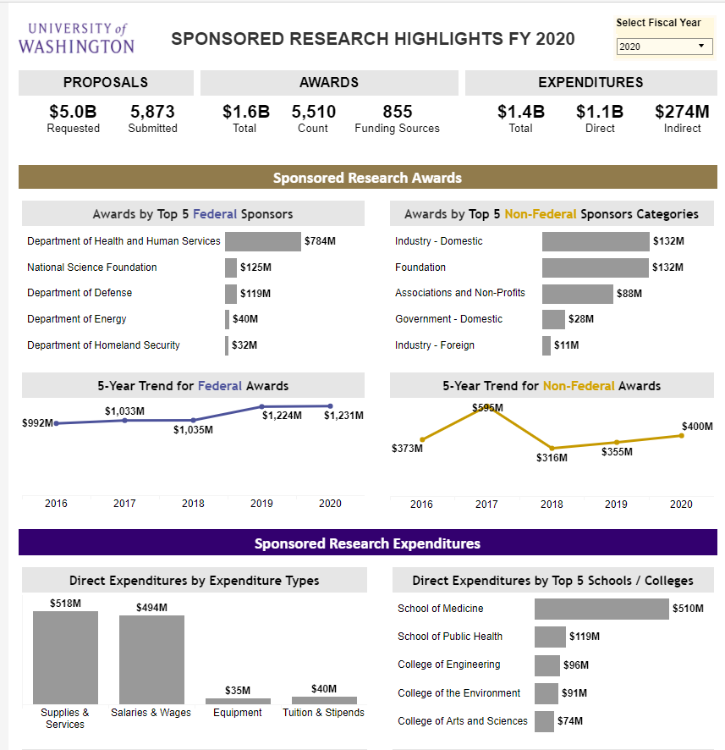
VISUALIZATIONS
SPONSORED RESEARCH HIGHLIGHTS
Each visualization has an overview tab explaining how to interpret data and be aware of limitations
This visualization is like a high-level view of the Annual Report
Data is updated nightly
Filters data by fiscal year
Notes:
Put in context; high level university use, no department or college level details

Slide 10
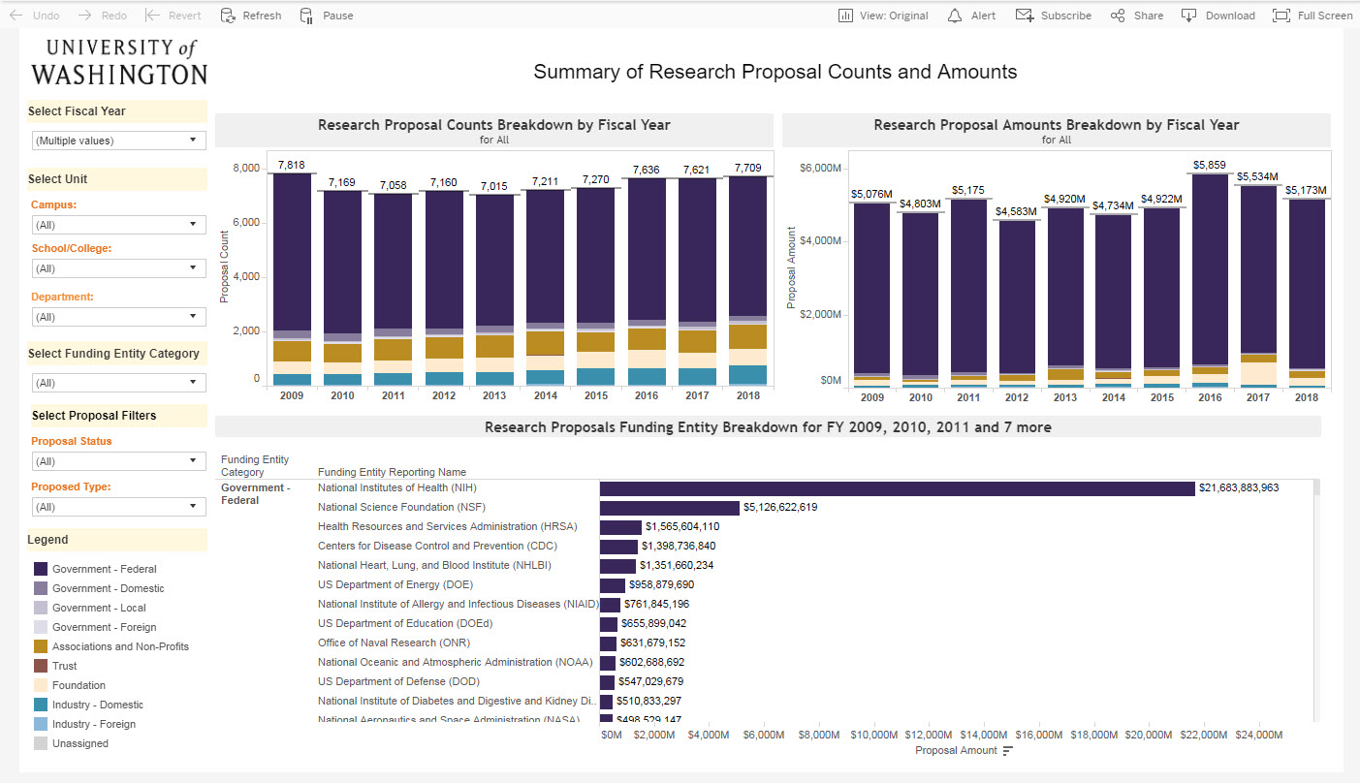
VISUALIZATIONS
SUMMARY OF RESEARCH PROPOSAL COUNTS & AMOUNTS
A Proposal is not an Award
Proposal Count: a count of eGC1s that have reached at least “In OSP” status
Date of Proposal: the date that the eGC1 reached “In OSP” status the first time.
Filters: fiscal year, campus, school, department, but not Division, proposal status, proposal type, and funding entity

Slide 11
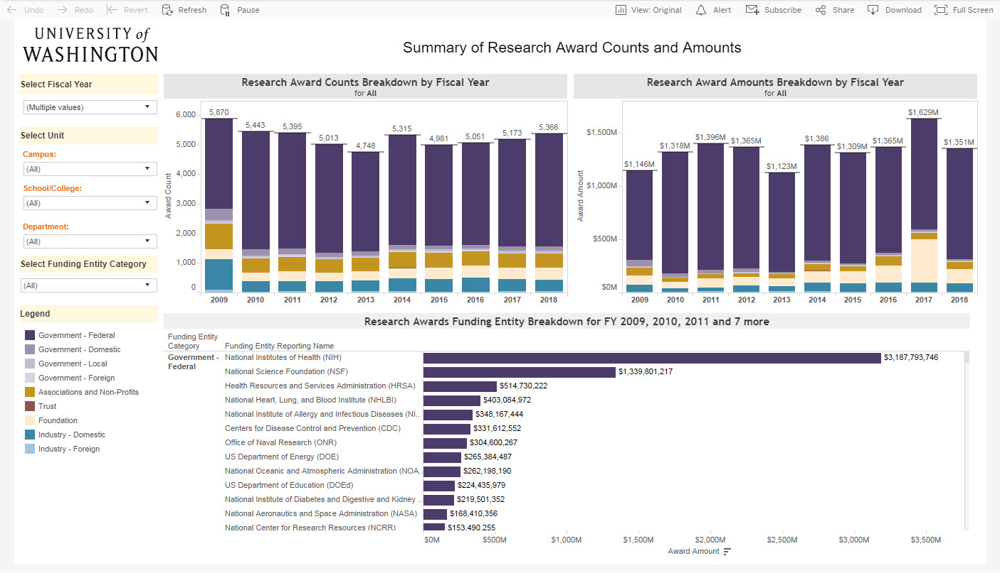
VISUALIZATIONS
SUMMARY OF RESEARCH AWARD COUNTS & AMOUNTS
The Award Count is a count of the Funding Actions on an awarded Proposal
It looks a lot like the previous one! They could be compared side by side
Filters: fiscal year, campus, school/college, department, funding entity category

Slide 12
VISUALIZATIONS
Why use visualizations?
Easy to read and interactive dashboards of RAD
Each visualization has overview with a description and functionality info
Simple filters like date range and college and/or department
Easy to customize, share a copy of your filtered dashboard, download as image, PDF, or PPT a slide
CURRENT RAD VISUALIZATIONS:
Sponsored Research Highlights
Proposal counts and amounts
Award counts and amounts
Comparison of Research Direct and Indirect Expenditures
Summary of Research Total Expenditures by Funding Entities
Overview of Research Total Expenditures

Slide 13
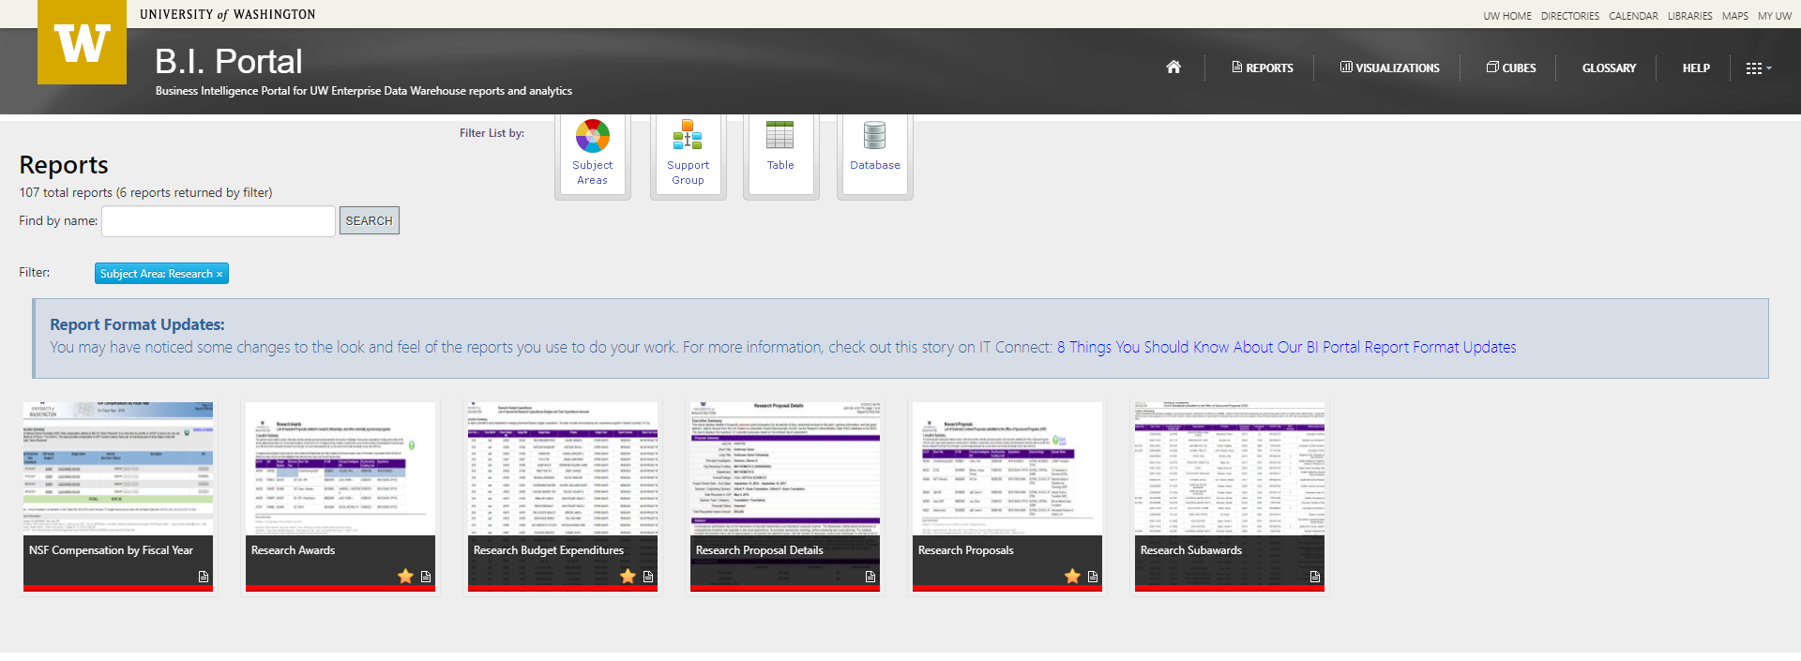
REPORTS
Notes:
Reports - less constructed data views, but more details
Class Hands-On
Note: Slide packet will include information on all of the RAD Reports covered during the hands-on session

Slide 14
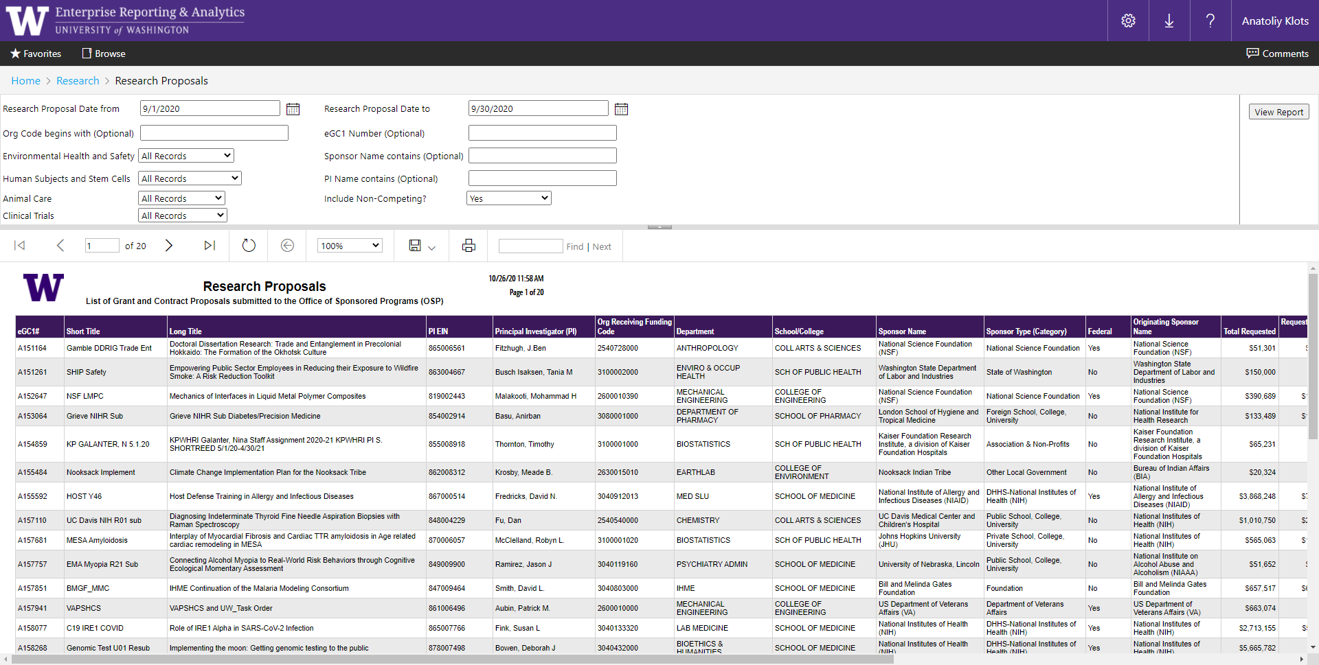
REPORTS
RESEARCH PROPOSALS
A list of all the proposals (SAGE eGC1s) that were submitted within (filtered) date range and reached at least the “In OSP” status

Slide 15
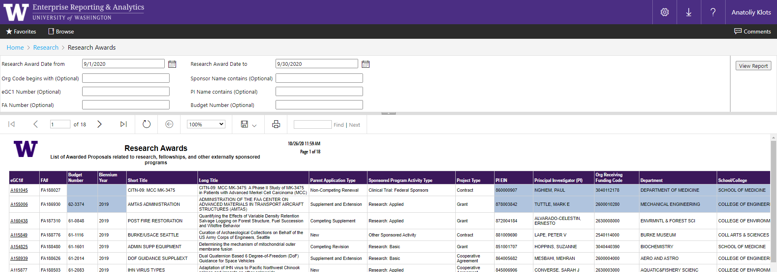
REPORTS
RESEARCH AWARDS
This report is a list of FAs enacted during the selected (filtered) date range

Slide 16
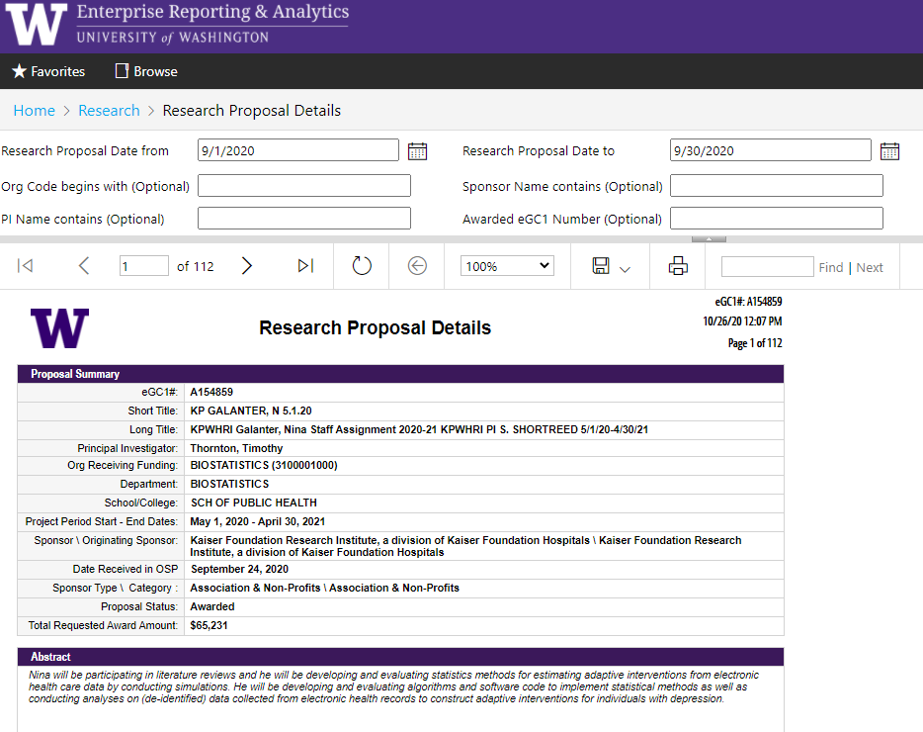
REPORTS
RESEARCH PROPOSAL DETAILS
This report is ideal as a snapshot of a proposal, particularly when first awarded
Each “page” of the report is a proposal, with associated details and FAs

Slide 17
REPORT DOWNLOADS to Excel
Notes:
This is a demo - NOT hands-on for the class
Demonstrates Report Downloads
Introduces what it will be like to work with the RAD Cube

Slide 18
REPORTS
RECAP
Detailed data in a spreadsheet format
Powerful filters including org code, PI name, and eGC1 number
Remember: each report has unique data limitations
REPORT AREAS:
Proposals
Awards
Subawards
Expenditures

Slide 19
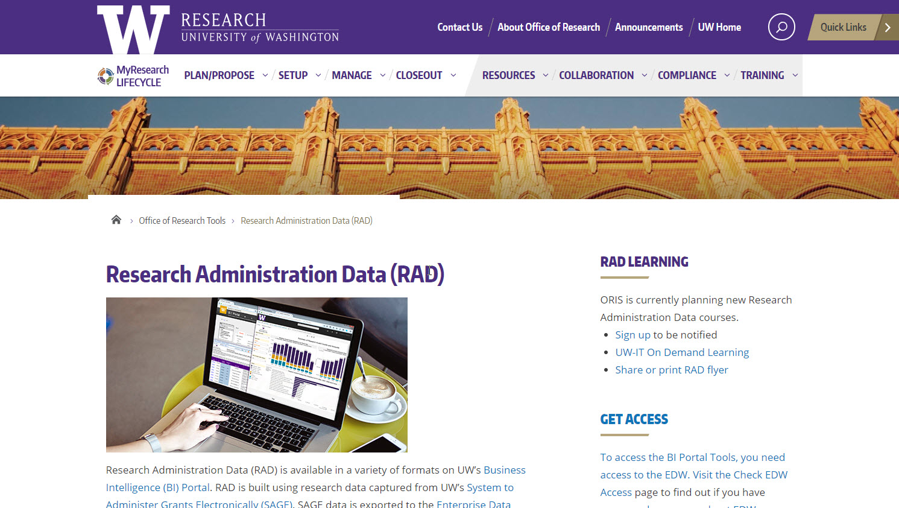
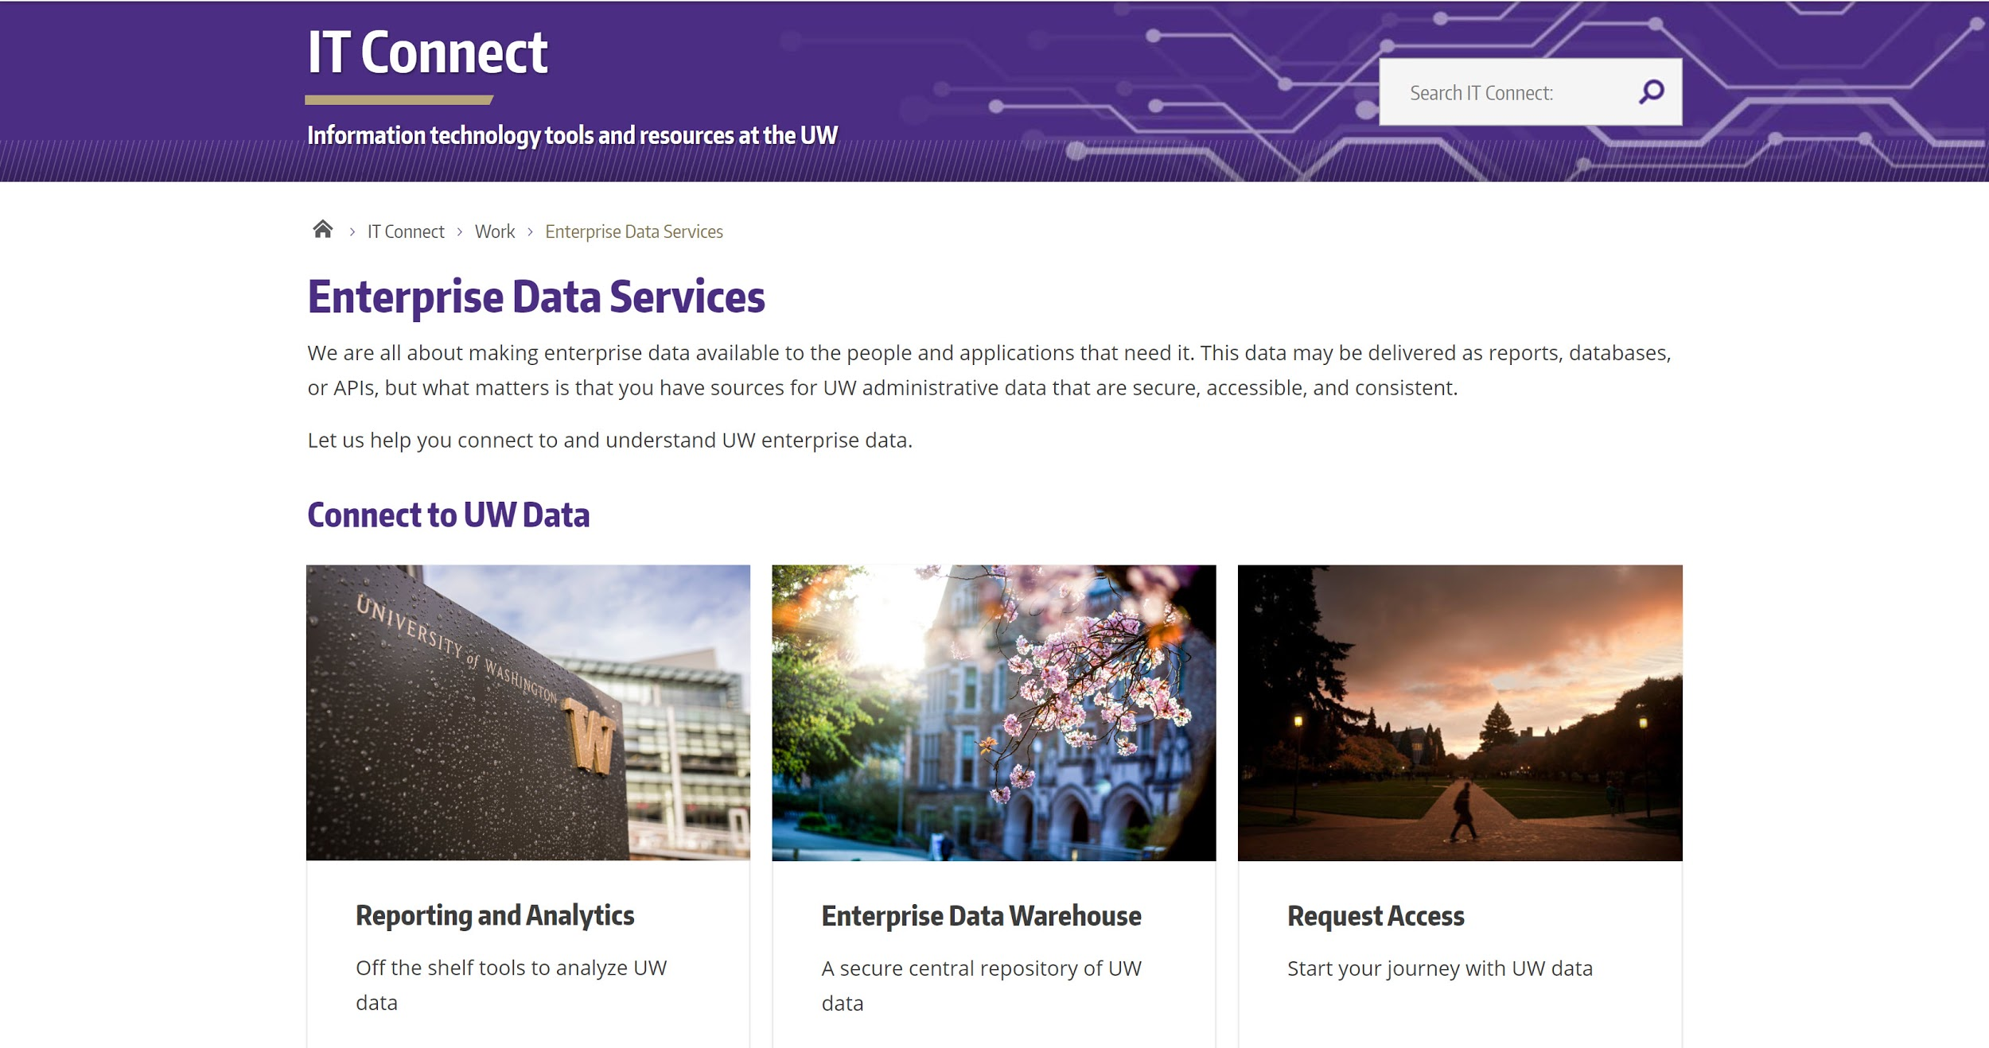
RESOURCES: WEBPAGES
Research Administration Data
Enterprise Information, Integration & Analytics
https://www.washington.edu/research/tools/research-administration-data-rad/
https://itconnect.uw.edu/work/decision-support/

Slide 20
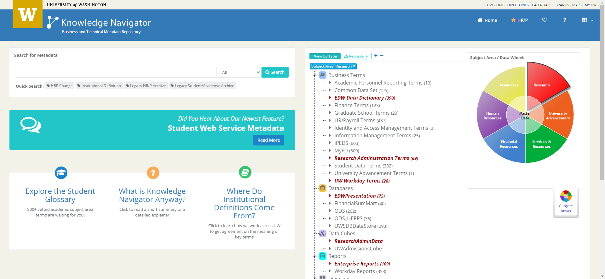
RESOURCES: EIIA and UW-IT
Knowledge Navigator
UW Data Definitions
Represents business terms visually and textually, highlighting linkages between old and new systems
Definitions are vetted and approved by data custodians
https://metadata.uw.edu/
Notes:
Knowledge Navigator displays business terms
and data relationships both visually and textually,
highlighting linkages between old and new systems.
Definitions are vetted and approved by data custodians

Slide 21
RESOURCES: HELP
Research Administration Data questions: grantrpt@uw.edu
Will go to ORIS Decision Support Services (DSS) team
Technical BI Portal questions, including how to connect: help@uw.edu
Put “EDW Question” in subject line
Will be forwarded to Enterprise Information, Integration and Analytics (EIIA) team

Slide 22
RESOURCES: UPCOMING TRAINING
CORE Training: Calendar & Course Descriptions
https://www.washington.edu/research/training/core/
Research Administration Data Cube Class
11/19/2020 (hybrid course)
Jeff Babauta, Director of Finance and Reporting

Slide 23
QUESTIONS?
Thank you!

