Slide 1
MRAM | Monthly Research Administration Meeting
December 10, 2020 9:00 AM – 10:30 AM HOSTED REMOTELY Join the LIVE Webinar: https://washington.zoom.us/j/346891888
TOPIC | PRESENTER | EMAIL | MIN
Welcome | Kirsten DeFries Research Compliance & Operations | kirsten5@uw.edu | 2
Federal Relations Update | Sarah Castro Office of External Affairs | smcastro@uw.edu | 15
Research Terms & Conditions | Matt Gardner Post Award Fiscal Compliance | gcafco@uw.edu | 5
Human Subjects Updates: e-Consent, subject payment, & COVID planning | Karen Moe Human Subjects Division | kemoe@uw.edu | 15
FY20 National Defense Authorization Act (NDAA): Covered Telecommunications Equipment and Services | Ray Hsu, Claudia Christensen, Kassy Ellefson Procurement | rayhsu@uw.edu claudiac@uw.edu ellefson@uw.edu | 15
Export Control review of eGC1s | Mark Stomski Office of Research | stomski@uw.edu | 5
CORE Training Update | Laurie Stephan, Andra Sawyer Collaborative On Research Education (CORE) | corehelp@uw.edu | 10
CARES Act Funding Tracking | Matt Gardner Post Award Fiscal Compliance | gcafco@uw.edu | 10
GCA Updates | Liz Lee Grant & Contract Accounting | gcahelp@uw.edu | 5
NEXT MEETING January 14, 2021 9:00 AM - 10:00 AM

Slide 2
Federal Relations Update
MRAM
December 2020
Sarah Castro
Director of Federal Relations

Slide 3
UPDATED RESEARCH TERMS & CONDITIONS
MRAM
December, 2020
Matt Gardner
Post Award Fiscal Compliance

Slide 4
Updated Research Terms & Conditions (RTCs)
What are the RTCs?
Several participating federal agencies attempted to create a streamlined and consistent implementation of the federal regulations (Uniform Guidance)
The RTCs live on the NSF website and contain:
Overlay to 2 CFR 200
Prior Approval Matrix
Subaward Requirements
National Policy Requirements
https://www.nsf.gov/awards/managing/rtc.jsp
MRAM – Matt Gardner – PAFC

Slide 5
Updated Research Terms & Conditions (RTCs)
RTC Participating Agencies:
National Aeronautics & Space Administration (NASA)
National Institutes of Health (NIH)
National Science Foundation (NSF)
Dept. of Agriculture/NIFA (USDA)
Dept. of Commerce (DOC)
Dept. of Energy (DOE)
Dept. of Homeland Security (DHS)
Grants & Financial Assistance Division (GFAD)
Federal Emergency Management Agency (FEMA)
MRAM – Matt Gardner – PAFC

Slide 6
Updated Research Terms & Conditions (RTCs)
Updated RTCs effective November 12, 2020
Adopted the recent revisions to 2 CFR 200 - Uniform Guidance
Issued updated Agency Implementation Statements
These statements by the Agencies indicate to which awards the RTCs apply and the effective dates.
Issued an updated Prior Approval Matrix
MRAM – Matt Gardner – PAFC

Slide 7
Research Terms & Conditions:
Prior Approval Matrix
The Prior Approval Matrix indicates whether prior written approval is required for a variety of Award actions and expenditures
The requirements for prior approval differ from agency to agency
The Prior Approval Matrix can be found at: https://www.nsf.gov/bfa/dias/policy/fedrtc/appendix_a.pdf
MRAM – Matt Gardner – PAFC

Slide 8
Prior Approval Matrix: Notable Changes
Dept. of Homeland Security (DHS) has added prior approval requirements for Awards issued by:
Grants & Financial Assistance Division (GFAD), and
Federal Emergency Management Agency (FEMA)
The DHS requirements tend to be stricter than the other RTC agencies. For example, DHS requires prior approval before:
Using Unrecovered Indirect Costs (UIDC) to meet cost share
Incurring allowable pre-award costs
If you have Awards from DHS, please review the RTCs and the Prior Approval Matrix.
MRAM – Matt Gardner – PAFC

Slide 9
Prior Approval Matrix: Notable Changes
NASA made several changes
Prior written approval is now required on NASA Awards for:
Changes in cost sharing
Issuing a subaward
Rebudgeting funds out of the Participant Support category
The changes apply to all new NASA grants and cooperative agreements, and funding amendments on existing grants and cooperative agreements.
MRAM – Matt Gardner – PAFC

Slide 10
References
RTC Overlay: https://www.nsf.gov/bfa/dias/policy/fedrtc/rtcoverlay_nov20.pdf
Prior Approval Matrix: https://www.nsf.gov/bfa/dias/policy/fedrtc/appendix_a.pdf
Agency Implementation Statements: https://www.nsf.gov/bfa/dias/policy/fedrtc/agencyimpstatements_nov20.pdf
MRAM – Matt Gardner – PAFC

Slide 11
Questions
Post Award Fiscal Compliance (PAFC)
gcafco@uw.edu
https://finance.uw.edu/pafc/
Andra Sawyer
andra2@uw.edu
Matt Gardner
mgard4@uw.edu
Available for calls via Teams and/or Zoom
MRAM – Matt Gardner – PAFC

Slide 12
Human Subjects Update: e-Consent, Subject Payment & COVID Planning
Karen Moe, Director, Human Subjects Division
MRAM Meeting
December 10, 2020

Slide 13
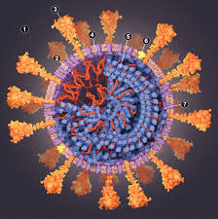
Planning for COVID-19 possibilities
Researchers should plan for what they would do if restrictions must be re-imposed on human subjects research.
Examples
UW Medicine restrictions on research that occurs in UW Medicine clinical units
Additional IRB restrictions on research that requires close in-person interactions with subjects

Slide 14
E-Consent
Using an electronic system to
Provide information to prospective subjects
Facilitate comprehension and time to consider
Document consent
A valuable option
Minimizes in-person contact (COVID-19)
Expands possibilities for who can be subjects
Increases efficiency
Increases regulatory compliance

Slide 15
E-consent project, now completed
Goals
Expand e-consent methods available for UW research
Offer an e-consent method that meets FDA requirements
Offer an e-consent method that can also be used for HIPAA authorization
Ensure that UW e-consent methods meet all federal and state requirements for electronic signatures
Partial list of project participants
HSD, School of Medicine (ITHS; Compliance), UW Medicine (Compliance; HIPAA), UW Attorney General’s Office

Slide 16
New Option
Use the UW ITHS REDCap e-signature function to obtain and store legally valid electronic consent signatures.
A web-based application for research electronic data capture. Already used to
Administer recruiting or data surveys
Collect data
Track adverse events
Create longitudinal studies with automatic follow-up surveys
Administer multi-site studies
UW ITHS provides exceptional support and training for REDCap.
https://www.iths.org/investigators/services/bmi/redcap/

Slide 17
Requirements for REDCap e-consent
Obtain specific IRB approval to use it
Use one of the ITHS REDCap e-consent signature templates
Include required additional consent information specific to electronic signatures (see HSD’s consent template & consent guidance)
Retain the signed consent form in REDCap

Slide 18
Studies reviewed by other IRBs instead of the UW IRB
E-consent option can be used only if allowed by that IRB.
Examples
Fred Hutch IRB: Only for minimal risk studies.
Seattle Childrens IRB: Contact the IRB office.
WIRB (WCG IRB): Allowed
Advarra IRB: Allowed

Slide 19
More Information
ITHS REDCap site
https://www.iths.org/investigators/services/bmi/redcap/
HSD e-consent guidance
https://www.washington.edu/research/policies/guidance-electronic-informed-consent/
Required consent elements also provided in HSD standard consent template
https://www.washington.edu/research/forms-and-templates/template-consent-form-standard/

Slide 20
Subject Payment: New guidance
GUIDANCE Subject Payment is a HSD webpage that provides detailed guidance for designing and evaluating research subject payments.
https://www.washington.edu/research/hsd/special-topics/subject-payment/
Specific tips
IRB concerns such as “undue influence” on subjects’ decisions about participating in research
Based on recent work by prominent bioethicists which offers compelling reasons why IRBs have often been too conservative on this issue

Slide 21
Context for this new guidance
The most frequently mentioned source of confusion in the last campus satisfaction survey
With this guidance, HSD has now completed its work on all of the issues identified in that survey. Examples:
Guidance: Return of Results
Guidance: Single IRB
Video tutorial: Getting Started in Zipline
Zipline instructions: shorter, more navigable
Improved options for e-consent
Thank you for helping us to identify what would be helpful to you!

Slide 22
National Defense Authorization Act: Prohibition on covered telecommunications products/services
December, 2020 MRAM
Ray Hsu
Procurement Services

Slide 23
National Defense Authorization Act (NDAA)
Section 889:
Prohibits agencies from entering into contracts with entities (such as the UW) that use equipment, systems, or services that integrate “covered” telecommunications equipment or services deemed to be a “substantial or essential component of any system” or “critical technology as part of any system.”
e.g. covered entity =Huawei and others
Prohibits use of federal funding to procure or obtain “covered” telecommunications equipment or services
Effective August 13, 2020
Notes:
Thank you for the opportunity to provide an update on actions our office (Procurement Services) has taken ensure compliance with this Act. As many of you may know, this requirements applies to all new acquisitions and renewals.

Slide 24
Procurement Service Implementation
Flowdown clauses updated to include FAR 52.204.24-26
Automatically referenced on all Ariba orders using federal funds, regardless of dollar value.
Internal Purchasing and Policy 7.1.3 updated
Standard solicitation language requires bidder to certify their compliance.
Standard language created to incorporate into contract extensions.
Ariba order variable (added by Buying staff to orders) updated to reference FAR 52.204.24-26.
Category added to Exception List
Ariba order process prompts purchasers to acknowledge they reviewed the exception list.
Notes:
Actions

Slide 25
Procurement Service Implementation
WEB PAGE UPDATES
Procurement Webpages updated to call out this requirement
How to Buy Page
General Terms and Conditions
Procard Webpage updated to alert purchasers to this requirement
Statement links to OSP guidance for PIs
Notes:
Actions take to communicate

Slide 26
Questions

Slide 27
Export Control review of eGC1s
MRAM
December 2020
Mark Stomski
Office of Research - Export Controls

Slide 28
CORE TRAINING UPDATE
MRAM December 2020
Laurie Stephan, CORE core@uw.edu
Andra Sawyer, PAFC andra2@uw.edu

Slide 29
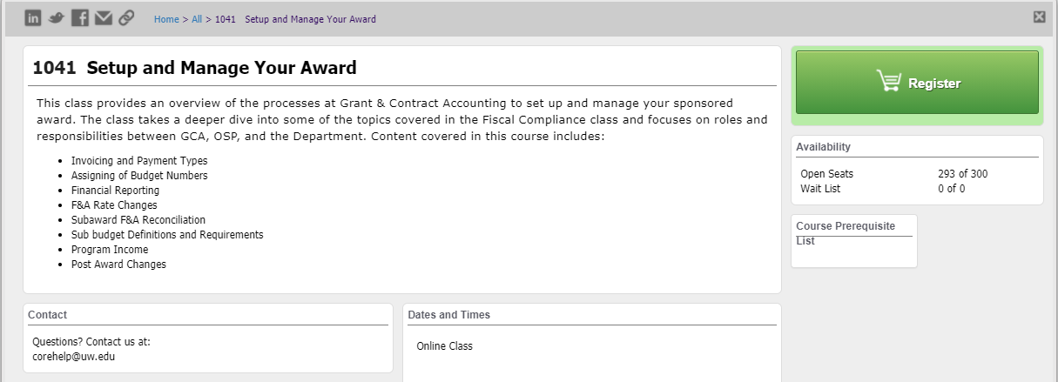
Setup and Manage Your Award
Available On-Demand!
No longer offered live
Companion class, “Processes at Award Closeout” under development
Notes:
Laurie –we are pleased to be able to announce that the class “Setup and Manage Your Award” taught by Matt Gardner which is part of the CORE certificate in Research Administration is now an on-demand course. This means you can take it anytime. You no longer have to wait for it to be scheduled as part of our in-person offerings. The course consists of a series of video lectures delivered by Matt and each lecture follows with Knowledge Checks. There is new content in the class and Matt goes into depth in some topics he didn’t have time to visit thoroughly in the in-person class.

Slide 30
Course Recordings in Two Locations
Different locations for different purposes:
CORE class—formal learning toward credential
Stand Alone on the PAFC and GCA websites for contextual learning
Notes:
This is the first time we are doing this. And we are doing it to meet the different learning goals of different users. There are users who want this content to help them gain a credential proving their understanding of the practice of research administration at the UW. Through CORE this is achieved by tracking completion of activities that show a formal understanding of basic concepts. The second group of users we are catering to are those for whom this content is best accessed on the job at the moment one needs assistance or knowledge. Both purposes are valid and should be met. In the best of all scenarios the same video would meet both purposes. Unfortunately our learning management systems being where they are, we can not meet both needs with one resource. Therefore we’ve made the resources available in two places. Let me explain a little bit more about the formal learning through CORE, what that looks like. Andra will expand on the contextual learning format.

Slide 31
CORE Course Content
Goals:
Gain big picture of research administration activity in this area
Consolidate learning through Knowledge Checks
Gain credit toward the Research Administration Certificate
Notes:
Laurie

Slide 32
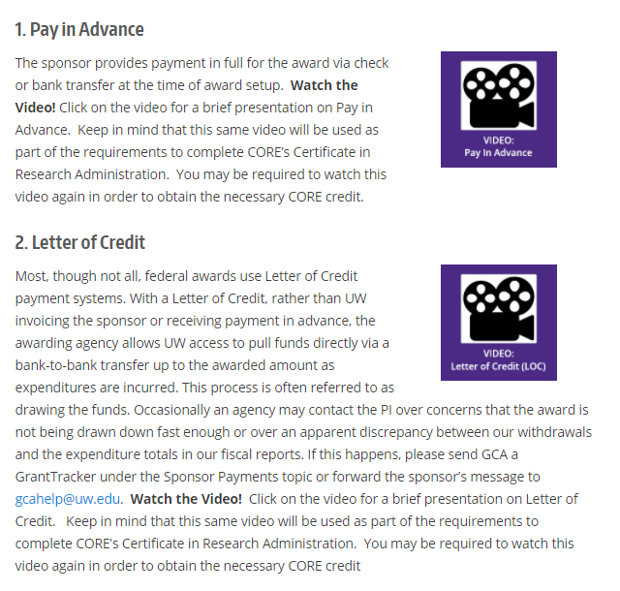
Stand Alone Videos
Embedded in GCA webpages to be available for review as needed
Same content
No registration
No Knowledge Checks
Notes:
Andra takes over

Slide 33
What this Means..
You may end up having to watch a video more than once.
Let’s use a Scenario…
Notes:
Andra

Slide 34
Scenario: Contextual Learning
In December 2020 you receive a new Award and are told by GCA that there will be multiple budget numbers on this Award. You are curious as to why so you go to the GCA webpage and watch the video.
Notes:
Andra

Slide 35
Scenario: Formal Learning
In March 2021 you take the on-demand CORE class “Set Up & Manage Your Award” and one of the modules is “Budget Numbers” and you say:
“Wait a minute…. haven’t I seen this already?”
Notes:
Andra

Slide 36
Scenario Answer: Yes
Yes, you may have to watch the video again (without the option to fast forward through it) and this time complete the Knowledge Check to receive credit.
Notes:
Andra

Slide 37
Cost Share Videos
Embedded on the GCA webpage:
https://finance.uw.edu/gca/cost-share
PAFC Training webpage:
https://finance.uw.edu/pafc/cost-share-videos
Notes:
Andra

Slide 38
Questions?
CORE:
corehelp@uw.edu
PAFC:
gcafco@uw.edu
Notes:
Andra

Slide 39
UPDATE: CARES ACT FUNDING AND COVID RESEARCH
MRAM December 2020
Matt Gardner
Post Award Fiscal Compliance
gcafco@uw.edu

Slide 40
Federal Appropriations/Aid Related to COVID
Three Acts of Congress relating to funding due to the impacts from COVID:
Coronavirus Preparedness and Response Supplemental Appropriations Act, 2020 (PL 116-123)
Coronavirus Aid, Relief, and Economic Security (CARES) Act (PL 116-136)
Paycheck Protection Program and Health Care Enhancement Act (PL 116-139)
MRAM – Matt Gardner – PAFC

Slide 41
Federal Appropriations Related to COVID
OMB has instructed federal agencies to separately track and report funding from the “Three Acts”.
UW will also track funds from the “Three Acts” because:
If federal agencies are tracking funds separately, it is prudent for UW to follow their lead.
High probability these funds are audited in the future; separate accountability is critical to preparing for an audit.
MRAM – Matt Gardner – PAFC

Slide 42
COVID Research Not Funded by the “Three Acts”
There may (will) be Awards which are classified as “COVID Research” that are not funded by the “Three Acts”
Example: COVID research funded via a non-federal sponsor/non-federal funds
UW will also track overall research related to COVID
MRAM – Matt Gardner – PAFC

Slide 43
Update of GCA actions for Tracking CARES and/or COVID funding
Last month, GCA reviewed Notice of Awards and applicable documentation and took the following actions:
Activated Grant Control Flags for Awards with “Three Acts” or COVID funding
Set up sub budgets, when applicable, in order to ensure separate accountability for funding under the “Three Acts”.
Going forward – GCA will continue to review all incoming Notice of Awards to determine if GCFs or sub budgets are required.
GCA will notify campus units if a sub budget is required to separately track funding.
MRAM – Matt Gardner – PAFC

Slide 44
Questions
Grant and Contract Accounting
gcahelp@uw.edu
https://finance.uw.edu/gca/gca-home
MRAM – Matt Gardner – PAFC

Slide 45
GCA Updates
December 2020 MRAM
Liz Lee

Slide 46
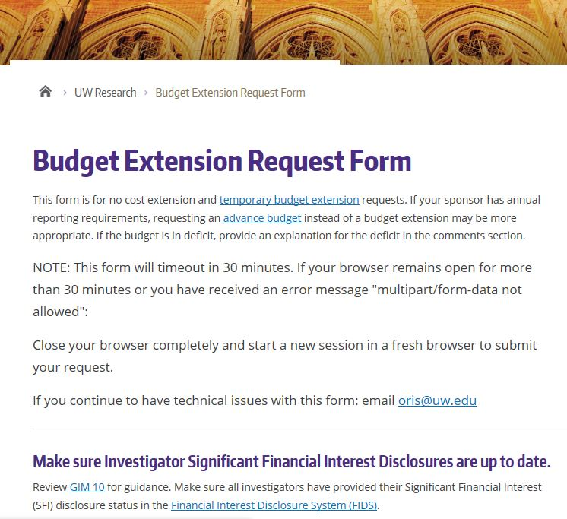
New! GCA Receiving NCE/TBE’s Notification
GCA and OSP are working together on No Cost Extension and Temporary Budget Extension Requests
GCA is now cc’d on requests
Gives us an idea of what to expect
We may reach out via GT if formal extension has not been processed prior to closeout
Request Form: https://www.washington.edu/research/myresearch-lifecycle/manage/award-changes/budget-extensions/#request

Slide 47
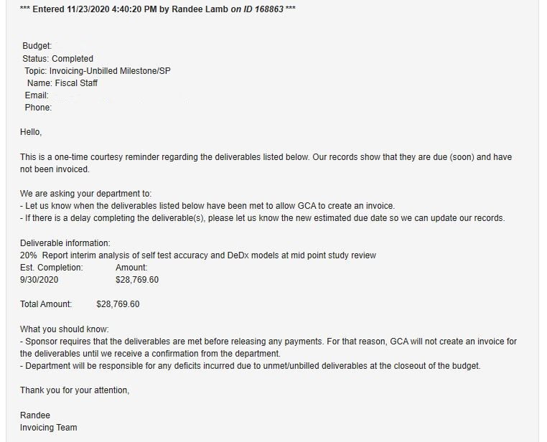
New! Milestone Communication via Grant Tracker
Courtesy reminder approximately one month prior to deliverable due date
No longer following up on unanswered Grant Tracker notes

Slide 48
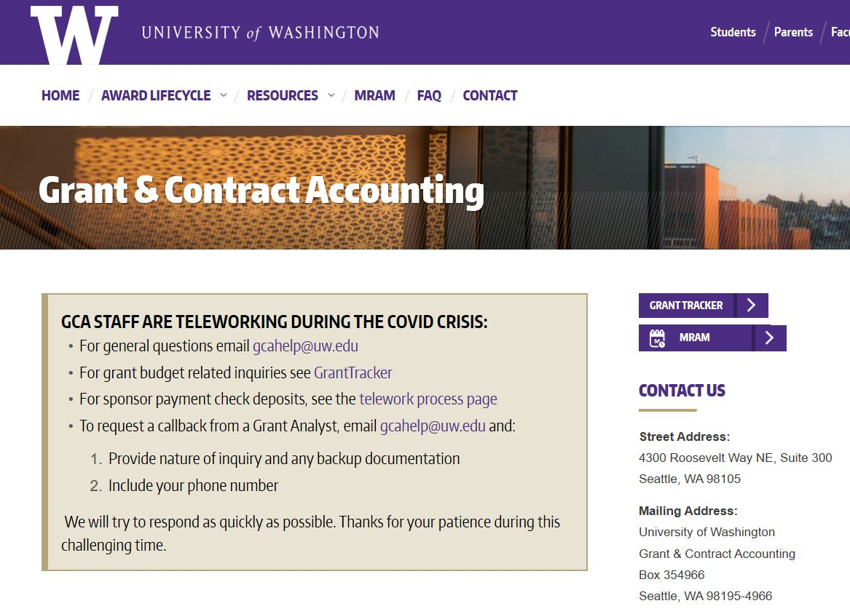
GCA Website Under Construction
Revising the entire website!
Updating/formatting material
Information is still available, may look different than normal
Recent Updates
Cost Share Page/ New Videos
FAQ’s
VA Invoicing Webpage
We invite feedback and suggestions!
GCA Webpage: https://finance.uw.edu/gca/gca-home

Slide 49
Questions?
gcahelp@uw.edu

