Slide 1
CORE TRAINING UPDATE
MRAM December 2020
Laurie Stephan, CORE core@uw.edu
Andra Sawyer, PAFC andra2@uw.edu

Slide 2
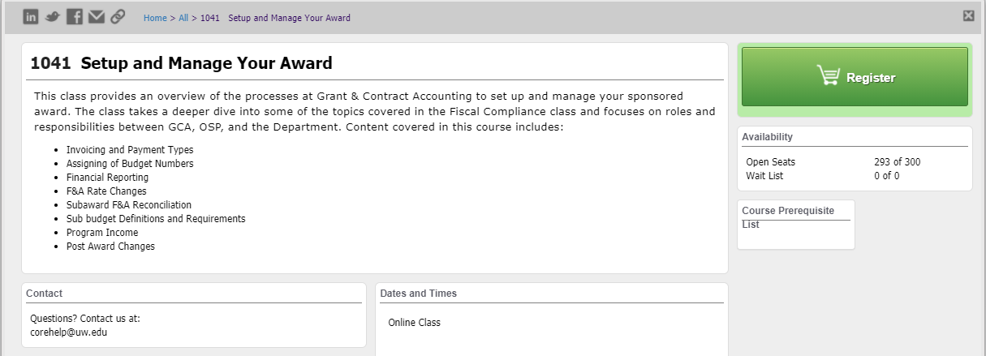
Setup and Manage Your Award
Available On-Demand!
No longer offered live
Companion class, “Processes at Award Closeout” under development
Notes:
Laurie –we are pleased to be able to announce that the class “Setup and Manage Your Award” taught by Matt Gardner which is part of the CORE certificate in Research Administration is now an on-demand course. This means you can take it anytime. You no longer have to wait for it to be scheduled as part of our in-person offerings. The course consists of a series of video lectures delivered by Matt and each lecture follows with Knowledge Checks. There is new content in the class and Matt goes into depth in some topics he didn’t have time to visit thoroughly in the in-person class.

Slide 3
Course Recordings in Two Locations
Different locations for different purposes:
CORE class—formal learning toward credential
Stand Alone on the PAFC and GCA websites for contextual learning
Notes:
This is the first time we are doing this. And we are doing it to meet the different learning goals of different users. There are users who want this content to help them gain a credential proving their understanding of the practice of research administration at the UW. Through CORE this is achieved by tracking completion of activities that show a formal understanding of basic concepts. The second group of users we are catering to are those for whom this content is best accessed on the job at the moment one needs assistance or knowledge. Both purposes are valid and should be met. In the best of all scenarios the same video would meet both purposes. Unfortunately our learning management systems being where they are, we can not meet both needs with one resource. Therefore we’ve made the resources available in two places. Let me explain a little bit more about the formal learning through CORE, what that looks like. Andra will expand on the contextual learning format.

Slide 4
CORE Course Content
Goals:
Gain big picture of research administration activity in this area
Consolidate learning through Knowledge Checks
Gain credit toward the Research Administration Certificate
Notes:
Laurie

Slide 5
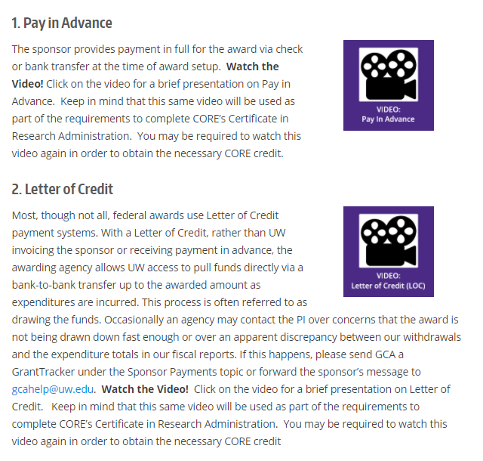
Stand Alone Videos
Embedded in GCA webpages to be available for review as needed
Same content
No registration
No Knowledge Checks
Notes:
Andra takes over

Slide 6
What this Means..
You may end up having to watch a video more than once.
Let’s use a Scenario…
Notes:
Andra

Slide 7
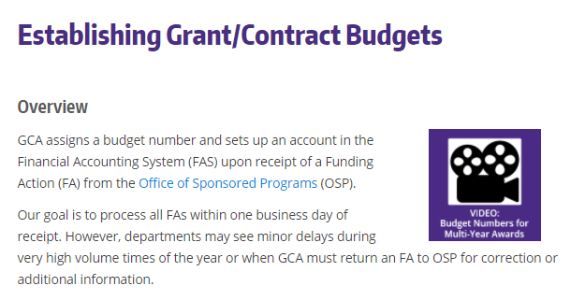
Scenario: Contextual Learning
In December 2020 you receive a new Award and are told by GCA that there will be multiple budget numbers on this Award. You are curious as to why so you go to the GCA webpage and watch the video.
Notes:
Andra

Slide 8
Scenario: Formal Learning
In March 2021 you take the on-demand CORE class “Set Up & Manage Your Award” and one of the modules is “Budget Numbers” and you say:
“Wait a minute…. haven’t I seen this already?”
Notes:
Andra

Slide 9
Scenario Answer: Yes
Yes, you may have to watch the video again (without the option to fast forward through it) and this time complete the Knowledge Check to receive credit.
Notes:
Andra

Slide 10
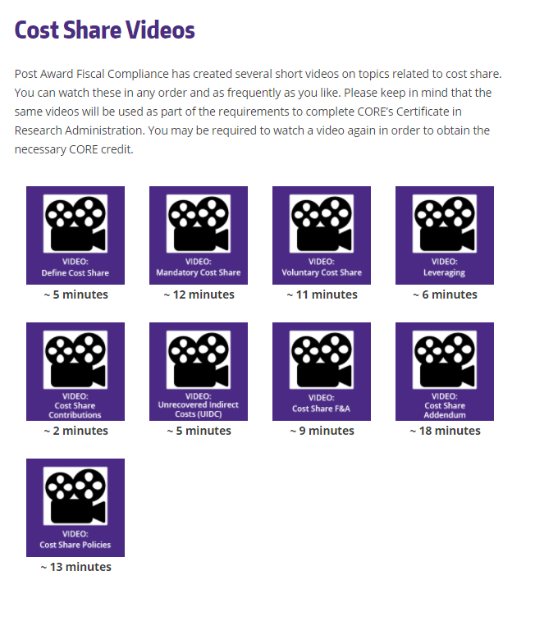
Cost Share Videos
Embedded on the GCA webpage:
https://finance.uw.edu/gca/cost-share
PAFC Training webpage:
https://finance.uw.edu/pafc/cost-share-videos
Notes:
Andra

Slide 11
Questions?
CORE:
corehelp@uw.edu
PAFC:
gcafco@uw.edu
Notes:
Andra

