Slide 1
GCA Updates
December 2020 MRAM
Liz Lee

Slide 2
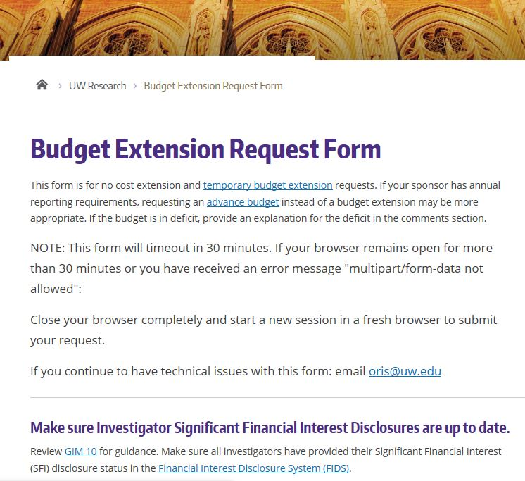
New! GCA Receiving NCE/TBE’s Notification
GCA and OSP are working together on No Cost Extension and Temporary Budget Extension Requests
GCA is now cc’d on requests
Gives us an idea of what to expect
We may reach out via GT if formal extension has not been processed prior to closeout
Request Form: https://www.washington.edu/research/myresearch-lifecycle/manage/award-changes/budget-extensions/#request

Slide 3
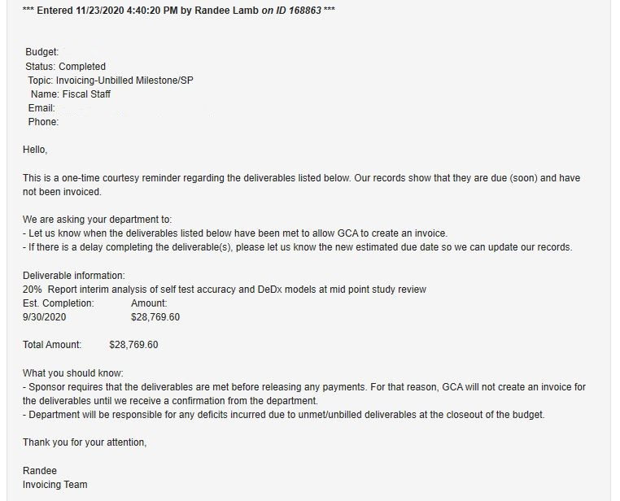
New! Milestone Communication via Grant Tracker
Courtesy reminder approximately one month prior to deliverable due date
No longer following up on unanswered Grant Tracker notes

Slide 4
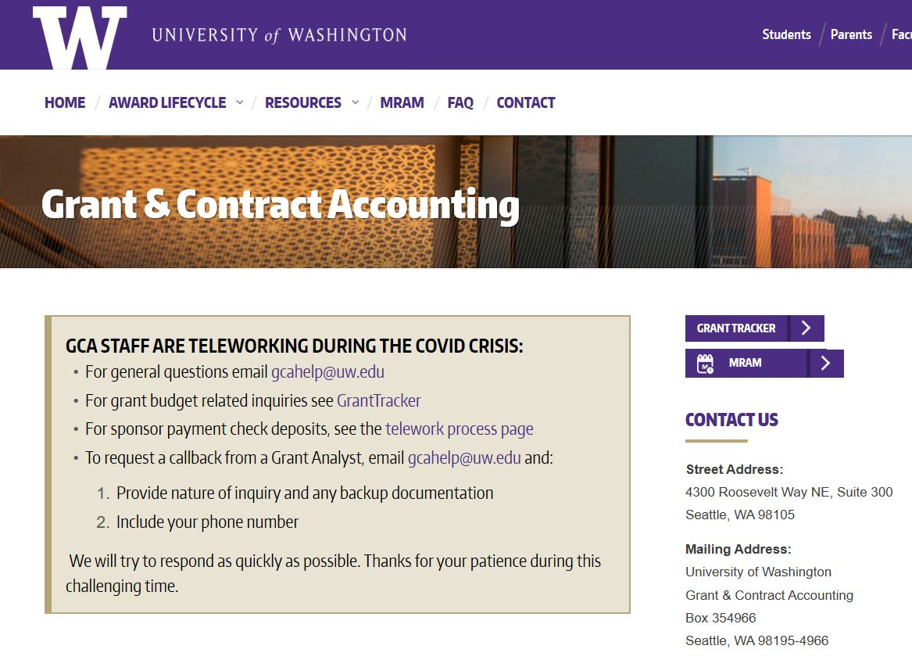
GCA Website Under Construction
Revising the entire website!
Updating/formatting material
Information is still available, may look different than normal
Recent Updates
Cost Share Page/ New Videos
FAQ’s
VA Invoicing Webpage
We invite feedback and suggestions!
GCA Webpage: https://finance.uw.edu/gca/gca-home

Slide 5
Questions?
gcahelp@uw.edu

