Slide 1
MRAM | Monthly Research Administration Meeting
January 14, 2021 9:00 AM – 10:00 AM HOSTED REMOTELY Join the LIVE Webinar: https://washington.zoom.us/j/346891888
TOPIC | PRESENTER | EMAIL | MIN
Welcome | Kirsten DeFries Research Compliance & Operations | kirsten5@uw.edu | 2
Fetch the Future - Rethink the Ink | Barbara Benson Records Management Services | recmgt@uw.edu | 15
China Telecommunications Restrictions | Andra Sawyer, Matt Gardner Post Award Fiscal Compliance | gcafco@uw.edu | 10
Addendum on COVID Funding to the Compliance Supplement | Matt Gardner Post Award Fiscal Compliance | gcafco@uw.edu | 5
Federal Reporting of Outside Research Work | Joe Giffels Office of Research | jgiffels@uw.edu | 10
GIM 8: Subrecipient Monitoring Updates | Amanda Snyder Office of Sponsored Programs | acs229@uw.edu | 5
Grant Tracker Updates | Azalea Vasquez Grant & Contract Accounting | gcahelp@uw.edu | 10
CORE Update | Amanda Snyder Collaborative On Research Education (CORE) | corehelp@uw.edu | 2
NEXT MEETING February 11, 2021 9:00 AM - 10:00 AM

Slide 2
Fetch the Future - Rethink the Ink
MRAM
January 2021
Barbara Benson
Records Management Services

Slide 3
Restrictions on Purchases of Telecommunications Equipment and Services on Federal Awards
MRAM
January 2021
Andra Sawyer
Post Award Fiscal Compliance
andra2@uw.edu
gcafco@uw.edu

Slide 4
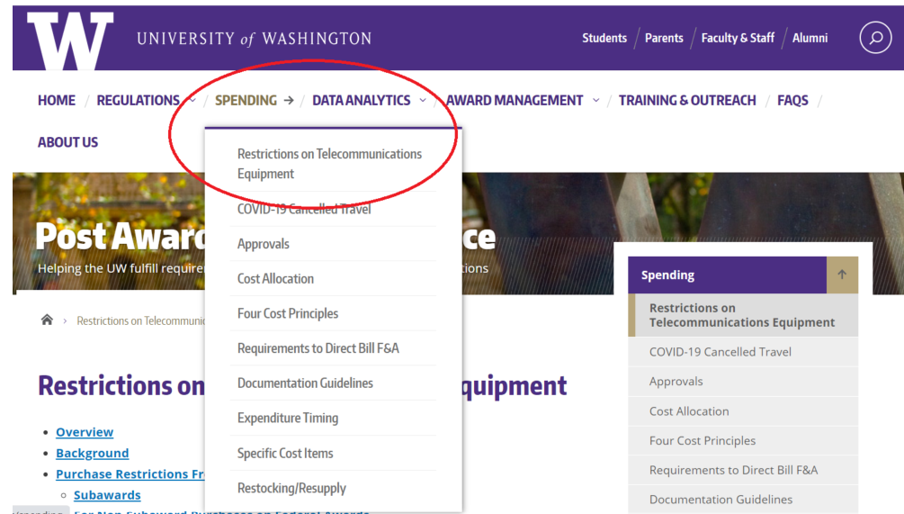
Telecommunications Restrictions: UW Policy
UW policy: https://finance.uw.edu/pafc/restrictions-telecommunications-equipment
Notes:
Show where policy is on the web

Slide 5
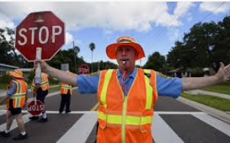
But first…
Legislation, not executive order
Effective 13 August 2020
FAR 52.204-25 (contracts)
2 CFR 200.216 & 200.471 (grants & cooperative agreements)

Slide 6
What is it?
Federal award funds may not be used to pay for or use, either as a direct or indirect cost:
“Covered equipment & services”…
Deemed to be a “substantial or essential component of any system” or “critical technology as part of any system”…
From “restricted companies.”

Slide 7
Translation
UW can’t use federal funds to pay for or use gizmos produced by specific companies.
Applies to:
Direct costs on a federal award
Indirect costs (because feds pay indirect)
Made via:
purchases & subawards

Slide 8
Advice: Direct & Indirect Costs
Gizmos? Do not purchase or use any items produced by any restricted company.
A current list of restricted companies is available at www.sam.gov. You can also search for a particular company.

Slide 9
PAFC Web Page: SAM.gov…

Slide 10
Restricted Company Example…

Slide 11
Purchases
Compliance is up to individual units making purchases via:
Ariba
Procard
Individual reimbursement
Review the SAM website for a list of restricted companies, or to search for a particular company, prior to initiating or approving purchases.

Slide 12
Subawards
OSP’s routine subrecipient monitoring includes reviewing SAM prior to issuing a subaward.
OSP will flow down the requirements as part of any subaward subject to the restrictions.

Slide 13
Existing Agreements
Effective as of 13 August 2020, expenditures for covered telecommunications equipment and services cannot be made on federal awards.
Contact OSP if your federal award cannot continue without the use of covered equipment or services.
Note: There is a waiver process for certain procurement activity on federal contracts, but not on federal assistance funding.

Slide 14
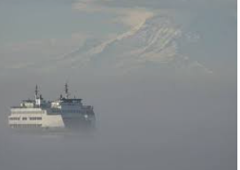
Personal Equipment
Use of personal telecommunications equipment (which is discouraged) from a restricted company to support work on a federal award could be considered a violation.
It depends on whether it is a substantial or essential component or critical technology of the program.

Slide 15
Not Subject to Restriction
Purchases on funding sources that do not have such restrictions and….
…where equipment or services are not a substantial or essential component or critical technology of the program.

Slide 16
Questions?
PAFC: gcafco@uw.edu
Subawards: ospsubs@uw.edu

Slide 17
ADDENDUM TO THE COMPLIANCE SUPPLEMENT
MRAM
January, 2021
Matt Gardner
Post Award Fiscal Compliance

Slide 18
Addendum to the Compliance Supplement
Provides additional guidance to the 2020 Compliance Supplement related to COVID-19 funding and impacts from COVID-19
Released December 21, 2020
Effective for audits of fiscal years beginning on or after June 30, 2019
MRAM – Matt Gardner – PAFC

Slide 19
Addendum to the Compliance Supplement –
Key Takeaways
No substantial changes to audit directives; auditors will test compliance with:
Cost principles
Cash management
Effort
Equipment management
Program Income
Cost Share
Reporting
Procurement
MRAM – Matt Gardner – PAFC

Slide 20
Addendum to the Compliance Supplement –
Key Takeaways
Auditors are directed to consider agency guidelines for COVID flexibilities when evaluating compliance with regulations.
If your award implemented a COVID-19 flexibility allowed by your sponsor, be sure to document:
The specific agency flexibility which permits the transaction or action, and
Any communication with the sponsor
MRAM – Matt Gardner – PAFC

Slide 21
Compliance Supplement - References
2020 OMB Compliance Supplement:
https://www.whitehouse.gov/wp-content/uploads/2020/08/2020-Compliance-Supplement_FINAL_08.06.20.pdf
Addendum to the Compliance Supplement:
https://www.whitehouse.gov/wp-content/uploads/2020/08/2020-Compliance-Supplement_FINAL_08.06.20.pdf
PAFC Webpage on COVID-19 Flexibilities
https://finance.uw.edu/pafc/covid19-information-sponsored-awards
MRAM – Matt Gardner – PAFC

Slide 22
Draft NSF PAPPG
NSF issued a draft PAPPG with comments open until February 12, 2021
https://www.nsf.gov/bfa/dias/policy/papp/pappg22_1/FedReg/draftpappg_dec2020.pdf
Changes involve updating the guide with the revisions to the Uniform Guidance, including:
NDAA provision on purchases of certain telecommunications equipment
120-day closeout requirement
No other major changes from a post award fiscal compliance perspective
MRAM – Matt Gardner – PAFC

Slide 23
Questions
Post Award Fiscal Compliance (PAFC)
gcafco@uw.edu
https://finance.uw.edu/pafc/
Andra Sawyer
andra2@uw.edu
Matt Gardner
mgard4@uw.edu
We’re available for calls on Teams or Zoom. Email us to schedule a meeting.
MRAM – Matt Gardner – PAFC

Slide 24
FEDERAL REPORTING OF OUTSIDE RESEARCH WORK
MRAM
January 2021
Joe Giffels
Office of Research

Slide 25
NIH Other Support (existing regulation)
All Key Personnel
“… all resources made available to a researcher in support of and/or related to all of their research endeavors, regardless of whether or not they have monetary value …”
MRAM – Joe Giffels – Office of Research

Slide 26
Outside Work Meets Other Support…

Slide 27
NIH Other Support – Expectations for Outside Work (future state)
Employment with research at a foreign site
Translated employment contracts
Looking for scientific overlap
Sharing with law enforcement
Federal law enforcement database
MRAM – Joe Giffels – Office of Research

Slide 28
Outside Work for Compensation
Examples
Foreign employment, affiliation, appointment, providing mentorship, lectures, academic instruction as a “guest,” consultancy, etc.
For any form of compensation, including honoraria or in-kind
List in Other Support and/or Biosketch when it relates to Key Personnel’s research
MRAM – Joe Giffels – Office of Research

Slide 29
Not Yet – and this is what would be new
Documentation -- translated copy of foreign employment contract, appointment letter or other form of contract, even if only an e-mail agreement with the foreign entity
MRAM – Joe Giffels – Office of Research

Slide 30
How will we support compliance (future state)?
PI
Department
School/College
OR/OSP
MRAM – Joe Giffels – Office of Research

Slide 31
GIM 8: Subrecipient Monitoring
Updates
January, 2021 MRAM
Amanda Snyder
Office of Sponsored Programs

Slide 32
What is GIM 8?
UW policy on subrecipient monitoring
Incorporates federal rules (Uniform Guidance)
Covers both programmatic and entity-level monitoring

Slide 33
Why is it being updated?
We received feedback that language in GIM 8 was causing confusion
Invoice approval
Invoice processing in ARIBA

Slide 34
What do you need to know?
Does the PI need to personally approve all invoices from a subrecipient?
Yes
This approval is a component of programmatic subrecipient monitoring
Does the individual processing the invoice in ARIBA need delegated authority (GIM 2) from the PI to do so?
No
ARIBA user needs to have appropriate ASTRA role

Slide 35
Questions
OSP Subaward Team: ospsubs@uw.edu
Post Award Fiscal Compliance: gcafco@uw.edu
Notes:
Mention that update has been published to the web.

Slide 36
GCA Updates
MRAM
January 2021
Azalea Vasquez
Grant & Contract Accounting

Slide 37
Grant Tracker – Update to the Deficit Transfer Tool
The deficit transfer tool does not take into account the business rules for correctly processing a deficit for APL budgets, and budgets with indirect cost base 04 and 24.
APL budgets have Prorated Direct Costs and Fixed Fee
Base 04 and 24 limits indirect costs up to the amount of IDC allocated on the budget

Slide 38
Grant Tracker – Update to the Deficit Transfer Tool
If you have a budget that is in deficit you will now see the following message in Grant Tracker:

Slide 39
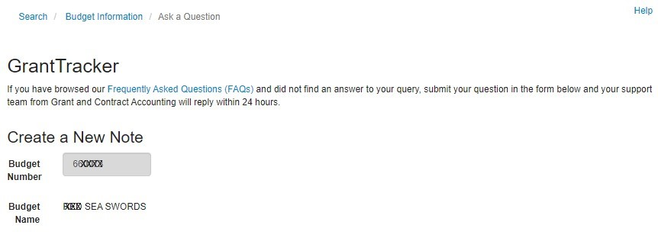
Grant Tracker – Update to the Deficit Transfer Tool
If you click on that link it will open a new Grant Tracker message which will make it easy for campus to contact us!

Slide 40
Revision to Calculating Final Action Date
Received feedback from Campus that the Final Action Date (FAD) was not calculating correctly for some budgets
This prompted a review of the business rules used in determining that date
We have finalized revised business rules, and are preparing to implement them on February 1, 2021

Slide 41
Revision to Calculating Final Action Date
In preparation for this change we will be moving reports that are currently listed under the parent budget to the appropriate sub budget(s) in Grant Tracker in January 2021.
This will only affect budgets whose awards require separate year accountability (e.g. Simons Foundation and American Heart Association)
This change is necessary so the correct Final Action Date can be shown on the sub budgets

Slide 42
Revision to Calculating Final Action Date
After the change has been implemented all the reports will still be viewable on the parent budget in GrantTracker, but the corresponding sub budget will be listed alongside each report.
Just a reminder – On April 1, 2020 GCA started setting up financial reports under the appropriate sub budget in GrantTracker.

Slide 43
Revision to Calculating Final Action Date
For budgets with a Temporary Budget Extension your Final Action Date will not change, but your budget will stay in FIN Status 1
Your FAD will update after we process the official No-Cost Extension Post Award Change (PAC) or Supplement/Extension Funding Action (FA)

Slide 44
Revision to Calculating Final Action Date
We will provide the new business rules on our Final Action Date web page which can be found here:
https://finance.uw.edu/gca/award-lifecycle/closing-your-award/final-action-date

Slide 45
Questions?
Contact GCA Help
gcahelp@uw.edu

Slide 46
CORE Update
MRAM
January 2021
Amanda Snyder
Collaborative On Research Education (CORE)

