Slide 1
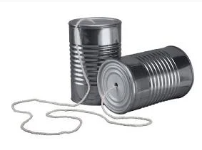
Restrictions on Purchases of Telecommunications Equipment and Services on Federal Awards
MRAM
January 2021
Andra Sawyer
Post Award Fiscal Compliance
andra2@uw.edu
gcafco@uw.edu

Slide 2
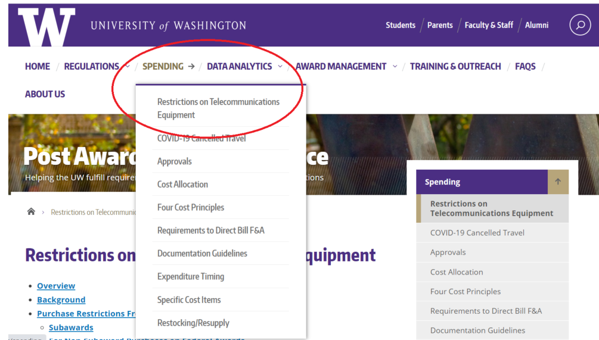
Telecommunications Restrictions: UW Policy
UW policy: https://finance.uw.edu/pafc/restrictions-telecommunications-equipment
Notes:
Show where policy is on the web

Slide 3
But first…
Legislation, not executive order
Effective 13 August 2020
FAR 52.204-25 (contracts)
2 CFR 200.216 & 200.471 (grants & cooperative agreements)

Slide 4
What is it?
Federal award funds may not be used to pay for or use, either as a direct or indirect cost:
“Covered equipment & services”…
Deemed to be a “substantial or essential component of any system” or “critical technology as part of any system”…
From “restricted companies.”

Slide 5
Translation
UW can’t use federal funds to pay for or use gizmos produced by specific companies.
Applies to:
Direct costs on a federal award
Indirect costs (because feds pay indirect)
Made via:
purchases & subawards

Slide 6
Advice: Direct & Indirect Costs
Gizmos? Do not purchase or use any items produced by any restricted company.
A current list of restricted companies is available at www.sam.gov. You can also search for a particular company.

Slide 7
PAFC Web Page: SAM.gov…

Slide 8
Restricted Company Example…

Slide 9
Purchases
Compliance is up to individual units making purchases via:
Ariba
Procard
Individual reimbursement
Review the SAM website for a list of restricted companies, or to search for a particular company, prior to initiating or approving purchases.

Slide 10
Subawards
OSP’s routine subrecipient monitoring includes reviewing SAM prior to issuing a subaward.
OSP will flow down the requirements as part of any subaward subject to the restrictions.

Slide 11
Existing Agreements
Effective as of 13 August 2020, expenditures for covered telecommunications equipment and services cannot be made on federal awards.
Contact OSP if your federal award cannot continue without the use of covered equipment or services.
Note: There is a waiver process for certain procurement activity on federal contracts, but not on federal assistance funding.

Slide 12
Personal Equipment
Use of personal telecommunications equipment (which is discouraged) from a restricted company to support work on a federal award could be considered a violation.
It depends on whether it is a substantial or essential component or critical technology of the program.

Slide 13
Not Subject to Restriction
Purchases on funding sources that do not have such restrictions and….
…where equipment or services are not a substantial or essential component or critical technology of the program.

Slide 14
Questions?
PAFC: gcafco@uw.edu
Subawards: ospsubs@uw.edu

