Slide 1
GCA Updates
MRAM
January 2021
Azalea Vasquez
Grant & Contract Accounting

Slide 2
Grant Tracker – Update to the Deficit Transfer Tool
The deficit transfer tool does not take into account the business rules for correctly processing a deficit for APL budgets, and budgets with indirect cost base 04 and 24.
APL budgets have Prorated Direct Costs and Fixed Fee
Base 04 and 24 limits indirect costs up to the amount of IDC allocated on the budget

Slide 3
Grant Tracker – Update to the Deficit Transfer Tool
If you have a budget that is in deficit you will now see the following message in Grant Tracker:

Slide 4
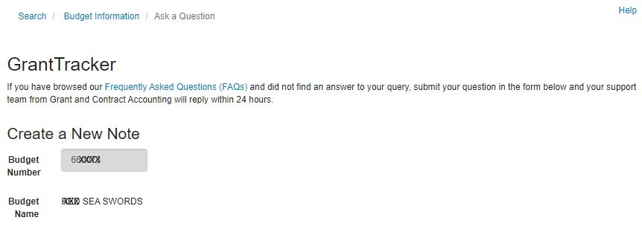
Grant Tracker – Update to the Deficit Transfer Tool
If you click on that link it will open a new Grant Tracker message which will make it easy for campus to contact us!

Slide 5
Revision to Calculating Final Action Date
Received feedback from Campus that the Final Action Date (FAD) was not calculating correctly for some budgets
This prompted a review of the business rules used in determining that date
We have finalized revised business rules, and are preparing to implement them on February 1, 2021

Slide 6
Revision to Calculating Final Action Date
In preparation for this change we will be moving reports that are currently listed under the parent budget to the appropriate sub budget(s) in Grant Tracker in January 2021.
This will only affect budgets whose awards require separate year accountability (e.g. Simons Foundation and American Heart Association)
This change is necessary so the correct Final Action Date can be shown on the sub budgets

Slide 7
Revision to Calculating Final Action Date
After the change has been implemented all the reports will still be viewable on the parent budget in GrantTracker, but the corresponding sub budget will be listed alongside each report.
Just a reminder – On April 1, 2020 GCA started setting up financial reports under the appropriate sub budget in GrantTracker.

Slide 8
Revision to Calculating Final Action Date
For budgets with a Temporary Budget Extension your Final Action Date will not change, but your budget will stay in FIN Status 1
Your FAD will update after we process the official No-Cost Extension Post Award Change (PAC) or Supplement/Extension Funding Action (FA)

Slide 9
Revision to Calculating Final Action Date
We will provide the new business rules on our Final Action Date web page which can be found here:
https://finance.uw.edu/gca/award-lifecycle/closing-your-award/final-action-date

Slide 10
Questions?
Contact GCA Help
gcahelp@uw.edu

