Slide 1
MRAM | Monthly Research Administration Meeting
February 11, 2021 9:00 AM – 10:00 AM HOSTED REMOTELY Join the LIVE Webinar: https://washington.zoom.us/j/346891888
TOPIC | PRESENTER | EMAIL | MIN
Welcome | Carol Rhodes Office of Sponsored Programs | carhodes@uw.edu | 2
Recap: Paperless, Subaward Approval & Telecommunications Restrictions | Andra Sawyer Post Award Fiscal Compliance | gcafco@uw.edu | 10
Advance Budget Request Streamlining: Sneak Peek & ASTRA Prep | Chris Carlson Office of Research Information Services | carlsc@uw.edu | 10
Research - A Sustaining Element of UW’s Mission? | Joe Giffels Office of Research | jgiffels@uw.edu | 5
Budget Number Update | Susan Wilbanks Grant & Contract Accounting | gcahelp@uw.edu | 5
NEXT MEETING March 11, 2021 9:00 AM - 10:00 AM

Slide 2
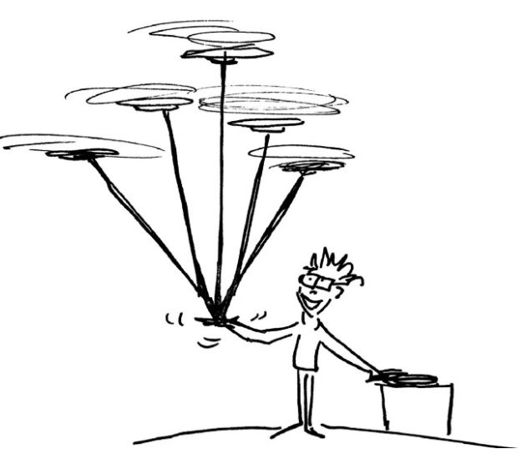
Recap: Going Paperless, Telecommunications Restrictions, & Subaward Invoice Approval
MRAM
February 2021
Andra Sawyer
Post Award Fiscal Compliance
andra2@uw.edu
gcafco@uw.edu

Slide 3
Telecommunication Restriction
UW can’t use federal funds to pay for or use “telecommunications equipment” produced by specific companies.
“Pay” applies to both direct costs on a federal award & indirect costs (because feds pay indirect).
“Use” means if you have this equipment then you must stop using it for any federal award.

Slide 4
Telecommunication Restriction: Definitions
“Telecommunications Equipment” is not well defined. Our advice is to not purchase or use any items produced by any restricted company.
Go to www.sam.gov for the current list of restricted companies.

Slide 5
Telecommunications Equipment: More Information
UW policy: https://finance.uw.edu/pafc/restrictions-telecommunications-equipment
MRAM Resources
December 2020: Procurement presentation: https://finance.uw.edu/gca/mram/meeting/2020-12
January 2021: PAFC presentation: https://finance.uw.edu/gca/mram/meeting/2021-01
January 2021 Follow Up Q&A:
https://finance.uw.edu/gca/node/1458

Slide 6
Subaward Invoice Approval
GIM 2 states, and has stated for many years, that PI’s must approve all subaward invoices.
Modifications were made to GIM 8 to align with GIM 2.

Slide 7
Going Paperless
Records Management taking the lead on creating an environment of “electronic workflows and record keeping.”
PAFC will provide support on this initiative for sponsored awards.
More information:
https://finance.uw.edu/recmgt/home
“Fetch the Future” video:
https://www.youtube.com/watch?v=M6Ydzccdw-I&feature=youtu.be

Slide 8
GCA Training & Outreach Webpage

Slide 9
GCA Process Videos

Slide 10
ADVANCE BUDGET REQUEST STREAMLINING Sneak Peek & ASTRA Prep for Campus
MRAM
February 11th, 2021
Chris Carlson - Program Lead
ORIS
carlsc@uw.edu

Slide 11
PROJECT GOALS
Goal: Streamline the process of establishing an advance budget
Highlights: Centralize all actions in SAGE Automate the eligibility check ---- Removes OSP role in process No duplicate entry ---- Leverages info from eGC1 and FIN Electronic routing for approval
Goal: Improve transparency of process and status to campus
Goal: Ensure consistency and clarity between GIM 9 and advance budget process
Goal: Redesign with eyes toward future post-award integration with Workday Financials

Slide 12
CURRENT-TO-FUTURE STREAMLINING
CURRENT ADVANCE PROCESS
9 Steps, taking up to 7 days (or up to 10 if SFI hold)
Campus/OSP/GCA have to use: Webform, Emails, Printed paper
ADV Eligibility webform submitted
Full disclosure & SFI Review
OSP marks eGC1 eligible & emails Dept
ADV Request submitted in SAGE
ADV form printed for PI and dept approvals
Signed ADV emailed
to GCA
GCA prints and reviews ADV
GCA sets up budget in
FIN & notifies Dept
Budget number becomes active
FUTURE ADVANCE PROCESS
6 Steps - taking as little as 3 days (8 if SFI hold)
No more: webforms, emails, printed paper to complete process
ADV Intake
initiated
in SAGE
ADV
Request submitted
in SAGE
PI & Dept approve online (New Advance only)
GCA
review (abbrev.)
GCA sets up budget in
FIN
Budget number becomes active
SFI review completed
Automated eligibility
SFI review triggered
SFI hold, until reviews complete
Campus notified, Compliance holds on pending FAs removed

Slide 13
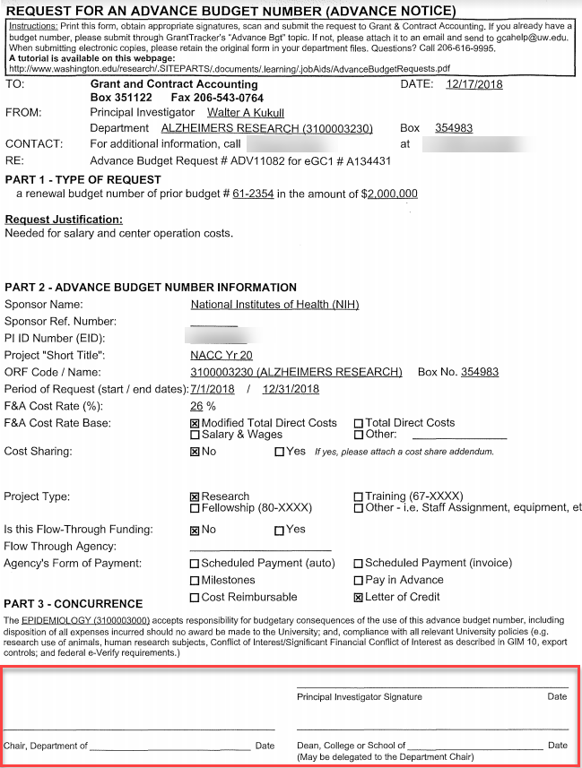
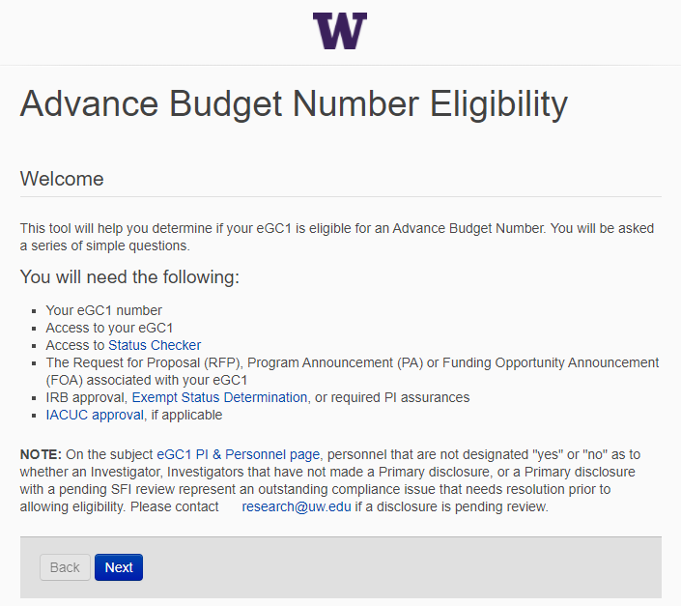
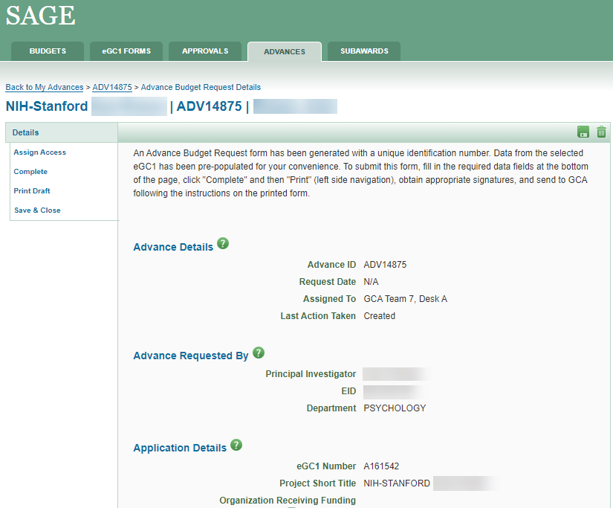
CURRENT-TO-FUTURE STREAMLINING
New & Improved!

Slide 14
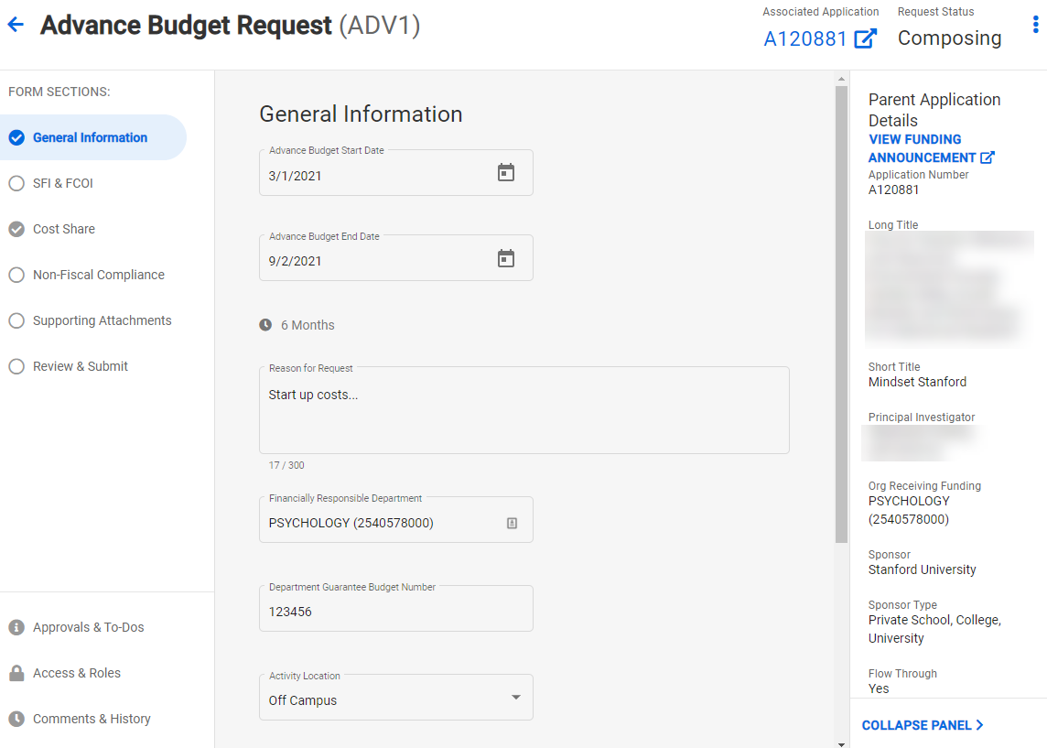
CURRENT-TO-FUTURE STREAMLINING

Slide 15
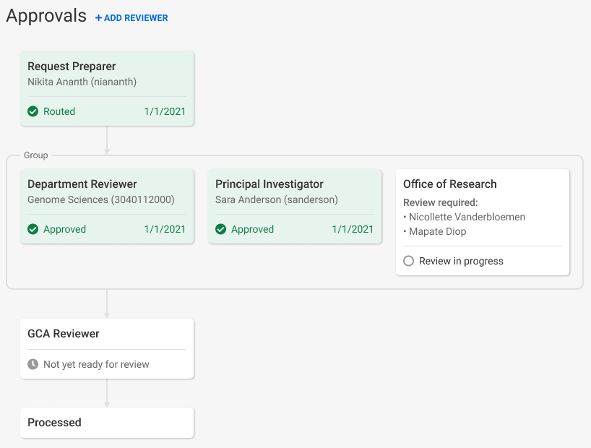
ADVANCE BUDGET REQUEST APPROVALS
Current: PI, Department Chair, and Dean must sign form
Future: PI and Fiscally Responsible Unit approve directly in SAGE

Slide 16
PREPARING FOR NEW PROCESS
Units need to assign a new SAGE ASTRA role for their organization code(s) to approve Advance Budget requests: Advance Reviewer
ASTRA Authorizers for existing SAGE Division and Department Reviewers have been granted authority to assign the new Advance Reviewer role
To look up a unit’s ASTRA Authorizer visit the ASTRA website
If an Advance Reviewer is not assigned, the Advance will be blocked from routing for review. On-screen alerts will make you aware of the missing reviewer.
Once a reviewer for the fiscally responsible unit is assigned, the alerts will disappear and you’ll be allowed to route for review.

Slide 17
PROJECT TIMELINE
ANALYSIS & DESIGN
DEVELOPMENT
TESTING & OUTREACH
3/2020-7/2020
7/2020-3/2021
3/2021-4/2021
April 2021

Slide 18
OUTREACH & SUPPORT
March MRAM: Brief project status update
April MRAM: Comprehensive overview and demo of new Advance Budget Request process
Resources and training will be available prior to release
Updates to guidance on GCA and Research websites
Email announcements to MRAM and SAGE contact lists

Slide 19
QUESTIONS?
Contact Chris Carlson at carlsc@uw.edu

Slide 20
Research --
A sustaining element of UW’s mission
MRAM
February 2021
Joe Giffels
Office of Research

Slide 21
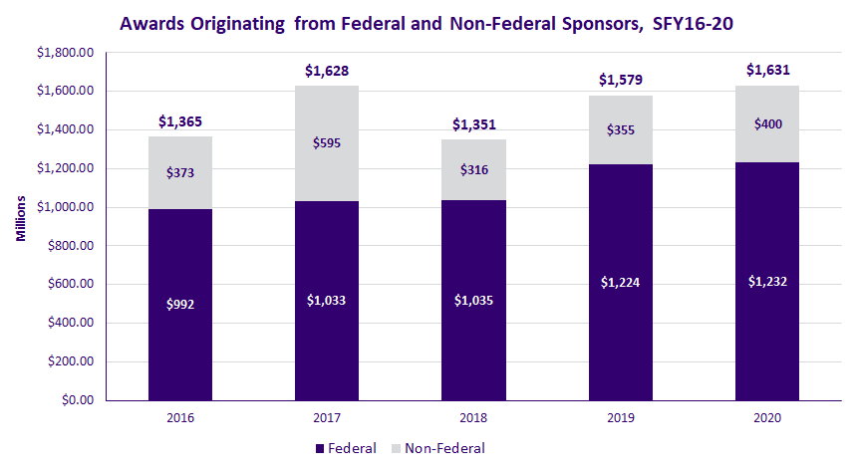
Research Awards – UW’s Performance Continues Its Upward Trend
* Note: A ten-year, $280M Foundation award accounts for the higher level of funding in FY 2017

Slide 22
We’re #2! (#1 among public universities)
Johns Hopkins U. | 2,765,393
U. Washington, Seattle | 1,308,260
U. California, San Francisco | 1,200,358
Stanford U. | 1,079,410
Duke U. | 1,072,436
U. Michigan, Ann Arbor | 1,067,777
U. California, San Diego | 1,052,466
U. California, Los Angeles | 1,021,366
U. Pennsylvania | 1,014,551
Columbia U. in the City of New York | 928,664
FY 2019 Research Expenditures (Thousands) -- HERD Survey

Slide 23
Our Overall Financial Position Is Stronger
Rating Action:
Moody's revises University of Washington's (WA) outlook to stable, assigns Aaa to series 2021 General Revenue Bonds
29 Jan 2021
New York, January 29, 2021 -- Moody's Investors Service has revised University of Washington's (UW) outlook to stable from negative and assigned a Aaa rating to its proposed $325 million bonds, including $81 million in General Revenue and Refunding Bonds, series 2021A, and $244 million General Revenue and Refunding Bonds, Series 2021B (Taxable).

Slide 24
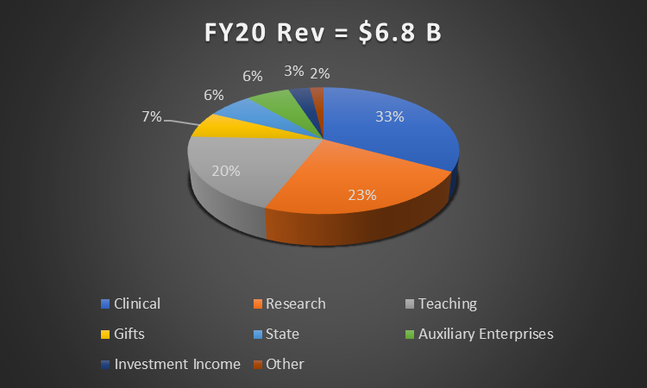
Research accounts for nearly a quarter of all revenue to UW

Slide 25
GCA Updates
Susan Wilbanks, Grant Analyst

Slide 26
68- Prefix for non-federal award budgets
GCA expects to run out of 63- and 66- prefix budget numbers in March or April.
We will begin using the 68- prefix for non-federal grant/contract budgets until 63- and 66- numbers become available again after biennium crossover.
We also use 68- for gift budgets.
The easiest way to determine if a 68- budget is a gift or a grant is checking its type/class:
05/xx – Grant or Contract
06/xx – Gift or Endowment

Slide 27
Updates to the Final Action Date (FAD) calculation
We’ve made several changes in how the FAD is calculated
Goal: to create a meaningful date for campus to finish spending on a budget and for the automatic status 3 process to begin.

Slide 28
Summary of FAD updates
Sub budgets
Sub budgets created to support separate year accountability now have FADs based on report due dates rather than following the parent budget
Program income sub budgets now have a FAD of 69 days after their expiration date rather than following the parent budget
Corrected calculations for budgets with a quick final invoice/report due date
Budgets with invoice/reports due same day as award end date will have FAD calculation of end date + 15 working days
Budgets with invoice/reports due 30 days or less after the budget end date will have FAD calculation of end date + 15 working days.
Perennial budgets like gifts don’t have a FAD anymore
Cancelled budgets don’t have a FAD either

