Slide 1
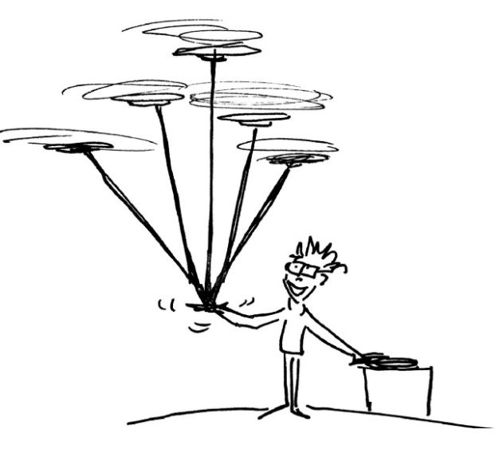
Recap: Going Paperless, Telecommunications Restrictions, & Subaward Invoice Approval
MRAM
February 2021
Andra Sawyer
Post Award Fiscal Compliance
andra2@uw.edu
gcafco@uw.edu

Slide 2
Telecommunication Restriction
UW can’t use federal funds to pay for or use “telecommunications equipment” produced by specific companies.
“Pay” applies to both direct costs on a federal award & indirect costs (because feds pay indirect).
“Use” means if you have this equipment then you must stop using it for any federal award.

Slide 3
Telecommunication Restriction: Definitions
“Telecommunications Equipment” is not well defined. Our advice is to not purchase or use any items produced by any restricted company.
Go to www.sam.gov for the current list of restricted companies.

Slide 4
Telecommunications Equipment: More Information
UW policy: https://finance.uw.edu/pafc/restrictions-telecommunications-equipment
MRAM Resources
December 2020: Procurement presentation: https://finance.uw.edu/gca/mram/meeting/2020-12
January 2021: PAFC presentation: https://finance.uw.edu/gca/mram/meeting/2021-01
January 2021 Follow Up Q&A:
https://finance.uw.edu/gca/node/1458

Slide 5
Subaward Invoice Approval
GIM 2 states, and has stated for many years, that PI’s must approve all subaward invoices.
Modifications were made to GIM 8 to align with GIM 2.

Slide 6
Going Paperless
Records Management taking the lead on creating an environment of “electronic workflows and record keeping.”
PAFC will provide support on this initiative for sponsored awards.
More information:
https://finance.uw.edu/recmgt/home
“Fetch the Future” video:
https://www.youtube.com/watch?v=M6Ydzccdw-I&feature=youtu.be

Slide 7
GCA Training & Outreach Webpage

Slide 8
GCA Process Videos

