Slide 1
ADVANCE BUDGET REQUEST STREAMLINING Sneak Peek & ASTRA Prep for Campus
MRAM
February 11th, 2021
Chris Carlson - Program Lead
ORIS
carlsc@uw.edu

Slide 2
PROJECT GOALS
Goal: Streamline the process of establishing an advance budget
Highlights: Centralize all actions in SAGE Automate the eligibility check ---- Removes OSP role in process No duplicate entry ---- Leverages info from eGC1 and FIN Electronic routing for approval
Goal: Improve transparency of process and status to campus
Goal: Ensure consistency and clarity between GIM 9 and advance budget process
Goal: Redesign with eyes toward future post-award integration with Workday Financials

Slide 3
CURRENT-TO-FUTURE STREAMLINING
CURRENT ADVANCE PROCESS
9 Steps, taking up to 7 days (or up to 10 if SFI hold)
Campus/OSP/GCA have to use: Webform, Emails, Printed paper
ADV Eligibility webform submitted
Full disclosure & SFI Review
OSP marks eGC1 eligible & emails Dept
ADV Request submitted in SAGE
ADV form printed for PI and dept approvals
Signed ADV emailed
to GCA
GCA prints and reviews ADV
GCA sets up budget in
FIN & notifies Dept
Budget number becomes active
FUTURE ADVANCE PROCESS
6 Steps - taking as little as 3 days (8 if SFI hold)
No more: webforms, emails, printed paper to complete process
ADV Intake
initiated
in SAGE
ADV
Request submitted
in SAGE
PI & Dept approve online (New Advance only)
GCA
review (abbrev.)
GCA sets up budget in
FIN
Budget number becomes active
SFI review completed
Automated eligibility
SFI review triggered
SFI hold, until reviews complete
Campus notified, Compliance holds on pending FAs removed

Slide 4
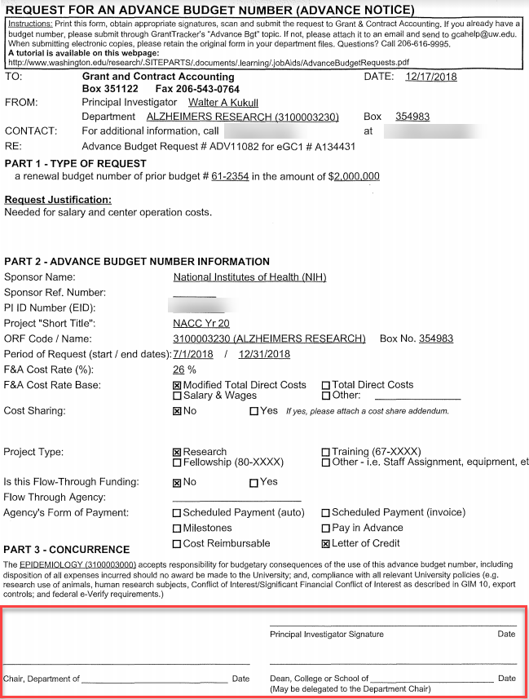
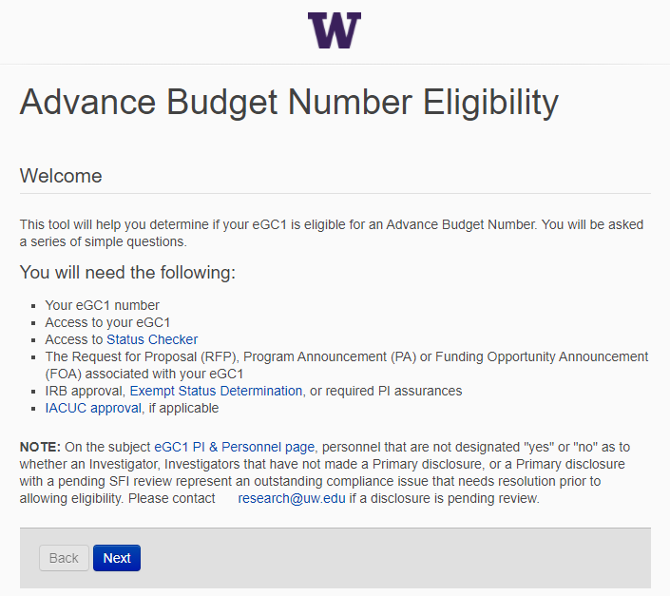
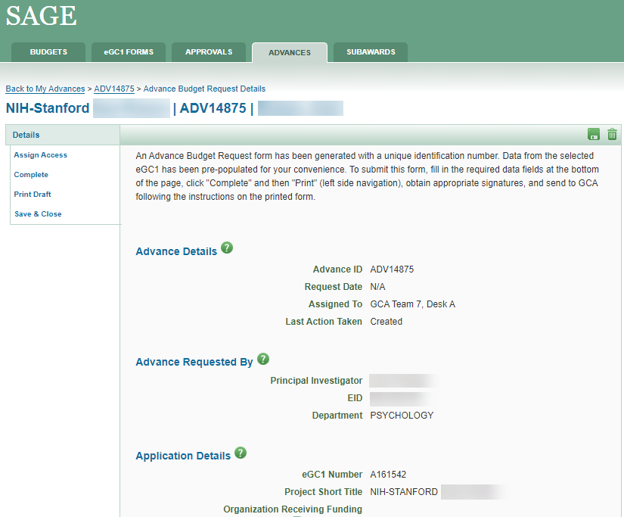
CURRENT-TO-FUTURE STREAMLINING
New & Improved!

Slide 5
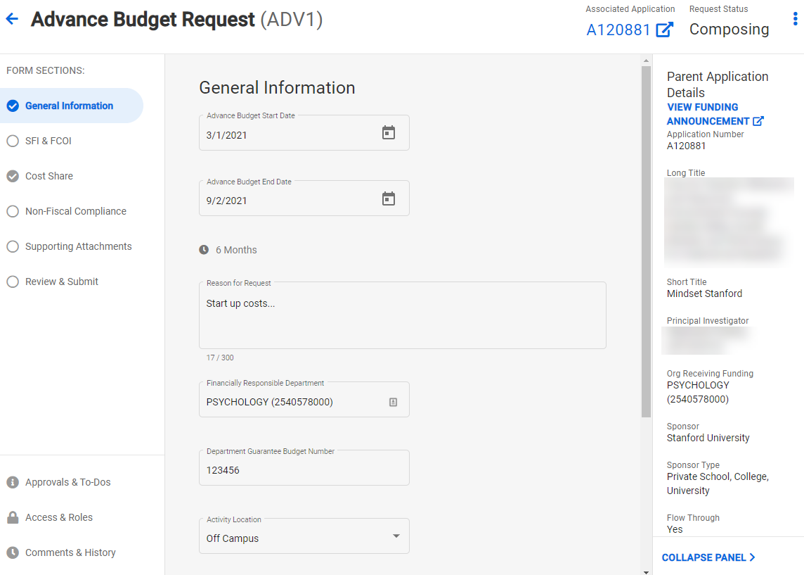
CURRENT-TO-FUTURE STREAMLINING

Slide 6
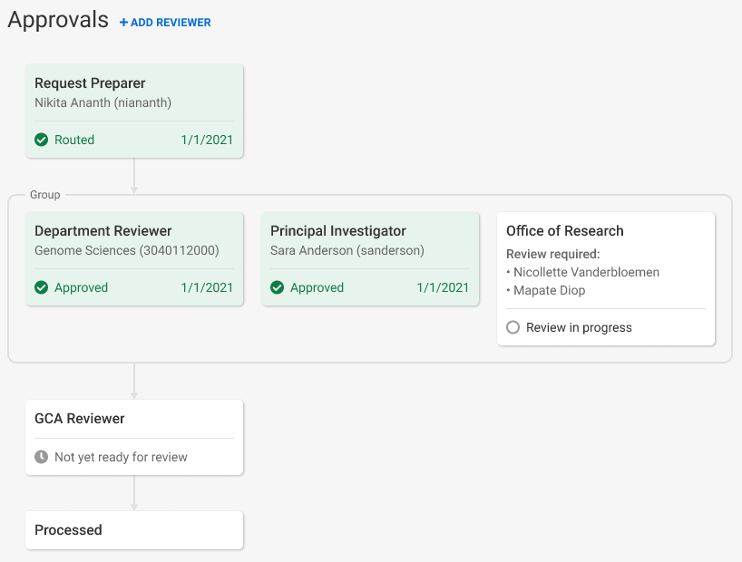
ADVANCE BUDGET REQUEST APPROVALS
Current: PI, Department Chair, and Dean must sign form
Future: PI and Fiscally Responsible Unit approve directly in SAGE

Slide 7
PREPARING FOR NEW PROCESS
Units need to assign a new SAGE ASTRA role for their organization code(s) to approve Advance Budget requests: Advance Reviewer
ASTRA Authorizers for existing SAGE Division and Department Reviewers have been granted authority to assign the new Advance Reviewer role
To look up a unit’s ASTRA Authorizer visit the ASTRA website
If an Advance Reviewer is not assigned, the Advance will be blocked from routing for review. On-screen alerts will make you aware of the missing reviewer.
Once a reviewer for the fiscally responsible unit is assigned, the alerts will disappear and you’ll be allowed to route for review.

Slide 8
PROJECT TIMELINE
ANALYSIS & DESIGN
DEVELOPMENT
TESTING & OUTREACH
3/2020-7/2020
7/2020-3/2021
3/2021-4/2021
April 2021

Slide 9
OUTREACH & SUPPORT
March MRAM: Brief project status update
April MRAM: Comprehensive overview and demo of new Advance Budget Request process
Resources and training will be available prior to release
Updates to guidance on GCA and Research websites
Email announcements to MRAM and SAGE contact lists

Slide 10
QUESTIONS?
Contact Chris Carlson at carlsc@uw.edu

