Slide 1
Research --
A sustaining element of UW’s mission
MRAM
February 2021
Joe Giffels
Office of Research

Slide 2
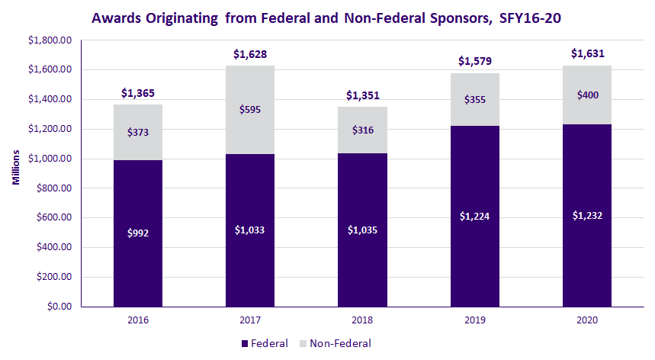
Research Awards – UW’s Performance Continues Its Upward Trend
* Note: A ten-year, $280M Foundation award accounts for the higher level of funding in FY 2017

Slide 3
We’re #2! (#1 among public universities)
Johns Hopkins U. | 2,765,393
U. Washington, Seattle | 1,308,260
U. California, San Francisco | 1,200,358
Stanford U. | 1,079,410
Duke U. | 1,072,436
U. Michigan, Ann Arbor | 1,067,777
U. California, San Diego | 1,052,466
U. California, Los Angeles | 1,021,366
U. Pennsylvania | 1,014,551
Columbia U. in the City of New York | 928,664
FY 2019 Research Expenditures (Thousands) -- HERD Survey

Slide 4
Our Overall Financial Position Is Stronger
Rating Action:
Moody's revises University of Washington's (WA) outlook to stable, assigns Aaa to series 2021 General Revenue Bonds
29 Jan 2021
New York, January 29, 2021 -- Moody's Investors Service has revised University of Washington's (UW) outlook to stable from negative and assigned a Aaa rating to its proposed $325 million bonds, including $81 million in General Revenue and Refunding Bonds, series 2021A, and $244 million General Revenue and Refunding Bonds, Series 2021B (Taxable).

Slide 5
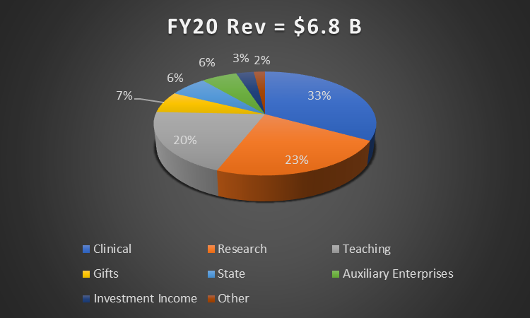
Research accounts for nearly a quarter of all revenue to UW

