Slide 1
MRAM | Monthly Research Administration Meeting
March 11, 2021 9:00 AM – 10:00 AM HOSTED REMOTELY Join the LIVE Webinar: https://washington.zoom.us/j/346891888
TOPIC | PRESENTER | EMAIL | MIN
Welcome | Kirsten DeFries Research Compliance & Operations | kirsten5@uw.edu | 2
Advance Budget Project Update | Chris Carlson Office of Research Information Services | carlsc@uw.edu | 5
NIH Fellowship Allowances | Andra Sawyer Post Award Fiscal Compliance | gcafco@uw.edu | 5
Outside Work | Melissa Petersen Office of Research | petermm@uw.edu | 8
CORE Update | Laurie Stephan Collaborative On Research Education (CORE) | corehelp@uw.edu | 15
NEXT MEETING April 8, 2021 9:00 AM - 10:00 AM

Slide 2
ADVANCE BUDGET REQUEST STREAMLINING Update & ASTRA Prep Reminder
MRAM
March 11th, 2021
Chris Carlson - Program Lead
ORIS
carlsc@uw.edu

Slide 3
PROJECT TIMELINE
ANALYSIS & DESIGN
DEVELOPMENT
TESTING & OUTREACH
3/2020-7/2020
7/2020-3/2021
3/2021-4/2021
April 2021
May

Slide 4
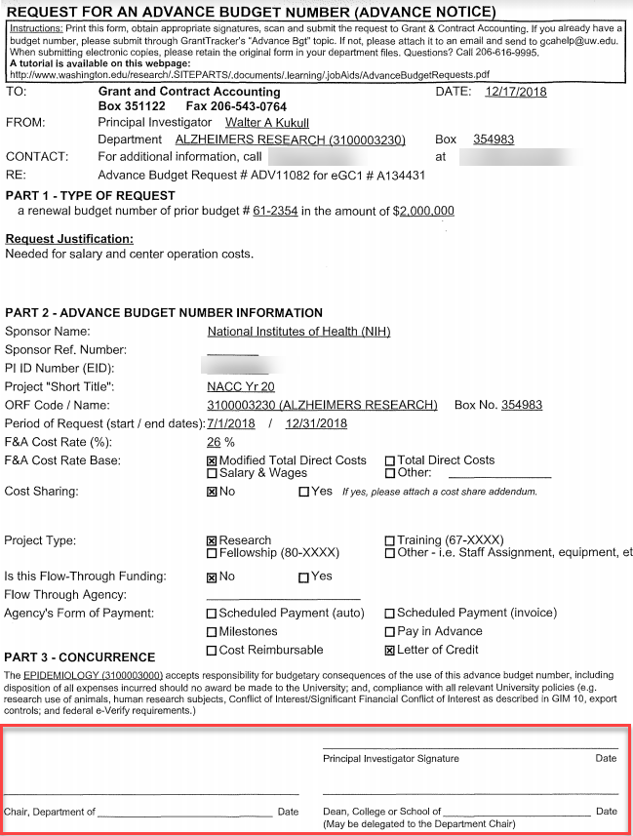
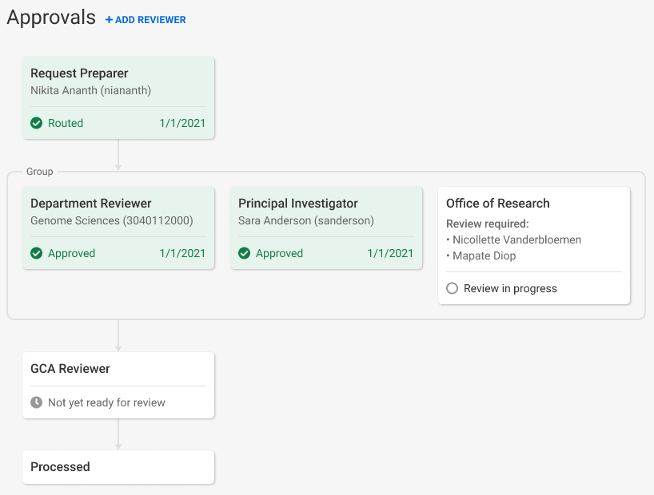
ADVANCE BUDGET REQUEST APPROVALS
Current: PI, Department Chair, and Dean must sign form
Future: PI and Fiscally Responsible Unit approve directly in SAGE

Slide 5
PREPARING FOR NEW PROCESS
Units need to assign a new SAGE ASTRA role for their organization code(s) to approve Advance Budget requests: Advance Reviewer
ASTRA Authorizers for existing SAGE Division and Department Reviewers have been granted authority to assign the new Advance Reviewer role
To look up a unit’s ASTRA Authorizer visit the ASTRA website
If an Advance Reviewer is not assigned, the Advance will blocked from routing for review. On-screen alerts will make you aware of the missing reviewer.
Once a reviewer for the fiscally responsible unit is assigned, the alerts will disappear and you’ll be allowed to route for review.

Slide 6
UPCOMING OUTREACH & SUPPORT
May MRAM: Comprehensive overview and demo of new Advance Budget Request process
Resources and training will be available prior to release
Updates to guidance on GCA and Research websites
Email announcements to MRAM and SAGE contact lists

Slide 7
QUESTIONS?
Contact Chris Carlson at carlsc@uw.edu

Slide 8
NIH Fellowship Allowances
MRAM
March 2021
Andra Sawyer
Post Award Fiscal Compliance

Slide 9
NIH NRSA Fellowship Update
NIH is adding a childcare allowance to its NRSA Fellowship program
Effective 8 April 2021
PAFC is working on determining if this is allowable and, if so, its implementation
Please stay tuned – any questions contact PAFC @ gcafco@uw.edu
NIH Link: https://grants.nih.gov/grants/guide/notice-files/NOT-OD-21-069.html

Slide 10
Outside Work
MRAM
March 2021
Melissa Petersen
Office of Research

Slide 11
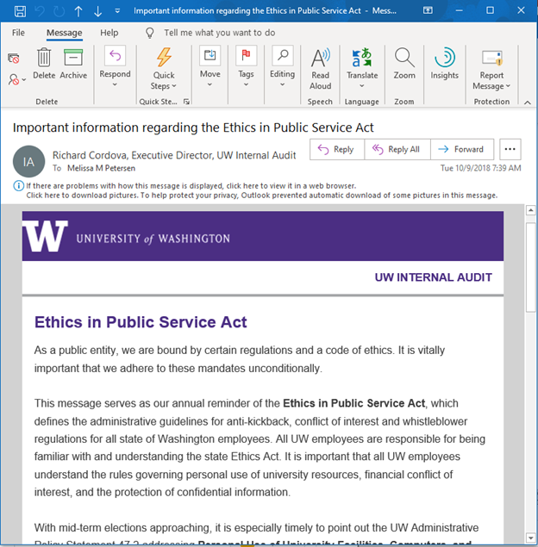
BACKGROUND
WA State Ethics in Public Service (2005 Revision)
Office of Research Informational Page
School of Medicine Policies List
Internal Audit - Ethics in Public Service Act
MRAM – Melissa Petersen – Office of Research

Slide 12
IMPORTANCE
“Safe Harbor”
University Compliance
Tenure and promotion reviews
Audit risk
Research sponsor concerns
WA State Ethics violations
MRAM – Melissa Petersen – Office of Research

Slide 13
POLICIES
Executive Order No. 57 - Outside Professional Work Policy
Applies to Faculty, Librarians, and other Academic Personnel
Academic Personnel includes postdoctoral scholars, as defined by Administrative Policy Statement 40.1 - Types of University Personnel
Administrative Policy Statement 47.3 - Outside Consulting Activities and Part-Time Employment by Professional or Classified Staff Employees
Applies to staff (pretty much anyone paid by the UW not listed above, but as always… it depends)
MRAM – Melissa Petersen – Office of Research

Slide 14
FORMS
Form 1460
School of Medicine Online Portal
Seattle and Tacoma
UW Bothell - Accessed via Faculty SharePoint on this site
Form 1558
Staff
MRAM – Melissa Petersen – Office of Research

Slide 15
REVIEW PROCESS (for the most part)
Form 1460
Faculty, Librarian or other Academic Personnel completes the Form 1460, submit to their Department Chair
Department Chair reviews for scope of activities, conflict of commitment, etc.
School Dean, or their designee, also reviews for scope of activities and conflict of commitment but as they relate to larger school/college interests
Forms received by the Office of Research are considered “Approved”, unless a review is required for compliance or conflict of interest (management plans may be issued)
Form 1558 - it depends
MRAM – Melissa Petersen – Office of Research

Slide 16
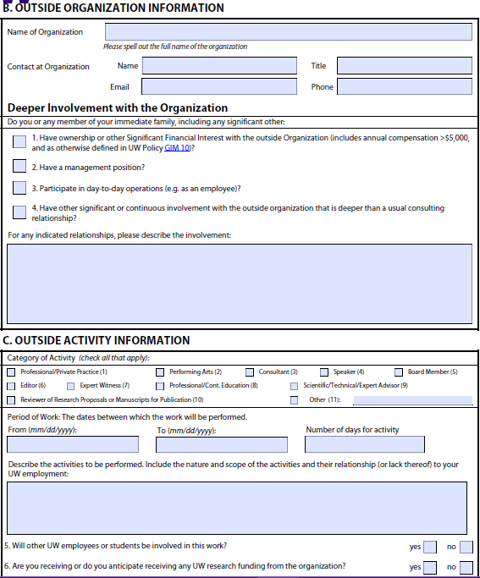
FORM 1460
EXAMPLE PURPOSES ONLY
Entity – Source of Payment
Non-UW Person Recommended
1
2
2
3
I receive >$5,000 in salary¹ for my role as President² where I guide in strategic decision making³.
MRAM – Melissa Petersen – Office of Research

Slide 17
FORM 1460
EXAMPLE PURPOSES ONLY
May not exceed 12-months
In SoM must align with FY
Averaged over the Period of Work as agreed upon with their chair/supervisor
7/1/2021
6/30/2022
52
Benefit to the UW!
I’ll lead a research project at the company that will help launch new directions of inquiry in my UW lab, but is unrelated to any current or planned projects, including the study they’re currently sponsoring⁴
Maybe not an FCOI, yet…
X
On second thought
4
MRAM – Melissa Petersen – Office of Research

Slide 18
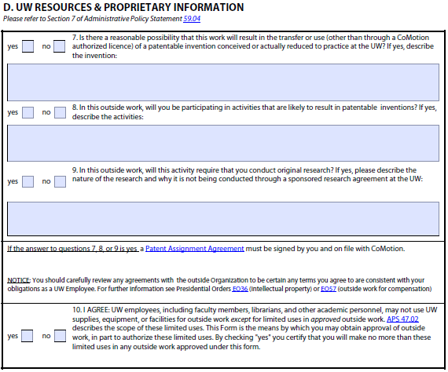
FORM 1460
EXAMPLE PURPOSES ONLY
Selecting yes to any/all of boxes 7, 8, and/or 9 will trigger the Patent Assignment Agreement requirement.
Contact CoMotion via uwassign@uw.edu for verifications.
MRAM – Melissa Petersen – Office of Research

Slide 19
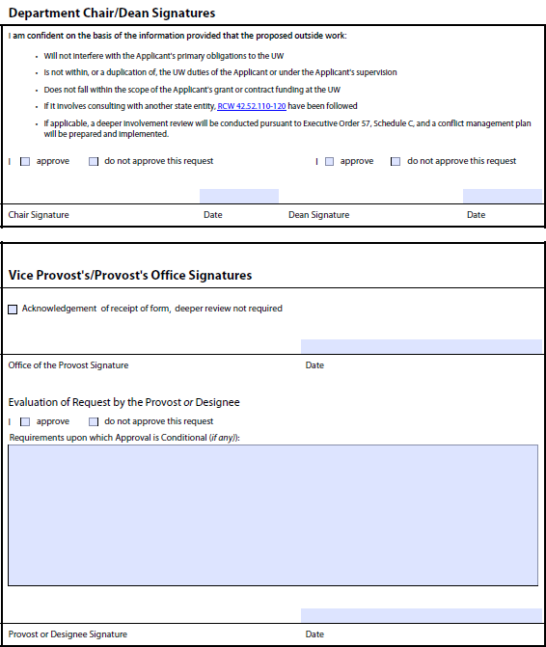
FORM 1460
EXAMPLE PURPOSES ONLY
Department and School/College/Campus Approval
School/College/Campus Approval is Final
Reviewed by the Provost, or more often their delegate. Approvals may be contingent upon written conditions and restrictions or an enclosed, or referenced, conflict management plan
MRAM – Melissa Petersen – Office of Research

Slide 20
CONTACT
Office of Research
Haley (Hibbs) Roady
Melissa Petersen
work1460@uw.edu
(206) 616-0804
MRAM – Melissa Petersen – Office of Research

Slide 21
Updates
Spring quarter schedule open --IMPORTANT--use link sent within the Zoom webinar invitation to assure attendance tracked
Classes being migrated to on-demand mode for Spring Quarter
Workshop on Preparing Sponsored Project Budgets
Introduction to Cost Share
60% of required courses for the certificate now on-demand
CORE Registration:
https://uwresearch.gosignmeup.com/public/course/browse
CORE Home: https://www.washington.edu/research/training/core/
Notes:
Good morning!

Slide 22
Recognition!
Certificate in Research Administration Graduates
340 enrolled in the certificate
55 graduates—CONGRATULATIONS!
28 as of October 2020
27 as of February 2021
Notes:
And now for the fun part! Today we are recognizing the second group of graduates from the CORE Certificate in Research Administration. CORE launched this certificate in the fall of 2019. Since then over 340 people have enrolled in the certificate program and as of Friday, February 26, this year, 55 of those enrollees have met all requirements to receive the certificate. We recognized the first 28 recipients in October and today we are going to take a moment to recognize the achievements the 27 people who have completed their certificate since October. Not all of them chose to include their names in today’s announcement but you all know who you are! Let’s give a shout out to some of our most recent graduates!

Slide 23
Certificate in Research Administration Program Graduates
Notes:
Here’s who they are—let’s give them a hand!

Slide 24
Mirelle Aziz Program Operations Specialist Department of Laboratory Medicine & Pathology
School of Medicine
Congratulations!

Slide 25
Susan Carpenter-Brandt Grants Manager Human Centered Design & Engineering
College of Engineering
Congratulations!

Slide 26
Gerald Cofer
Financial Analyst
Institute for Health Metrics and Evaluation (IHME)
Congratulations!

Slide 27
Susie Hawkey Operations Manager Accessible Technology Services, UW IT
Congratulations!

Slide 28
Alexander T. Huynh
Program Operations Specialist Polar Science Center
Applied Physics Laboratory
Congratulations!

Slide 29
Lindsey A. Hwang Grants & Contracts Manager Mechanical Engineering
College of Engineering
Congratulations!

Slide 30
Ruth L. Levy Budget/Fiscal Analyst Biostatistics Department
School of Public Health
Congratulations!

Slide 31
Erik Luc Grants & Operations Manager Center on Reinventing Public Education
UW Bothell
Congratulations!

Slide 32
Deborah Malarek Grants & Contracts Manager Cooperative Institute for Climate, Ocean, and Ecosystem Studies (CICOES)
Congratulations!

Slide 33
Courtney A. Miller Grants & Contract Manager Washington National Primate Center
Congratulations!

Slide 34
Mandy Morneault Administrator Department of Bioethics & Humanities
School of Medicine
Congratulations!

Slide 35
Laura E. Pflum Program Manager Center for the Science of Synthesis Across Scales
Congratulations!

Slide 36
Mallory Shaw Research Development Coordinator The Information School
Congratulations!

Slide 37
Lori T. Sommerfelt Grants & Contracts Specialist Department of Medicine
School of Medicine
Congratulations!

Slide 38
Janeth M. Talty Budget Fiscal Analyst Department of Microbiology
School of Medicine
Congratulations!

Slide 39
Gina Trenkamp Administrative Specialist Office of Research
Congratulations!

Slide 40
Sarah Verlinde Project & Fiscal Coordinator Office of Sponsored Research
UW Bothell
Congratulations!

Slide 41
Julia Yeh Administrator Applied Physics Laboratory
Congratulations!

Slide 42
Thank You!
Thanks to the staff and their supervisors
who support this important training!
You help make the UW an
effectively managed research enterprise.
Notes:
And a big thank you to all who support the ongoing professional development of our research administration staff!

