Slide 1
ADVANCE BUDGET REQUEST STREAMLINING Update & ASTRA Prep Reminder
MRAM
March 11th, 2021
Chris Carlson - Program Lead
ORIS
carlsc@uw.edu

Slide 2
PROJECT TIMELINE
ANALYSIS & DESIGN
DEVELOPMENT
TESTING & OUTREACH
3/2020-7/2020
7/2020-3/2021
3/2021-4/2021
April 2021
May

Slide 3
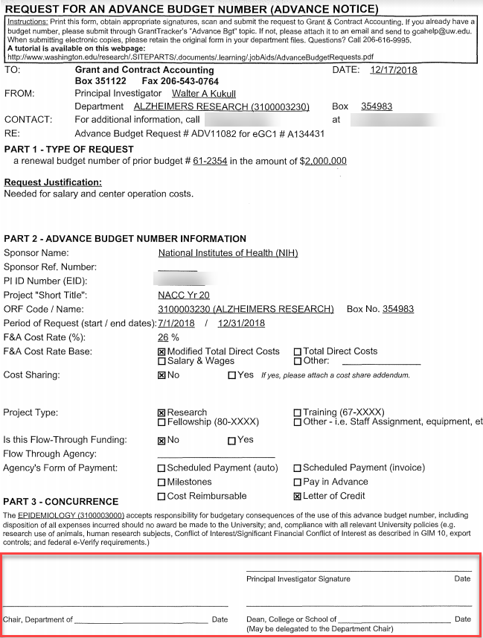
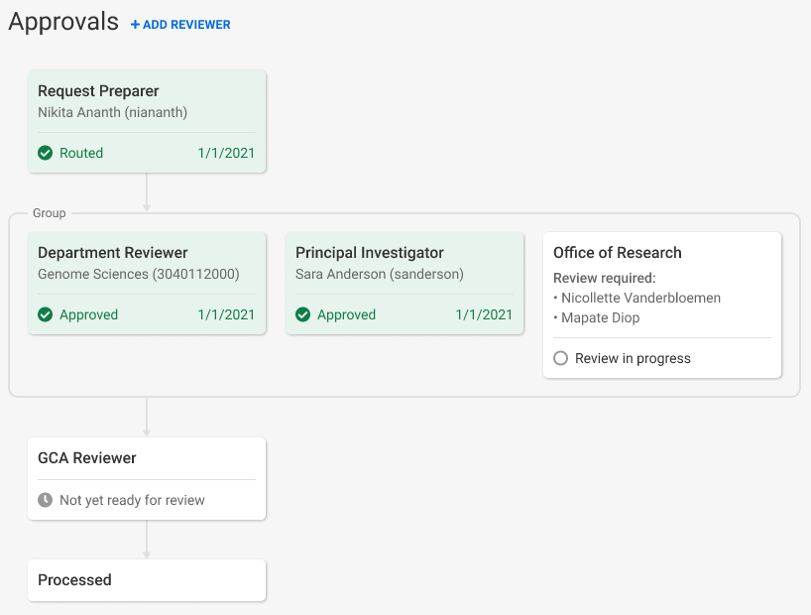
ADVANCE BUDGET REQUEST APPROVALS
Current: PI, Department Chair, and Dean must sign form
Future: PI and Fiscally Responsible Unit approve directly in SAGE

Slide 4
PREPARING FOR NEW PROCESS
Units need to assign a new SAGE ASTRA role for their organization code(s) to approve Advance Budget requests: Advance Reviewer
ASTRA Authorizers for existing SAGE Division and Department Reviewers have been granted authority to assign the new Advance Reviewer role
To look up a unit’s ASTRA Authorizer visit the ASTRA website
If an Advance Reviewer is not assigned, the Advance will blocked from routing for review. On-screen alerts will make you aware of the missing reviewer.
Once a reviewer for the fiscally responsible unit is assigned, the alerts will disappear and you’ll be allowed to route for review.

Slide 5
UPCOMING OUTREACH & SUPPORT
May MRAM: Comprehensive overview and demo of new Advance Budget Request process
Resources and training will be available prior to release
Updates to guidance on GCA and Research websites
Email announcements to MRAM and SAGE contact lists

Slide 6
QUESTIONS?
Contact Chris Carlson at carlsc@uw.edu

