Slide 1
Outside Work
MRAM
March 2021
Melissa Petersen
Office of Research

Slide 2
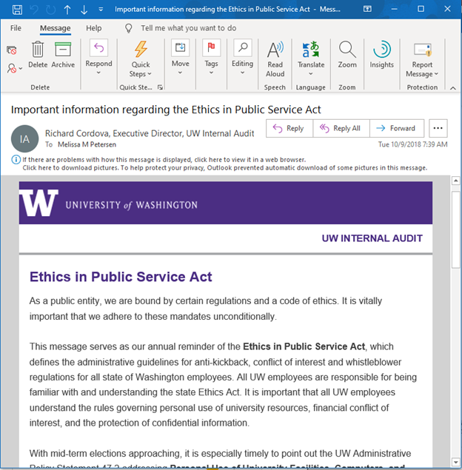
BACKGROUND
WA State Ethics in Public Service (2005 Revision)
Office of Research Informational Page
School of Medicine Policies List
Internal Audit - Ethics in Public Service Act
MRAM – Melissa Petersen – Office of Research

Slide 3
IMPORTANCE
“Safe Harbor”
University Compliance
Tenure and promotion reviews
Audit risk
Research sponsor concerns
WA State Ethics violations
MRAM – Melissa Petersen – Office of Research

Slide 4
POLICIES
Executive Order No. 57 - Outside Professional Work Policy
Applies to Faculty, Librarians, and other Academic Personnel
Academic Personnel includes postdoctoral scholars, as defined by Administrative Policy Statement 40.1 - Types of University Personnel
Administrative Policy Statement 47.3 - Outside Consulting Activities and Part-Time Employment by Professional or Classified Staff Employees
Applies to staff (pretty much anyone paid by the UW not listed above, but as always… it depends)
MRAM – Melissa Petersen – Office of Research

Slide 5
FORMS
Form 1460
School of Medicine Online Portal
Seattle and Tacoma
UW Bothell - Accessed via Faculty SharePoint on this site
Form 1558
Staff
MRAM – Melissa Petersen – Office of Research

Slide 6
REVIEW PROCESS (for the most part)
Form 1460
Faculty, Librarian or other Academic Personnel completes the Form 1460, submit to their Department Chair
Department Chair reviews for scope of activities, conflict of commitment, etc.
School Dean, or their designee, also reviews for scope of activities and conflict of commitment but as they relate to larger school/college interests
Forms received by the Office of Research are considered “Approved”, unless a review is required for compliance or conflict of interest (management plans may be issued)
Form 1558 - it depends
MRAM – Melissa Petersen – Office of Research

Slide 7
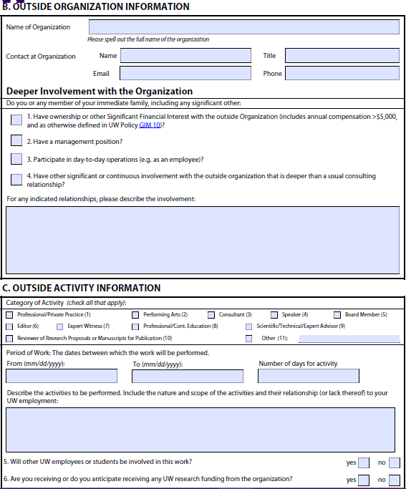
FORM 1460
EXAMPLE PURPOSES ONLY
Entity – Source of Payment
Non-UW Person Recommended
1
2
2
3
I receive >$5,000 in salary¹ for my role as President² where I guide in strategic decision making³.
MRAM – Melissa Petersen – Office of Research

Slide 8
FORM 1460
EXAMPLE PURPOSES ONLY
May not exceed 12-months
In SoM must align with FY
Averaged over the Period of Work as agreed upon with their chair/supervisor
7/1/2021
6/30/2022
52
Benefit to the UW!
I’ll lead a research project at the company that will help launch new directions of inquiry in my UW lab, but is unrelated to any current or planned projects, including the study they’re currently sponsoring⁴
Maybe not an FCOI, yet…
X
On second thought
4
MRAM – Melissa Petersen – Office of Research

Slide 9
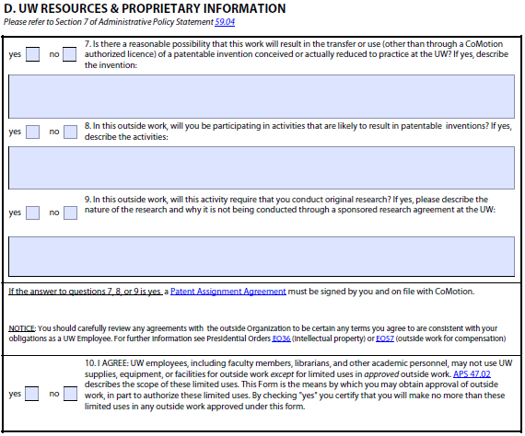
FORM 1460
EXAMPLE PURPOSES ONLY
Selecting yes to any/all of boxes 7, 8, and/or 9 will trigger the Patent Assignment Agreement requirement.
Contact CoMotion via uwassign@uw.edu for verifications.
MRAM – Melissa Petersen – Office of Research

Slide 10
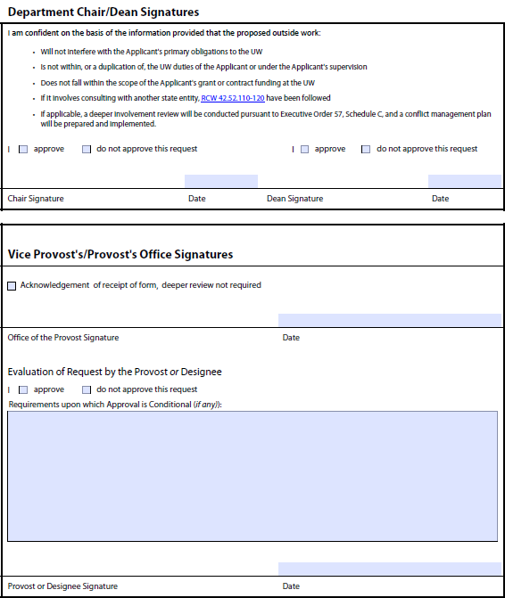
FORM 1460
EXAMPLE PURPOSES ONLY
Department and School/College/Campus Approval
School/College/Campus Approval is Final
Reviewed by the Provost, or more often their delegate. Approvals may be contingent upon written conditions and restrictions or an enclosed, or referenced, conflict management plan
MRAM – Melissa Petersen – Office of Research

Slide 11
CONTACT
Office of Research
Haley (Hibbs) Roady
Melissa Petersen
work1460@uw.edu
(206) 616-0804
MRAM – Melissa Petersen – Office of Research

