Slide 1
MRAM | Monthly Research Administration Meeting
April 8, 2021 9:00 AM – 10:00 AM HOSTED REMOTELY Join the LIVE Webinar: https://washington.zoom.us/j/346891888
TOPIC | PRESENTER | EMAIL | MIN
Welcome | Carol Rhodes Office of Sponsored Programs | carhodes@uw.edu | 2
Advance Budget Request Clean-Up | Lily Gebrengus Grant & Contract Accounting | lgebren@uw.edu | 2
NIH Child Care Allowance & NIH Closeout Deadline | Andra Sawyer, Matt Gardner Post Award Fiscal Compliance | gcafco@uw.edu | 5
University Requirements for Researchers Engaging with Minors | Caroline Shelton Youth Programs Development & Support | cshelton@uw.edu | 10
T32 Partnerships with Fred Hutchinson Cancer Research Center | Amanda Snyder Office of Sponsored Programs | acs229@uw.edu | 5
Foreign Interest and Sponsored Research | Melissa Petersen Office of Research | petermm@uw.edu | 2
NIH Biosketch & Other Support Format Changes | Carol Rhodes Office of Sponsored Programs | carhodes@uw.edu | 10
NIH Current Policies: What We are Seeing | Tim Mhyre Office of Sponsored Programs | tmhyre@uw.edu | 5
COVID-19 GIM 19 Waivers | Carol Rhodes Office of Sponsored Programs | carhodes@uw.edu | 1
NEXT MEETING May 13, 2021 9:00 AM - 10:00 AM

Slide 2
Advance Budget Request Clean-Up
MRAM
April 2021
Lily Gebrengus
Grant & Contract Accounting

Slide 3
NIH Updates: Fellowship Allowances & Close Out Deadlines
MRAM
April 2021
Andra Sawyer & Matt Gardner
Post Award Fiscal Compliance

Slide 4
NIH NRSA Fellowship Update
NIH has added a childcare allowance to its NRSA Fellowship program
Effective April 8 2021
Please continue to stay tuned
NIH Link: https://grants.nih.gov/grants/guide/notice-files/NOT-OD-21-069.html

Slide 5
NIH Notice on Reminders for Closeout
NOT-OD-21-102: https://grants.nih.gov/grants/guide/notice-files/NOT-OD-21-102.html
120 Closeout period for final draws and submission of final financial reports (SF425).
Any revisions after 120 days require the notification of the Grants Management Specialist and…
An explanation as to the reason for the revision and what process is in place to prevent future revisions.
MRAM – Matt Gardner – PAFC

Slide 6
NIH Notice on Reminders for Closeout – Credits/Refunds
Any credit requires revision of the financial report (and a refund to NIH) regardless of the time elapsed
Recipients always have to give money back to the feds. Always.
NIH guidance states any corrections/revisions should occur within:
1 Year of the submission of an annual FFR, or
Within 180 days of the end of the period of performance
MRAM – Matt Gardner – PAFC

Slide 7
Closeout Reminders
The feds are tightening regulations and policy around final closeout.
It is the responsibility of recipients (UW) to make sure awards are reconciled and closed in a timely manner.
This applies equally to subawardees
MRAM – Matt Gardner – PAFC

Slide 8
Questions?
Post Award Fiscal Compliance
gcafco@uw.edu
Matt Gardner
mgard4@uw.edu
Andra Sawyer
andra2@uw.edu
Call via Microsoft Teams, Zoom or Skype

Slide 9
OVERVIEW OF
ADMINISTRATIVE
POLICY STATEMENT 10.13
REQUIREMENTS FOR UNIVERSITY
& THIRD PARTY LED YOUTH PROGRAMS (AND RESEARCH)
Notes:
CAROLINE
Thank you for the opportunity to present to this group. I will provide a brief overview of this relatively new administrative policy statement.
Note that though the policy title refers to youth programs, research is also included. I hope you can forgive the misnomer. Also, I may use the term minors or youth, and in both cases I am referring to individuals under the age of 18.

Slide 10
Office Operations
Policy Administrator
Primary: EO 56, APS 10.13
Policy partner for: APS 10.9, APS 44.3, EO 31, EO 51, EO 54, EO 55.
University Consultant
Risk mitigation, triage behaviors of concern or incidents involving minors
Policy compliance strategies, general programming best practices
Convener
Coordinate efforts among youth program providers, health, safety and risk SMEs to raise awareness of youth on campus
Youth Safety Champion
Focus on youth safety in adult-oriented University setting
https://www.uw.edu/youth
Notes:
First, a brief introduction to our office. We were established in 2016 and serve as a central resource for questions and concerns regarding the safety of youth who engage with the University. In our last tally, we estimate that the University engages with over 320,000 youth on an annual basis. These numbers mostly do not include research subjects, so the number will likely continue to rise as we receive more registrations.
We are the primary policy administrator for this policy as well as EO 56, reporting suspected child abuse or neglect. We also partner with others to address policy concerns when there are intersections with minors.
We are available to consult with departments on policy compliance and have developed educational resources to support effective compliance with policies.
We also consult on risk mitigation strategies, triage incidents and discuss best practices with anyone in the UW system.
We regularly convene meetings among youth programs to support best practices and policy compliance.
We also bring health, safety and risk management stakeholders together to raise awareness of youth on campus.
Over the past year of the pandemic we have worked closely with EH&S to develop COVID-19 prevention protocols for youth programs, and also worked closely with the Privacy Office and UW IT to develop guidelines for virtual engagement with minors.

Slide 11
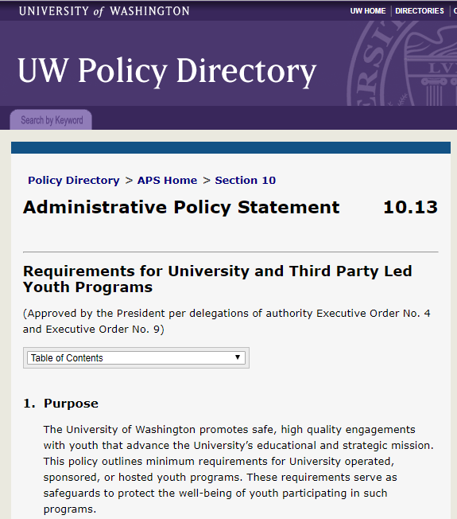
APS 10.13
Establishes minimum standards to safeguard the well-being of youth (persons under age 18) participating in UW led activities, events, programs, or research.
regardless of location
inclusive of virtual interactions
Notes:
Despite the many ways in which UW departments interact with youth, there are historically few University standards that speak specifically to this population.
Basic requirements that have been in place, such as background screenings and lab safety regulations were not well understood or consistently implemented.
With the adoption of APS 10.13 in September of 2019, for first time we now have University requirements for what would generally be regarded in most youth centered settings as minimum standards for safe operations.

Slide 12
APS 10.13
This policy applies to current and future UW led research that includes youth as a primary human subject population.
Also including:
exempt research
student led research
research occurring on or off campus locally or internationally
research that involves virtual interactions with youth
Notes:
The requirements of APS 10.13 apply to UW led research that includes youth as a human subject population.
This may also include research that is deemed exempt from IRB review, and student led research. The main criteria for applicability is whether there is a study team at UW, or contracted by UW, that is responsible for interacting with minors as subjects. If the answer is yes, it is likely that they should follow the requirements of APS 10.13.
Whether the research occurs on or off campus does not affect applicability. Also, virtual interactions, meaning contact with minors by phone, e-mail, or other online platforms, prompt the same level of adherence to the policy as an in-person interaction would.

Slide 13
APS 10.13 exceptions
Third party led research involving no UW staff interactions with youth
Retrospective research that does not involve in-person or virtual interactions with youth
are not subject to the requirements of this policy.
Notes:
Third Party led research, meaning research which is designed and conducted by a non-UW entity with no UW PI or co-investigator is exempted from this policy.
There may be occasional instances of external IRB approved research that does involve UW staff interacting with minor human subjects, and in these cases policy adherence should occur.
Retrospective research that does not involve any current or future interactions with youth is exempt from the requirements.

Slide 14
Overview of Requirements
Registration of research into the UW Youth Program Registration System
Meet screening, training, and conduct requirements
Report behaviors of concern
Maintain safe environments
Emergency and safety planning and response
Standards for data privacy (Research is exempt from this requirement)
Notes:
CAROLINE
There are six components of APS 10.13, five of which apply to Research. The sixth component, Privacy, is already thoroughly addressed by existing IRB protocols so the University felt it appropriate to exempt researchers from this additional requirement.
These requirements do require additional steps to be taken by research teams. Screening, training and conduct requirements are in place for personnel who may have unsupervised access to minors or other supervisory, custodial or caregiving responsibilities. We refer to these individuals as “authorized personnel.”

Slide 15
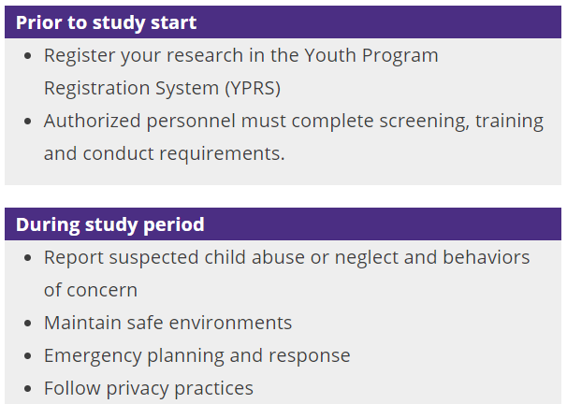
Notes:
Most of the required policy actions are taken prior to the start of the study.
The first step is that the study must be registered in the Youth Program Registration System. In YPRS (as we fondly refer to it) there is a specific form for registering a research study. The PI (or, if they delegate this, the study coordinator) will provide a few details about the study and must include names of authorized personnel who will need to complete required screenings, online trainings, and a conduct attestation. Any identified authorized personnel will automatically receive instructions with links to complete the required steps. The expectation is that all of these actions are completed by authorized personnel prior to beginning any unsupervised interactions with minor subjects.
We are working on a process to have YPRS initiate the registration automatically using information from Zipline so that there is a form started for any new study that is submitted for IRB approval. Once this is implemented, the PI will receive an e-mail notification requesting that they complete the registration, including a link to access the form. We hope to have this feature live by mid-May.
During the study, what is expected is likely already practiced by researchers assuming they are following other university policies and regulations. Specifics will differ depending on the nature of the study, such as whether parents are present, where the research protocols take place, etc.
We welcome folks to reach out to us with any specific questions about the requirements.

Slide 16
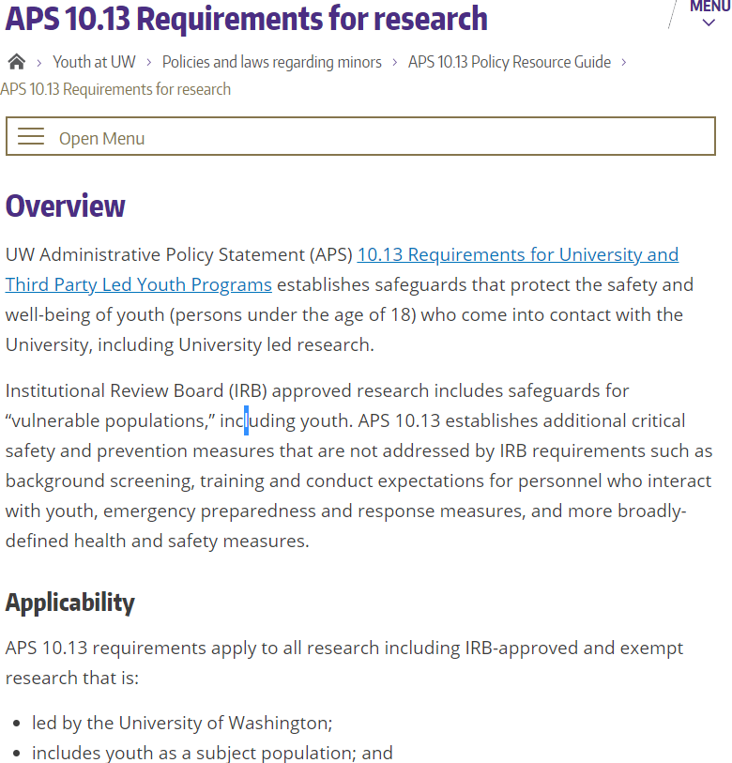
Support from the Office for YPDS
Web-based resources
FAQs
Registration Support
Consultation
https://www.uw.edu/youth/policy/protecting-youth-at-uw-aps-10-13/aps-10-13-info-for-researchers/
Notes:
Our office is available to assist research groups with understanding and implementing the requirements.
We have developed an array of resources on our website including a specific page for research.
<include link in chat>

Slide 17
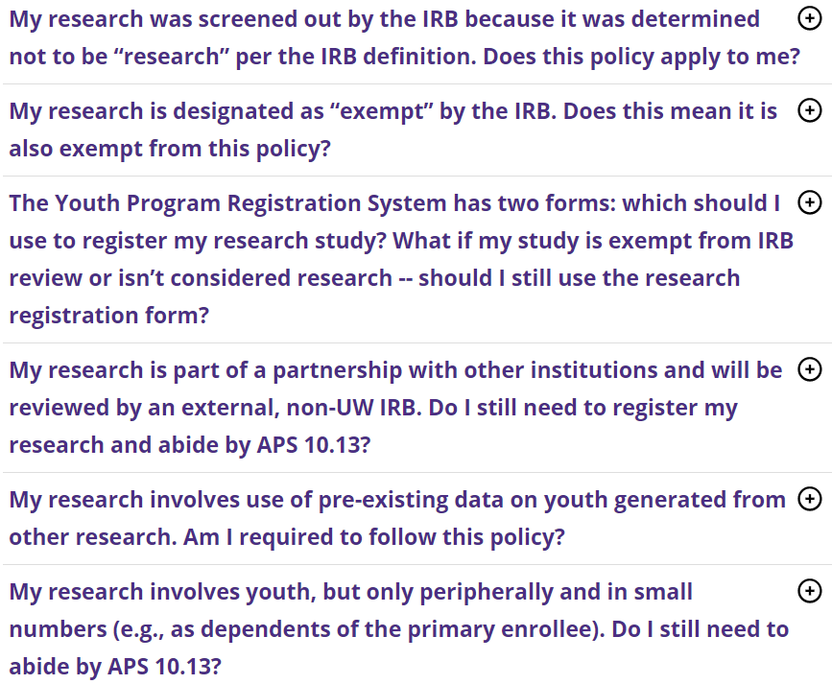
Support from the Office for YPDS
Web-based resources
FAQs
Registration Support
Consultation
https://www.uw.edu/youth/policy/protecting-youth-at-uw-aps-10-13/youth-program-faqs/#researchers
Notes:
We have developed a set of FAQs for researchers which can be found on the research landing page.
The most frequent questions we get are whether a certain study is in or out of scope.
We recommend reviewing these FAQs and then contacting us if your question is not answered.
<Add FAQ link to chat>

Slide 18
Support from the Office for YPDS
Web-based resources
FAQs
Registration Support
Consultation
https://apps.ideal-logic.com/uwypds
Notes:
We are happy to support researchers in the registration process.
We have developed a written tutorial that will walk them through the process. This is located on the web page for researchers.
Again we welcome questions by e-mail and phone and are happy to set up a brief zoom meeting- whatever best fits your needs.

Slide 19
Support from the Office for YPDS
Web-based resources
FAQs
Registration Support
Consultation
Contact uwminors@uw.edu
Call 206-616-5706
Notes:
Our general inbox and main office number are listed here.
Again we’re happy to consult on the specifics of APS 10.13 or any other topic that relates to the safety of youth.

Slide 20
How do researchers become aware of APS 10.13?
From departmental administration
Quarterly YPRS compliance reports
During IRB review
Zipline question
IRB Protocol 6.4
YPRS auto-registration trigger (coming soon)
Notes:
We have been doing outreach throughout the University about APS 10.13 since fall of 2019. All unit deans, VPs and administrators have received information, including quarterly compliance reports as well. If our outreach hasn’t yet reached you and you would like us provide a brief presentation on these requirements to your group, we are very happy to do so.
Additionally, the requirements are mentioned in a couple of places, including at the point of IRB application.
And as I mentioned, soon we will be automatically initiating registrations for new IRB applications.

Slide 21
Contact information
Caroline Shelton cshelton@uw.edu
Laura Harrington laurah13@uw.edu
General inbox uwminors@uw.edu
Notes:
Please don’t hesitate to contact us with any questions or to request a presentation to your research group or department.
Thank you for your time!

Slide 22
T32 Partnerships with Fred Hutchinson Cancer Research Center
MRAM
April 2021
Amanda Snyder
Office of Sponsored Programs

Slide 23
What is This About?
The UW has T32 training grants which pay stipends for post doctoral research trainees at Fred Hutchinson Cancer Research Center (FHCRC).
These post doctoral trainees perform research on FHCRC research projects and are mentored and supervised by FHCRC based PIs.
The same thing happens with FHCRC based post-doctoral trainees at the UW.

Slide 24
What’s New?
The UW and FHCRC have agreed to handle these situations via subawards.
Our new process is being finalized.
More information will be shared via the Training Grant listserv as well the Research and GCA websites.
If you have T32s that involve Fred Hutch - Stay tuned!

Slide 25
Subscribe to the Training Grant Listserv
To subscribe, send an email with the text
“Subscribe to the training grants listserv” to
research@uw.edu

Slide 26
Foreign Interest in Sponsored Research
MRAM
April 2021
Melissa Petersen
Office of Research

Slide 27
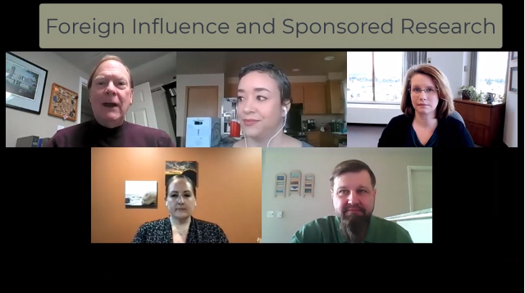
New Resource!
MRAM – Melissa Petersen – Office of Research
Notes:
Description
Concerns about improper foreign influence on federally-funded research at US universities have led to increased scrutiny and compliance enforcement. This video provides context and guidance for researchers engaged in international research collaborations in the form of a question-and-answer conversation between a principal investigator and UW subject matter experts.
Some of the questions asked and answered here (and more):
How would I recognize a “foreign talent recruitment program”?
What qualifies as a “foreign component”?
When am I required to disclose or seek approval for international travel related to research?
Under what circumstances does an international graduate student or postdoctoral scholar need to be identified as Key Personnel or Other Support?
What export control regulations might apply to my international collaborations?
Audience
Researchers & Research Administrators

Slide 28
NIH: Biographical Sketch and Other Support Format Changes May 25, 2021
MRAM
April 2021
Carol Rhodes
Office of Sponsored Programs

Slide 29
Why is NIH changing Biosketch & Other Support Format?
To align with the guidance from the Office of Science and Technology Policy (OSTP) Joint Committee on the Research Environment, issued in January 2021.
OSTP:
helps OMB with annual review and analysis of Federal research and development in budgets.
leads interagency science and technology policy coordination efforts.
serves as scientific and technological analysis and judgment for the President.

Slide 30
Changes: Effective May 25, 2021
Biosketch and Other Support (OS) pages,
and associated instructions
Two new big requirements for Senior/Key Personnel:
Electronic Signature on OS
Copies of any foreign contracts for foreign appointments and/or employment with a foreign institution
Translated, if not in English
Make a PDF copy available within supporting documentation

Slide 31
What type of Electronic Signature
is acceptable to NIH?
We don’t have the answer yet!
We are exploring NIH electronic signature options:
Scanning ink signature
not advised and probably not allowed
Signing via Adobe Acrobat signature
OSP uses this method regularly
Docusign via eSignatures Service, centrally managed and supported by UW-IT
Guidance will be added to Research website for acceptable e-signature methods.

Slide 32
Copies of Foreign Contracts?
NIH does not define or elaborate on:
“Foreign”, not clear if this means subsidiaries of foreign entities
Employment/Affiliation “Contract”
Please include:
Appointment letters with foreign entities
Foreign talent program agreements
Affiliation agreements with foreign entities
Consulting agreement with foreign entity in which the consulting is related to the senior/KP research
No Signed Agreement?
Consider an e-mail or other electronic exchange forming
the relationship as a “contract” & include

Slide 33
Copy of Contracts: Some Considerations
UW is not party to these contracts
Sensitive/proprietary info might be included in contracts:
sponsor system subject to FOIA
SAGE/UW e-mail system subject to WA Public Records law
These considerations are being discussed with NIH.
Notes:
We will proceed with submission if senior/KP says there is no contract or does not wish to provide contract. If provided, and needs translation, KP must take care of translation services.

Slide 34
Biosketch - Changes to Format
Section B renamed to ‘Positions, Scientific Appointments, and Honors’
Non-fellowship Biosketch: Entire Section D removed (Research Support)
Fellowship Biosketch: ‘Research Support” portion of Section D removed. The rest of Section D remains.
In Section A, Personal Statement: Include ongoing and completed research projects from the past three years that you want to draw attention to (previously known as research support)

Slide 35
Biosketch: What to Include in Section B?
Section B: ‘Positions, Scientific Appointments, and Honors’
List in reverse chronological order all positions and scientific appointments both domestic and foreign, including affiliations with foreign entities or governments
Includes titled academic, professional, or institutional appointments whether or not remuneration is received, and whether full-time, part-time, or voluntary (including adjunct, visiting, or honorary)
How far back? Further guidance requested
from NIH.
Notes:
Question posed to NIH on how far back to go

Slide 36
Biosketch Q&A
Is ScienCV in the new NIH format?
Yes, ScienCV is updated to new format
Will NIH withdraw my application if I don’t follow the new Biosketch format?
While the new Biosketch format is required effective May 25th, they will not withdraw applications with the previous Biosketch format until January 25, 2022.
After that date, failure to follow appropriate Biosketch format may cause NIH to withdraw your application from consideration.

Slide 37
NOT-OD-21-073 - National Response
Council on Governmental Relations (COGR) letter to NIH:
Asks for an extension
Requested specificity on definitions
Clarification on how far back to report appointments in Section B of Biosketch
COGR will send more questions
UW contributing to these
Want to submit questions? email ospweb@uw.edu
Notes:
UW part of these conversations

Slide 38
Recap: NIH Defines Other Support
NIH Other Support: “All resources made available to a researcher in support of and/or related to all of their research endeavors, regardless of whether or not they have monetary value and regardless of whether they are based at the institution the researcher identifies for the current grant.”
Notes:
Other Support includes all resources made available to a researcher in support of and/or related to all of their research endeavors, regardless of whether or not they have monetary value and regardless of whether they are based at the institution the researcher identifies for the current grant.

Slide 39
Recap:
What Do I Report as Other Support? Examples
Other Support Examples:
Grants and contracts, processed by the UW or through another institution
Domestic or international positions held by the Senior/Key Personnel, whether compensated or not
Affiliations (even if described as honorary or adjunct) with foreign entities or governments
Consulting related to Senior/Key Personnel research
Notes:
Other Support includes all resources made available to a researcher in support of and/or related to all of their research endeavors, regardless of whether or not they have monetary value and regardless of whether they are based at the institution the researcher identifies for the current grant.

Slide 40
Recap:
What do I report as Other Support? - In-Kind Support
Lab or office space provided by an entity other than the UW
Scientific materials or equipment provided by an entity other than the UW
Student working in senior/key personnel lab on research, and funded by another organization, including a foreign organization
Notes:
* If space, equipment or other resources provided by UW, that is not considered Other Support. That should be listed in Facilities and Other Resources.

Slide 41
In-Kind Support Defined by NIH in Notice
NIH defines in-kind support as “office/laboratory space, equipment, supplies, or employees or students supported by an outside source” that is “made available to a researcher in support of and/or related to all of their research”.
It is further referred to in FAQs as “of high value” and “uniquely available” to senior/KP.
Notes:
* If space, equipment or other resources provided by UW, that is not considered Other Support. That should be listed in Facilities and Other Resources.
If in-kind contribution is a gift, that is not reportable as OS

Slide 42
Other Support:
What does not need to be reported?
Gifts
Prizes
Training Awards
Consulting work that is unrelated to senior/key personnel research
Role on Scientific Advisory Board
Volunteer work
Conference honoraria
While not reportable as Other Support, some of these may rise to level of Significant Financial Interest; please use FIDS to disclose SFI.

Slide 43
Resources
UW: Current and Pending, or Other Support
NIH: Other Support
NIH: NOT-OD-19-114
NIH: NOT-OD-21-073
More FAQ Scenarios will be posted on the Research website soon.

Slide 44
Foreign Interest:
NIH Current Policies: What We Are Seeing
MRAM
April 2021
Tim Mhyre
Office of Sponsored Programs

Slide 45
What we are seeing...
Division of Receipt and Referral, Center for Scientific Review may administratively withdraw applications that do not follow NIH policy.
Recent examples
No prior approval for $500,000 or more in direct costs (excluding consortium F&A costs)
Non-compliant use of hyperlinks and URLs
Non-compliant materials included as Appendix materials
Information that should have been included in the Research Strategy is included in other application sections
Notes:
Note: Some NIH staff have been more lenient with C19, but that will surely change.

Slide 46
$500K Direct Cost Requests
Policy - Section 2.3.7.2 NIH Grants Policy Statement
Applies to applications requesting $500K or more in direct costs (excluding consortium F&A costs) in any one budget period
Need prior approval at least 6 weeks before submission
Contact IC PO in writing or by phone
PO may open request form in eRA Commons Prior Approval Module (see NOT-OD-17-005)
Include statement in Cover Letter Attachment with attached prior approval documentation
Notes:
IC = Institute/Center; Note this is a Grant Runner & ASSIST check, will get a Warning
(Policy not applicable “to applications submitted in response to RFAs or other announcements with specific budgetary limits.”)

Slide 47
Use of Hyperlinks & URLs
Policy outlined in NOT-OD-20-174, NIH Application Guide - Format Attachments
Allowed when specifically noted in FOA and form field instructions
e.g., citing relevant publications in bioskteches, publication lists
“[M]ay not be used to provide information necessary to application review.”
Reviewers instructed not to view linked sites or directly accessing a website
Format - must hyperlink that actual URL text
e.g., NIH https://www.nih.gov/
Notes:
Purpose: This notice serves to remind the applicant community about existing guidance that restricts use of hypertext (e.g., hyperlinks and URLs) in NIH applications. Increasing use of unallowable hypertext in NIH grant applications raises multiple concerns, including:
Reviewer Confidentiality: The wide availability and sophistication of web-based tracking systems may allow applicants to identify reviewers who access websites through unallowable hypertext in an application.
“Overstuffing”: All material required for the review must be contained within the page limits of the application. Linking out to additional information, even if it is framed by the applicant as “optional” or “supplemental”, provides additional material to reviewers that may exceed the content limitations of the application, particularly in page-limited sections such as the Research Strategy. This is a matter of fairness, since all applicants should submit the same amounts and types of information to be considered as part of initial peer review.
Review Consistency: If some reviewers consider information provided by unallowable hypertext and others do not, the quality of review can be negatively impacted by inconsistency among the reviewers.
Malware: Once a reviewer clicks on a link in an application that is not on an NIH website, the possibility exists for malware or other breaches to occur on the reviewer’s computer and/or system.

Slide 48
Appendix Materials
Policy: NOT-OD-18-126
Allowable Appendix Materials (unless specifically stated in FOA Section IV.2, Appendix):
“Blank data collection forms, blank survey forms and blank questionnaire forms…
Simple lists of interview questions...
Blank informed consent/assent forms...
Other items only if they are specified in the FOA as allowable Appendix materials.”

Slide 49
“Science” in Sections Other than
Research Strategy
“Science” = information that should be within page limits of Research Strategy
Inappropriate to include this information in other sections that do not have page limits
Vertebrate Animals section
Human Subjects form
Appendix
Viewed as subverting “science” page limitations, conferring an unfair advantage during review process
Notes:
Recent example - publication abstracts included in Progress Report Publication List, which was previously allowable

Slide 50
Take Home Message
NIH regularly reminds us applications must comply with applicable format/content instructions:
NOT-OD-11-080
NOT-OD-15-095
Review NIH Grants Policy Statement, Application Guide, relevant NOTs, and specific FOAs
Great NIH landing page for Grants, including links to Open Mike Blog, News, etc.

Slide 51
Questions?

Slide 52
COVID-19
GIM 19 Waivers
MRAM
April 2021
Carol Rhodes
Office of Sponsored Programs

