Slide 1
OVERVIEW OF
ADMINISTRATIVE
POLICY STATEMENT 10.13
REQUIREMENTS FOR UNIVERSITY
& THIRD PARTY LED YOUTH PROGRAMS (AND RESEARCH)
Notes:
CAROLINE
Thank you for the opportunity to present to this group. I will provide a brief overview of this relatively new administrative policy statement.
Note that though the policy title refers to youth programs, research is also included. I hope you can forgive the misnomer. Also, I may use the term minors or youth, and in both cases I am referring to individuals under the age of 18.

Slide 2
Office Operations
Policy Administrator
Primary: EO 56, APS 10.13
Policy partner for: APS 10.9, APS 44.3, EO 31, EO 51, EO 54, EO 55.
University Consultant
Risk mitigation, triage behaviors of concern or incidents involving minors
Policy compliance strategies, general programming best practices
Convener
Coordinate efforts among youth program providers, health, safety and risk SMEs to raise awareness of youth on campus
Youth Safety Champion
Focus on youth safety in adult-oriented University setting
https://www.uw.edu/youth
Notes:
First, a brief introduction to our office. We were established in 2016 and serve as a central resource for questions and concerns regarding the safety of youth who engage with the University. In our last tally, we estimate that the University engages with over 320,000 youth on an annual basis. These numbers mostly do not include research subjects, so the number will likely continue to rise as we receive more registrations.
We are the primary policy administrator for this policy as well as EO 56, reporting suspected child abuse or neglect. We also partner with others to address policy concerns when there are intersections with minors.
We are available to consult with departments on policy compliance and have developed educational resources to support effective compliance with policies.
We also consult on risk mitigation strategies, triage incidents and discuss best practices with anyone in the UW system.
We regularly convene meetings among youth programs to support best practices and policy compliance.
We also bring health, safety and risk management stakeholders together to raise awareness of youth on campus.
Over the past year of the pandemic we have worked closely with EH&S to develop COVID-19 prevention protocols for youth programs, and also worked closely with the Privacy Office and UW IT to develop guidelines for virtual engagement with minors.

Slide 3
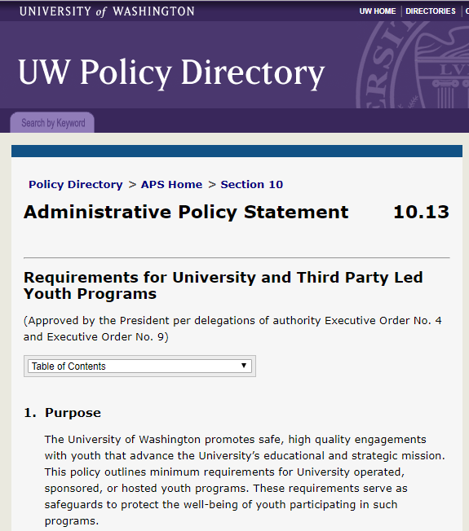
APS 10.13
Establishes minimum standards to safeguard the well-being of youth (persons under age 18) participating in UW led activities, events, programs, or research.
regardless of location
inclusive of virtual interactions
Notes:
Despite the many ways in which UW departments interact with youth, there are historically few University standards that speak specifically to this population.
Basic requirements that have been in place, such as background screenings and lab safety regulations were not well understood or consistently implemented.
With the adoption of APS 10.13 in September of 2019, for first time we now have University requirements for what would generally be regarded in most youth centered settings as minimum standards for safe operations.

Slide 4
APS 10.13
This policy applies to current and future UW led research that includes youth as a primary human subject population.
Also including:
exempt research
student led research
research occurring on or off campus locally or internationally
research that involves virtual interactions with youth
Notes:
The requirements of APS 10.13 apply to UW led research that includes youth as a human subject population.
This may also include research that is deemed exempt from IRB review, and student led research. The main criteria for applicability is whether there is a study team at UW, or contracted by UW, that is responsible for interacting with minors as subjects. If the answer is yes, it is likely that they should follow the requirements of APS 10.13.
Whether the research occurs on or off campus does not affect applicability. Also, virtual interactions, meaning contact with minors by phone, e-mail, or other online platforms, prompt the same level of adherence to the policy as an in-person interaction would.

Slide 5
APS 10.13 exceptions
Third party led research involving no UW staff interactions with youth
Retrospective research that does not involve in-person or virtual interactions with youth
are not subject to the requirements of this policy.
Notes:
Third Party led research, meaning research which is designed and conducted by a non-UW entity with no UW PI or co-investigator is exempted from this policy.
There may be occasional instances of external IRB approved research that does involve UW staff interacting with minor human subjects, and in these cases policy adherence should occur.
Retrospective research that does not involve any current or future interactions with youth is exempt from the requirements.

Slide 6
Overview of Requirements
Registration of research into the UW Youth Program Registration System
Meet screening, training, and conduct requirements
Report behaviors of concern
Maintain safe environments
Emergency and safety planning and response
Standards for data privacy (Research is exempt from this requirement)
Notes:
CAROLINE
There are six components of APS 10.13, five of which apply to Research. The sixth component, Privacy, is already thoroughly addressed by existing IRB protocols so the University felt it appropriate to exempt researchers from this additional requirement.
These requirements do require additional steps to be taken by research teams. Screening, training and conduct requirements are in place for personnel who may have unsupervised access to minors or other supervisory, custodial or caregiving responsibilities. We refer to these individuals as “authorized personnel.”

Slide 7
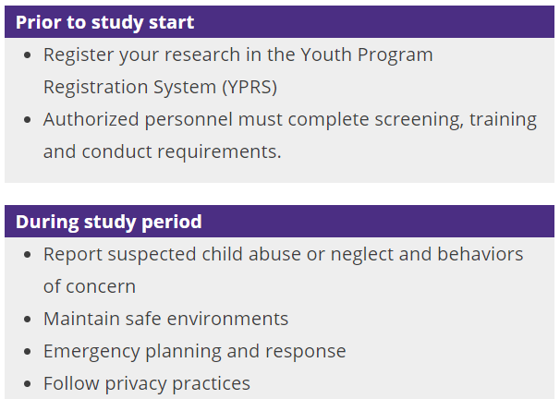
Notes:
Most of the required policy actions are taken prior to the start of the study.
The first step is that the study must be registered in the Youth Program Registration System. In YPRS (as we fondly refer to it) there is a specific form for registering a research study. The PI (or, if they delegate this, the study coordinator) will provide a few details about the study and must include names of authorized personnel who will need to complete required screenings, online trainings, and a conduct attestation. Any identified authorized personnel will automatically receive instructions with links to complete the required steps. The expectation is that all of these actions are completed by authorized personnel prior to beginning any unsupervised interactions with minor subjects.
We are working on a process to have YPRS initiate the registration automatically using information from Zipline so that there is a form started for any new study that is submitted for IRB approval. Once this is implemented, the PI will receive an e-mail notification requesting that they complete the registration, including a link to access the form. We hope to have this feature live by mid-May.
During the study, what is expected is likely already practiced by researchers assuming they are following other university policies and regulations. Specifics will differ depending on the nature of the study, such as whether parents are present, where the research protocols take place, etc.
We welcome folks to reach out to us with any specific questions about the requirements.

Slide 8
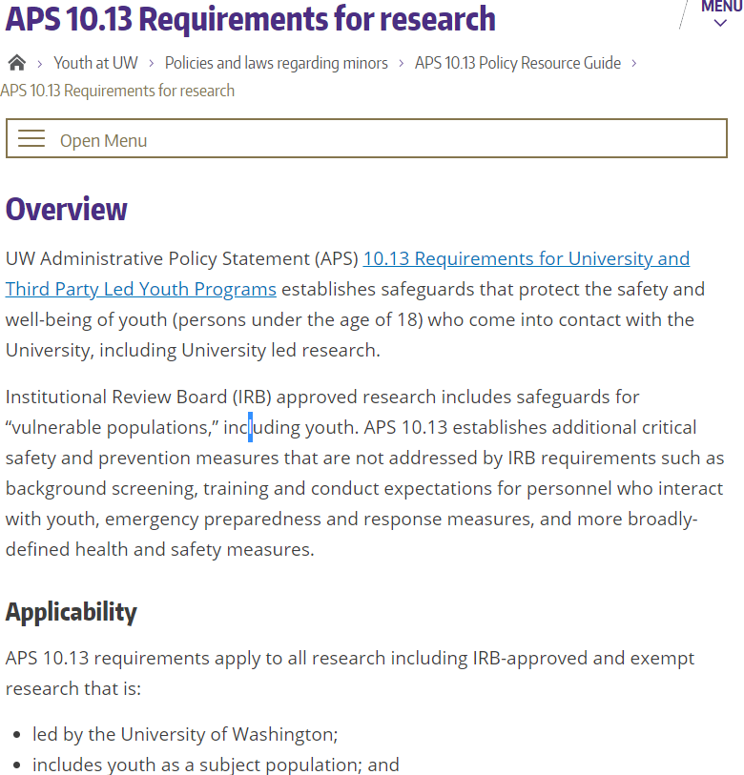
Support from the Office for YPDS
Web-based resources
FAQs
Registration Support
Consultation
https://www.uw.edu/youth/policy/protecting-youth-at-uw-aps-10-13/aps-10-13-info-for-researchers/
Notes:
Our office is available to assist research groups with understanding and implementing the requirements.
We have developed an array of resources on our website including a specific page for research.
<include link in chat>

Slide 9
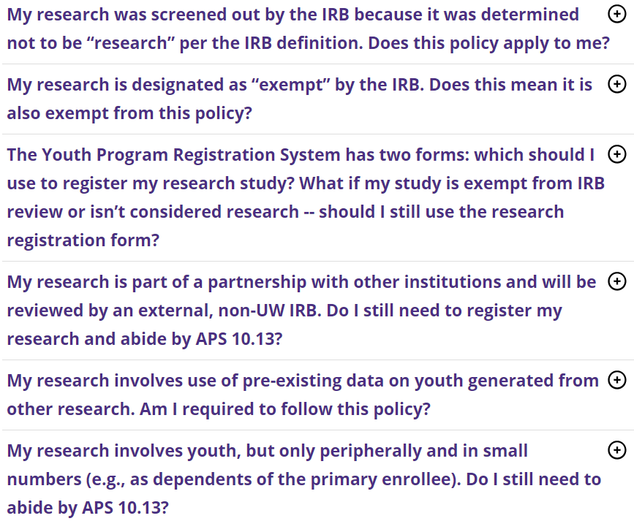
Support from the Office for YPDS
Web-based resources
FAQs
Registration Support
Consultation
https://www.uw.edu/youth/policy/protecting-youth-at-uw-aps-10-13/youth-program-faqs/#researchers
Notes:
We have developed a set of FAQs for researchers which can be found on the research landing page.
The most frequent questions we get are whether a certain study is in or out of scope.
We recommend reviewing these FAQs and then contacting us if your question is not answered.
<Add FAQ link to chat>

Slide 10
Support from the Office for YPDS
Web-based resources
FAQs
Registration Support
Consultation
https://apps.ideal-logic.com/uwypds
Notes:
We are happy to support researchers in the registration process.
We have developed a written tutorial that will walk them through the process. This is located on the web page for researchers.
Again we welcome questions by e-mail and phone and are happy to set up a brief zoom meeting- whatever best fits your needs.

Slide 11
Support from the Office for YPDS
Web-based resources
FAQs
Registration Support
Consultation
Contact uwminors@uw.edu
Call 206-616-5706
Notes:
Our general inbox and main office number are listed here.
Again we’re happy to consult on the specifics of APS 10.13 or any other topic that relates to the safety of youth.

Slide 12
How do researchers become aware of APS 10.13?
From departmental administration
Quarterly YPRS compliance reports
During IRB review
Zipline question
IRB Protocol 6.4
YPRS auto-registration trigger (coming soon)
Notes:
We have been doing outreach throughout the University about APS 10.13 since fall of 2019. All unit deans, VPs and administrators have received information, including quarterly compliance reports as well. If our outreach hasn’t yet reached you and you would like us provide a brief presentation on these requirements to your group, we are very happy to do so.
Additionally, the requirements are mentioned in a couple of places, including at the point of IRB application.
And as I mentioned, soon we will be automatically initiating registrations for new IRB applications.

Slide 13
Contact information
Caroline Shelton cshelton@uw.edu
Laura Harrington laurah13@uw.edu
General inbox uwminors@uw.edu
Notes:
Please don’t hesitate to contact us with any questions or to request a presentation to your research group or department.
Thank you for your time!

