Slide 1
Foreign Interest in Sponsored Research
MRAM
April 2021
Melissa Petersen
Office of Research

Slide 2
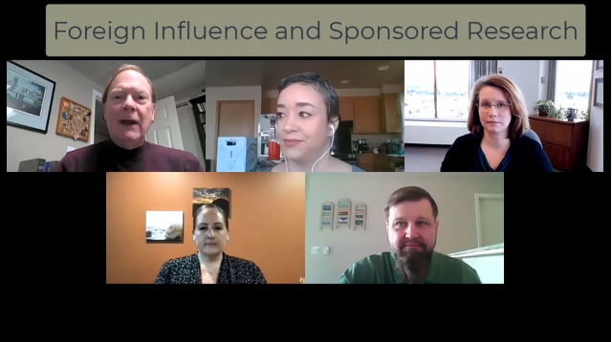
New Resource!
MRAM – Melissa Petersen – Office of Research
Notes:
Description
Concerns about improper foreign influence on federally-funded research at US universities have led to increased scrutiny and compliance enforcement. This video provides context and guidance for researchers engaged in international research collaborations in the form of a question-and-answer conversation between a principal investigator and UW subject matter experts.
Some of the questions asked and answered here (and more):
How would I recognize a “foreign talent recruitment program”?
What qualifies as a “foreign component”?
When am I required to disclose or seek approval for international travel related to research?
Under what circumstances does an international graduate student or postdoctoral scholar need to be identified as Key Personnel or Other Support?
What export control regulations might apply to my international collaborations?
Audience
Researchers & Research Administrators

