Slide 1
MRAM | Monthly Research Administration Meeting
May 13, 2021 9:00 AM – 10:00 AM HOSTED REMOTELY Join the LIVE Webinar: https://washington.zoom.us/j/346891888
TOPIC | PRESENTER | EMAIL | MIN
Welcome | Kirsten DeFries Research Compliance & Operations | kirsten5@uw.edu | 2
GCA Help Update | Austin Campbell Grant & Contract Accounting | gcahelp@uw.edu | 2
Advance Budget Number Request: New Process! | Lily Gebrenegus, Grant & Contract Accounting Chris Carlson, Office of Research Information Services | lgebren@uw.edu carlsc@uw.edu | 15
SAM.gov Update | Adelia Yee Office of Sponsored Programs | ayee@uw.edu | 5
Federal Regulation Update | Matt Gardner Post Award Fiscal Compliance | gcafco@uw.edu | 10
Phase Changes and UW Research | Joe Giffels Office of Research | jgiffels@uw.edu | 5
NEXT MEETING June 10, 2021 9:00 AM - 10:00 AM

Slide 2
Contacting GCA Help
MRAM
May 13, 2021
Austin Campbell, Grant Analyst
Grant and Contract Accounting (GCA)

Slide 3
Contacting GCA Help
Phone lines are back open!
Grant Analysts can be reached at 206-616-9995
Hours: M-F, 9am-12pm and 1-4pm
If the phones are closed, please leave a voicemail. We will review and respond as soon as possible.
Send a budget-specific note via Grant Tracker
Email gcahelp@uw.edu

Slide 4
New Advance Budget Process
May 13, 2021 MRAM

Slide 5
New Process & Benefits
CURRENT ADVANCE PROCESS
9 Steps, taking up to 7 days (or up to 10 if SFI hold)
Campus/OSP/GCA have to use: Webform, Emails, Printed paper
ADV Eligibility webform submitted
Full disclosure & SFI Review
OSP marks eGC1 eligible & emails Dept
ADV Request submitted in SAGE
ADV form printed for PI and dept approvals
Signed ADV emailed
to GCA
GCA prints and reviews ADV
GCA sets up budget in
FIN & notifies Dept
Budget number becomes active
FUTURE ADVANCE PROCESS
6 Steps - taking as little as 3 days (8 if SFI hold)
No more: Webforms, Emails, Printed paper to complete process
ADV Intake
initiated
in SAGE
ADV
Request submitted
in SAGE
PI & Dept approve online (New Advance only)
GCA
review (abbrev.)
GCA sets up budget in
FIN
Budget number becomes active
SFI review completed
Automated eligibility
SFI review triggered
SFI hold, until reviews complete
Campus notified, Compliance holds on pending FAs removed
Notes:
Lily

Slide 6
Important Dates
Mon, May 24 at 5pm:
Advance Budget Number Eligibility Form no longer available
New Advance Budget Request Freeze until June 8th
Fri, May 28 at 3pm:
Final day to submit a signed advance budget request to gcahelp@uw.edu
Mon, June 7:
Confirm Advance Reviewer ASTRA role in place for your unit
Tues, June 8 from 10-11:30am: Demo / Q&A Session
Wed, June 9: New Process Available in SAGE!
Notes:
Lily

Slide 7
Policy Updates Planned:
GIM 9 - Advance Budgets
Upcoming changes include:
Removing process steps and focusing on policy
Exploring request limits beyond the current 6 months for original requests and 3 months extensions
Additional consideration for clinical trials
New process can be found here:
New Advance Budget Process information
Expect web content updates from OSP
and GCA
Notes:
Lily

Slide 8
What You’ll See on June 9th
Advance Request List & Requesting Extension
The “Type” column will show you whether the Advance request is New, Renewal, or Extension
New and Renewal Advances can be extended if:
In “Processed” status
and
Started in last 18 mos.
Existing Advances in “Processed” status will be available to open in the new format.
Draft advances will be discarded.
Notes:
Call out How to Extend support doc link

Slide 9
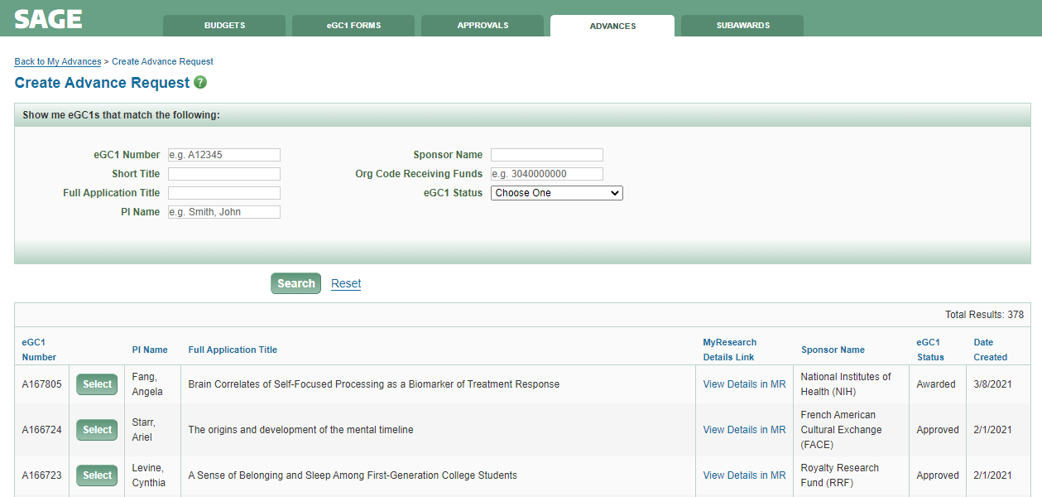
What You’ll See on June 9th
Requesting a New or Renewal Advance Budget
Eligibility Rules:
eGC1 status must be either Approved or Awarded.
Related eGC1 cannot have Type of NAA or Pre-Application.
eGC1 cannot have a related Funding Action in GCA.
SAGE will now automatically determine which eGC1s are eligible for an Advance and display them.
Click “Select” to create request.
Notes:
System does not factor in whether the Sponsor allows advance spend, so it’s up to the department to make that determination.
Call out MyResearch link

Slide 10
Steps to Prepare
Units need to assign the new Advance Reviewer SAGE ASTRA role for their organization code(s) to approve Advance Budget requests
Stay tuned for email reminders to MRAM and SAGE mailing lists, a new job aid, and updated user guides
Review information and timeline on Advance Budgets in SAGE webpage
Demo and Q&A on June 8th from 10:00-11:30 am
Notes:
The approver needs to be assigned to any org code entered as the fiscally responsible dept/org. If org is at the sub-division, assign reviewer to division code.

Slide 11
Questions
Lily Gebrenegus, GCA
lgebren@uw.edu
Chris Carlson, ORIS
sagehelp@uw.edu

Slide 12
SAM.gov Update
May, 2021 MRAM
Adelia Yee
Office of Sponsored Programs

Slide 13
SAM.gov Updates
System for Award Management (SAM.gov)
May 24, 2021: New modernized look & feel; core functions and data unchanged
Completely unavailable from Friday, May 21 at 4:00 PM EST through Monday, May 24 at 9:00 AM EST as it is upgraded

Slide 14
Individual Accounts Required
Need a Sam.gov account to search for entity profiles and exclusions
includes debarred/suspensions and special exclusions such as covered telecommunications equipment or services
Create a user account
Log in with username/password
2-factor authentication (2FA)
You do not need to contact OSP to register

Slide 15
Viewer Role
View entity registration
Search public data
Save search results
Viewer roles do not have to be affiliated with the UW
Anyone can have a Viewer role

Slide 16
NIH & NSF UPDATES
MRAM
May 2021
Matt Gardner
Post Award Fiscal Compliance

Slide 17
New NIH Grants Policy Statement Update
First update since December 2019
Applicable to all NIH grants and cooperative agreements beginning on or after October 1, 2020
Incorporates NIH Notices issued since October 2019
The GPS is considered a standard term and condition of NIH Awards.
Reference
https://grants.nih.gov/grants/policy/nihgps/nihgps.pdf
MRAM – Matt Gardner – PAFC

Slide 18
New NIH Grants Policy Statement Updates –
Significant Changes
Modification of section 8.1.2.6 – Change in PD/PI and Other Senior/Key Personnel
New language for requesting new or substitute PIs or Senior/Key Personnel:
“…the request for approval should include mention as to whether change(s) in PD/PI or Senior/Key Personnel is related to concerns about safety and/or work environments (e.g. due to concerns about harassment, bullying, retaliation, or hostile working conditions). NIH will in turn be better positioned to enable informed grant-stewardship decisions regarding matters including, but not limited to, substitute personnel and institutional management and oversight.”
MRAM – Matt Gardner – PAFC

Slide 19
New NIH Grants Policy Statement Updates –
Significant Changes
Modification of section 12.2.3.2.1 - Eligibility under the K99/R00 Program
Additional language regarding factors to consider for requests for extension of the K99 eligibility window.
Also: one year extension for childbirth within the four year K99 eligibility window.
MRAM – Matt Gardner – PAFC

Slide 20
New NIH Grants Policy Statement Updates –
Significant Changes
Updated elements on the Notice of Award beginning on October 1, 2020
Additional information provided on the “new” Page 1 of the NIH Award document (you’ve probably already seen this!)
The “new” standardized Page 1 will appear on every HHS Notice of Award.
MRAM – Matt Gardner – PAFC

Slide 21
NSF Updates –
Implementation of OMB M-21-20
OMB M-21-20: Guidance to federal agencies on implementation of the American Rescue Plan Act (the most recent federal stimulus)
https://www.whitehouse.gov/wp-content/uploads/2021/03/M_21_20.pdf
Appendix 3 provides for “Disaster Relief Flexibilities to Reduce Burden for Financial Assistance”
NSF Implemented some of the flexibilities
MRAM – Matt Gardner – PAFC

Slide 22
NSF Updates –
Implementation of OMB M-21-20
Flexibilities implemented concern SAM registration/recertification extensions, abbreviated non-competitive continuation requests, application deadlines, and physical inventory management
Applies to COVID-19 related funding, as well as awards not related to COVID-19
Reference:
https://www.nsf.gov/bfa/dias/policy/covid19/covid19_nsfomb2120implementation.pdf
MRAM – Matt Gardner – PAFC

Slide 23
Questions
Post Award Fiscal Compliance (PAFC)
gcafco@uw.edu
https://finance.uw.edu/pafc/
Andra Sawyer
andra2@uw.edu
Matt Gardner
mgard4@uw.edu
Available for Teams, Zoom or Skype calls.
MRAM – Matt Gardner – PAFC

Slide 24
Changing Phases
Guidelines for UW Research
MRAM
May 2021
Joe Giffels
Office of Research

Slide 25
Differences for Research
between Phases 2 and 3
Guidance – only one change
Virtual business meetings are still encouraged, but in-person business meetings are permitted
Masks and 6 ft distancing are still required
Remote access to meetings must be provided
Social Environment – a big change
Vaccinations
Availability
% of population vaccinated

Slide 26
Research@UW.edu

