Slide 1
New Advance Budget Process
May 13, 2021 MRAM

Slide 2
New Process & Benefits
CURRENT ADVANCE PROCESS
9 Steps, taking up to 7 days (or up to 10 if SFI hold)
Campus/OSP/GCA have to use: Webform, Emails, Printed paper
ADV Eligibility webform submitted
Full disclosure & SFI Review
OSP marks eGC1 eligible & emails Dept
ADV Request submitted in SAGE
ADV form printed for PI and dept approvals
Signed ADV emailed
to GCA
GCA prints and reviews ADV
GCA sets up budget in
FIN & notifies Dept
Budget number becomes active
FUTURE ADVANCE PROCESS
6 Steps - taking as little as 3 days (8 if SFI hold)
No more: Webforms, Emails, Printed paper to complete process
ADV Intake
initiated
in SAGE
ADV
Request submitted
in SAGE
PI & Dept approve online (New Advance only)
GCA
review (abbrev.)
GCA sets up budget in
FIN
Budget number becomes active
SFI review completed
Automated eligibility
SFI review triggered
SFI hold, until reviews complete
Campus notified, Compliance holds on pending FAs removed
Notes:
Lily

Slide 3
Important Dates
Mon, May 24 at 5pm:
Advance Budget Number Eligibility Form no longer available
New Advance Budget Request Freeze until June 8th
Fri, May 28 at 3pm:
Final day to submit a signed advance budget request to gcahelp@uw.edu
Mon, June 7:
Confirm Advance Reviewer ASTRA role in place for your unit
Tues, June 8 from 10-11:30am: Demo / Q&A Session
Wed, June 9: New Process Available in SAGE!
Notes:
Lily

Slide 4
Policy Updates Planned:
GIM 9 - Advance Budgets
Upcoming changes include:
Removing process steps and focusing on policy
Exploring request limits beyond the current 6 months for original requests and 3 months extensions
Additional consideration for clinical trials
New process can be found here:
New Advance Budget Process information
Expect web content updates from OSP
and GCA
Notes:
Lily

Slide 5
What You’ll See on June 9th
Advance Request List & Requesting Extension
The “Type” column will show you whether the Advance request is New, Renewal, or Extension
New and Renewal Advances can be extended if:
In “Processed” status
and
Started in last 18 mos.
Existing Advances in “Processed” status will be available to open in the new format.
Draft advances will be discarded.
Notes:
Call out How to Extend support doc link

Slide 6
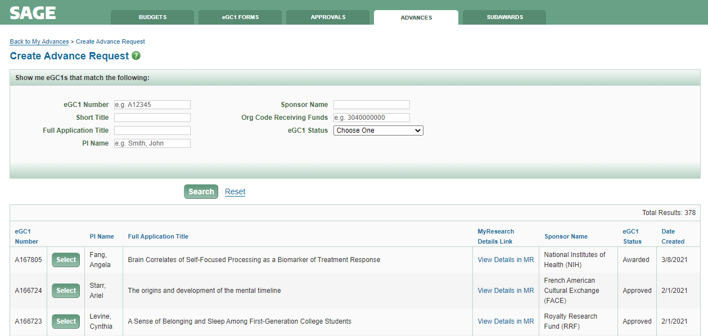
What You’ll See on June 9th
Requesting a New or Renewal Advance Budget
Eligibility Rules:
eGC1 status must be either Approved or Awarded.
Related eGC1 cannot have Type of NAA or Pre-Application.
eGC1 cannot have a related Funding Action in GCA.
SAGE will now automatically determine which eGC1s are eligible for an Advance and display them.
Click “Select” to create request.
Notes:
System does not factor in whether the Sponsor allows advance spend, so it’s up to the department to make that determination.
Call out MyResearch link

Slide 7
Steps to Prepare
Units need to assign the new Advance Reviewer SAGE ASTRA role for their organization code(s) to approve Advance Budget requests
Stay tuned for email reminders to MRAM and SAGE mailing lists, a new job aid, and updated user guides
Review information and timeline on Advance Budgets in SAGE webpage
Demo and Q&A on June 8th from 10:00-11:30 am
Notes:
The approver needs to be assigned to any org code entered as the fiscally responsible dept/org. If org is at the sub-division, assign reviewer to division code.

Slide 8
Questions
Lily Gebrenegus, GCA
lgebren@uw.edu
Chris Carlson, ORIS
sagehelp@uw.edu

