Slide 1
MRAM | Monthly Research Administration Meeting
July 8, 2021 9:00 AM – 10:00 AM HOSTED REMOTELY Join the LIVE Webinar: https://washington.zoom.us/j/346891888
TOPIC | PRESENTER | EMAIL | MIN
Welcome | Carol Rhodes Office of Sponsored Programs | carhodes@uw.edu | 2
NSF PAPPG | Andra Sawyer Post Award Fiscal Compliance | gcafco@uw.edu | 5
NSF Disclosures, UW Outside Work and FIDS | Melissa Petersen Office of Research | petermm@uw.edu | 10
NIH Other Support -eSign update | Carol Rhodes Office of Sponsored Programs | carhodes@uw.edu | 5
SAM.gov Unique Entity Identifier | Adelia Yee Office of Sponsored Programs | ayee@uw.edu | 10
SCRI Staff Assignments | Saamir Choudhary, Albert Lo Grant and Contract Accounting | saamirc@uw.edu loa2@uw.edu | 10
GCCR Records Retention | Barbara Benson Records Management Services | recmgt@uw.edu | 5
Guidelines for Returning to In-Person Research | Joe Giffels Office of Research | jgiffels@uw.edu | 5
NEXT MEETING August 12, 2021 9:00 AM - 10:00 AM

Slide 2
Updated NSF PAPPG
MRAM
July 2021
Andra Sawyer & Matt Gardner
Post Award Fiscal Compliance

Slide 3
NSF’s Proposal & Award Policies & Procedures Guide – 2021 Update
Nothing major, mostly alignments with 2 CFR 200 (Uniform Guidance):
Failure to submit required reports within one year from award end date will be reported to OMB as a UW “material failure to comply.”

Slide 4
2021 Updates to NSF’s PAPPG
Rent for home office workspace is not allowable.
Pre-award costs (if allowable…) must be charged to the Award’s initial budget period.
Program Income language modified to align with 2 CFR 200.

Slide 5
Questions?
Post Award Fiscal Compliance
gcafco@uw.edu
Matt Gardner (working in the office)
mgard4@uw.edu
Andra Sawyer
andra2@uw.edu
Call via Microsoft Teams, Zoom or Skype

Slide 6
NSF Disclosures, Outside Work & FIDS Procedures
July, 2021 MRAM
Melissa Petersen, Office of Research

Slide 7
NSF: Pre-award and Post-award Disclosures Relating to the Biographical Sketch and Current and Pending Support
The new PAPPG is effective for proposals submitted or due on or after October 4, 2021.
Includes: NSF Pre-award and Post-award Disclosures Relating to the Biographical Sketch and Current and Pending Support.
Identifies where pre & post-award disclosure information must be provided.
This resource can be used now!

Slide 8
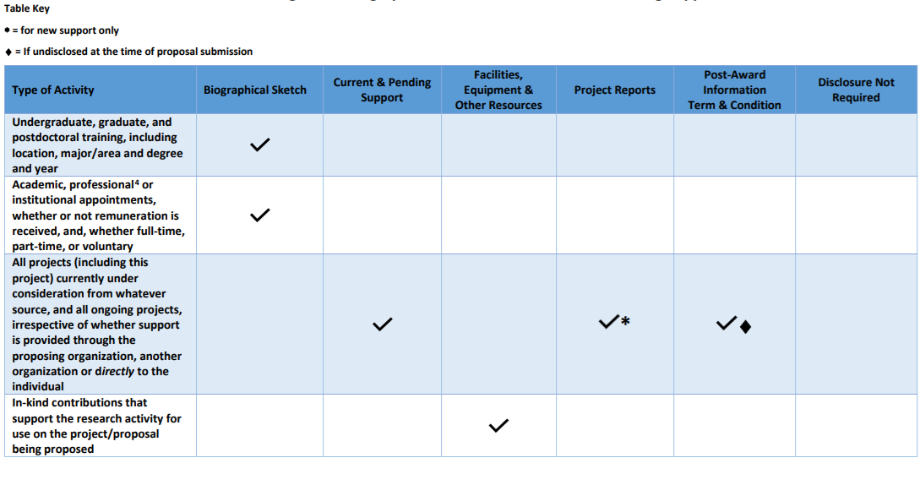
NSF & UW Outside Work and Significant Financial Disclosure Considerations (1 of 8)
Academic, professional⁴ or institutional appointments, whether or not remuneration is received, and whether full-time, part-time or voluntar
NSF: Report in Biographical Sketch
UW Disclosures:
Outside Work? - Probably
SFI? - Maybe
NSF 4: Senior personnel must identify all current domestic or foreign professional appointments outside of the individual's academic, professional, or institutional appointments at the proposing organization.
Notes:
focusing on items where you should consider whether appropriate Outside Work approvals and or Significant Financial Disclosure Is needed.

Slide 9
...Disclosure Considerations (2 of 8)
All projects (including this project) currently under consideration from whatever source, and all ongoing projects, irrespective of whether support is provided through the proposing organization, another organization or directly to the individual
NSF:
Current and Pending Support
Project Reports *for new support only
Post Award Information terms & conditions
UW Disclosures:
Outside Work? - Probably not
SFI Disclosure? - Maybe

Slide 10
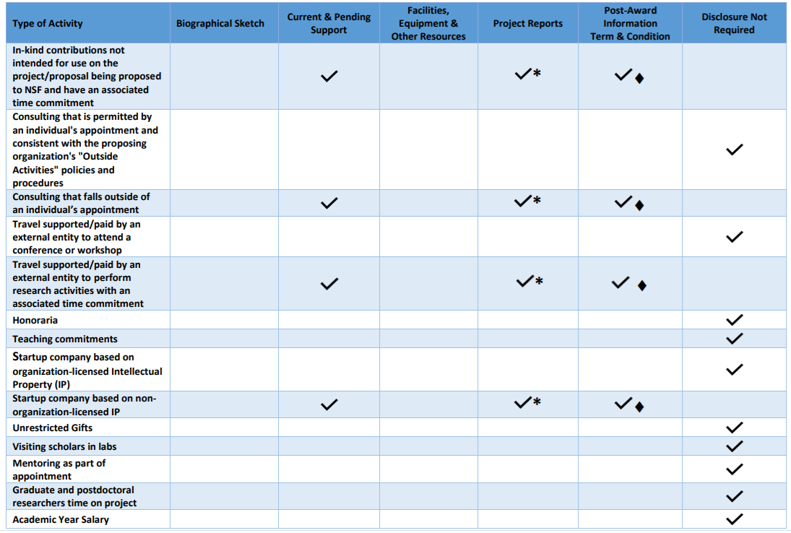
...Disclosure Considerations (3 of 8)
Consulting* that is permitted by an individual's appointment and consistent with the proposing organization's "Outside Activities" policies and procedures
NSF: Disclosure Not Required
UW Disclosures:
Outside Work? - Definitely
SFI Disclosure? - Maybe
*UW’s Outside Professional Work Policy Executive Order No. 57 distinguishes between “consulting” and “deeper than consulting”
Notes:
Carol

Slide 11
...Disclosure Considerations (4 of 8)
Consulting that falls outside of an individual’s appointment
NSF:
Current and Pending Support
Project Reports *for new support only
Post Award Information terms & conditions
UW Disclosures: Hopefully this doesn’t apply!!
Notes:
Carol

Slide 12
...Disclosure Considerations (5 of 8)
Travel supported/paid by an external entity to attend a conference or workshop
NSF: Disclosure Not Required
UW Disclosures:
Outside Work? -Maybe
SFI Disclosure? - Probably (if costs exceeded $50)
Notes:
Carol

Slide 13
...Disclosure Considerations (6 of 8)
Travel supported/paid by an external entity to perform research activities with an associated time commitment
NSF:
Current and Pending Support
Project Reports *for new support
Post Award Information terms and conditions
UW Disclosures
Outside Work? - Maybe
SFI Disclosure? - Probably (if costs exceeded $50)
Notes:
Carol

Slide 14
...Disclosure Considerations (7 of 8)
Startup company based on organization-licensed Intellectual Property (IP)
NSF: Disclosure Not Required
UW Disclosures:
Outside Work? -Maybe
SFI Disclosure? - Probably
Notes:
Carol

Slide 15
...Disclosure Considerations (8 of 8)
Startup company based on non-organization-licensed IP
NSF:
Current and Pending Support
Project Reports
Post Award Information terms and conditions
UW Disclosures
Outside Work? - Maybe
SFI? - Most likely (refer to SFI disclosure thresholds and requirements in GIM 10)
Notes:
Carol

Slide 16
UW Resources
Current and Pending or Other Support
Financial Conflict of Interest (FCOI):
FCOI Guidance
Policy: GIM 10
Financial Interest Disclosure System: FIDS
Outside Professional Work:
Guidance
Policy
Foreign Interests in Sponsored Programs
Notes:
NSF links from CPOS page : NSF: Proposal and Award Policies & Procedures Guide (PAPPG 20-1): Current & Pending Support
Current and Pending Support Guidance and Links
Current and Pending Support FAQs
NSF Webinar on Approved Formats
Pre & Post Award Disclosures Related to the Biosketch & Current and Pending Support

Slide 17
NSF Resources
Pre & Post Award Disclosures Relating to the Biosketch & Current and Pending Support
FAQS - Current and Pending Support
Approved Formats for Current and Pending Support

Slide 18
Questions

Slide 19
NIH - eSignature Requirement
July, 2021 MRAM
Carol Rhodes
Office of Sponsored Programs

Slide 20
NIH eSignature Requirement Recap
New formats for Other Support (OS) and Biosketch
OS includes an electronic signature requirement
Effective on and after January 25, 2022
As always, withdrawal or delay in funding if formats / instructions not followed for submissions after requirement effective dates
Notes:
Per NIH guidelines, the signed Other Support page must be “flattened” before being submitted to NIH. To do so,
select “Download a Copy” and select the printer icon in the top right of the screen. In the printer drop-down
menu, select the “Microsoft Print to PDF” option to properly “flatten” the signed Other Support page. After
doing so, the signer should retain a copy of the original Adobe Sign document and a copy of the “flattened”
version of the signed Other Support document.

Slide 21
Electronic Signatures on OS
Electronic signatures are not yet required, though NIH encourages them.
NIH expects integration of electronic signature into SciENcv as of January 2022.
If you are using electronic signatures you must retain the original signed document in your project files.
Notes:
Per NIH guidelines, the signed Other Support page must be “flattened” before being submitted to NIH. To do so,
select “Download a Copy” and select the printer icon in the top right of the screen. In the printer drop-down
menu, select the “Microsoft Print to PDF” option to properly “flatten” the signed Other Support page. After
doing so, the signer should retain a copy of the original Adobe Sign document and a copy of the “flattened”
version of the signed Other Support document.
Flattened digital signatures. A Flattened signature occurs when flattening pushes the appearance of the signature annotation into the page content, effectively deleting interactive elements, but retaining the visual appearance of those elements

Slide 22
Achieving an Electronic Signature
There are many ways to achieve an electronic signature.
OSP recommendations until SciENcv integration:
Docusign, or
Ink/Scan
Both administrators & faculty tested Docusign for OS in April and May. Thank you testers!
Reminder:
“Flatten” signed PDFs
Notes:
Per NIH guidelines, the signed Other Support page must be “flattened” before being submitted to NIH. To do so,
select “Download a Copy” and select the printer icon in the top right of the screen. In the printer drop-down
menu, select the “Microsoft Print to PDF” option to properly “flatten” the signed Other Support page. After
doing so, the signer should retain a copy of the original Adobe Sign document and a copy of the “flattened”
version of the signed Other Support document.
Flattened digital signatures. A Flattened signature occurs when flattening pushes the appearance of the signature annotation into the page content, effectively deleting interactive elements, but retaining the visual appearance of those elements

Slide 23
If you use Docusign . . .
Campus organizational units must assign “Delegated Administrator” role
UW IT Training required for Delegated Administrator role
Many units already have someone assigned to the role
OSP is not overseeing the Docusign Process. Docusign has many uses & each unit must decide the permission levels that work for them.
The Delegated Administrator assigns “Signer” permissions to individual(s) in the unit who need to sign documents electronically
UW IT hosts non-required training for other roles (Sender & Signer)

Slide 24
Final Thoughts
Upcoming NIH vision for ScienCV functionality for electronic signatures is still an unknown.
We’ll keep you posted!
If you have trouble routing JIT in eRA Commons, or the PI has trouble submitting their RPPR, use eRA Commons helpdesk.
If OSP has trouble submitting, we’ll keep you in the loop & troubleshoot.
Notes:
We’ve had successful submissions, with signatures,
so far!

Slide 25
Questions

Slide 26
SAM.gov Update:
Unique Entity Identifiers & Searching in SAM
July, 2021 MRAM
Adelia Yee
Office of Sponsored Programs

Slide 27
New Unique Entity Identifier (UEI)
Entities that conduct business with the federal government will begin to use a Unique Entity Identifier (UEI) created in SAM.gov.
The UW’s UEI is now available and visible
DUNS 605799469, the UEI is HD1WMN6945W6
DoEd Only - DUNS 042803536, the UEI is NFJ3CMQ4B418
Refer to them from our UW Facts & Rates page
You will start to see the UEI as a field name.

Slide 28
Grants.gov & the UEI
Grants.gov is displaying and auto-populating the UEI on applications.
Follow sponsor instructions on applications.
Enter the DUNS number if the field label reads “DUNS”
Enter the UEI number if the field label reads “SAM UEI”
Using the Unique Entity Identifier (UEI) in Grants.gov

Slide 29
Reminder: eGC1 Debarment Certification
The PI certifies on each eGC1 that:
“By submitting this application, the PI certifies that the PI and other Key Personnel (anyone involved in the design, conduct or reporting of the research) have not been debarred, suspended, proposed for debarment, declared ineligible or voluntarily excluded from covered transactions by any federal department or agency.”
GIM 1
Debarment Statement
Notes:
this is not a new requirement

Slide 30
Who, What, Why Search in SAM?
Campus verifies:
Personnel have not been debarred or suspended
Vendor is not considered a “covered telecommunications” equipment or services supplier
Procurement purchases under $35k
Procurement checks vendors for purchases over $35k
OSP verifies subrecipient entities

Slide 31
Do I Need a SAM.gov Account?
Not required to search SAM for exclusions.
Required to save search results, submit reports for specific federal contract requirements, or to search entity profiles.
Searching entity profiles is different than searching debarred or suspended entities or individuals.

Slide 32
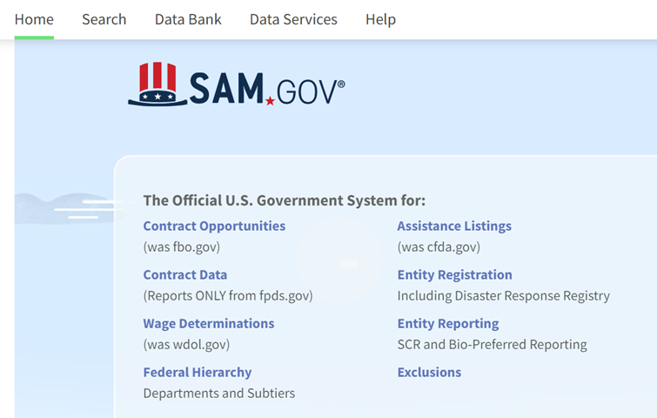
How to Search in SAM (1 of 3)
Go to SAM.gov and click on Exclusions.

Slide 33
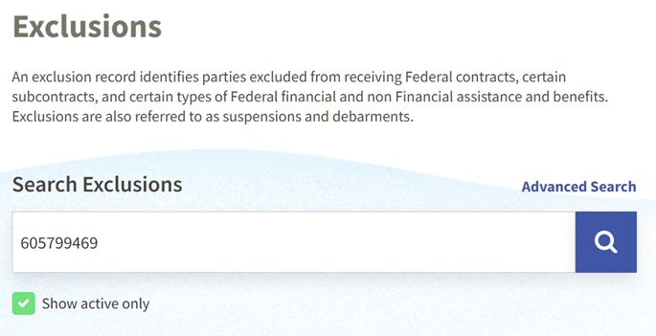
How to Search in SAM (2 of 3)
Enter the entity’s DUNS number in the box under Search Exclusions.

Slide 34
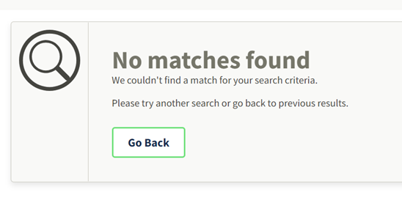
How to Search in SAM (3 of 3)
If the entity you searched has no exclusions, the system will display the following.

Slide 35
Save Your Search
You must have a SAM.gov account and log in to save your searches.
To save, select Actions.

Slide 36
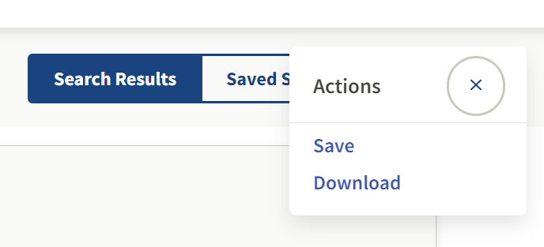
Download or Save
You have the option to either Save or Download your search.

Slide 37
Questions

Slide 38
SCRI Staff Assignment Updates
MRAM
June 10, 2021
Albert Lo, GCA Complex Grant Analyst
Saamir Choudhary, GCA Complex Grant Analyst

Slide 39
Background
UW executed staff assignment MOU with SCRI in 2012
Results include increased challenges with reconciliation and tracking staff assignment activity
30% of the 2017-2019 cycle of SA budget numbers had deficits totaling $350,000 almost 1 year after expiration

Slide 40
Background (cont.)
UW/SCRI working group started in April 2020
Includes representatives from GCA, OSP, SOM
Goal is to streamline the process internally and work with SCRI on joint improvements

Slide 41
Reminders
Current biennium staff assignment budget numbers will expire 6/30/2021
Tuition YTD invoiced?
Reconcile deficits within 120 days from expiration, as per UW Deficit policy, GIM 2 and GIM 39.
Follow up with outstanding payments
Ensure that all payments have been applied to the appropriate budget number
Transfer any deficits to a nonfederal budget number
Please use updated SCRI Staff Assignment Agreement form for 2021 – 2023 Staff Awards
https://www.washington.edu/research/forms-and-templates/scri-saa-form/

Slide 42
Process Updates
Effective 7/1/2021
SCRI will send all payments to GCA Lockbox
Reduce the need to go to campus to look for checks
Payments will be applied to budgets faster
Upload all copies of future staff assignment awards and modifications to Grant Tracker
Currently resides with departments only
Ensures accessibility and ease of administration
GCA will handle invoicing for tuition and other costs for all staff assignments
Previous deficits were due to unbilled tuition amounts
New process will reduce confusion between campus and SCRI

Slide 43
In the works…
Future meetings with SCRI to discuss
Continued improvements to the SAA form
Establish a clear payment identifier on back-ups for checks
GCA to build SCRI information website

Slide 44
Questions
Albert Lo, loa2@uw.edu
Saamir Choudhary, saamirc@uw.edu

Slide 45
GCCR Retention MRAM July 2021

Slide 46
MAA Training
Retention Period has increased
You are required to hold GCCR records for 12 years (as of February 2021).
It used to be 6 years
Applies to All GCCRs

Slide 47
Does This Change Apply To Other Financial Records
Major concern
No
This retention change only applies to GCCRs
All other Grant financial records are STILL
6 years after submission of a Financial Status Report
Notes:
FSR Submission: The date the Financial Status Report (FSR) was submitted to the sponsor. FSR Submission types are Final FSR or Quarterly or Annual FSRs for awards renewed quarterly or annually.
Final Invoice Date: The date the Final Invoice was submitted to the sponsor, where no FSR is required.
Budget Closeout: The date the final budget reconciliation was completed, where the sponsor does not require an FSR or Final Invoice. Includes invoiceable budgets.

Slide 48
Why Did The Retention Change?
It's all about compliance
GCCRs tend to be run by PI
Include multiple grants with multiple FSR submission dates
6 years may not cover all the grants listed on a GCCR
SNAP grants
Grants where no FSR is required
Grants where no FSR or final invoice is required

Slide 49
What Do I Do With My GCCRs?
Paper, Scanned, or Digital
If you scanned GCCRs, shred the original paper
Use DocuSign or Adobe to sign GCCRs electronically
Don’t print, save as electronic records
Old paper GCCRs (not scanned)
School of Medicine, sent to UW Medicine Records Center
All other departments: until February 2022, send to University Records Center

Slide 50
Questions? Barbara Benson bbenson@uw.edu https://finance.uw.edu/recmgt/

Slide 51
Back to Research
MRAM
July, 2021
Joe Giffels
Office of Research

Slide 52
BACK TO RESEARCH (July 7 – September 10)
Requirement | Fully Vaccinated | Non-Fully Vaccinated
Return to In-Person Research Plan | Must be updated | Must be updated
Symptom attestation | No longer required, but self-monitor symptoms and do not come to work if you are ill | No longer required, but self-monitor symptoms and do not come to work if you are ill
Vaccination attestation | Required | Required
Masks | No longer required | Required indoors; recommended outdoors when distancing is not possible
Distancing | No longer required | No longer required, but recommended
[Extraordinary] cleaning & disinfecting | TBD relaxed requirements | TBD relaxed requirements
Site-specific | Comply with site-specific requirements (UW Med clinical facilities, field research locations) | Comply with site-specific requirements (UW Med clinical facilities, field research locations)
Lab density | No longer restricted | No longer restricted
https://www.ehs.washington.edu/covid-19-prevention-and-response/covid-19-health-and-safety-resources

