Slide 1
NSF Disclosures, Outside Work & FIDS Procedures
July, 2021 MRAM
Melissa Petersen, Office of Research

Slide 2
NSF: Pre-award and Post-award Disclosures Relating to the Biographical Sketch and Current and Pending Support
The new PAPPG is effective for proposals submitted or due on or after October 4, 2021.
Includes: NSF Pre-award and Post-award Disclosures Relating to the Biographical Sketch and Current and Pending Support.
Identifies where pre & post-award disclosure information must be provided.
This resource can be used now!

Slide 3
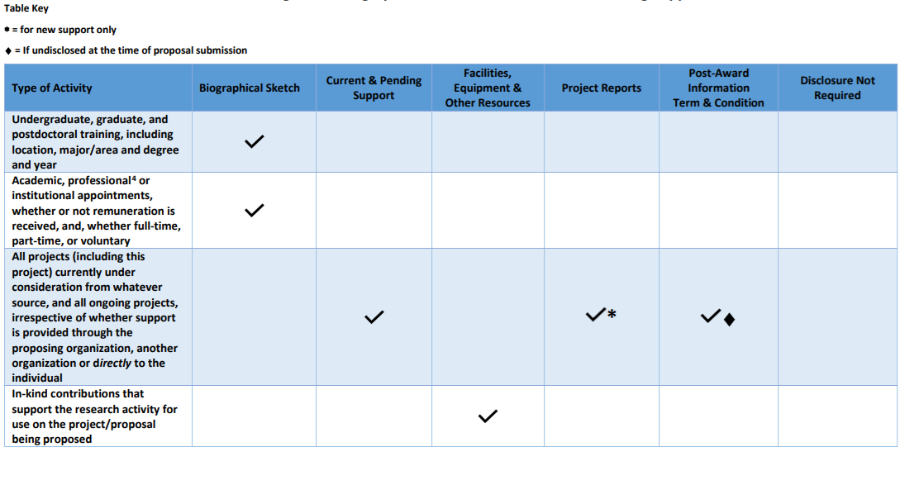
NSF & UW Outside Work and Significant Financial Disclosure Considerations (1 of 8)
Academic, professional⁴ or institutional appointments, whether or not remuneration is received, and whether full-time, part-time or voluntary
NSF: Report in Biographical Sketch
UW Disclosures:
Outside Work? - Probably
SFI? - Maybe
NSF 4: Senior personnel must identify all current domestic or foreign professional appointments outside of the individual's academic, professional, or institutional appointments at the proposing organization.
Notes:
focusing on items where you should consider whether appropriate Outside Work approvals and or Significant Financial Disclosure Is needed.

Slide 4
...Disclosure Considerations (2 of 8)
All projects (including this project) currently under consideration from whatever source, and all ongoing projects, irrespective of whether support is provided through the proposing organization, another organization or directly to the individual
NSF:
Current and Pending Support
Project Reports *for new support only
Post Award Information terms & conditions
UW Disclosures:
Outside Work? - Probably not
SFI Disclosure? - Maybe

Slide 5
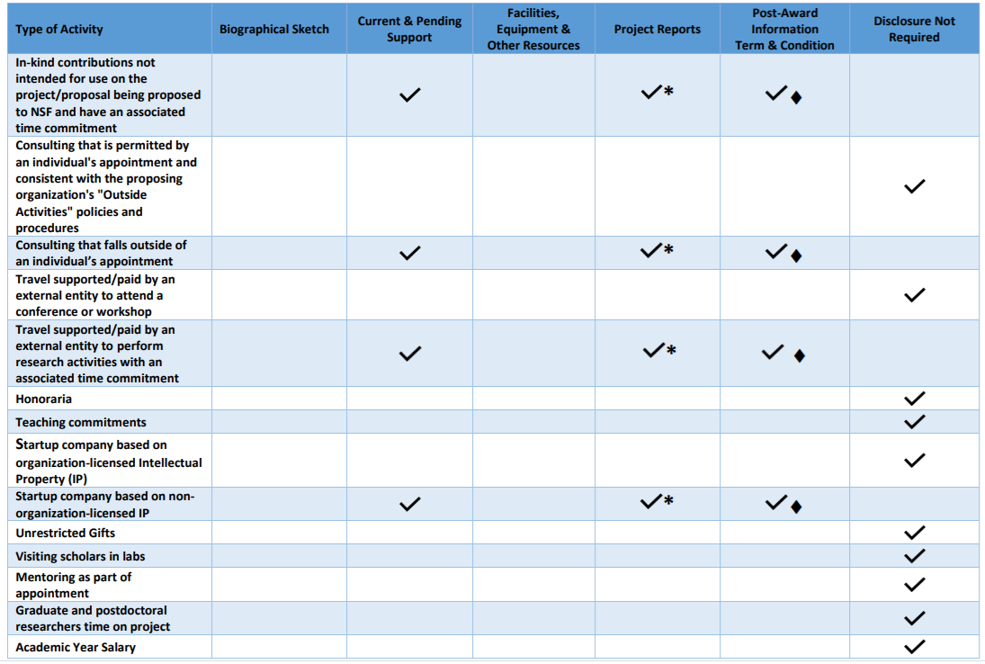
...Disclosure Considerations (3 of 8)
Consulting* that is permitted by an individual's appointment and consistent with the proposing organization's "Outside Activities" policies and procedures
NSF: Disclosure Not Required
UW Disclosures:
Outside Work? - Definitely
SFI Disclosure? - Maybe
*UW’s Outside Professional Work Policy Executive Order No. 57 distinguishes between “consulting” and “deeper than consulting”
Notes:
Carol

Slide 6
...Disclosure Considerations (4 of 8)
Consulting that falls outside of an individual’s appointment
NSF:
Current and Pending Support
Project Reports *for new support only
Post Award Information terms & conditions
UW Disclosures: Hopefully this doesn’t apply!!
Notes:
Carol

Slide 7
...Disclosure Considerations (5 of 8)
Travel supported/paid by an external entity to attend a conference or workshop
NSF: Disclosure Not Required
UW Disclosures:
Outside Work? -Maybe
SFI Disclosure? - Probably (if costs exceeded $50)
Notes:
Carol

Slide 8
...Disclosure Considerations (6 of 8)
Travel supported/paid by an external entity to perform research activities with an associated time commitment
NSF:
Current and Pending Support
Project Reports *for new support
Post Award Information terms and conditions
UW Disclosures
Outside Work? - Maybe
SFI Disclosure? - Probably (if costs exceeded $50)
Notes:
Carol

Slide 9
...Disclosure Considerations (7 of 8)
Startup company based on organization-licensed Intellectual Property (IP)
NSF: Disclosure Not Required
UW Disclosures:
Outside Work? -Maybe
SFI Disclosure? - Probably
Notes:
Carol

Slide 10
...Disclosure Considerations (8 of 8)
Startup company based on non-organization-licensed IP
NSF:
Current and Pending Support
Project Reports
Post Award Information terms and conditions
UW Disclosures
Outside Work? - Maybe
SFI? - Most likely (refer to SFI disclosure thresholds and requirements in GIM 10)
Notes:
Carol

Slide 11
UW Resources
Current and Pending or Other Support
Financial Conflict of Interest (FCOI):
FCOI Guidance
Policy: GIM 10
Financial Interest Disclosure System: FIDS
Outside Professional Work:
Guidance
Policy
Foreign Interests in Sponsored Programs
Notes:
NSF links from CPOS page : NSF: Proposal and Award Policies & Procedures Guide (PAPPG 20-1): Current & Pending Support
Current and Pending Support Guidance and Links
Current and Pending Support FAQs
NSF Webinar on Approved Formats
Pre & Post Award Disclosures Related to the Biosketch & Current and Pending Support

Slide 12
NSF Resources
Pre & Post Award Disclosures Relating to the Biosketch & Current and Pending Support
FAQS - Current and Pending Support
Approved Formats for Current and Pending Support

Slide 13
Questions

