Slide 1
SAM.gov Update:
Unique Entity Identifiers & Searching in SAM
July, 2021 MRAM
Adelia Yee
Office of Sponsored Programs

Slide 2
New Unique Entity Identifier (UEI)
Entities that conduct business with the federal government will begin to use a Unique Entity Identifier (UEI) created in SAM.gov.
The UW’s UEI is now available and visible
DUNS 605799469, the UEI is HD1WMN6945W6
DoEd Only - DUNS 042803536, the UEI is NFJ3CMQ4B418
Refer to them from our UW Facts & Rates page
You will start to see the UEI as a field name.

Slide 3
Grants.gov & the UEI
Grants.gov is displaying and auto-populating the UEI on applications.
Follow sponsor instructions on applications.
Enter the DUNS number if the field label reads “DUNS”
Enter the UEI number if the field label reads “SAM UEI”
Using the Unique Entity Identifier (UEI) in Grants.gov

Slide 4
Reminder: eGC1 Debarment Certification
The PI certifies on each eGC1 that:
“By submitting this application, the PI certifies that the PI and other Key Personnel (anyone involved in the design, conduct or reporting of the research) have not been debarred, suspended, proposed for debarment, declared ineligible or voluntarily excluded from covered transactions by any federal department or agency.”
GIM 1
Debarment Statement
Notes:
this is not a new requirement

Slide 5
Who, What, Why Search in SAM?
Campus verifies:
Personnel have not been debarred or suspended
Vendor is not considered a “covered telecommunications” equipment or services supplier
Procurement purchases under $35k
Procurement checks vendors for purchases over $35k
OSP verifies subrecipient entities

Slide 6
Do I Need a SAM.gov Account?
Not required to search SAM for exclusions.
Required to save search results, submit reports for specific federal contract requirements, or to search entity profiles.
Searching entity profiles is different than searching debarred or suspended entities or individuals.

Slide 7
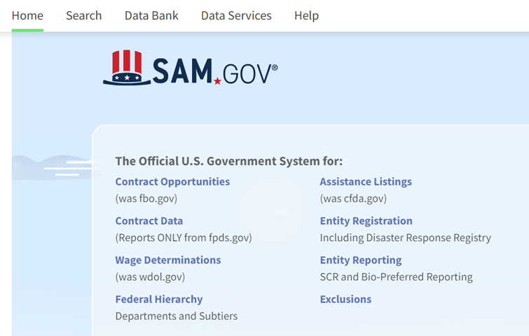
How to Search in SAM (1 of 3)
Go to SAM.gov and click on Exclusions.

Slide 8
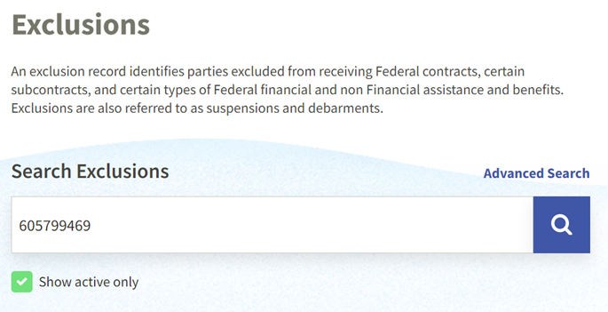
How to Search in SAM (2 of 3)
Enter the entity’s DUNS number in the box under Search Exclusions.

Slide 9
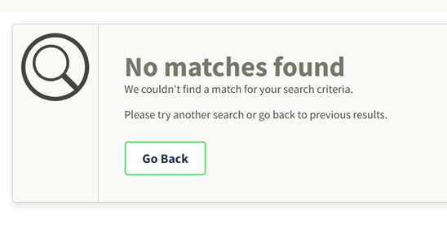
How to Search in SAM (3 of 3)
If the entity you searched has no exclusions, the system will display the following.

Slide 10
Save Your Search
You must have a SAM.gov account and log in to save your searches.
To save, select Actions.

Slide 11
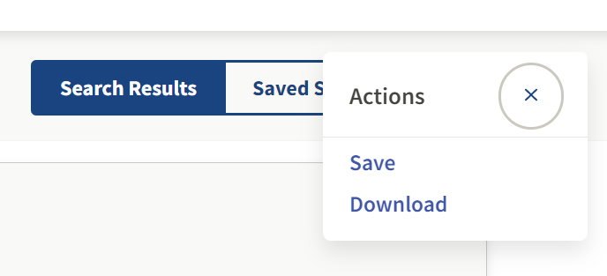
Download or Save
You have the option to either Save or Download your search.

Slide 12
Questions

