Slide 1
MRAM | Monthly Research Administration Meeting
August 12, 2021 9:00 AM – 10:00 AM HOSTED REMOTELY Join the LIVE Webinar: https://washington.zoom.us/j/346891888
TOPIC | PRESENTER | EMAIL | MIN
Welcome | Carol Rhodes Office of Sponsored Programs | carhodes@uw.edu | 2
PAFC Hot Topic: Re-budgeting | Matt Gardner Post Award Fiscal Compliance | gcafco@uw.edu | 10
NIH Fellowship Child Care Allowance – Update | Andra Sawyer Post Award Fiscal Compliance | gcafco@uw.edu | 5
MythBusters: SFI Review | Melissa Petersen Office of Research | petermm@uw.edu | 10
Office of Research Personnel Changes | Joe Giffels Office of Research | jgiffels@uw.edu | 10
NEXT MEETING September 9, 2021 9:00 AM - 10:00 AM

Slide 2
PAFC HOT TOPICS: RE-BUDGETING
MRAM
August 2021
Matt Gardner
Post Award Fiscal Compliance

Slide 3
Re-budgeting
Standard Question:
“The PI needs to purchase X.
The purchase of X was not included in the proposal budget.
The PI wants to re-budget from [some other cost category] to purchase X.
Is this allowed?”
MRAM – Matt Gardner – PAFC Hot Topics: Re-budgeting

Slide 4
Re-budgeting and Prior Approval
Whether re-budgeting is appropriate is determined by the sponsor’s policies.
Some sponsors require prior written approval in order to re-budget between cost categories. While others waive prior approval unless there is a change in scope.
MRAM – Matt Gardner – PAFC Hot Topics: Re-budgeting

Slide 5
Re-budgeting: Change in Scope
Sponsors typically require prior approval for any change in the scope of the work.
Whether re-budgeting represents a change in scope is a question only the PI can answer.
If there is a question as to whether there is a change in scope, the PI should have a discussion with the sponsor.
MRAM – Matt Gardner – PAFC Hot Topics: Re-budgeting

Slide 6
Re-budgeting: Change in Scope, cont’d
Some cost categories require approval regardless of whether there is a change in scope. For example:
Equipment
Issuing a new subaward
Food
Approval comes back to the sponsor’s policies.
MRAM – Matt Gardner – PAFC Hot Topics: Re-budgeting

Slide 7
Additional Resources
PAFC Webpage
https://finance.uw.edu/pafc/rebudgeting
Research Terms & Conditions Prior Approval Matrix:
https://www.nsf.gov/bfa/dias/policy/fedrtc/appendix_a.pdf
NIH Grants Policy Statement
https://grants.nih.gov/policy/nihgps/index.htm
NSF PAPPG
https://www.nsf.gov/publications/pub_summ.jsp?ods_key=nsf22001
MRAM – Matt Gardner – PAFC Hot Topics: Re-budgeting

Slide 8
Questions
Post Award Fiscal Compliance (PAFC)
gcafco@uw.edu
https://finance.uw.edu/pafc/
Andra Sawyer
andra2@uw.edu
Matt Gardner
mgard4@uw.edu
206-543-2610
Available for Teams and Zoom calls!
MRAM – Matt Gardner – PAFC

Slide 9
NIH Fellowship Childcare Allowance
MRAM
August 2021
Andra Sawyer
Post Award Fiscal Compliance

Slide 10
The Most Important Part of this Presentation
If eligible for this allowance, you may request the funds from NIH but you may NOT yet disburse them to the fellows.
Watch this space for updates:
https://finance.uw.edu/gca/award-lifecycle/sponsor-specific-information/nih-childcare-allowance

Slide 11
Childcare Allowance: Definition
Allowance to offset childcare expenses for eligible fellows
Effective April 2021; can be retroactive

Slide 12
Childcare Allowance: Requirements
Reimbursement for actual expenses:
from WA state licensed childcare provider;
up to $2,500 per fellow (not per child); and
per fellowship award budget year.
Taxable
Child(ren) must:
be aged 12 or under; 17 if disabled; and
reside with fellow.
Unused funds cannot be rebudgeted into other fellowship award cost categories.

Slide 13
Childcare Allowance: Current State
Funds (new or supplemental) can be requested from NIH per their instructions: https://grants.nih.gov/grants/guide/notice-files/NOT-OD-21-074.html
Funds may not yet be disbursed:
GCA will set up sub budgets for funds received
Sub budgets will be in status 2 (expenses cannot be posted)

Slide 14
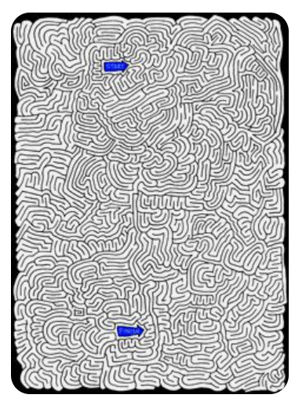
Childcare Allowance: Disbursement?
Pending resolution of tax requirements & disbursement process

Slide 15
Childcare Allowance: Questions?
Post Award Fiscal Compliance
gcafco@uw.edu
Matt Gardner
mgard4@uw.edu
Andra Sawyer
andra2@uw.edu

Slide 16
MYTH BUSTING: SFI REVIEW
MRAM
August 2021
Melissa Petersen
Office of Research

Slide 17
OVERVIEW
Significant Financial Interest (SFI) Review occurs in the Office of Research
The team is also responsible for:
Outside Professional Work for Compensation (Form 1460)
Complying with sponsor reporting requirements
Conflict management plan compliance monitoring
Embryonic Stem Cell Research Oversight (ESCRO) Committee
Responsible Conduct of Research (RCR) Training
Research compliance web content and curriculum
MRAM – Melissa Petersen – Office of Research

Slide 18
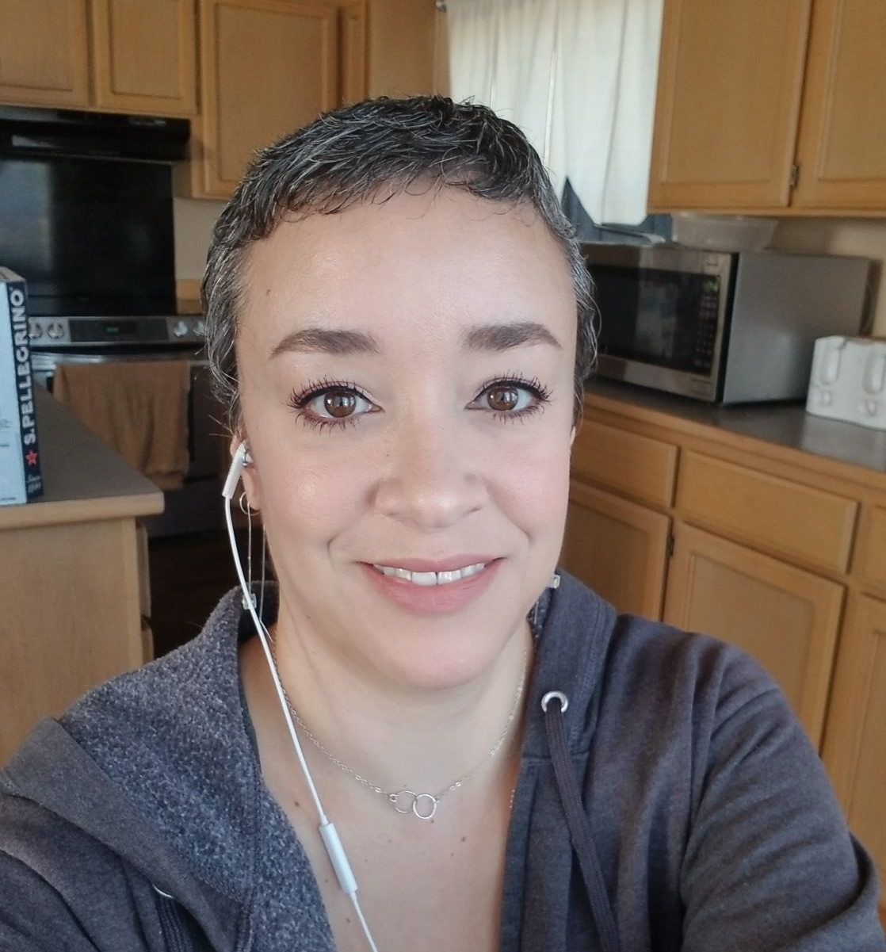
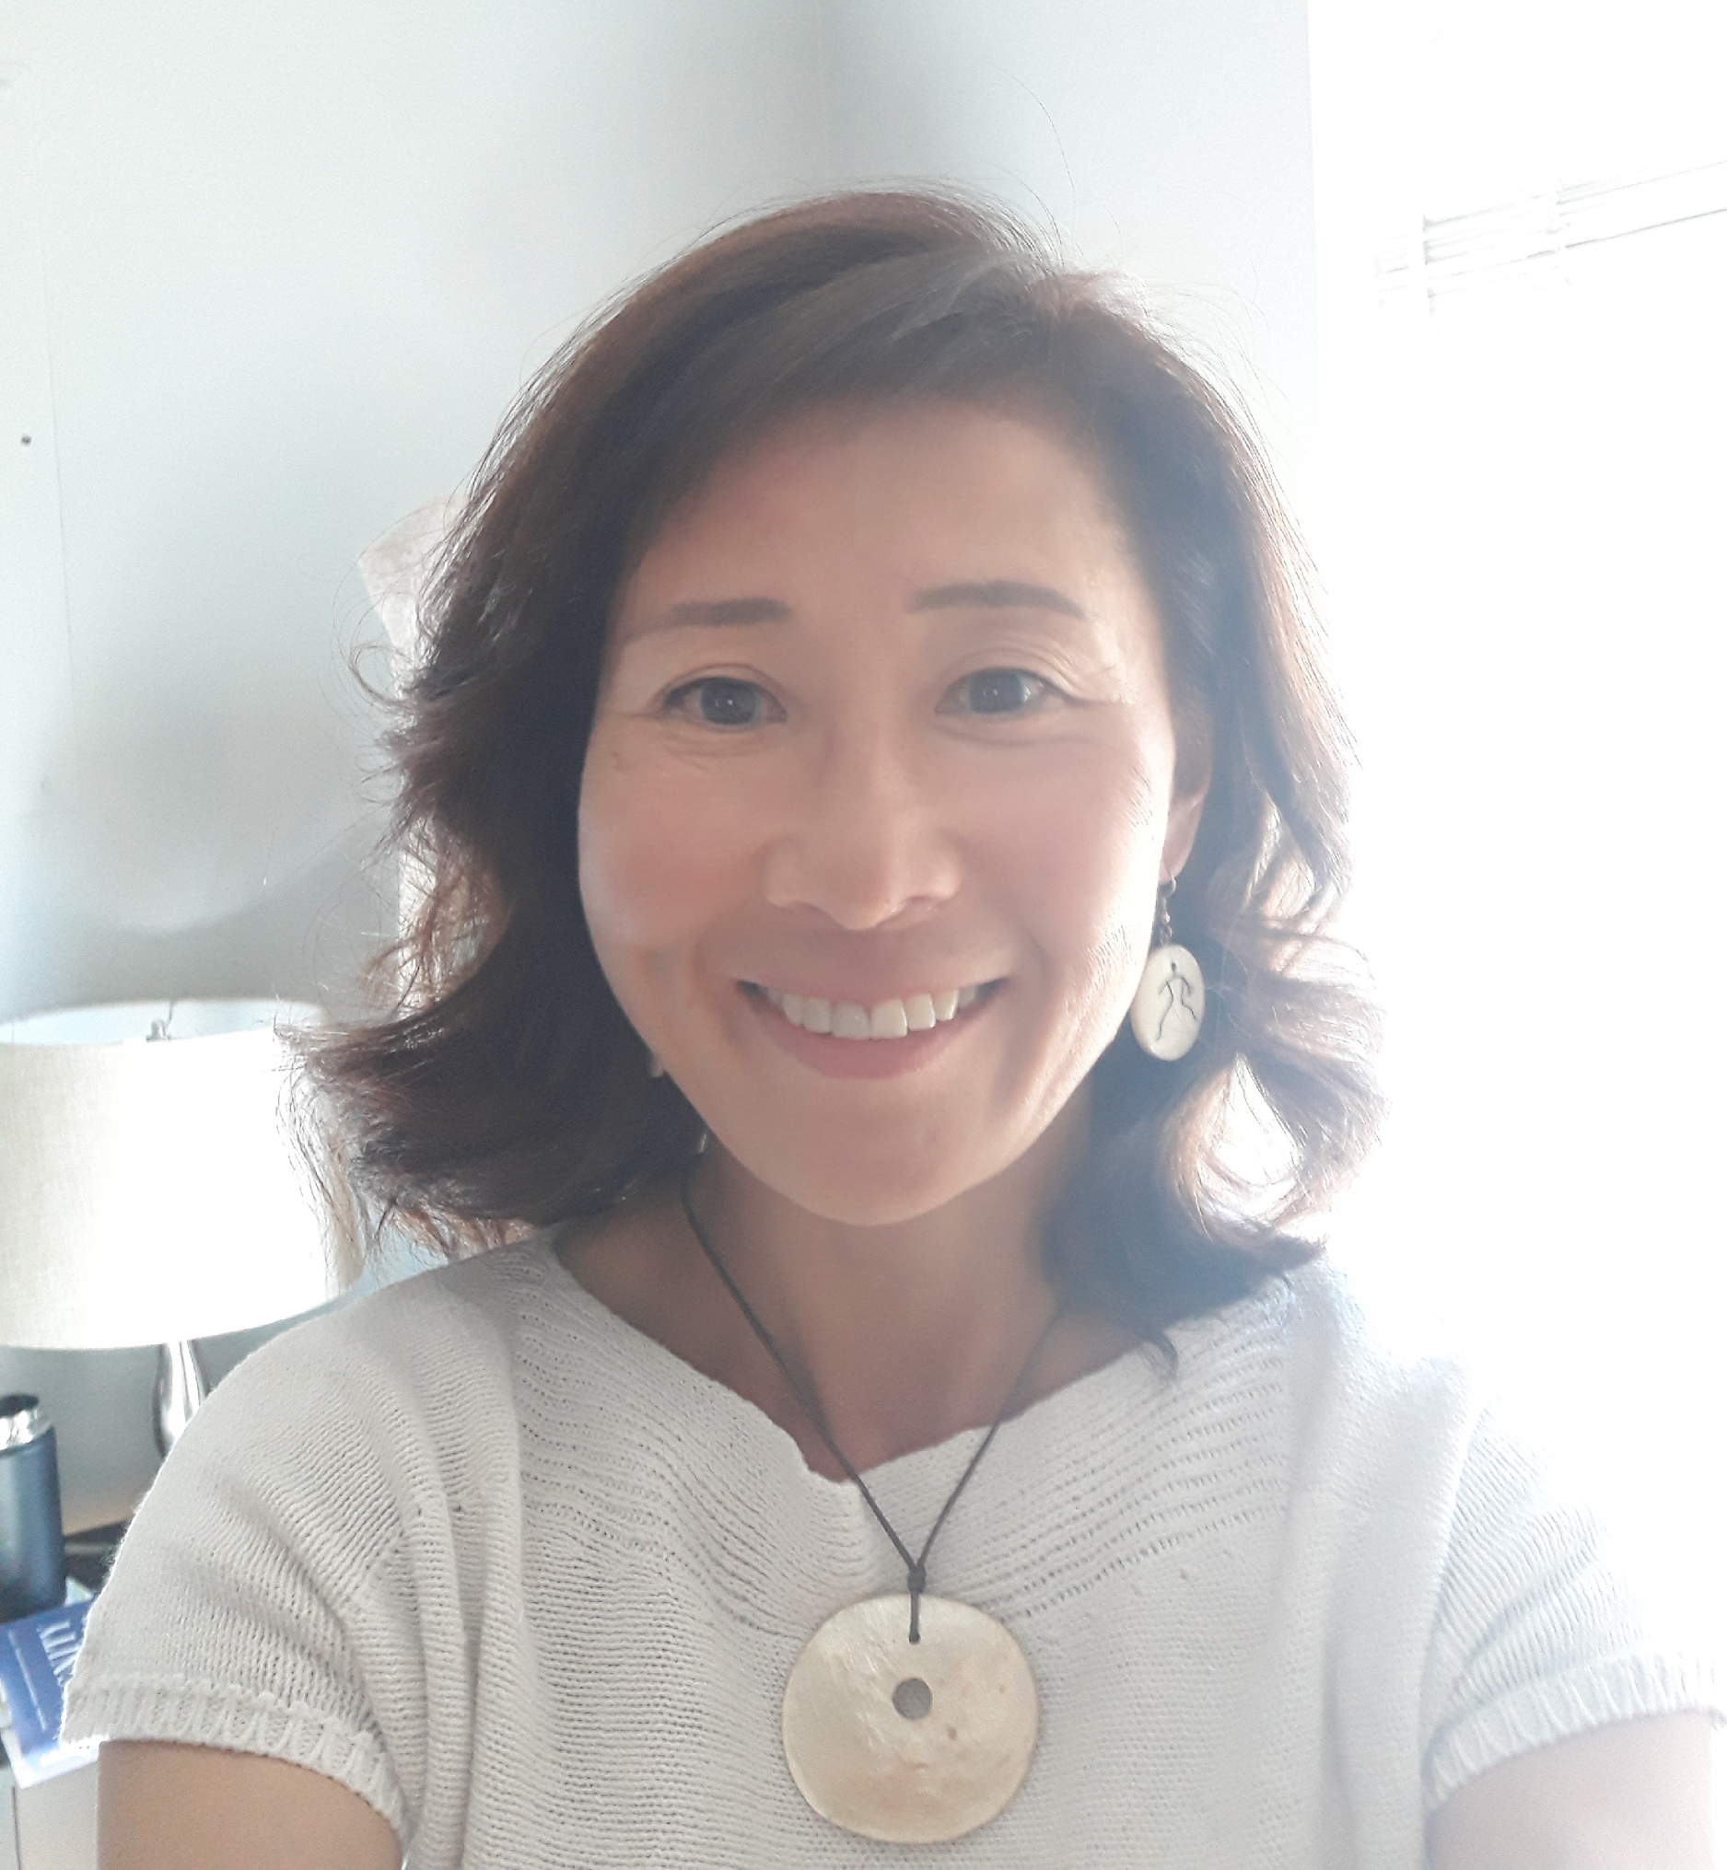
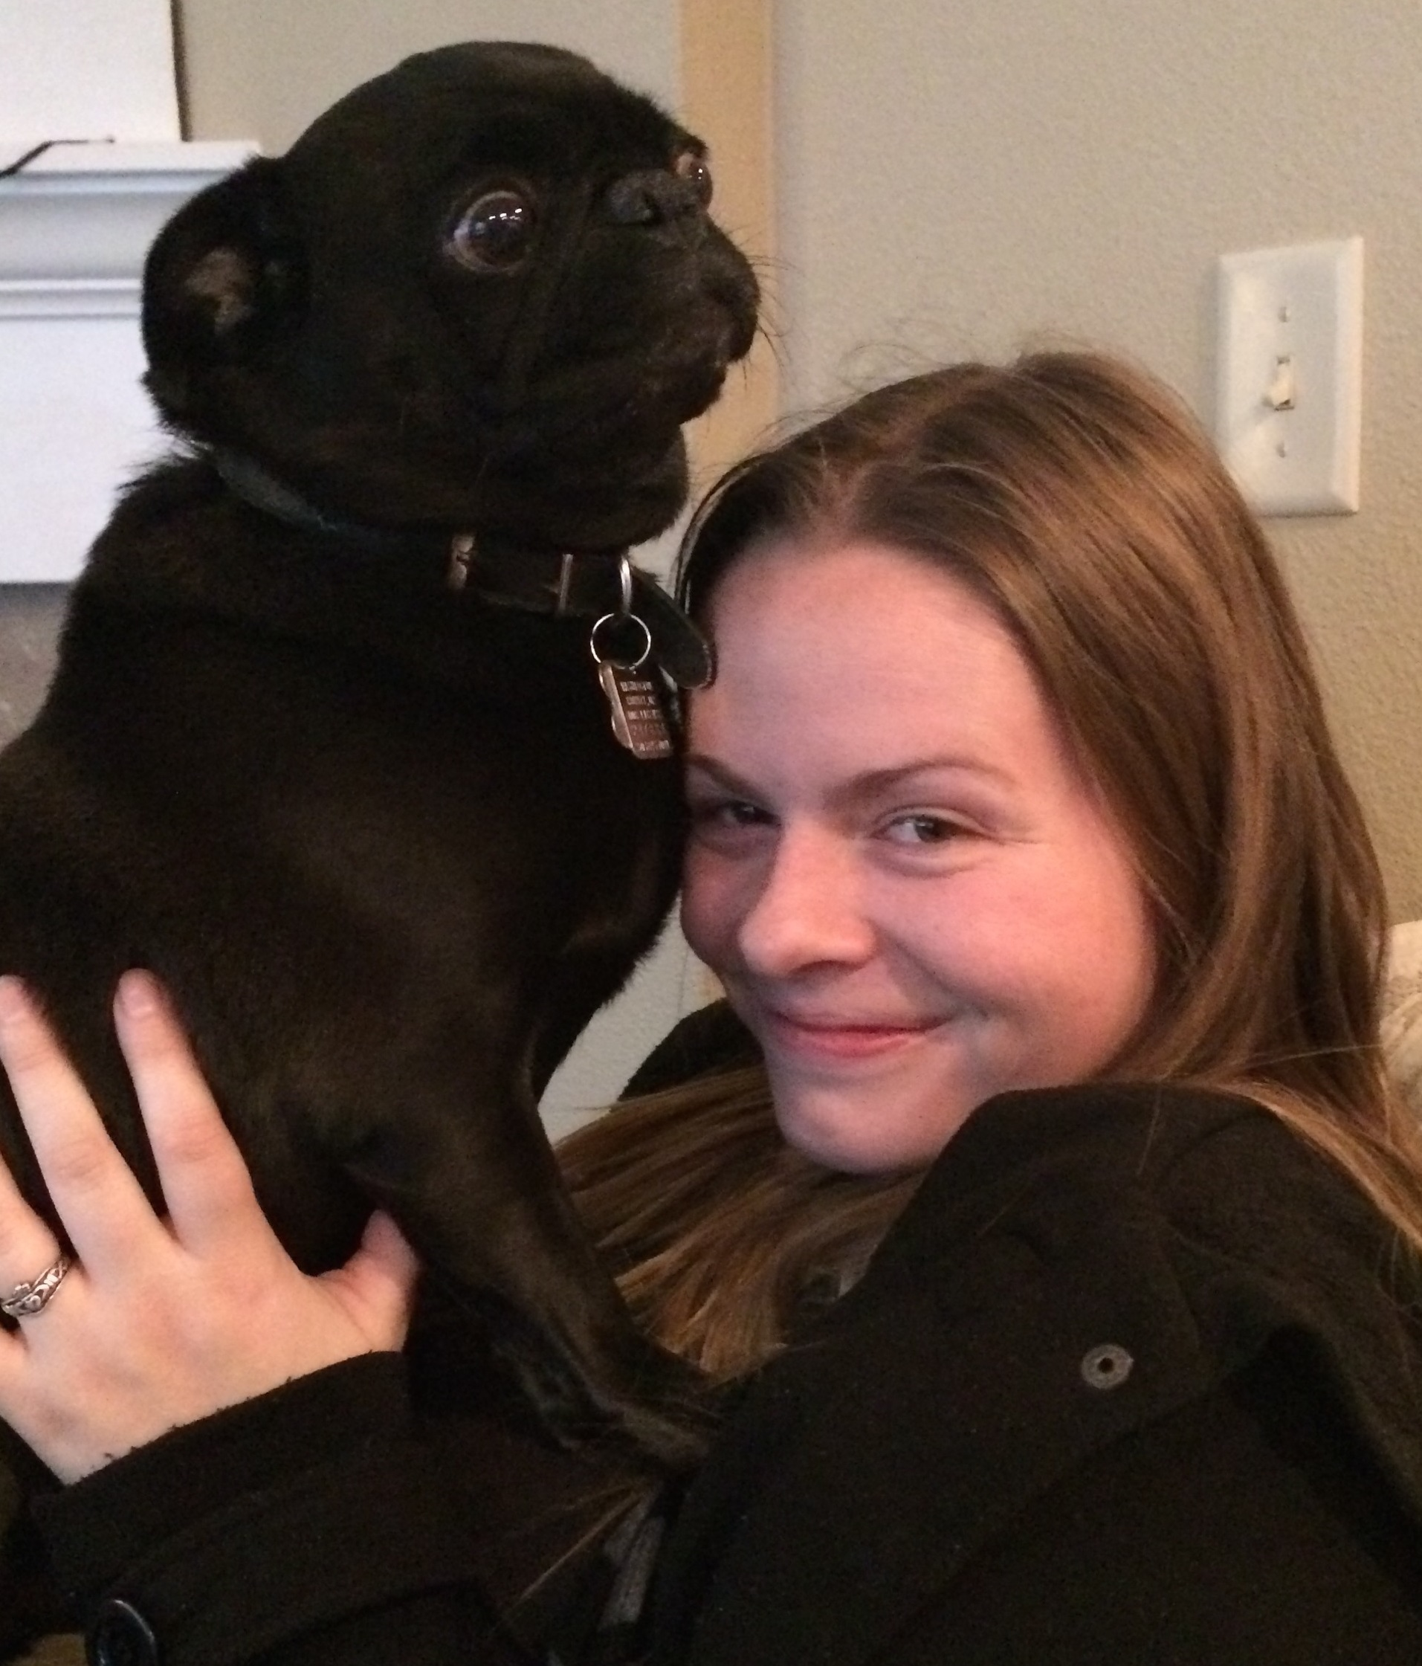
ABOUT US
Emily Berríos
Compliance Analyst
emilyb02@uw.edu
Kim Blakemore
Compliance Analyst
kblakemo@uw.edu
Haley Roady
Administrative Coordinator
hibbsh@uw.edu
Office of Research: research@uw.edu
Outside Work: work1460@uw.edu
Public/Federal reporting of FCOI: fcoirep@uw.edu
Embryonic Stem Cell Research Oversight (ESCRO): escro@uw.edu
Melissa Petersen: petermm@uw.edu
MRAM – Melissa Petersen – Office of Research

Slide 19
ABOUT US
Emily Berríos, Compliance Analyst
Performs all preliminary review of SFIs
Evaluates disclosed compensation in accordance with GIM 10 including vetting of foreign entities
Primary contact at research@uw.edu for all Significant Financial Interest (SFI), GIM 10, Financial Interest Disclosure System (FIDS) inquiries
Audits eGC1s received for GIM 10 review for accuracy and compliance requirements
Responsible for public and federal reporting of Financial Conflicts of Interest
Issues conflict management plans and monitors Investigator compliance
Generates FCOI metrics for publication in iSTAR
Responsible for developing process and standardized templates/resources
Serves on two Office of Research committees: Communications, Research Compliance & Integrity
Special projects: UW policy and resource language translation
MRAM – Melissa Petersen – Office of Research

Slide 20
ABOUT US
Kim Blakemore, Compliance Analyst
Reviews majority of Significant Financial Interests (SFIs)
Investigates SFI entities
Review proposed scientific research activities
Interact with Investigators to gather additional information
Complete review of SFIs where there is an ongoing Financial Conflict of Interest (FCOI), SFI is related but not an FCOI, SFI is not related
Makes recommendations based on analysis to AVP for potential conflict management
Program Administrator for the Embryonic Stem Cell Research Oversight (ESCRO) Committee
Manages daily administration of the FCOI Sponsorship process for subrecipients
Serves as subject matter expert (SME) and collaborator in generation of unit policy and process materials
Coordinates updates from other SMEs related to required research trainings, curriculum descriptions, and associated web updates
MRAM – Melissa Petersen – Office of Research

Slide 21
ABOUT US
Haley Roady, Administrative Coordinator
Primary contact for general inquiries received by the Office of Research (research@uw.edu)
Primary contact for Outside Work (work1460@uw.edu)
Evaluates received Form 1460s for accuracy and completion, collaborates with campus until final
Performs administrative review and processing of Form 1460s where no conflicts exist
Escalates Form 1460s where a potential conflict of interest exists to the Assistant Vice Provost for Research Compliance
Additional duties for the Office of Research’s Director of Finance (Jefferey Babauta) as supervised by the Assistant Director of HR (Matt Orefice)
MRAM – Melissa Petersen – Office of Research

Slide 22
ABOUT US
Melissa Petersen
Assistant Vice Provost for Research Compliance
Establishes conflict management plans for Investigators and Innovators as it relates to UW research and technology transfer activities.
Partners with compliance officers in the schools and colleges regarding compliance with GIM 10, EO 57, and EO 32. Consults on EO 43, APS 47.2, APS 47.3
Reviews and approves Outside Professional Work for Compensation (Form 1460)s when a potential conflict exists
Develops and delivers curriculum for dissemination (Office of Research website, CORE, etc.)
Engages nationally with organizations and other institutions related to research administration, research compliance, and financial conflicts of interest
MRAM – Melissa Petersen – Office of Research

Slide 23
BY THE NUMBERS - FCOI
May 2019
Joint Committee on Research Enterprise (JCORE) established in the White House Office of Science and Technology Policy (OSTP)
To address issues within the research enterprise, including research security
October 2019
NIH Investigates Foreign Influence at U.S. Grantee Institutions
May 8, 2020
The First Federal Indictment of a University faculty member for false claims.
Currently the list includes faculty from:
Emory, Harvard, University of Kansas, and MIT
Year | Disclosures | Administrative Action | Management Plans | Average Turnaround (Days)
2020 | 19,912 | 4,867 | 130 | 10
2019 | 19,506 | 4,720 | 182 | 9
2018 | 19,593 | 3,803* | 131 | 4
August 2018
NIH Director Francis Collins issues letters to US University Presidents regarding Foreign Influence concerns
Date | eGC1s on hold, incomplete/pending Investigator action
7/8/2021 | 25
7/12/2021 | 18
7/21/2021 | 16
7/30/2021 | 28
8/2/2021 | 32
*pre-dates current process for manual tallies
MRAM – Melissa Petersen – Office of Research

Slide 24
BY THE NUMBERS – OUTSIDE WORK
Fiscal Year | Total Forms | Forms to AVP | Average Turnaround (Days)
2021 | 1,567 | 1,131 (72%) | >4
2020 | 1,480 | 991 (67%) | >2
2019 | 1,873 | 1,046 (56%) | >1
2018 | 1,273 | 582 (46%) | >1
MRAM – Melissa Petersen – Office of Research

Slide 25
STATUSES AND WHEN TO CONTACT
SFI Disclosure and Review status may be viewed in MyResearch or on the PI, Personnel, & Organizations tab of your eGC1
Please work with your Investigator(s) to complete their disclosure(s). If still on SFI hold once complete contacting research@uw.edu may expedite review.
If your eGC1 is on SFI hold and any disclosure is in ‘Waiting for JIT’ contact us at research@uw.edu, we may not even know about it!
Any disclosure in ‘Pending Answer’ means the SFI hold is due to an Investigator having an incomplete task or open inquiry.
Disclosures in ‘Review Required’ are absolutely pending us! You’re welcome to inquire.. but please give us a couple days of lead time.
MRAM – Melissa Petersen – Office of Research

Slide 26
QUESTIONS?
FCOI Informational Page
FCOI Policy, GIM 10
Investigator Requirements: FCOI Training, Annual Disclosures
Outside Work Informational Page
Outside Professional Work Policy, EO 57
MyResearch quick link format: http://myresearch.Washington.edu/portfolio/funding/A12345/
eGC1 quick link format: https://sage.admin.uw.edu/era/uwnetid/sage/list.aspx?caid=12345&pg=pi
MRAM – Melissa Petersen – Office of Research

Slide 27
LEADERSHIP CHANGES
In the Office of Research
MRAM
August 12, 2021
Joe Giffels
Office of Research

Slide 28
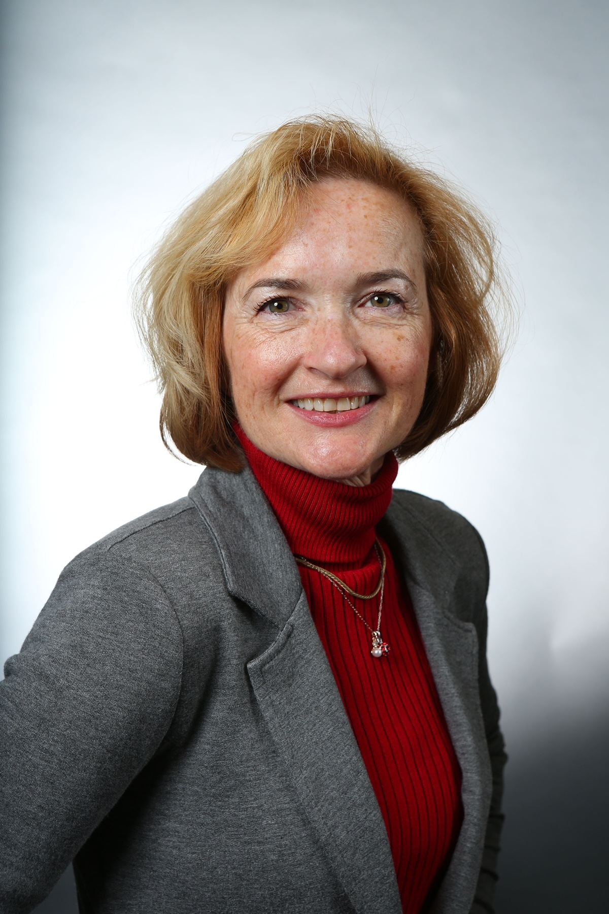
Sally Thompson-Iritani: New Assistant Vice Provost for Animal Operations
MRAM – Joe Giffels – Office of Research

Slide 29
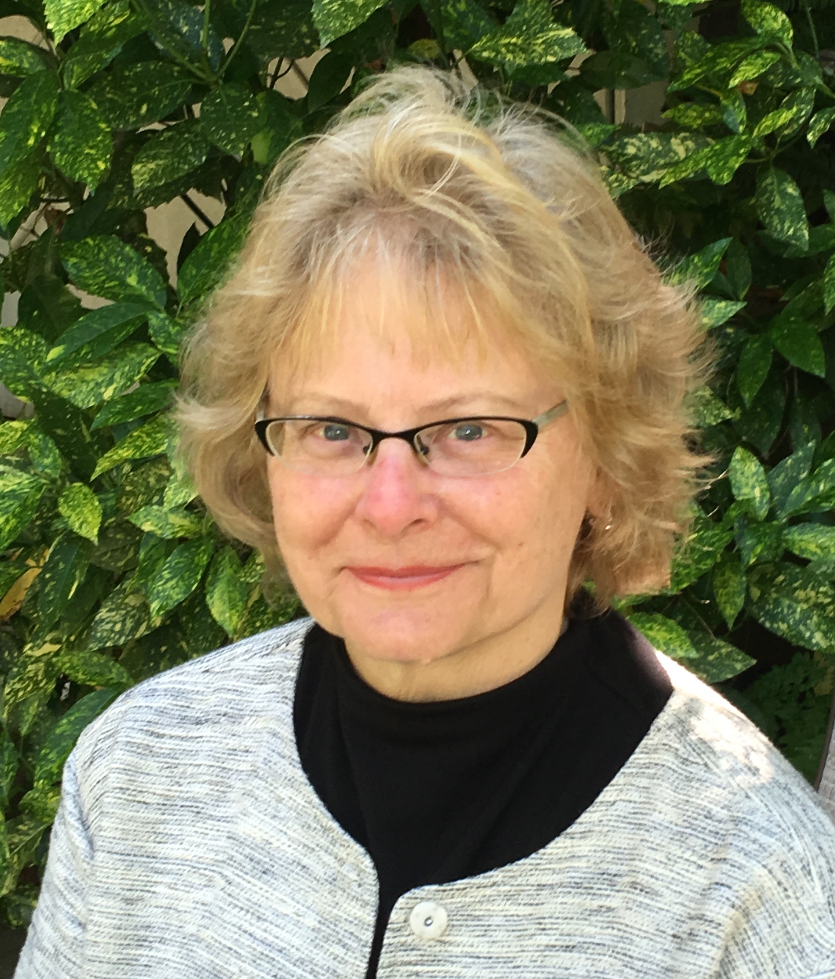
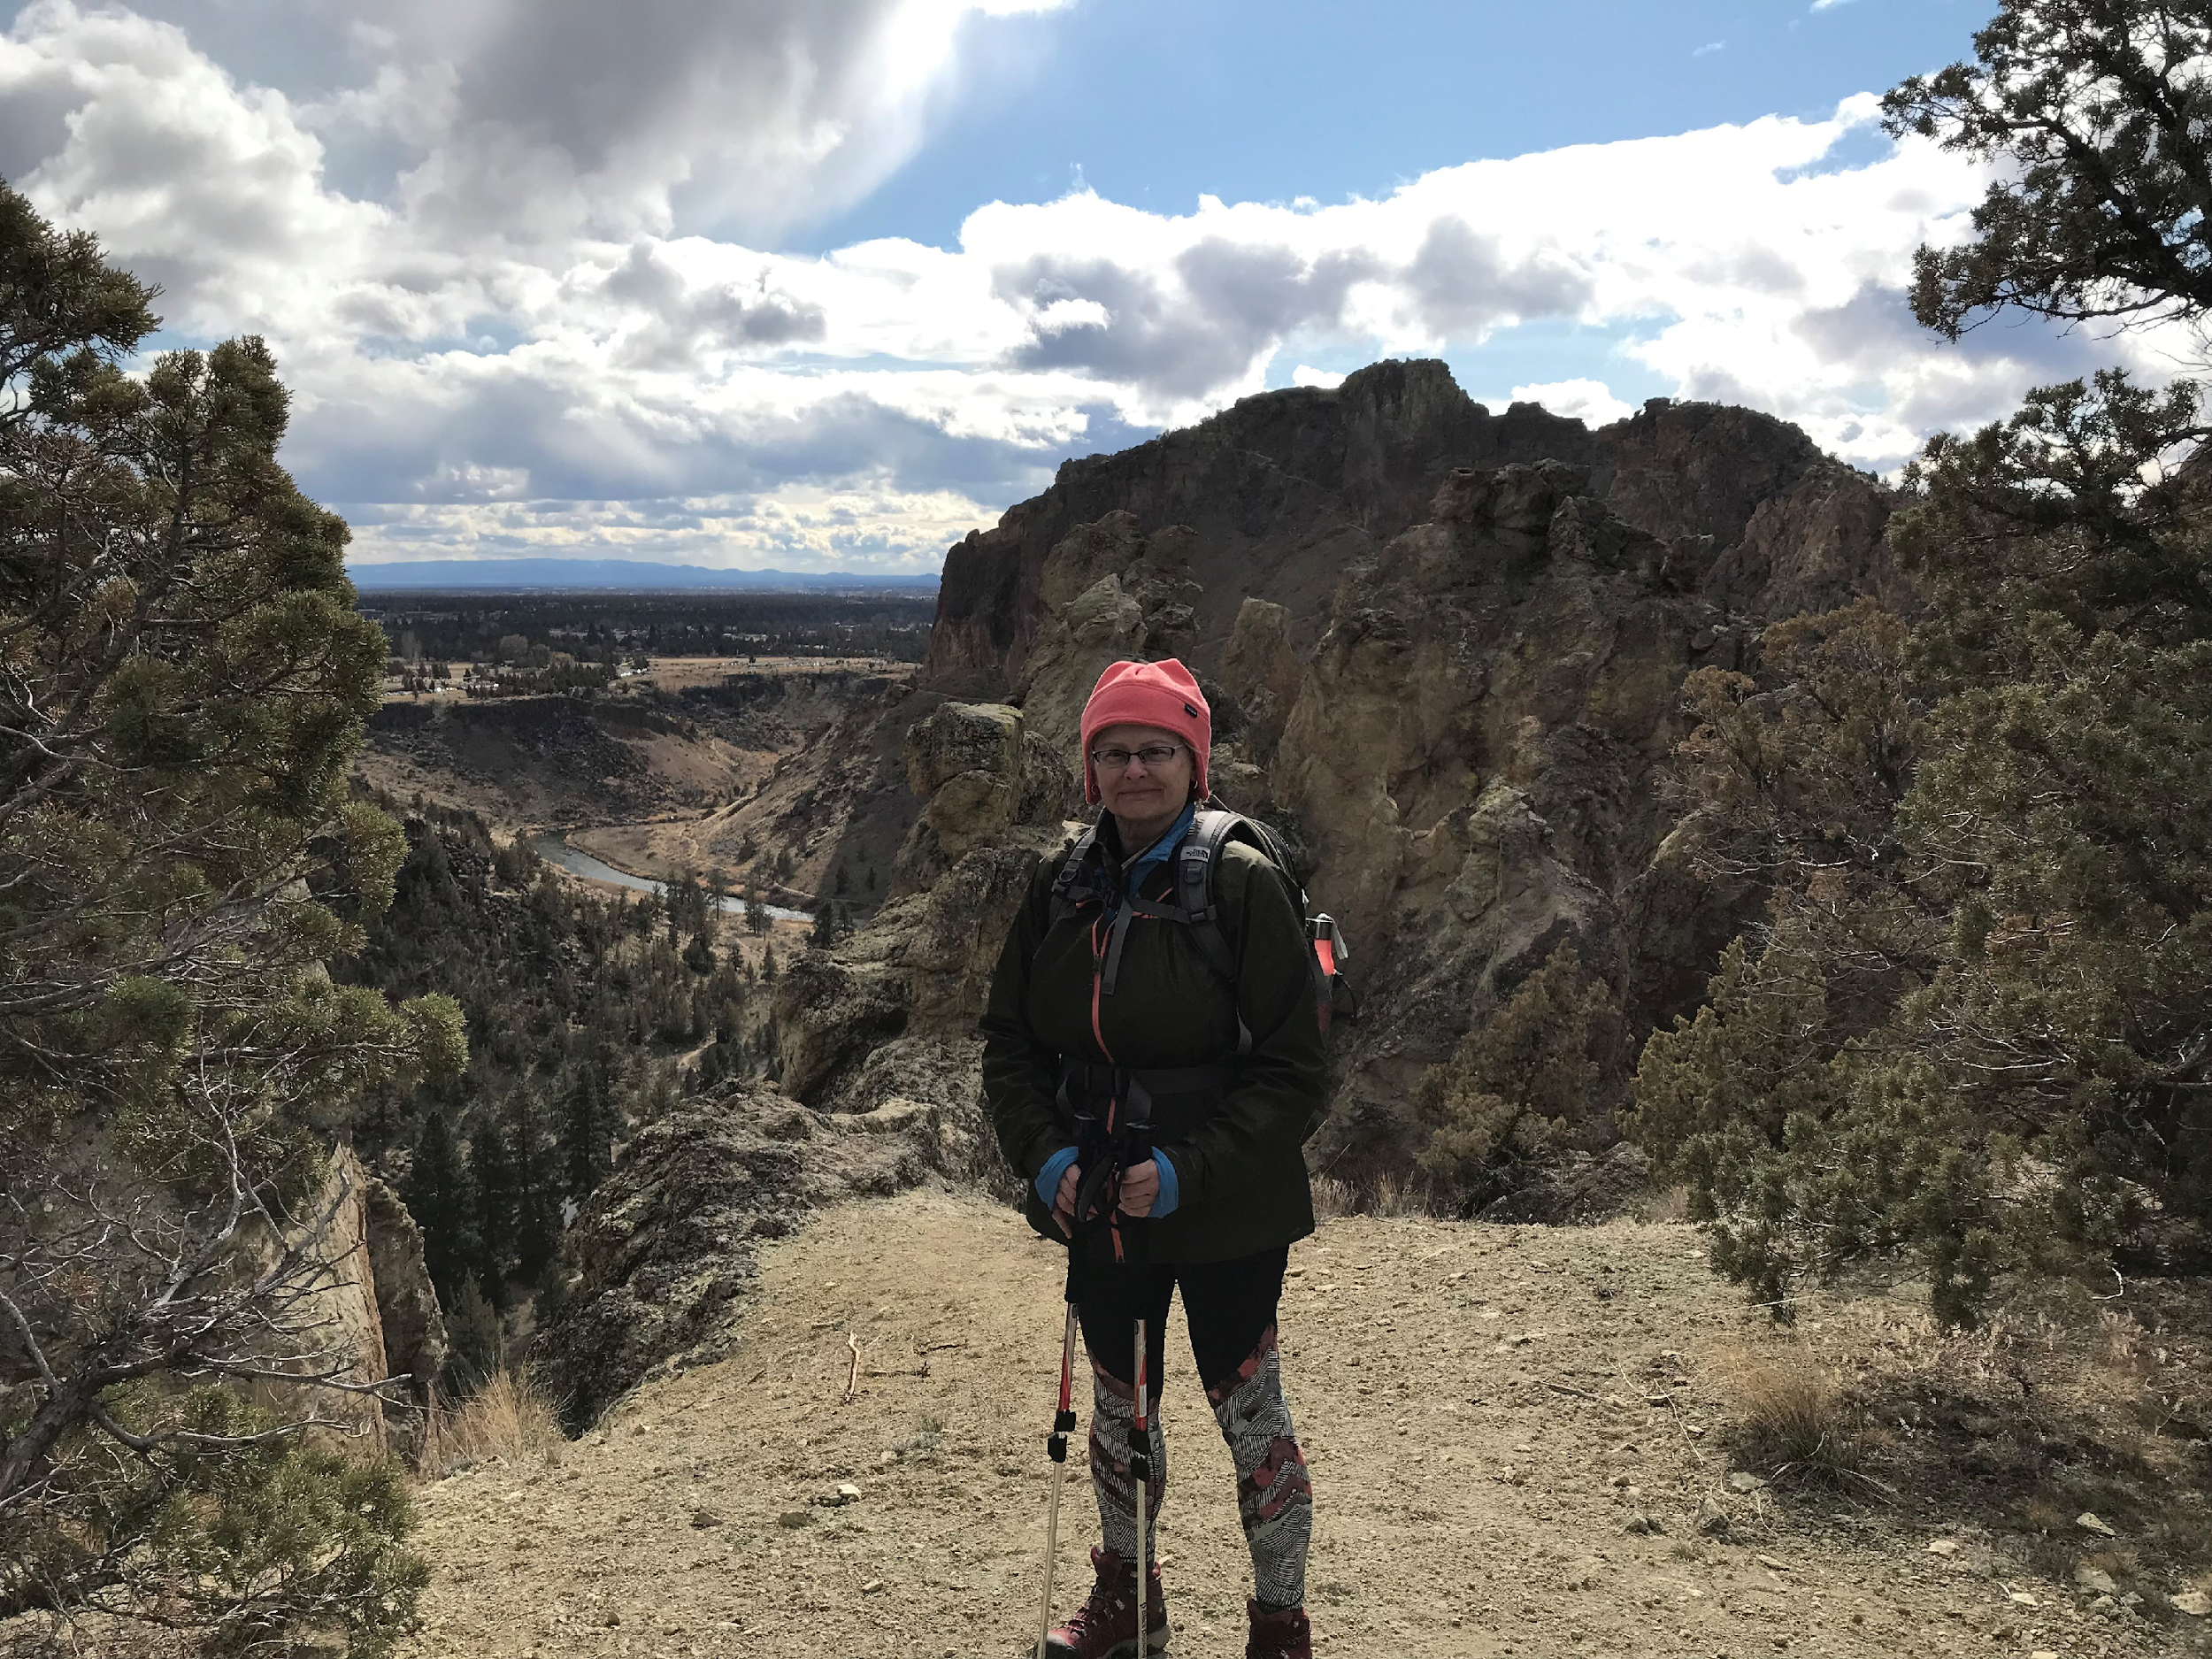
Karen Moe, Director of the Human Subjects Division: Retiring

Slide 30
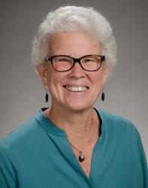
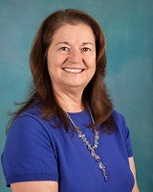
Associate Vice Provost for Research: Transition
September 1
Caroline “Carrie” Harwood
Cecelia “Ceci” Giachelli

Slide 31
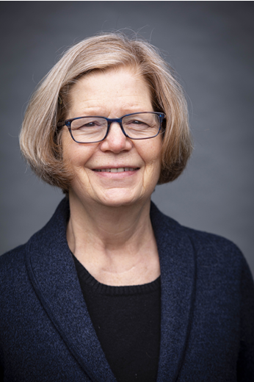
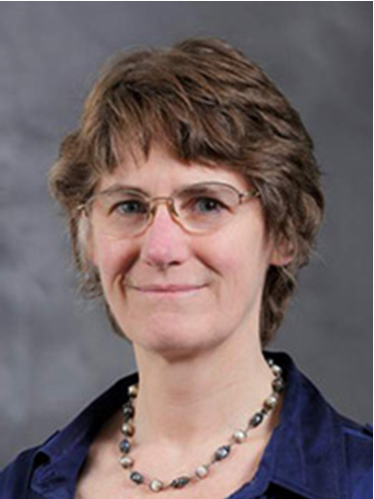
Vice Provost for Research: Transition
September 1
Mary Lidstrom
Mari Ostendorf

Slide 32
THANK YOU, ANDRA!

Slide 33
Top Five List:
“Things I’ve Learned from Andra”
5. There is no need to consistently define terms.
4. Just put whatever we want on our websites… nobody reads it.
3. If we think we won’t get audited, then it’s okay!
2. PAFC is the place to go to get confirmation that your complex and detailed international flight itinerary complies with the Fly America Act.
Buy as many Snuggies as you want and charge them all to sponsored awards… especially federal awards.
Actually… don’t do any of these things. We’re serious!

Slide 34
Thank You, Andra!
MRAM – Matt Gardner – PAFC

