Slide 1
NIH Fellowship Childcare Allowance
MRAM
August 2021
Andra Sawyer
Post Award Fiscal Compliance

Slide 2
The Most Important Part of this Presentation
If eligible for this allowance, you may request the funds from NIH but you may NOT yet disburse them to the fellows.
Watch this space for updates:
https://finance.uw.edu/gca/award-lifecycle/sponsor-specific-information/nih-childcare-allowance

Slide 3
Childcare Allowance: Definition
Allowance to offset childcare expenses for eligible fellows
Effective April 2021; can be retroactive

Slide 4
Childcare Allowance: Requirements
Reimbursement for actual expenses:
from WA state licensed childcare provider;
up to $2,500 per fellow (not per child); and
per fellowship award budget year.
Taxable
Child(ren) must:
be aged 12 or under; 17 if disabled; and
reside with fellow.
Unused funds cannot be rebudgeted into other fellowship award cost categories.

Slide 5
Childcare Allowance: Current State
Funds (new or supplemental) can be requested from NIH per their instructions: https://grants.nih.gov/grants/guide/notice-files/NOT-OD-21-074.html
Funds may not yet be disbursed:
GCA will set up sub budgets for funds received
Sub budgets will be in status 2 (expenses cannot be posted)

Slide 6
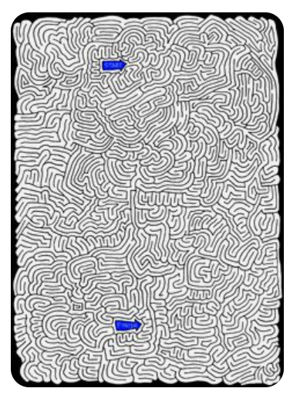
Childcare Allowance: Disbursement?
Pending resolution of tax requirements & disbursement process

Slide 7
Childcare Allowance: Questions?
Post Award Fiscal Compliance
gcafco@uw.edu
Matt Gardner
mgard4@uw.edu
Andra Sawyer
andra2@uw.edu

