Slide 1
MYTH BUSTING: SFI REVIEW
MRAM
August 2021
Melissa Petersen
Office of Research

Slide 2
OVERVIEW
Significant Financial Interest (SFI) Review occurs in the Office of Research
The team is also responsible for:
Outside Professional Work for Compensation (Form 1460)
Complying with sponsor reporting requirements
Conflict management plan compliance monitoring
Embryonic Stem Cell Research Oversight (ESCRO) Committee
Responsible Conduct of Research (RCR) Training
Research compliance web content and curriculum
MRAM – Melissa Petersen – Office of Research

Slide 3
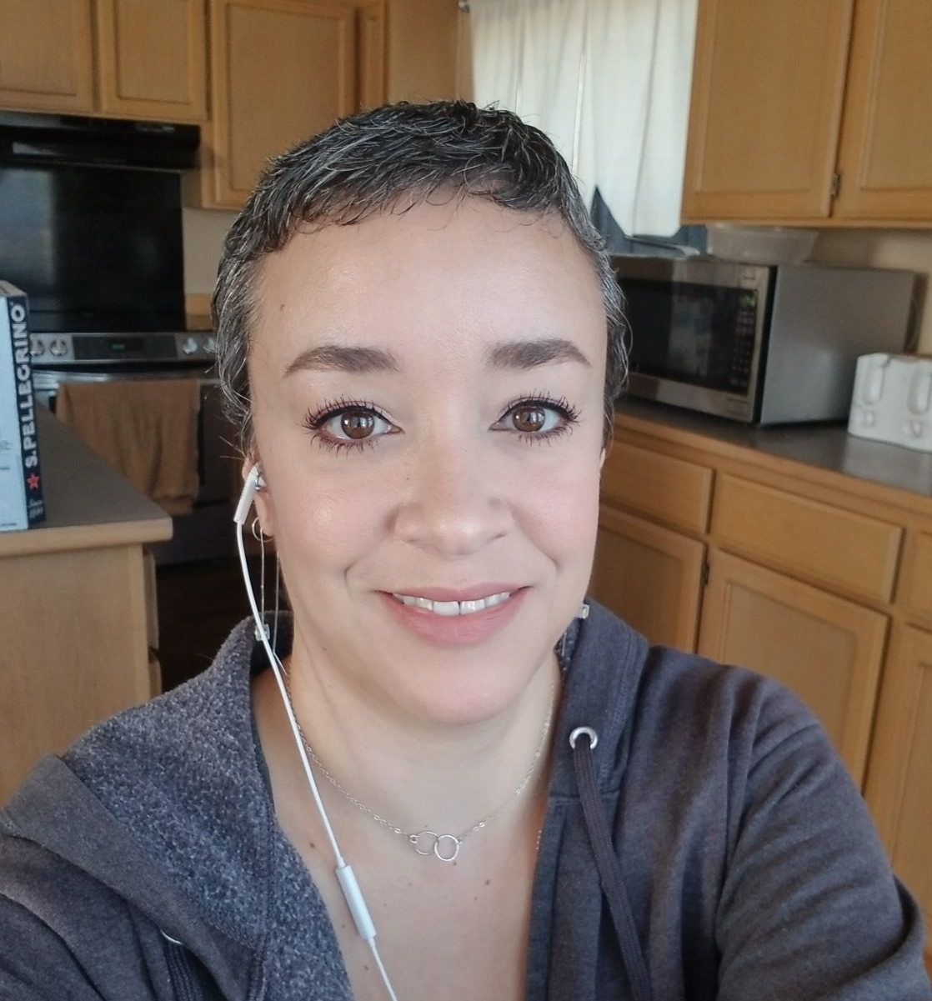
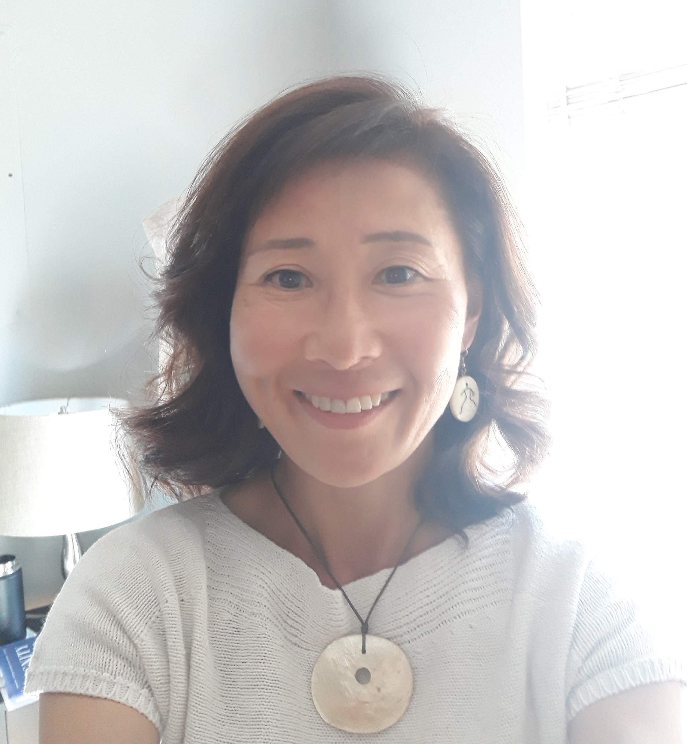
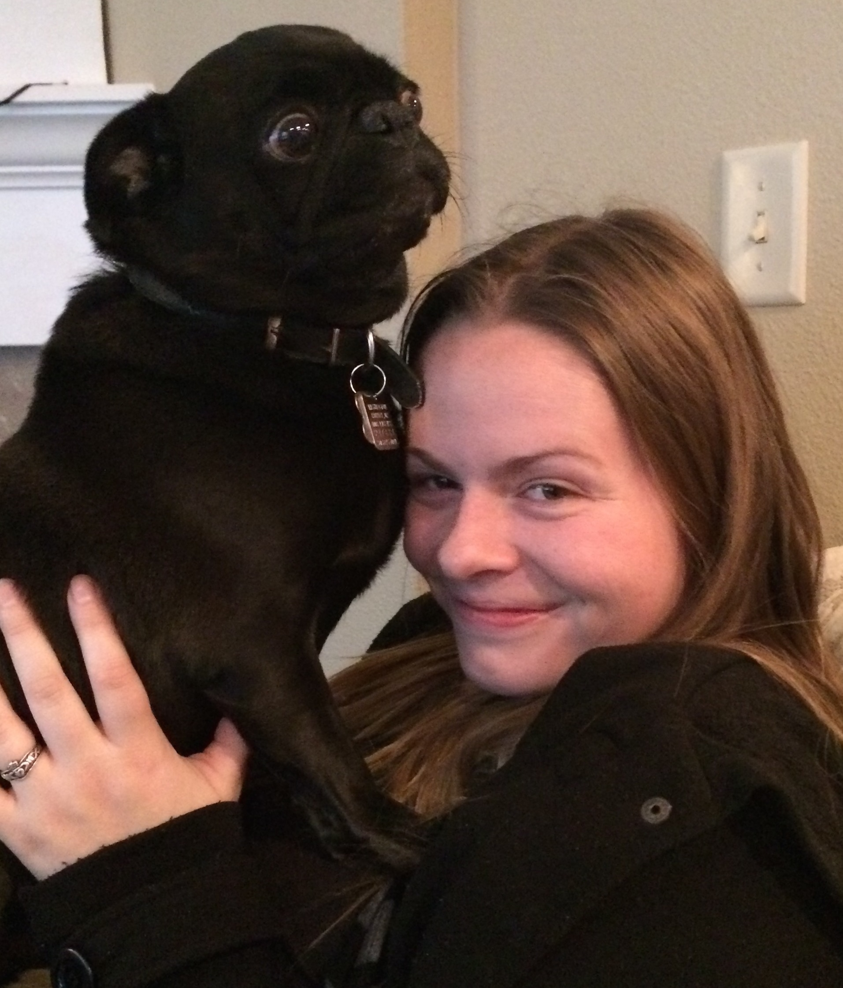
ABOUT US
Emily Berríos
Compliance Analyst
emilyb02@uw.edu
Kim Blakemore
Compliance Analyst
kblakemo@uw.edu
Haley Roady
Administrative Coordinator
hibbsh@uw.edu
Office of Research: research@uw.edu
Outside Work: work1460@uw.edu
Public/Federal reporting of FCOI: fcoirep@uw.edu
Embryonic Stem Cell Research Oversight (ESCRO): escro@uw.edu
Melissa Petersen: petermm@uw.edu
MRAM – Melissa Petersen – Office of Research

Slide 4
ABOUT US
Emily Berríos, Compliance Analyst
Performs all preliminary review of SFIs
Evaluates disclosed compensation in accordance with GIM 10 including vetting of foreign entities
Primary contact at research@uw.edu for all Significant Financial Interest (SFI), GIM 10, Financial Interest Disclosure System (FIDS) inquiries
Audits eGC1s received for GIM 10 review for accuracy and compliance requirements
Responsible for public and federal reporting of Financial Conflicts of Interest
Issues conflict management plans and monitors Investigator compliance
Generates FCOI metrics for publication in iSTAR
Responsible for developing process and standardized templates/resources
Serves on two Office of Research committees: Communications, Research Compliance & Integrity
Special projects: UW policy and resource language translation
MRAM – Melissa Petersen – Office of Research

Slide 5
ABOUT US
Kim Blakemore, Compliance Analyst
Reviews majority of Significant Financial Interests (SFIs)
Investigates SFI entities
Review proposed scientific research activities
Interact with Investigators to gather additional information
Complete review of SFIs where there is an ongoing Financial Conflict of Interest (FCOI), SFI is related but not an FCOI, SFI is not related
Makes recommendations based on analysis to AVP for potential conflict management
Program Administrator for the Embryonic Stem Cell Research Oversight (ESCRO) Committee
Manages daily administration of the FCOI Sponsorship process for subrecipients
Serves as subject matter expert (SME) and collaborator in generation of unit policy and process materials
Coordinates updates from other SMEs related to required research trainings, curriculum descriptions, and associated web updates
MRAM – Melissa Petersen – Office of Research

Slide 6
ABOUT US
Haley Roady, Administrative Coordinator
Primary contact for general inquiries received by the Office of Research (research@uw.edu)
Primary contact for Outside Work (work1460@uw.edu)
Evaluates received Form 1460s for accuracy and completion, collaborates with campus until final
Performs administrative review and processing of Form 1460s where no conflicts exist
Escalates Form 1460s where a potential conflict of interest exists to the Assistant Vice Provost for Research Compliance
Additional duties for the Office of Research’s Director of Finance (Jefferey Babauta) as supervised by the Assistant Director of HR (Matt Orefice)
MRAM – Melissa Petersen – Office of Research

Slide 7
ABOUT US
Melissa Petersen
Assistant Vice Provost for Research Compliance
Establishes conflict management plans for Investigators and Innovators as it relates to UW research and technology transfer activities.
Partners with compliance officers in the schools and colleges regarding compliance with GIM 10, EO 57, and EO 32. Consults on EO 43, APS 47.2, APS 47.3
Reviews and approves Outside Professional Work for Compensation (Form 1460)s when a potential conflict exists
Develops and delivers curriculum for dissemination (Office of Research website, CORE, etc.)
Engages nationally with organizations and other institutions related to research administration, research compliance, and financial conflicts of interest
MRAM – Melissa Petersen – Office of Research

Slide 8
BY THE NUMBERS - FCOI
May 2019
Joint Committee on Research Enterprise (JCORE) established in the White House Office of Science and Technology Policy (OSTP)
To address issues within the research enterprise, including research security
October 2019
NIH Investigates Foreign Influence at U.S. Grantee Institutions
May 8, 2020
The First Federal Indictment of a University faculty member for false claims.
Currently the list includes faculty from:
Emory, Harvard, University of Kansas, and MIT
Year | Disclosures | Administrative Action | Management Plans | Average Turnaround (Days)
2020 | 19,912 | 4,867 | 130 | 10
2019 | 19,506 | 4,720 | 182 | 9
2018 | 19,593 | 3,803* | 131 | 4
August 2018
NIH Director Francis Collins issues letters to US University Presidents regarding Foreign Influence concerns
Date | eGC1s on hold, incomplete/pending Investigator action
7/8/2021 | 25
7/12/2021 | 18
7/21/2021 | 16
7/30/2021 | 28
8/2/2021 | 32
*pre-dates current process for manual tallies
MRAM – Melissa Petersen – Office of Research

Slide 9
BY THE NUMBERS – OUTSIDE WORK
Fiscal Year | Total Forms | Forms to AVP | Average Turnaround (Days)
2021 | 1,567 | 1,131 (72%) | >4
2020 | 1,480 | 991 (67%) | >2
2019 | 1,873 | 1,046 (56%) | >1
2018 | 1,273 | 582 (46%) | >1
MRAM – Melissa Petersen – Office of Research

Slide 10
STATUSES AND WHEN TO CONTACT
SFI Disclosure and Review status may be viewed in MyResearch or on the PI, Personnel, & Organizations tab of your eGC1
Please work with your Investigator(s) to complete their disclosure(s). If still on SFI hold once complete contacting research@uw.edu may expedite review.
If your eGC1 is on SFI hold and any disclosure is in ‘Waiting for JIT’ contact us at research@uw.edu, we may not even know about it!
Any disclosure in ‘Pending Answer’ means the SFI hold is due to an Investigator having an incomplete task or open inquiry.
Disclosures in ‘Review Required’ are absolutely pending us! You’re welcome to inquire.. but please give us a couple days of lead time.
MRAM – Melissa Petersen – Office of Research

Slide 11
QUESTIONS?
FCOI Informational Page
FCOI Policy, GIM 10
Investigator Requirements: FCOI Training, Annual Disclosures
Outside Work Informational Page
Outside Professional Work Policy, EO 57
MyResearch quick link format: http://myresearch.Washington.edu/portfolio/funding/A12345/
eGC1 quick link format: https://sage.admin.uw.edu/era/uwnetid/sage/list.aspx?caid=12345&pg=pi
MRAM – Melissa Petersen – Office of Research

