Slide 1
LEADERSHIP CHANGES
In the Office of Research
MRAM
August 12, 2021
Joe Giffels
Office of Research

Slide 2
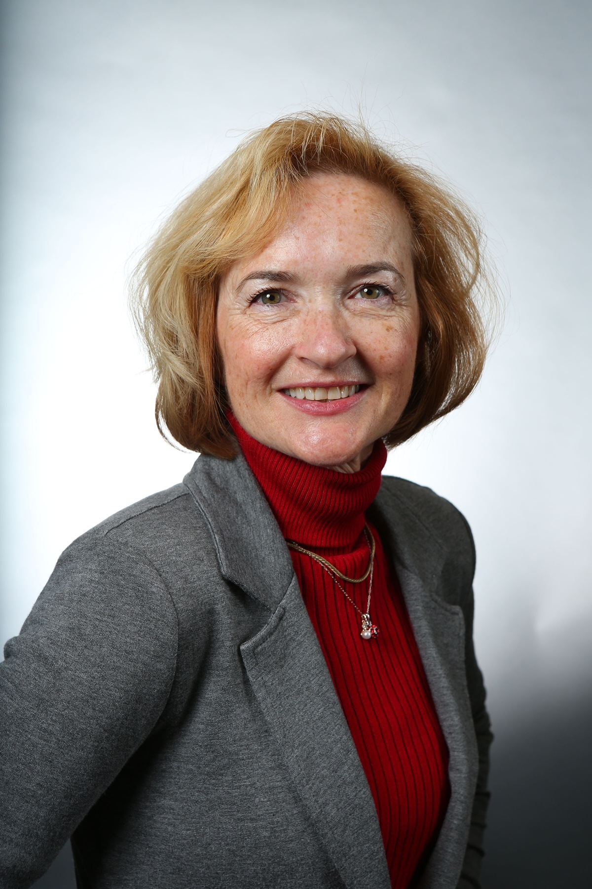
Sally Thompson-Iritani: New Assistant Vice Provost for Animal Operations
MRAM – Joe Giffels – Office of Research

Slide 3
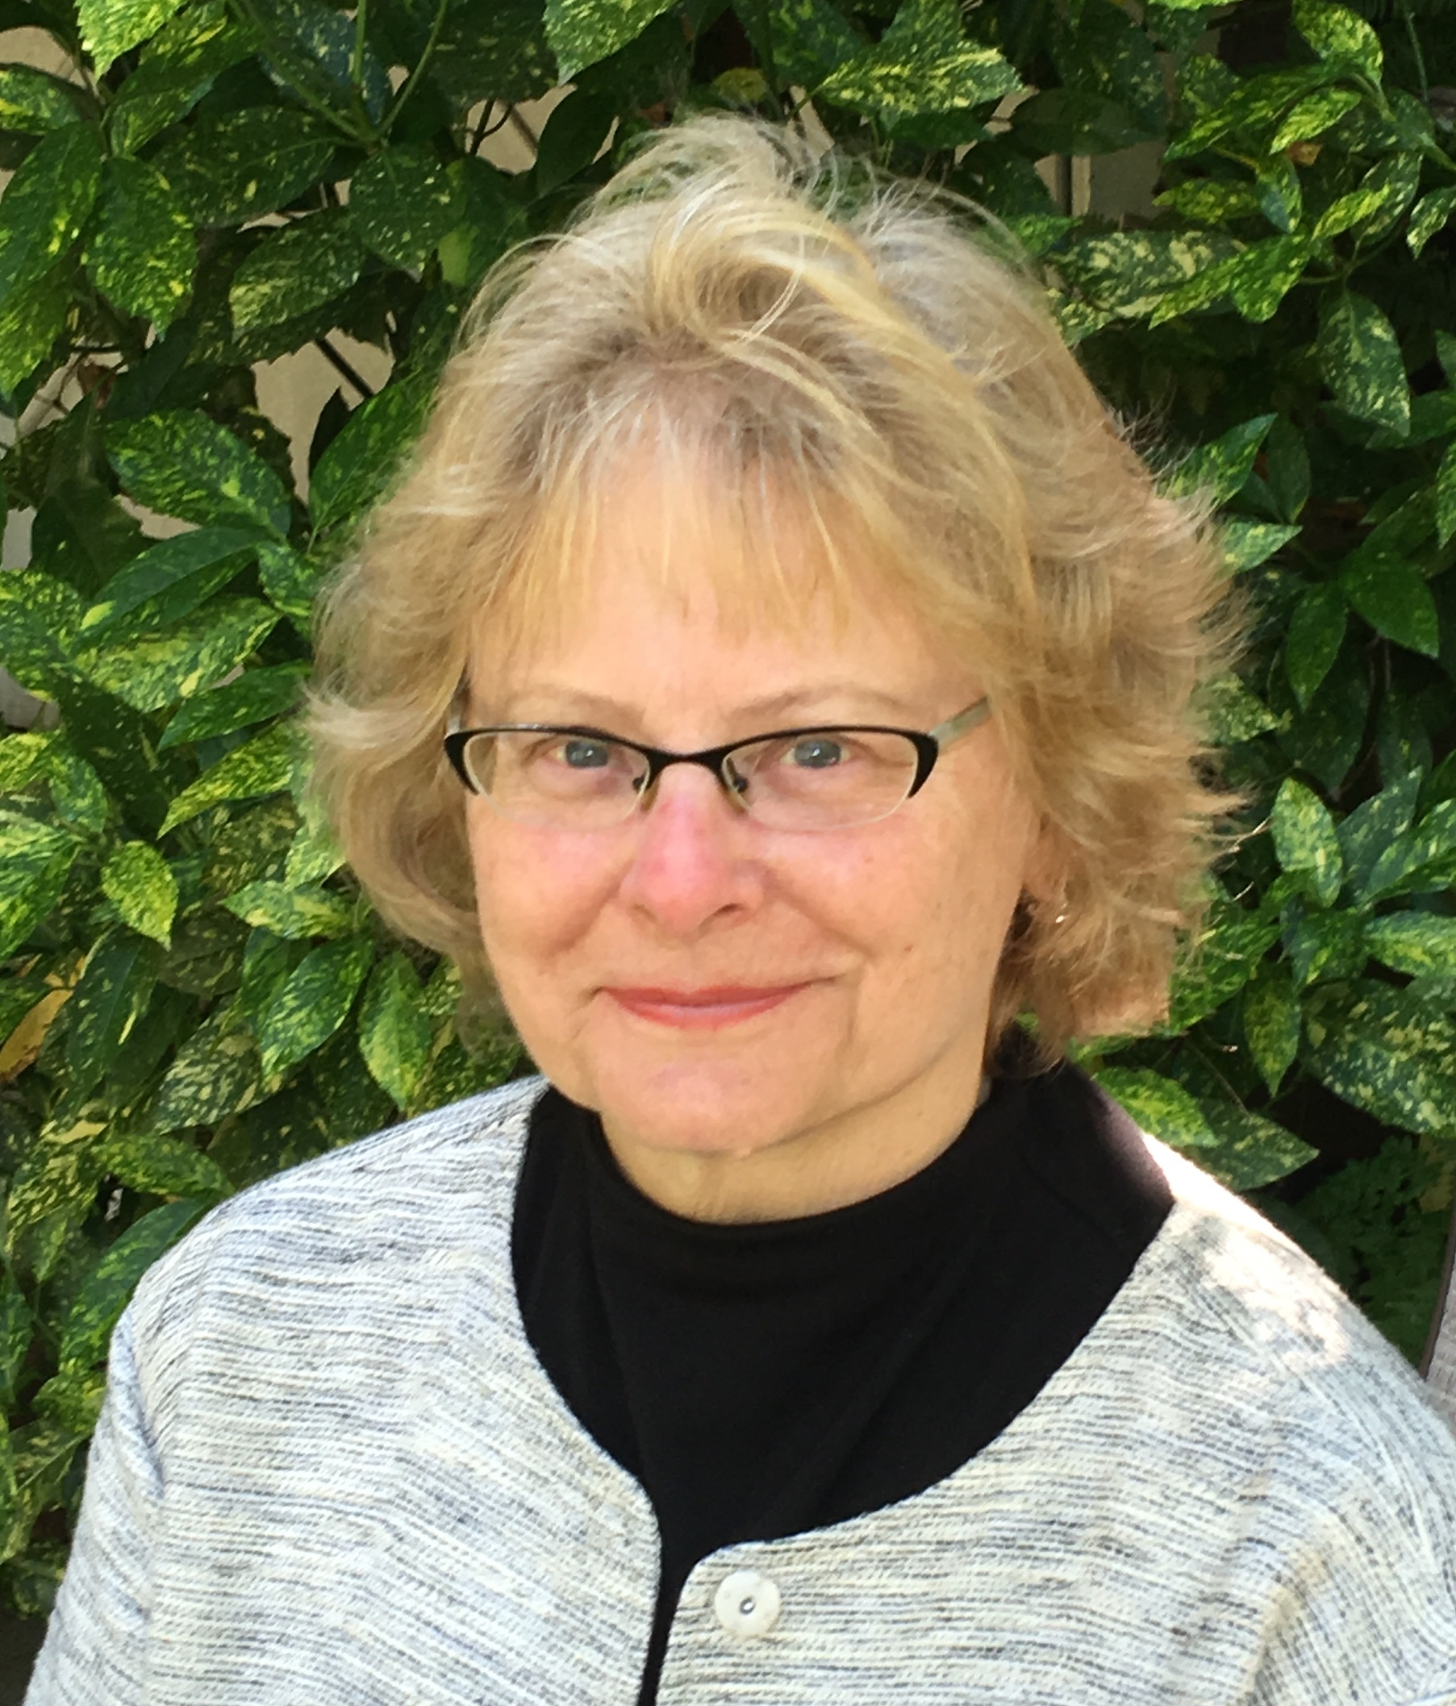
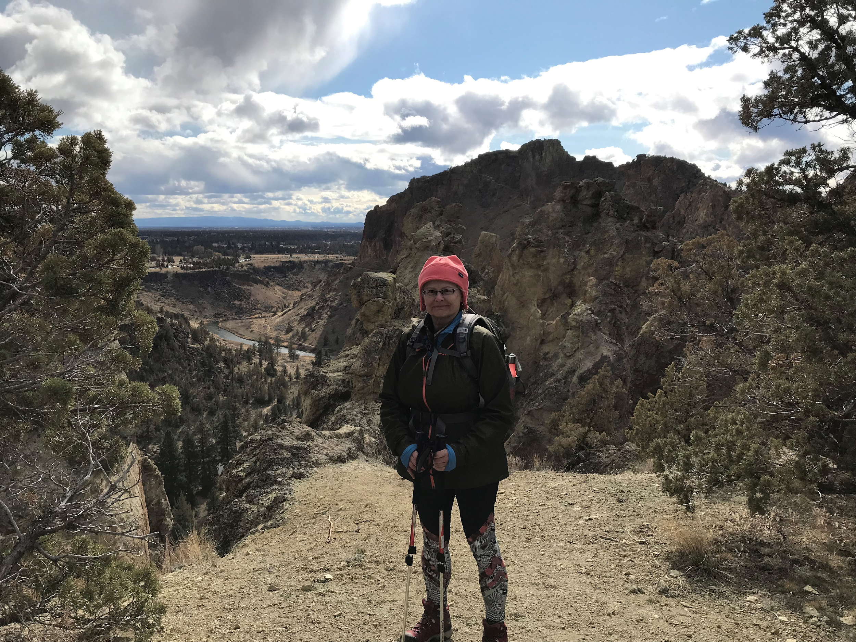
Karen Moe, Director of the Human Subjects Division: Retiring

Slide 4
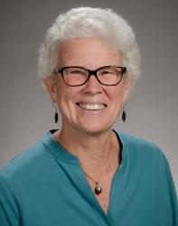
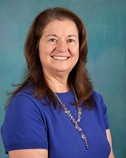
Associate Vice Provost for Research: Transition
September 1
Caroline “Carrie” Harwood
Cecelia “Ceci” Giachelli

Slide 5
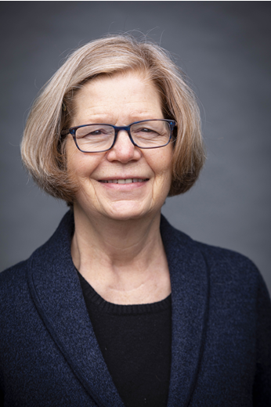
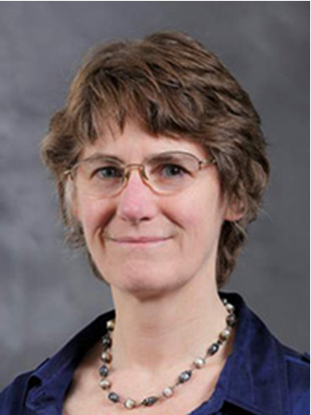
Vice Provost for Research: Transition
September 1
Mary Lidstrom
Mari Ostendorf

