Slide 1
MRAM | Monthly Research Administration Meeting
October 14, 2021 9:00 AM – 10:00 AM HOSTED REMOTELY Join the LIVE Webinar: https://washington.zoom.us/j/346891888
TOPIC | PRESENTER | EMAIL | MIN
Welcome | Kirsten DeFries Research Compliance & Operations | kirsten5@uw.edu | 2
NIH Child Care Allowance Update | Matt Gardner Post Award Fiscal Compliance | gcafco@uw.edu | 10
PAFC Hot Topic: Equipment and Subawards | Matt Gardner Post Award Fiscal Compliance | gcafco@uw.edu | 10
Covid-19 Vaccine Confirmation and Sponsor Requirements | Carol Rhodes Office of Sponsored Programs | carhodes@uw.edu | 10
UW Principal Investigators and the Vaccination Policy | Joe Giffels Office of Research | jgiffels@uw.edu | 5
Sponsored Program by the Numbers (FY21) | Carol Rhodes Office of Sponsored Programs | carhodes@uw.edu | 5
Advance Budget Process Update | Lily Gebrenegus Grant & Contract Accounting | lgebren@uw.edu | 5
Recognition for CORE Research Administration Certificate Recipients | Laurie Stephan Collaborative On Research Education (CORE) | corehelp@uw.edu | 15
NEXT MEETING November 4, 2021 9:00 AM - 10:00 AM

Slide 2
NIH CHILDCARE UPDATES
MRAM
October 2021
Matt Gardner
Post Award Fiscal Compliance

Slide 3
NIH Childcare Allowance
Overview/Review:
NIH is providing a Childcare Allowance on NRSA Fellowships and Institutional Training Grants
Guidance is now posted on the GCA website regarding the process for reimbursement for the allowance (Links at the end of the slides)
The allowance is not available on other NIH awards; NRSA Fellowships and Training Grants are currently the only mechanisms to provide the allowance
MRAM – Matt Gardner – PAFC

Slide 4
NIH Childcare Allowance – Policy Points
The NIH Childcare Allowance:
Is available in addition to UW’s Childcare Assistance Program
Must be treated as taxable income
Must be paid on a cost-reimbursement basis up to a maximum of $2,500 per budget period per NRSA fellow/trainee
Is available per NIH fellow/trainee (not per child)
Must be charged to a fellowship or training grant award sub budget to ensure that funds are not co-mingled or used for expenses other than this childcare allowance
MRAM – Matt Gardner – PAFC

Slide 5
NIH Childcare Allowance – Fellowships
Only eligible on F30, F31, F32, and F33 mechanisms
Funds must be requested by the recipient (NIH will not automatically fund)
Instructions for requesting funds can be found on the relevant NIH Notice: NOT-OD-21-074
https://grants.nih.gov/grants/guide/notice-files/NOT-OD-21-074.html
Department must ensure that Fellows are eligible to receive reimbursement
MRAM – Matt Gardner – PAFC

Slide 6
NIH Childcare Allowance – Training Grants
Only eligible on T32, TL1, TU2, and T90 mechanisms
NIH will obligate $2,500 per trainee slot on the Notice of Award
Beginning with Awards issued on or after October 1, 2021
Departments do not have to request the funding from NIH (different than NIH Fellowships)
Departments must ensure Trainees are eligible to receive reimbursement
If the funds aren’t used (e.g., Trainees don’t qualify), the funds are returned to NIH and may not be rebudgeted
MRAM – Matt Gardner – PAFC

Slide 7
NIH Childcare Allowance – Training Grants
Example
UW Training Grant has four trainee slots
NIH will obligate $10,000 on the Notice of Award for the Childcare Allowance ($2,500 x 4 slots)
One trainee is eligible for reimbursement, while the other three are not
$2,500 is available for reimbursement to the eligible trainee
$7,500 is restricted and will be returned to NIH upon closeout of the budget year
MRAM – Matt Gardner – PAFC

Slide 8
NIH Childcare Allowance – Training Grants
What does all this mean?
There will be funds obligated to NRSA Institutional Training Grants which may not be spent because not all trainees will be eligible
GCA will enter the funds into object code 37-99 as Restricted Funds and the funds may not be rebudgeted
It is the responsibility of the Department to ensure that only eligible trainees receive reimbursement
MRAM – Matt Gardner – PAFC

Slide 9
Resources
Please see the GCA webpage for instructions on reimbursement
GCA (Process):
https://finance.uw.edu/gca/award-lifecycle/sponsor-specific-information/nih-childcare-allowance
PAFC (Policy)
https://finance.uw.edu/pafc/nih-childcare-allowance
MRAM – Matt Gardner – PAFC

Slide 10
Thank You
Office of Research
Tax Office
Internal Audit
Procurement
Labor Relations
Attorney General’s Office
Grant & Contract Accounting
…for help working through the policy and process issues!
MRAM – Matt Gardner – PAFC

Slide 11
PAFC HOT TOPIC: EQUIPMENT & SUBAWARDS
MRAM
October 2021
Matt Gardner
Post Award Fiscal Compliance

Slide 12
Equipment and Subawards
Equipment purchases on subawards can raise complex issues
Questions arise frequently regarding:
Prior approvals
Ownership/Title
Replacement
Disposition
These questions can become increasingly complex when the prime sponsor is the Federal government
MRAM – Matt Gardner – PAFC

Slide 13
Equipment and Subawards:
New Web Content
PAFC and the OSP Subaward Team developed new content and guidance for the PAFC webpage to address these complex issues
Link:https://finance.uw.edu/pafc/subawards-and-equipment
MRAM – Matt Gardner – PAFC

Slide 14
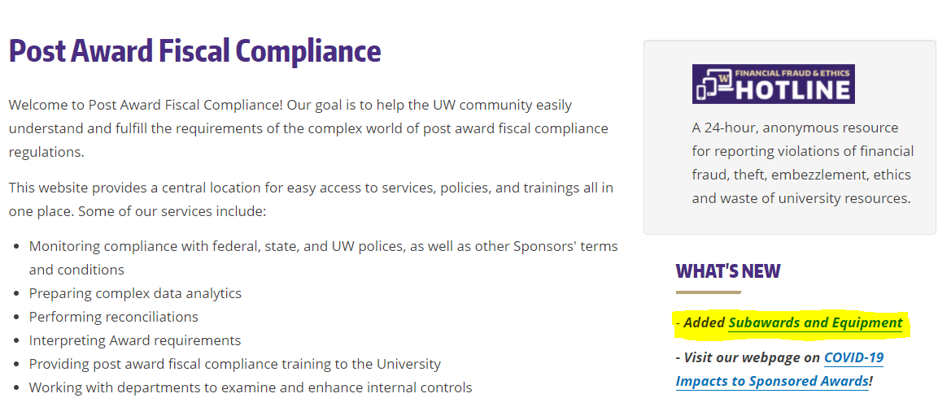
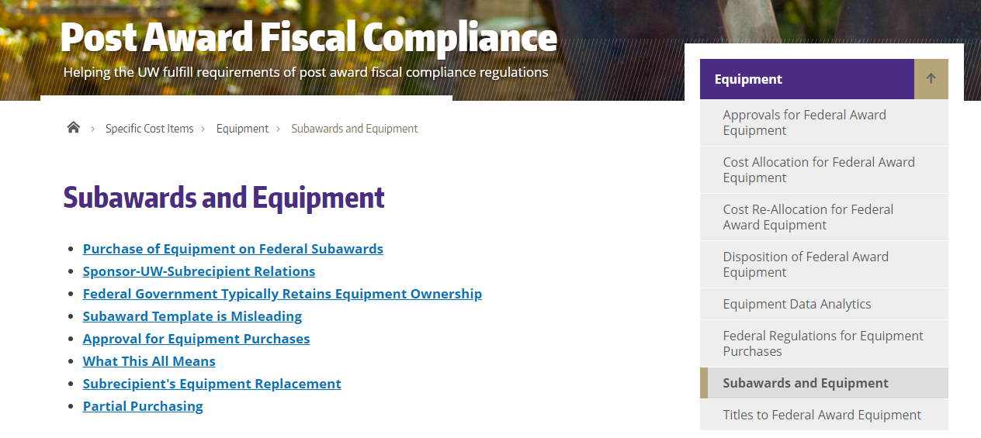
Equipment and Subawards:
New Web Content

Slide 15
Equipment and Subawards:
New Web Content
Topics covered on the web page:
Purchase of Equipment on Federal Subawards
Sponsor-UW-Subrecipient Relations
Federal Government Ownership Policies
Subaward Template Issue
Approval for Equipment Purchases
Subrecipient's Equipment Replacement
Partial Purchasing
MRAM – Matt Gardner – PAFC

Slide 16
Equipment and Subawards
Special thanks to Bo Park at OSP Subaward Team for help and collaboration in developing the web guidance
MRAM – Matt Gardner – PAFC

Slide 17
Questions
Post Award Fiscal Compliance (PAFC)
gcafco@uw.edu
https://finance.uw.edu/pafc/
Matt Gardner
mgard4@uw.edu
206-543-2610
MRAM – Matt Gardner – PAFC

Slide 18
Covid-19 Vaccine Verification and Sponsor Requirements
October, 2021 MRAM
Carol Rhodes
Office of Sponsored Programs

Slide 19
Federal Information
September 30, 2021: FAR Council memo directs agencies that issue contracts under the FAR to incorporate a clause in their solicitations and contracts to implement guidance issued by the Safer Fed Workforce Task Force pursuant to E.O. 14042.
New FAR 52.223-99, Ensuring Adequate COVID-19 Safety Protocols for Federal Contractors.
Each agency is issuing its own implementing memo and agencies are being encouraged to expand use of the FAR clause beyond what's required.
Federal Links:
Executive Order 14042: on Ensuring Adequate COVID Safety Protocols for Federal Contractors
Safer Federal Workforce FAQs
Memorandum for FAR Clause Implementation

Slide 20
Federal Contract Implementation &
Effective Dates
Contract officers may implement the clause on or before October 15, 2021.
On or after October 15, 2021
New solicitations & contracts issued pursuant to those solicitations.
Extensions, renewals or options on existing contracts or orders.
On or after November 14th
New contracts awarded from solicitations issued before October 15th.

Slide 21
Project Specific Award Modification -
Simple Confirmations
Simple confirmation that the UW has a process meeting sponsor requirements?
OSP will create PAC, sign, approve, notify campus

Slide 22
Project Specific Award Modification -
Attestation or Certifications
More detailed attestation or certification of project personnel vaccination status?
OSP Reviewers will reach out to the PI & department contact to request written confirmation that the requirement is met (such as an email) from the appropriate department HR individual.

Slide 23
Project Specific Award Modification -
Vendor/Supplier or Subrecipients
Request for attestation or certification of vendors/suppliers or subrecipients process to check vaccine status?
PI & department to check the list of companies from Procurement’s site.
Do I need to request a subaward modification to flow down terms?
OSP will flow down any appropriate language as required during the normal course of subaward requests, unless there are specific deadlines to attest or certify.
Notes:
If specific deadline, OSP will work with department on what is needed.

Slide 24
What NOT to send OSP
Copies of vaccination proof (e.g. C19 vaccine cards)
Workday screenshots
Workday attestation reports for the unit
Individual vendor/supplier or subrecipient Declarations

Slide 25
Questions
Notes:
Declaration premised on WA state Governor’s proclamation and may not meet sponsor requirements.

Slide 26
UW Principal Investigators
and the Vaccination Policy
MRAM
October 2021
Joe Giffels
Office of Research

Slide 27
Sponsored Programs by the Numbers (FY21)
October, 2021 MRAM
Carol Rhodes
Office of Sponsored Programs

Slide 28
Application Type | FY19 | FY20 | FY21
Competing Renewal | 187 | 144 | 155
Competing Revisions | 37 | 57 | 37
Competing Supplement | 137 | 157 | 149
New | 4316 | 4562 | 4201
Non-Award Agreement - Continuation | 39 | 60 | 112
Non-Award Agreement - New | 457 | 920 | 934
Non-Competing Renewal | 663 | 553 | 576
Non-Competing Revisions | 53 | 86 | 61
Non-Competing Supplement | 242 | 232 | 226
Pre-Application | 162 | 105 | 119
Resubmission - Previously Denied | 484 | 512 | 495
Supplement & Extension | 414 | 455 | 422
Transfer from Another Institution | 46 | 50 | 44
Grand Total | 7237 | 7893 | 7531
eGC1 Totals FY19 thru
FY21
Total Competing Proposals for FY21: 5081

Slide 29
Application Type | FY20 | FY21
Competing Renewal |  | 4
Competing Revisions | 25 | 8
Competing Supplement | 36 | 20
New | 182 | 204
Non-Award Agreement - Continuation | 1 | 2
Non-Award Agreement - New | 27 | 103
Non-Competing Renewal | 1 | 2
Non-Competing Revisions | 1 | 5
Non-Competing Supplement | 21 | 30
Pre-Application | 1 | 5
Resubmission - Previously Denied |  | 15
Supplement & Extension | 7 | 17
Grand Total | 302 | 415
Covid Related Totals
FY20 &
FY21

Slide 30
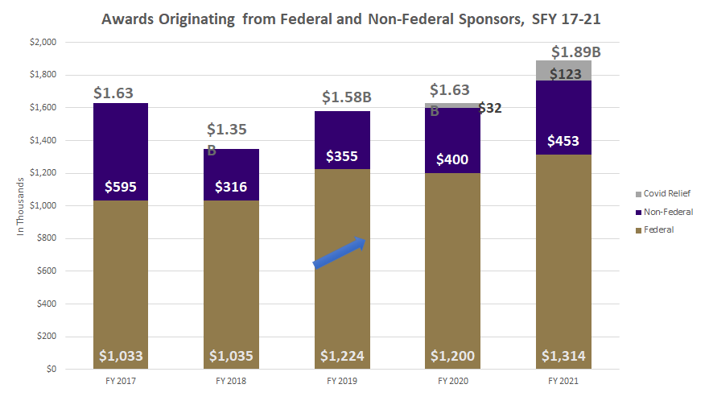
Notes:
* A ten-year, $280M Foundation award accounts for the higher level of funding in FY 2017
^ COVID relief funds included in total - ~$32M in FY 2020 and $123M in FY 2021

Slide 31
Awards by Sponsor Type FY21 (1 of 2)
Application Type | FY21 # | FY21 $
Association & Non-Profits | 1114 | $155,311,388
City of Seattle | 11 | $848,416
Federal Government | 2438 | $1,193,687,573
Foreign Government | 12 | $1,103,908
Foreign Non-Profit | 51 | $6,821,093
Foreign Private Industry | 35 | $5,669.670
Foreign School, College, University | 35 | $4,971,382
Foundation | 326 | $273,903,216
King County | 20 | $2,406,151

Slide 32
Awards by Sponsor Type FY21 (2 of 2)
Application Type | FY21 # | FY21 $
Other Local Government | 25 | $1, 837. 419
Other State | 17 | $2,274,007
Private Industry | 478 | $94,526,173
Private School, College, University | 331 | $51,070,772
Public School, College, University | 422 | $46,918,248
State of Washington | 113 | $47,792,779
Washington School District | 2 | $260,243
Washington School, College, University | 19 | $1,513,900

Slide 33
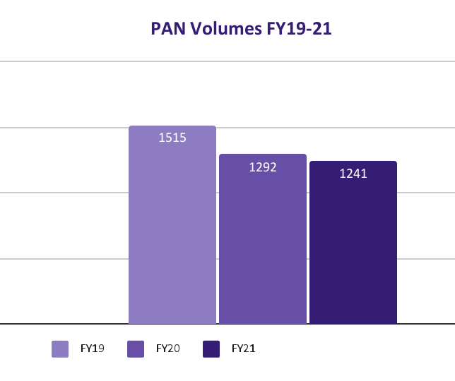
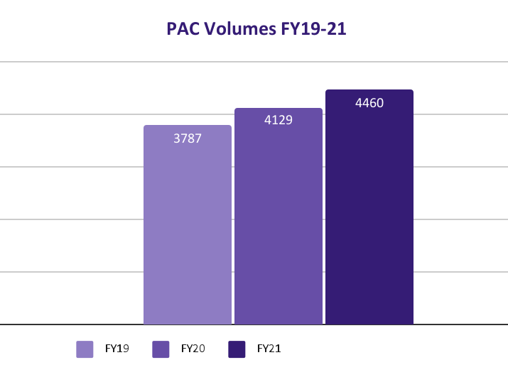
Pre-Award Notification (PAN) &
Post-Award Change (PAC)

Slide 34
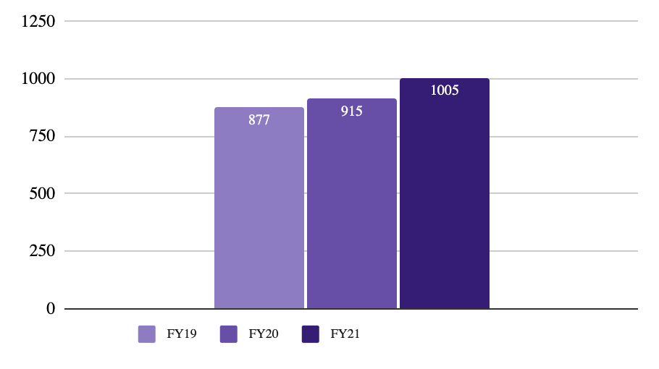
Non-Award Agreements (NAA)

Slide 35
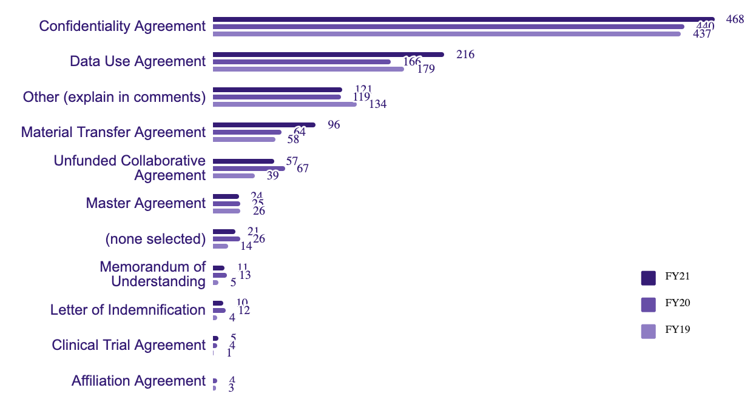
NAA by Type FY19-FY21

Slide 36
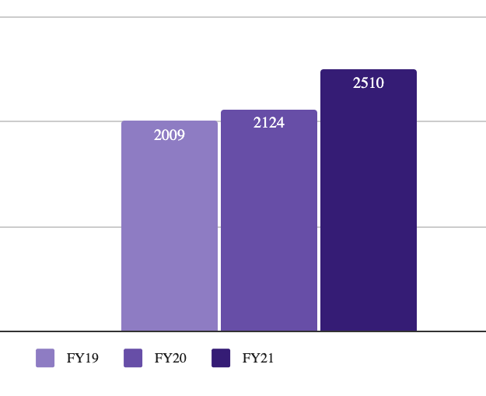
Subawards & Subaward Modifications

Slide 37
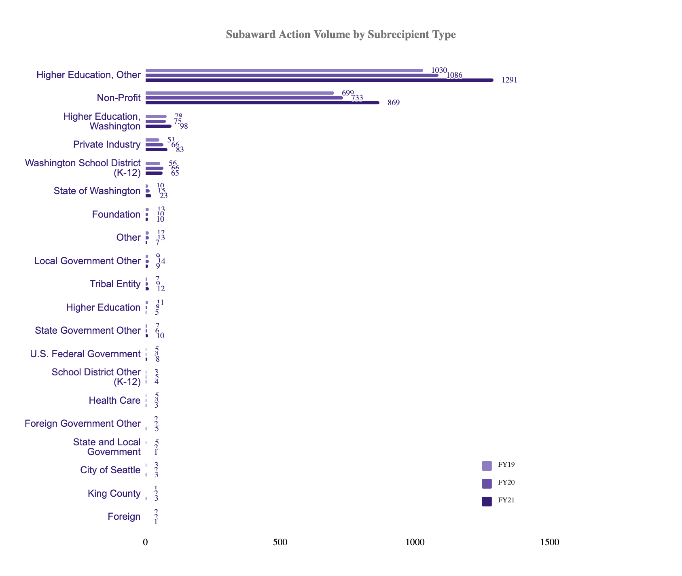
Subawards by Subrecipient Type

Slide 38
Questions

Slide 39
Advance Budget Project Update
Lily Gebrenegus
Director, Grant & Contract Accounting
October 2021 MRAM

Slide 40
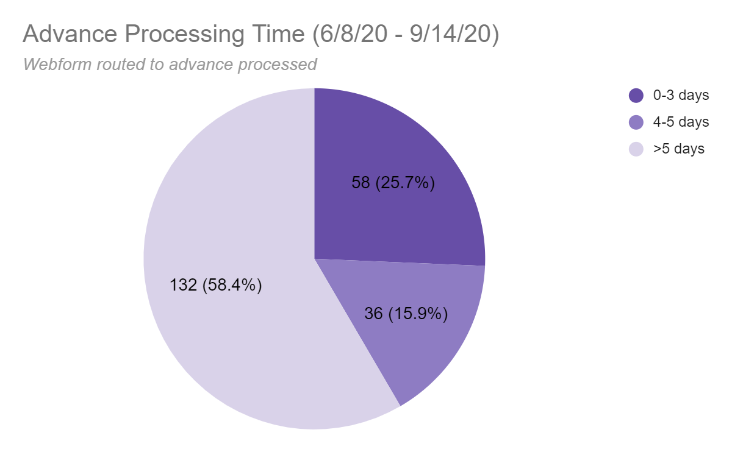
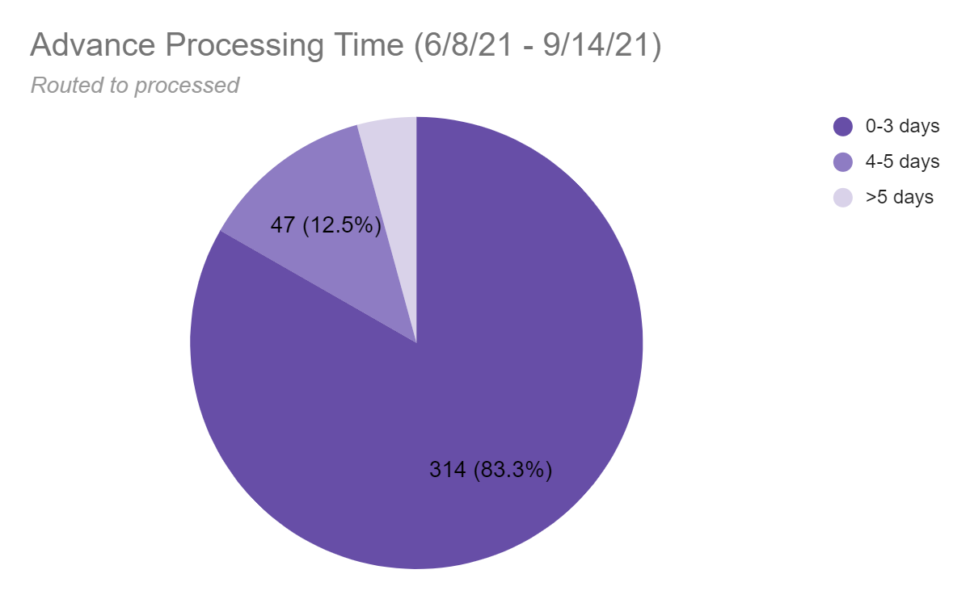
Advance Budget Update
Progress toward goal: Processing Time

Slide 41
In Closing
Thank you to ORIS and OSP for a great collaboration and to our campus partners for providing feedback along the way.
Please send questions about the advance budget process to gcahelp@uw.edu or visit:
Create an Advance Budget Request
GCA Advance Budget Process

Slide 42
Updates
Five-year window for CORE Certificate completion
Course planner updated
Changes to the way we count elective coursework for the Certificate
Introduction to Research Administration –CORE gateway class– now on-demand
IMPORTANT--if you dial-in to a Zoom class please send CORE the phone number for credit purposes
CORE Registration
https://uwresearch.gosignmeup.com/public/course/browse
CORE Home https://www.washington.edu/research/training/core/
Contact CORE
corehelp@uw.edu
Notes:
Good morning!

Slide 43
Recognition!
Certificate in Research Administration Graduates
414 enrolled in the certificate
87 graduates—CONGRATULATIONS!
28 graduates, October 2020
27 graduates, February 2021
32 graduates, October 2021
Notes:
And now for the fun part! Today we are recognizing the second group of graduates from the CORE Certificate in Research Administration. CORE launched this certificate in the fall of 2019. Since then 414 people have enrolled in the certificate program and as October 7, 87 of those enrollees have met all requirements to receive the certificate. We recognize the recipients on a semi-annual basis in the MRAM venue and today we are going to take a moment to recognize the achievements in this last round completers. Not all of them chose to include their names in today’s announcement but you all know who you are! Let’s give a shout out to some of our most recent graduates!

Slide 44
Certificate in Research Administration Program Graduates
Notes:
Here’s who they are—let’s give them a hand!

Slide 45
Marie Bolstad Finance & Operations Manager Center for Social Sector Analytics & Technology
School of Social Work
Congratulations!

Slide 46
Devon Bushnell Program Operations Specialist Innovative Programs Research Group & Center for Womens’ Welfare
School of Social Work
Congratulations!

Slide 47
Laura Ciotti
Program Operations Specialist
ADVANCE Center for Institutional Change College of Engineering
Congratulations!

Slide 48
Shar Conner Lead Grants Manager ABC Shared Services Department School of Medicine
Congratulations!

Slide 49
Carol L. Crowell
Fiscal Specialist II Paul G. Allen School of Computer Science & Engineering College of Engineering
Congratulations!

Slide 50
Emily Elliott Administrator for the Superfund Research Program & EDGE Center Department of Environmental & Occupational Health (DEOHS)
School of Public Health
Congratulations!

Slide 51
Yuichi Fukuda Program and Grants Manager Division of Allergy & Infectious Diseases
School of Medicine
Congratulations!

Slide 52
Lisa A. Guerrero Grants Manager/Budget Analyst Health Sciences Library School of Medicine
Congratulations!

Slide 53
Jayashree Hari Budget/Fiscal Analyst Department of Chemistry College of Arts & Sciences
Congratulations!

Slide 54
Brianna Holden Granado Grants & Contracts Specialist Department of Research Administration Washington National Primate Center
Congratulations!

Slide 55
Kellie List Grants Specialist Department of Global Health
School of Public Health
Congratulations!

Slide 56
Eva Lu Budget Fiscal Analyst Lead Washington National Primate Center
Congratulations!

Slide 57
Amanda L. Minogue Proposal Development Officer Institute for Health Metrics & Evaluation School of Medicine
Congratulations!

Slide 58
Matthew F. Nichols Grants Specialist ABC Shared Services Department
School of Medicine
Congratulations!

Slide 59
Leena C. Perera Budget/Fiscal Analyst Lead Office of Sponsored Programs Office of Research
Congratulations!

Slide 60
Donna Prybell Budget Fiscal Analyst Department of Pediatrics School of Medicine
Congratulations!

Slide 61
Teri Thomson Randall Program Director Community Engagement
College of Built Environments
Congratulations!

Slide 62
Belinda Sachs Grants Manager Center for Studies in Demography & Ecology College of Arts & Sciences
Congratulations!

Slide 63
Mary M. Schiffgens Program Operations Analyst UW Medicine Heart Institute Division of Cardiology School of Medicine
Congratulations!

Slide 64
Elaine Shelley Grants Manager Paul G. Allen School of Computer Science & Engineering College of Engineering
Congratulations!

Slide 65
Hilary Walker Grants & Contracts Manager Center for Environment & Information Systems Applied Physics Laboratory
Congratulations!

Slide 66
Melissa Woldeit Program Director International & Academic Programs Continuum College
Congratulations!

Slide 67
Chiemi Yamaoka Research Administration Support Paul G. Allen School of Computer Science & Engineering College of Engineering
Congratulations!

Slide 68
Eunice Yang Budget/Fiscal Unit Supervisor Department of Earth & Space Sciences College of the Environment
Congratulations!

Slide 69
Thank You!
Thanks to the staff and their supervisors
who support this important training!
You help make the UW an
effectively managed research enterprise.
Notes:
And a big thank you to all who support the ongoing professional development of our research administration staff!

