Slide 1
PAFC HOT TOPIC: EQUIPMENT & SUBAWARDS
MRAM
October 2021
Matt Gardner
Post Award Fiscal Compliance

Slide 2
Equipment and Subawards
Equipment purchases on subawards can raise complex issues
Questions arise frequently regarding:
Prior approvals
Ownership/Title
Replacement
Disposition
These questions can become increasingly complex when the prime sponsor is the Federal government
MRAM – Matt Gardner – PAFC

Slide 3
Equipment and Subawards:
New Web Content
PAFC and the OSP Subaward Team developed new content and guidance for the PAFC webpage to address these complex issues
Link: https://finance.uw.edu/pafc/subawards-and-equipment
MRAM – Matt Gardner – PAFC

Slide 4
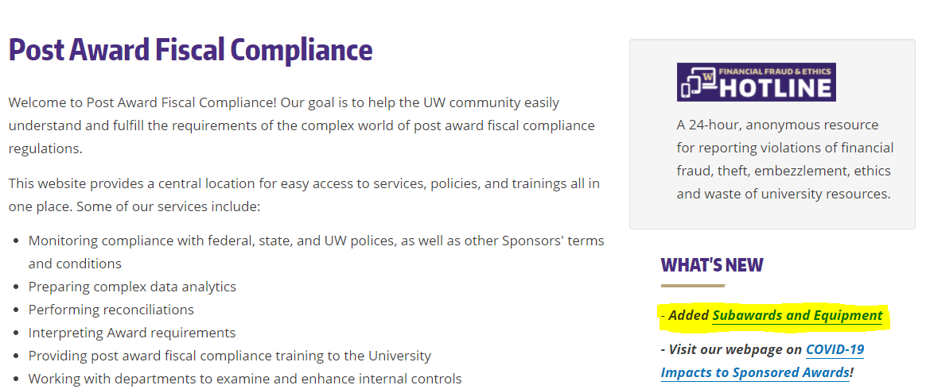
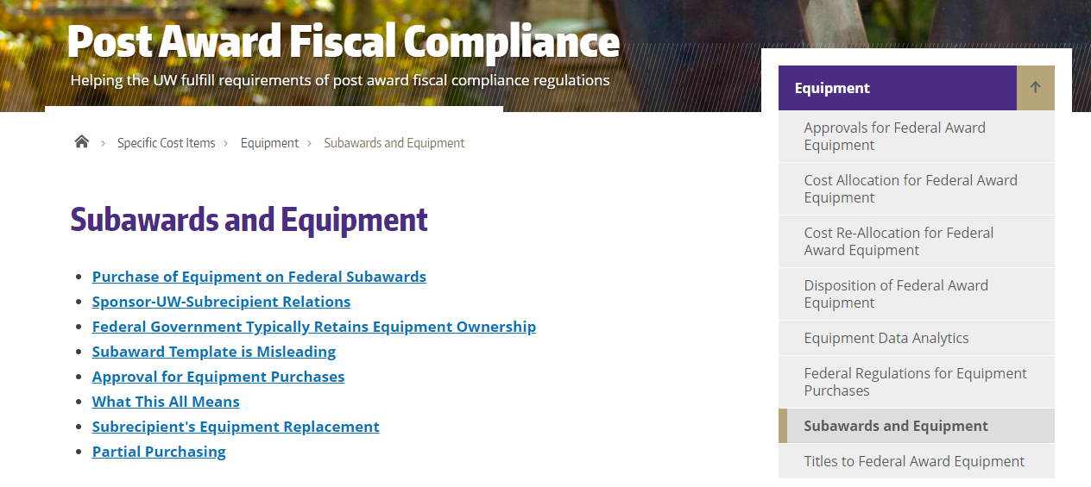
Equipment and Subawards:
New Web Content

Slide 5
Equipment and Subawards:
New Web Content
Topics covered on the web page:
Purchase of Equipment on Federal Subawards
Sponsor-UW-Subrecipient Relations
Federal Government Ownership Policies
Subaward Template Issue
Approval for Equipment Purchases
Subrecipient's Equipment Replacement
Partial Purchasing
MRAM – Matt Gardner – PAFC

Slide 6
Equipment and Subawards
Special thanks to Bo Park at OSP Subaward Team for help and collaboration in developing the web guidance
MRAM – Matt Gardner – PAFC

Slide 7
Questions
Post Award Fiscal Compliance (PAFC)
gcafco@uw.edu
https://finance.uw.edu/pafc/
Matt Gardner
mgard4@uw.edu
206-543-2610
MRAM – Matt Gardner – PAFC

