Slide 1
Sponsored Programs by the Numbers (FY21)
October, 2021 MRAM
Carol Rhodes
Office of Sponsored Programs

Slide 2
Application Type | FY19 | FY20 | FY21
Competing Renewal | 187 | 144 | 155
Competing Revisions | 37 | 57 | 37
Competing Supplement | 137 | 157 | 149
New | 4316 | 4562 | 4201
Non-Award Agreement - Continuation | 39 | 60 | 112
Non-Award Agreement - New | 457 | 920 | 934
Non-Competing Renewal | 663 | 553 | 576
Non-Competing Revisions | 53 | 86 | 61
Non-Competing Supplement | 242 | 232 | 226
Pre-Application | 162 | 105 | 119
Resubmission - Previously Denied | 484 | 512 | 495
Supplement & Extension | 414 | 455 | 422
Transfer from Another Institution | 46 | 50 | 44
Grand Total | 7237 | 7893 | 7531
eGC1 Totals FY19 thru
FY21
Total Competing Proposals for FY21: 5081

Slide 3
Application Type | FY20 | FY21
Competing Renewal |  | 4
Competing Revisions | 25 | 8
Competing Supplement | 36 | 20
New | 182 | 204
Non-Award Agreement - Continuation | 1 | 2
Non-Award Agreement - New | 27 | 103
Non-Competing Renewal | 1 | 2
Non-Competing Revisions | 1 | 5
Non-Competing Supplement | 21 | 30
Pre-Application | 1 | 5
Resubmission - Previously Denied |  | 15
Supplement & Extension | 7 | 17
Grand Total | 302 | 415
Covid Related Totals
FY20 &
FY21

Slide 4
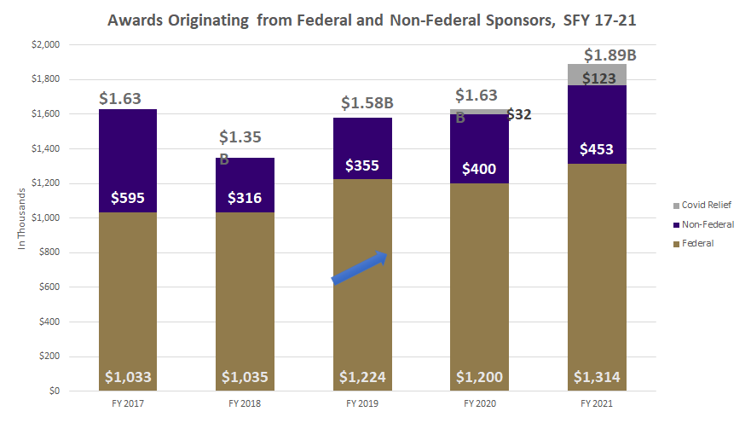
Notes:
* A ten-year, $280M Foundation award accounts for the higher level of funding in FY 2017
^ COVID relief funds included in total - ~$32M in FY 2020 and $123M in FY 2021

Slide 5
Awards by Sponsor Type FY21 (1 of 2)
Application Type | FY21 # | FY21 $
Association & Non-Profits | 1114 | $155,311,388
City of Seattle | 11 | $848,416
Federal Government | 2438 | $1,193,687,573
Foreign Government | 12 | $1,103,908
Foreign Non-Profit | 51 | $6,821,093
Foreign Private Industry | 35 | $5,669.670
Foreign School, College, University | 35 | $4,971,382
Foundation | 326 | $273,903,216
King County | 20 | $2,406,151

Slide 6
Awards by Sponsor Type FY21 (2 of 2)
Application Type | FY21 # | FY21 $
Other Local Government | 25 | $1, 837. 419
Other State | 17 | $2,274,007
Private Industry | 478 | $94,526,173
Private School, College, University | 331 | $51,070,772
Public School, College, University | 422 | $46,918,248
State of Washington | 113 | $47,792,779
Washington School District | 2 | $260,243
Washington School, College, University | 19 | $1,513,900

Slide 7
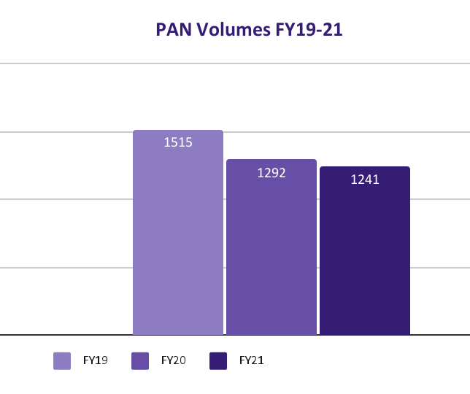
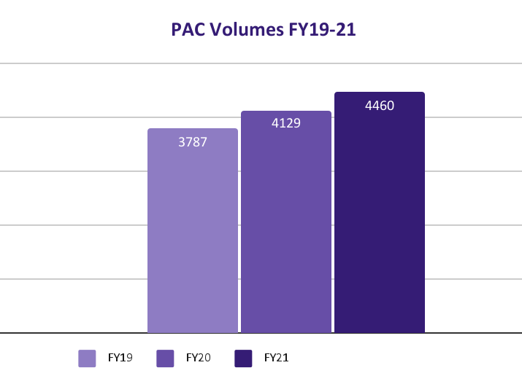
Pre-Award Notification (PAN) &
Post-Award Change (PAC)

Slide 8
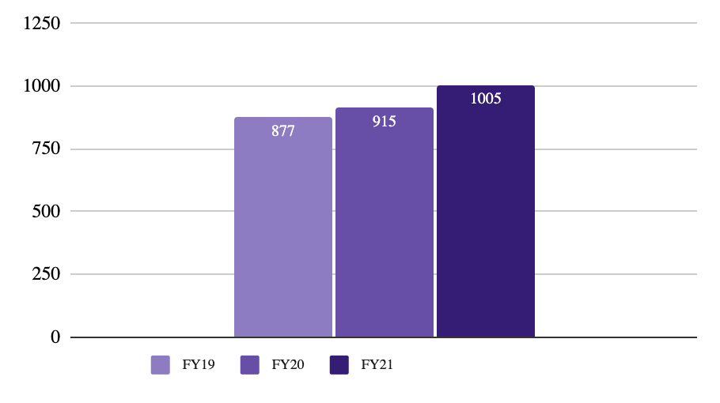
Non-Award Agreements (NAA)

Slide 9
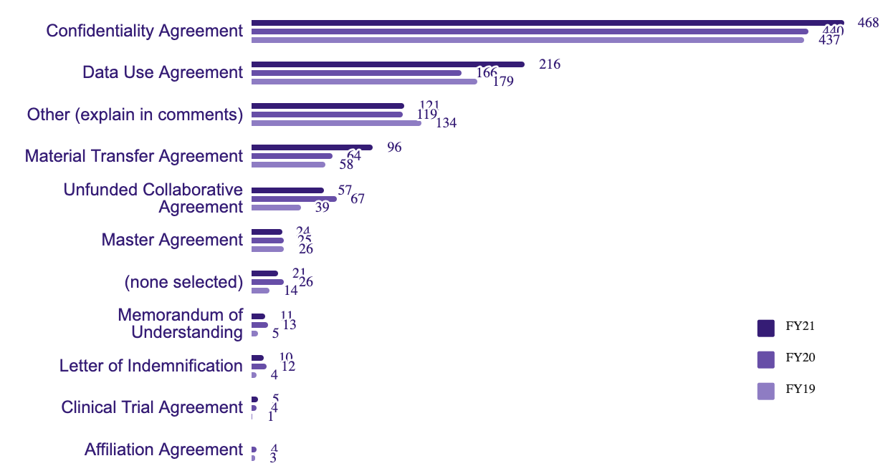
NAA by Type FY19-FY21

Slide 10
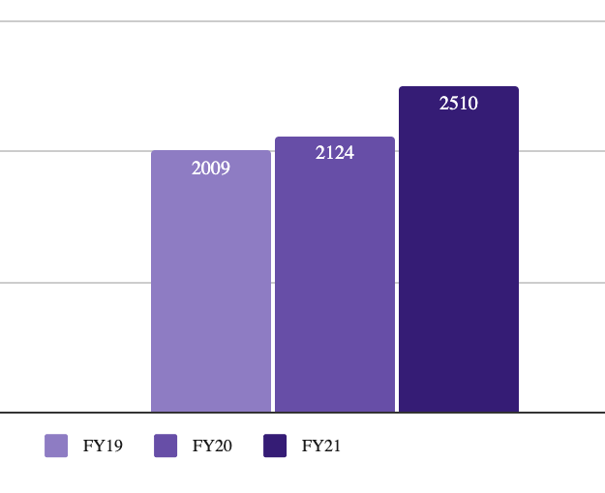
Subawards & Subaward Modifications

Slide 11
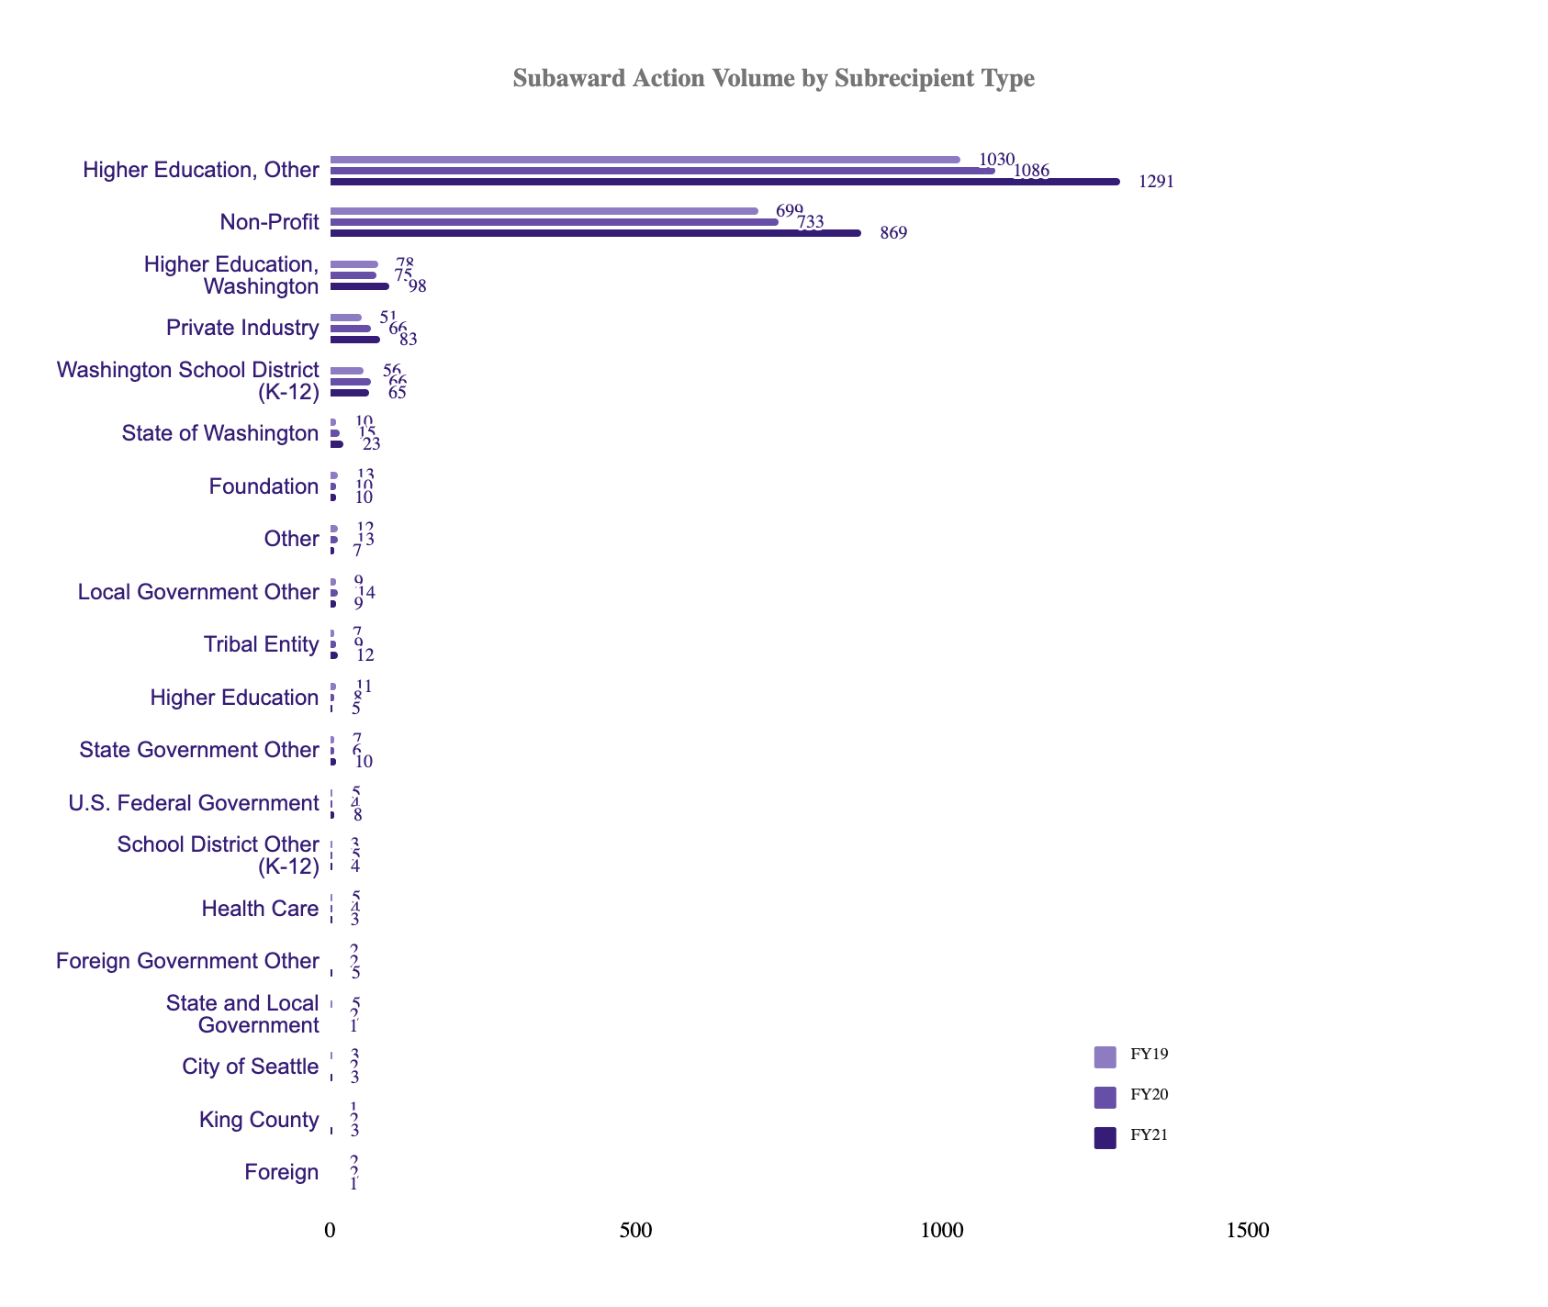
Subawards by Subrecipient Type

Slide 12
Questions

