Slide 1
Advance Budget Project Update
Lily Gebrenegus
Director, Grant & Contract Accounting
October 2021 MRAM

Slide 2
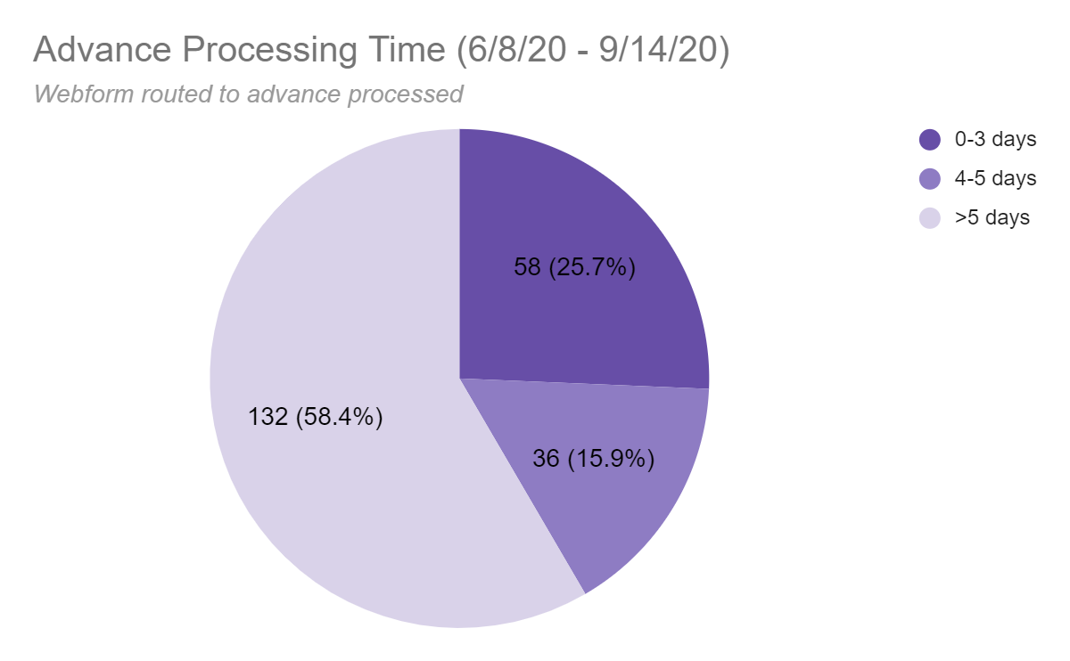
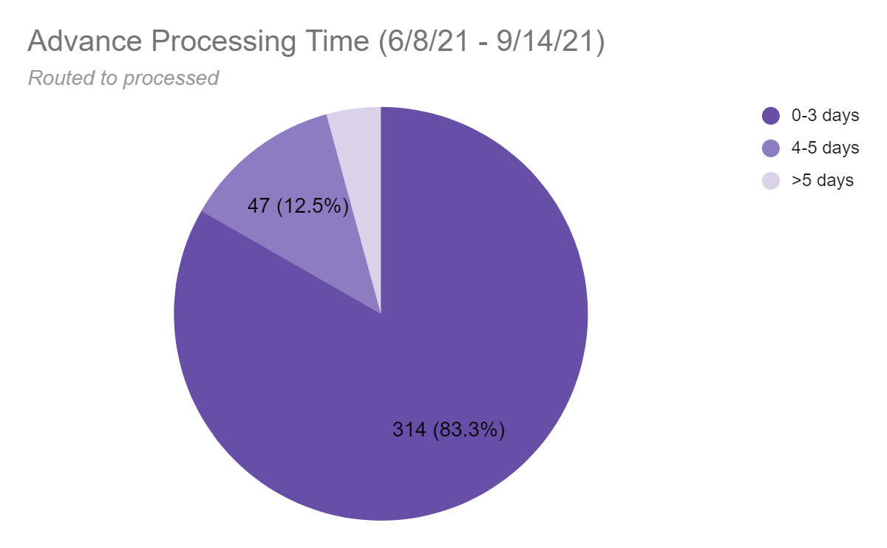
Advance Budget Update
Progress toward goal: Processing Time

Slide 3
In Closing
Thank you to ORIS and OSP for a great collaboration and to our campus partners for providing feedback along the way.
Please send questions about the advance budget process to gcahelp@uw.edu or visit:
Create an Advance Budget Request
GCA Advance Budget Process

