Slide 1
MRAM | Monthly Research Administration Meeting
November 4, 2021 9:00 AM – 10:00 AM HOSTED REMOTELY Join the LIVE Webinar: https://washington.zoom.us/j/346891888
TOPIC | PRESENTER | EMAIL | MIN
Welcome | Kirsten DeFries Research Compliance & Operations | kirsten5@uw.edu | 2
PAFC: Cost Share | Matt Gardner Post Award Fiscal Compliance | gcafco@uw.edu | 10
Sponsored Program Scope & Process: Proposals, Awards, & Non-Award Agreements | Jesse Kindra Ari Santander Office of Sponsored Program | osp@uw.edu | 15
New IRB 101 tutorial and pending requirement | Karen Moe Human Subjects Division | kemoe@uw.edu | 5
Changes to Privacy and Personal Data Protection Practices | Ann Nagel UW Privacy Office | uwprivacy@uw.edu | 15
Data Privacy & Sponsored Programs | Carol Rhodes Office of Sponsored Programs | carhodes@uw.edu | 5
NEXT MEETING December 9, 2021 9:00 AM - 10:00 AM

Slide 2
COMPLIANCE HOT TOPIC: COST SHARE
MRAM
November 2021
Matt Gardner
Post Award Fiscal Compliance

Slide 3
Cost Share Pain Points
Faculty Effort Cost Share
Dollar-based commitments
Non-FEC Cost Share
Tagging expenditures
Third Party or Subaward Commitments
Reducing or eliminating Cost Share commitments
MRAM – Matt Gardner – PAFC

Slide 4
Faculty Effort Cost Share –
Dollar-Based Commitments
Issues arise during the Award if:
The incorrect Institutional Base Salary (“IBS”) is used on the Addendum
The faculty members’ salary changes over the course of the commitment period
MRAM – Matt Gardner – PAFC

Slide 5
Institutional Base Salary
IBS is comprised of multiple pay components (General Salary Plan, Endowment Supplements, etc.)
The full IBS is used to calculate the Cost Share commitment
The actual paid IBS is used to calculate the Cost Share contribution when certifying the FEC
Reference (MAA website):
https://finance.uw.edu/maa/fec/overview/ibs-components
MRAM – Matt Gardner – PAFC

Slide 6
Faculty Effort Cost Share –
Salary Changes
Scenario: A faculty members’ paid IBS decreases during the Cost Share commitment period
An IBS decrease can occur if:
Loss of an IBS component (Endowment Supplement, etc.), or
Reduction in FTE percentage (Faculty is reduced from 100% FTE to 60% FTE)
The commitment won’t change when these reductions occur but the amount of effort to meet the commitment will increase
MRAM – Matt Gardner – PAFC

Slide 7
Faculty Effort Cost Share –
Dollar-Based Commitments
Dollar-Based Cost Share contributions are based on the actual paid IBS during the commitment period
If during the FEC process the cost share contribution is coming up short, it’s likely due to an IBS issue
Keep an eye on your dollar-based commitments, specifically noting salary changes
MRAM – Matt Gardner – PAFC

Slide 8
Non-FEC Cost Share –
Tagging Expenditures
The “tagging” process identifies direct expenditures used to meet a Cost Share commitment
Supplies
Equipment
Travel
Non-Faculty Salaries
Remember to tag expenditures on a routine basis (Recommendation: quarterly, at a minimum)
All tagged expenses must be allowable and benefit the Award objectives
MRAM – Matt Gardner – PAFC

Slide 9
Cost Share –
Third Party or Subaward Commitments
It is the responsibility of the UW PI to ensure all Cost Share commitments are met
If a Third Party or Sub recipient does not provide the required Cost Share, the UW is still responsible for the commitment
The PI would need to find additional resources to cover the commitment
MRAM – Matt Gardner – PAFC

Slide 10
Cost Share –
Reducing or Eliminating Commitments
A Cost Share commitment cannot be reduced or eliminated without written approval from the Sponsor
A Post Award Change (PAC) documenting Sponsor approval is required to reduce/eliminate Cost Share
GCA cannot/will not reduce or eliminate a Cost Share commitment without a PAC
MRAM – Matt Gardner – PAFC

Slide 11
Cost Share –
Resources
GCA web:
https://finance.uw.edu/gca/cost-share
MAA web (IBS components):
https://finance.uw.edu/maa/fec/overview/ibs-components
GIM 21: Cost Share on Sponsored Programs
https://www.washington.edu/research/policies/gim-21-cost-share-on-sponsored-programs/
MRAM – Matt Gardner – PAFC

Slide 12
Questions
Post Award Fiscal Compliance (PAFC)
gcafco@uw.edu
https://finance.uw.edu/pafc/
Matt Gardner
mgard4@uw.edu
206-543-2610
Teams and Zoom
MRAM – Matt Gardner – PAFC

Slide 13
Sponsored Program Scope & Process: Proposals, Awards & Non-Award Agreements
November, 2021 MRAM
Ari Santander, Proposals & Awards Team Manager
Jesse Kindra, Contracts Team Manager
Office of Sponsored Programs

Slide 14
Proposals and Awards Team
Team of 25
Managers: Tim Mhyre, Ari Santander
Program Coordinators: Just-in-Times (JITs), No Cost Extensions (NCE), NIH Certificate of Confidentiality (CoCs)
Grant Analysts: NSF, NIH Modular Proposals, Unilateral Federal Awards & Mods
Grant & Contract Analysts: All Other Proposals, Awards & Mods, (includes Team Leads - Operation Role)

Slide 15
Proposals
Timely submission of complete, accurate and fully compliant proposals
Deadline driven
Supported by UW Policy

Slide 16
University Policy
7 Business Days in Advance
Detailed review proposal elements
should be in final form and viewable in sponsor system
Scope of Work (SOW) in draft form
compliance issues identifiable
Substantive review to extent reasonable
nature of proposal/arrival time in OSP
GIM 19: Internal Deadline For Proposals to External Entities

Slide 17
University Policy
3 Business Days in Advance
Ready to submit
Review to extent necessary to assure proposal is transmitted to Sponsor for review
Will be reviewed for accuracy, completion and compliance - to the extent reasonable given THE nature of proposal and arrival time in OSP
GIM 19: Internal Deadline For Proposals to External Entities

Slide 18
Awards
Reviews and negotiates incoming sponsored program funding
Accepts sponsored program funding on behalf of the University (GIM 2)
Prepares and approves Funding Actions

Slide 19
Awards: Funding Action Volumes
Time Period | 2016 | 2017 | 2018 | 2019 | 2020 | 2021 | 2022 | Grand Total
January | 322 | 366 | 379 | 360 | 404 | 322 |  | 2153
February | 357 | 325 | 324 | 360 | 363 | 379 |  | 2108
March | 453 | 485 | 416 | 409 | 513 | 459 |  | 2735
April | 439 | 373 | 434 | 450 | 477 | 478 |  | 2651
May | 466 | 496 | 573 | 467 | 402 | 437 |  | 2841
June | 554 | 628 | 600 | 574 | 632 | 594 |  | 3582
July | 546 | 510 | 573 | 576 | 633 | 614 | 646 | 4098
August | 564 | 562 | 734 | 647 | 653 | 676 | 703 | 4539
September | 551 | 551 | 533 | 594 | 550 | 630 | 518 | 3927
October | 348 | 322 | 318 | 423 | 325 | 392 | 275 | 2403
November | 306 | 308 | 353 | 317 | 329 | 285 |  | 1898
December | 365 | 395 | 379 | 384 | 395 | 428 |  | 2346
Grand Total | 5271 | 5321 | 5616 | 5561 | 5676 | 5694 | 2142 | 35281
Notes:
FAs for the entire office

Slide 20
Process
Proposals are prioritized
2 day touchback for proposals
Awards - reviewed and processed in order received and according to reviewer workload
Current notes (every 14 days)
Check Status On MyResearch Portal

Slide 21
MyResearch Portal
Funding Status - Check the status of eGC1s & FAs
View all eGC1s, awards, and non-award agreements (NAAs)
See real-time progress, status changes, details, and history
Know whom to contact
See OSP and GCA’s comments that will inform you of compliance and fiscal information changes
MyResearch

Slide 22
Contracts Team
Name | Title | Email | Phone
Jesse Kindra | Manager, Contracts Team | jkindra@uw.edu | 206.685.5425
Richard Glover | Senior Contract Specialist | rglover@uw.edu | 206.543.7581
Autumn Eck | Senior Contract Specialist | afe@uw.edu | 206.543.4838
Karl Neumann | Senior Contract Specialist | neumannk@uw.edu | 206.685.7117
Vali Gazula | Senior Contract Specialist | vrg2@uw.edu | 206.685.7119
Mike Snow | Senior Contract Specialist | mikesnow@uw.edu | 206.221.0553
Claire Stamm | Senior Contract Specialist | cstamm@uw.edu | 206.543.1467
Elizabeth Walker-Tilley | Senior Contract Specialist | ewtilley@uw.edu | 206.616.1343
S. Elaine Eldridge | Contract Specialist | see4@uw.edu | 206.543.2081
Dahra Latham | Contract Specialist | dahra@uw.edu | 206.685.0338
Notes:
A total of 10 on the contracts team to focus on agreements and help get more efficient by distributing workload on the team. Newest members are Mike Snow who we were able to recruit from our Proposals and Awards Team, and Claire Stamm from Georgia Tech.

Slide 23
What?
NAAs, FAs and PACs:
Affiliation Agreements
Clinical Trial (Industry) and Clinical Studies
CDA/NDAs
Data Use Agreements (DUAs)
Letters of Indemnification
Master Agreements
Material Transfer Agreements (MTAs)
Memoranda of Understanding (MOUs)
Collaborative Research Agreements (Funded/Unfunded)
Notes:
We handle a variety of agreements under NAAs and FAs. Team will also handle Government contracts and other complex agreements as reassigned from the Proposals and Awards team.

Slide 24
Non-Award Agreement Volumes
Type | 2019 | 2020 | 2021 | 2022 | Grand Total
Non-Award Agreement | 971 | 1028 | 1179 | 361 | 3539
Affiliation Agreement | 4 | 4 |  |  | 8
Clinical Trial Agreement | 1 | 4 | 4 | 2 | 11
Confidentiality Agreement | 429 | 491 | 530 | 182 | 1632
Data Use Agreement | 178 | 179 | 228 | 74 | 659
Letter of Indemnification | 9 | 8 | 16 | 2 | 35
Master Agreement | 30 | 25 | 28 | 9 | 92
Material Transfer Agreement | 74 | 68 | 135 | 26 | 303
Memorandum of Understanding | 15 | 17 | 13 | 1 | 46
Other (explain in comments) | 158 | 123 | 128 | 31 | 440
Unfunded Collaborative Agreement | 49 | 75 | 65 | 19 | 208
Notes:
Average 7-9 agreements per person per week

Slide 25
Non-Federal Clinical Trial Agreements
Time Period | 2016 | 2017 | 2018 | 2019 | 2020 | 2021 | 2022 | Grand Total
January | 17 | 20 | 24 | 21 | 31 | 35 |  | 148
February | 11 | 19 | 25 | 22 | 20 | 16 |  | 113
March | 37 | 22 | 15 | 20 | 29 | 35 |  | 158
April | 17 | 23 | 24 | 32 | 24 | 26 |  | 146
May | 21 | 15 | 25 | 31 | 15 | 27 |  | 134
June | 23 | 17 | 20 | 9 | 26 | 34 |  | 129
July | 25 | 17 | 17 | 21 | 19 | 33 | 26 | 158
August | 12 | 17 | 19 | 23 | 23 | 19 | 36 | 149
September | 13 | 43 | 12 | 29 | 17 | 21 | 38 | 173
October | 27 | 13 | 15 | 18 | 22 | 32 | 27 | 154
November | 11 | 16 | 12 | 14 | 33 | 20 |  | 106
December | 21 | 13 | 10 | 23 | 26 | 25 |  | 118
Grand Total | 235 | 235 | 218 | 263 | 285 | 323 | 127 | 1686
Notes:
Non-Federal Clinical Trial Agreements – FAs created.

Slide 26
What Is Being Done?
Notes
Updates To Website/Templates
Internal Tools And Meetings
Externship Program
Notes:
In addition to new staff members, focusing workload on experience, notes every 14 days. Updated info on MTAs, DUAs and CDAs on website including a template CDA that you can request we use. Internal tools – checklists have been developed for CDAs and working on this with the team for DUAs. Contracts Team Playbook. Internal meetings: Clinical Trial Meeting, Federal Contracts Meeting and regular Contracts Team Meetings

Slide 27
OSP Request for eGC1s related to Agreements
Editable Agreement
Sponsor (Negotiator) Contact Name, Email And Phone Number
Identify Related eGC1s
Use eGC1 Campus Comments Field
More Information The Better
Option - Use OSP Templates

Slide 28
Additional Info
Approval of an ATF eGC1 doesn’t indicate approval of an agreement
Check Status on MyResearch Portal
OSP prioritizes based on first-in with complete information
Delays caused by fluctuation of workflow and/or necessary compliance approvals outside OSP and/or third-party templates/review and increasing volumes
Notes:
MyResearch Portal – see for notes on FAs or NAAs.

Slide 29
Questions?

Slide 30
Introducing the IRB 101 TUTORIAL Karen Moe, Human Subjects Division MRAM Meeting Nov 4, 2021

Slide 31
IRB 101 Tutorial and Requirement
Address an important gap in training on human subjects protections for the most inexperienced researchers
Provide an introduction to human subjects protections, researcher responsibilities and a practical guide to the IRB review process
Plus, the tutorial will also be available as a resource for other researchers who are new to the IRB process

Slide 32
IRB 101 Tutorial
The 60-minute tutorial will help researchers:
Understand what an IRB is and what it does
Determine whether or not an IRB application needs to be submitted
Submit a new IRB application for review
Notes:
Designed to be comprehensive, practical and interactive. Discusses history, Belmont principles, when IRB review is required, the regulatory ladder, consent, post-approval responsibilities, how to submit a Zipline application. Takes about an hour to complete.

Slide 33
IRB 101 Tutorial
Completion of IRB 101 will be required for students and residents listed as PI on an IRB application that is reviewed by the UW IRB.

Slide 34
IRB 101 Tutorial
Completion of IRB 101 will be required for students and residents listed as PI on an IRB application that is reviewed by the UW IRB.
This requirement will not apply to externally reviewed studies
It will not apply to previously approved studies (only to new studies)
IRB applications can be submitted before the tutorial has been completed, but IRB approval won’t be granted until completion.

Slide 35
Logistics of IRB 101 requirement
Student completes tutorial
Tutorial generates certificate of completion
Student uploads certificate to Zipline
IRB Admin verifies completion
Application is approved
Notes:
We will not be keeping a record of completion certificates
Students are responsible for keeping a copy of their own completion certificates
We don’t expect many to be submitting more than one application to HSD, but if needed can locate in prior application

Slide 36
Communication of the requirement
New Zipline account creation
Outreach to campus units
Class presentation requests
IRB Protocol application form
Zipline student question

Slide 37
ZIPLINE Smartform question

Slide 38
IRB 101 Researcher Support
Megan Tedell-Hlady
Training and Education Specialist
(206) 685-6718
mth13@uw.edu

Slide 39
MRAM UW Privacy Office November 4, 2021

Slide 40
PRIVACY AT UW UNDERSTANDING CURRENT STATE
This material is current as of Nov. 4, 2021
Please be aware that:
Privacy and data protection laws and regulations are rapidly evolving
UW’s approach to privacy is also evolving
For the most recent information see privacy.uw.edu

Slide 41
PRIVACY AT UW UNDERSTANDING CURRENT STATE
CURRENT STATE
UW lacks comprehensive and cohesive information about personal data collection, purpose, and processing activities
Lack of information makes it challenging to universally:
Create transparency with individuals
Decrease duplication of efforts and increase efficiency
Assess and address risk to UW and privacy impact to individuals
Develop cohesive approach to privacy
Identify gaps and needs for policies, templates, tools, and guidance

Slide 42
PEOPLE, PROCESS, AND TECHNOLOGY CHANGE MANAGEMENT
KEY OBJECTIVE
Prepare UW for evolving expectations and requirements
Increase transparency with constituents
Address (where appropriate) New laws/regulations or changes to existing laws/regulations
China – Personal Information Protection Act, effective Nov 1, 2021
Europa - General Data Protection Regulation (GDPR) changes announced June 2021, effective Sept 27, 2021
United Kingdom – Data Protection Act, effective Dec 31, 2020
RCWs
Others

Slide 43
PEOPLE, PROCESS, AND TECHNOLOGY CHANGE MANAGEMENT
KEY OBJECTIVE
Align requirements - TrustArc Privacy Management Platform
UW Policy APS 2.2
UW Policy Misc.
UW Medicine Policy
UW Policy APS 2.6
HIPAA § 45 CFR 164.306(a)
GDPR Article 5.1(f)
Put in place appropriate administrative, physical, and technical safeguards to protect personal information…
HIPAA § 45 CFR 164.530(c)(1)
GDPR Article 32.1
Virginia CDPA §59.1-574.A.3.
UK GDPR Art. 5.1(f)
Virginia CDPA §59.1-578.F.2.
LGPD Chapter I, Article 6.VII
UK GDPR Article 32.1
Singapore PDPA Section 24
New Zealand Privacy Act 2020 - IPP 5
LGPD Chapter VII, Section I, Article 46

Slide 44
PEOPLE, PROCESS, AND TECHNOLOGY CHANGE MANAGEMENT
KEY OBJECTIVES
Inventory, map, and assess personal data processing
Implement TrustArc Privacy Management Platform to help address strategic priorities identified by Privacy Steering Committee
Provide more comprehensive and cohesive guidance
Revise University Privacy Policy
Establish appropriate use standards
Align with industry standards for third party data processing
External agreement templates
Standard Contractual Clauses
Improve internal data sharing practices

Slide 45
PEOPLE, PROCESS, AND TECHNOLOGY CHANGE MANAGEMENT
KEY OBJECTIVE
Enhance engagement with campus
Identify Privacy Partners
Clarify roles and responsibilities
Build support mechanisms
PRIVACY PARTNERS
IN MULTIPLE UW ORGANIZATIONS
PRIVACY OFFICE

Slide 46
THIRD PARTY DATA PROCESSING
RECENT CHANGES
New Template Data Processing Agreement
New Standard Contractual Clauses
New Third Party Data Processing Registry

Slide 47
THIRD PARTY DATA PROCESSING WHY – CLARIFY APPLICABILITY
State or Federal Government
Affiliates
Sponsored Programs
Goods or Services
Data Processing Agreement
IT
Consortiums
Commercialization
Associations
Others?

Slide 48
THIRD PARTY DATA PROCESSING KEY TERMS: THIRD-PARTY
First-party (UW)
Third-party
(not UW)
https://privacy.uw.edu/education/glossary/

Slide 49
THIRD PARTY DATA PROCESSING KEY TERMS: PERSONAL DATA
Personal Data
Any records or information relating to an identified or identifiable natural person
https://privacy.uw.edu/education/glossary/

Slide 50
THIRD PARTY DATA PROCESSING KEY TERMS: DATA PROCESSING
Data Processing
Any operation(s) performed on Personal Data, whether or not by automated means, such as collection, recording, organization, storage, adaptation, alteration, retrieval, consultation, access, use, disclosure by transmission, dissemination, combination, restriction or destruction.
https://privacy.uw.edu/education/glossary/

Slide 51
THIRD PARTY DATA PROCESSING DETERMINE YOUR UNIT’S ROLE
UW Units Responsibilities
(Data) Controller
Determines the purpose and means of processing
(Data) Processor
Performs data processing on behalf of the Controller
https://privacy.uw.edu/education/glossary/

Slide 52
THIRD PARTY DATA PROCESSING DATA PROCESSING AGREEMENT
UW Units' Responsibilities
Inform UW contracting office
Procurement, UW Medicine Supply Chain Management, Office of Sponsored Programs, etc.
Inform third party
Identify UW and third party’s role in data processing
Determine appropriate data processing agreement
Execute and sign agreement
Register third party data processing
https://privacy.uw.edu/design/agreements/dpa

Slide 53
THIRD PARTY DATA PROCESSING TIMING WITH THIRD PARTIES
Include privacy in the design
Recognize there is no grace period for laws and regulations
Introduce data processing agreement
New contracts
Renewal (even automatic)
Plan ahead...it takes time

Slide 54
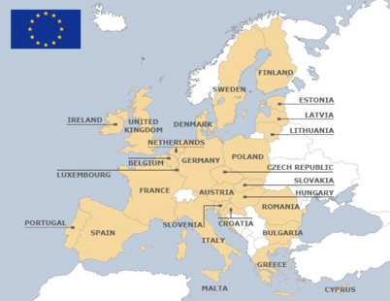
THIRD PARTY DATA PROCESSING STANDARD CONTRACTUAL CLAUSES
TERMS AND CONDITIONS
Mandated and authored by the European Commission
Used when transferring data from European Economic Area (EEA)
Includes specific terms for specific relationships
Cannot be modified except where permitted

Slide 55
THIRD PARTY DATA PROCESSING STANDARD CONTRACTUAL CLAUSES
UW UNITS' RESPONSIBILITIES
Review SCCs
https://privacy.uw.edu/design/agreements/dpa
Determine type of relationship
Review and as needed modify *[text]

Slide 56
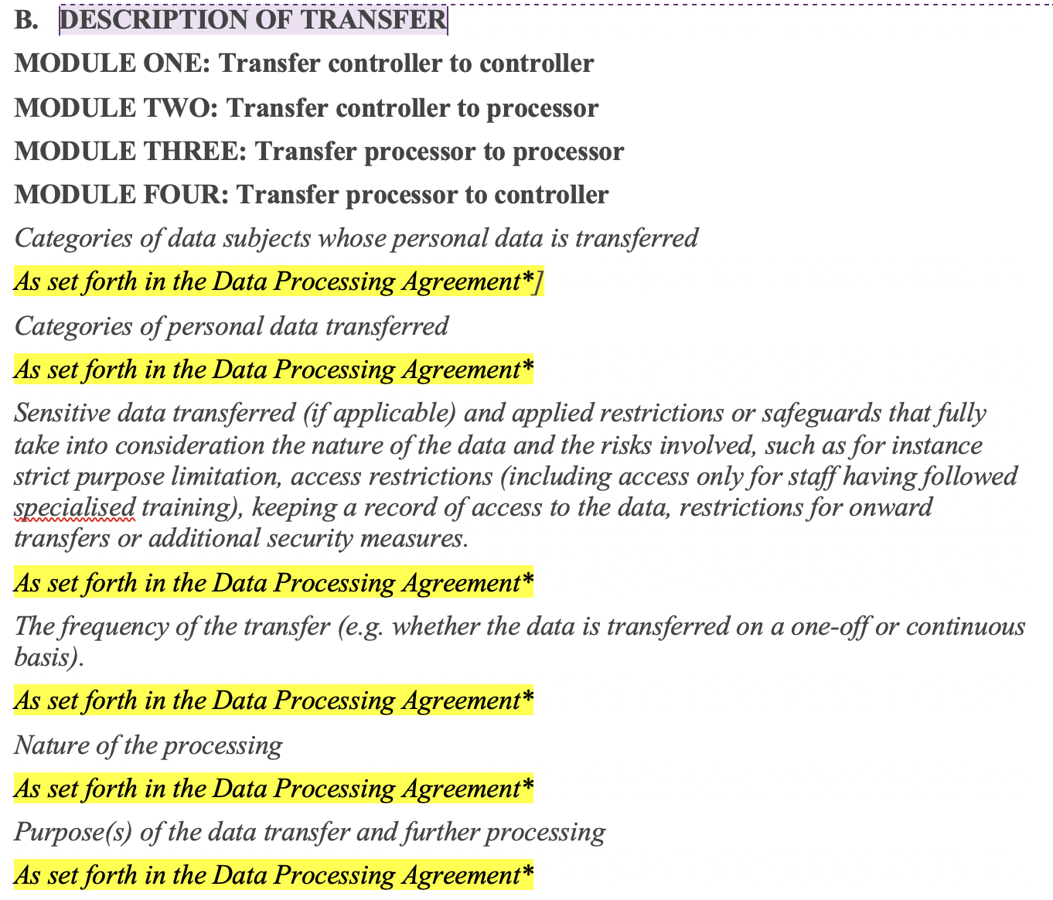
THIRD PARTY DATA PROCESSING STANDARD CONTRACTUAL CLAUSES
UW UNITS' RESPONSIBILITIES
Review and as needed modify the description of transfer

Slide 57
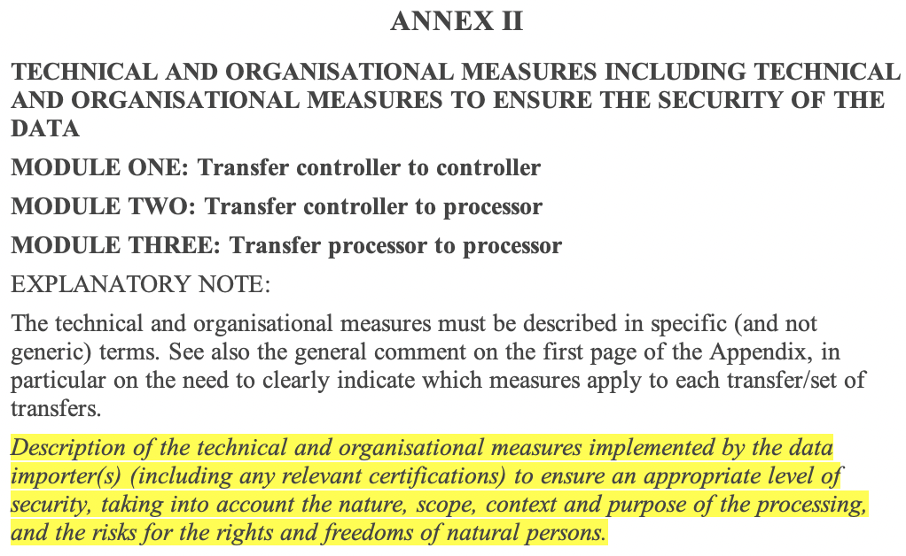
THIRD PARTY DATA PROCESSING STANDARD CONTRACTUAL CLAUSES
UW UNITS' RESPONSIBILITIES
Review and as needed modify the description of controls

Slide 58
THIRD PARTY DATA PROCESSING STANDARD CONTRACTUAL CLAUSES
TIMELINE WHEN SCCS ARE APPLICABLE
Agreements signed before Sept. 27, 2021
Use May 2019 version of SCCs
Update to Sept. 2021 version of SCCs before Dec. 2022
Agreements signed after Sept. 27, 2021
Use Sept. 2021 version of SCCs
https://privacy.uw.edu/education/glossary/

Slide 59
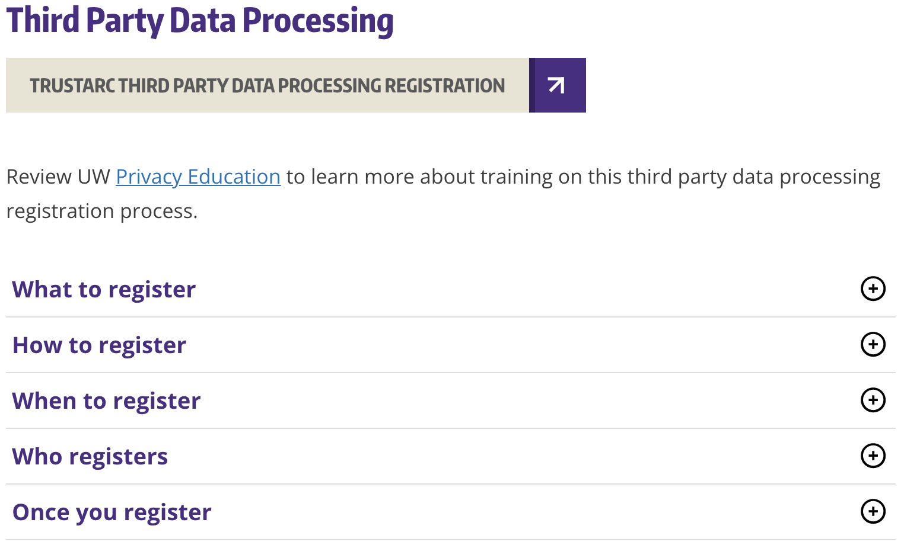
THIRD PARTY DATA PROCESSING REGISTRY
TRUSTARC PRIVACY MANAGEMENT PLATFORM
Privacy.uw.edu/design/trustarc/access

Slide 60
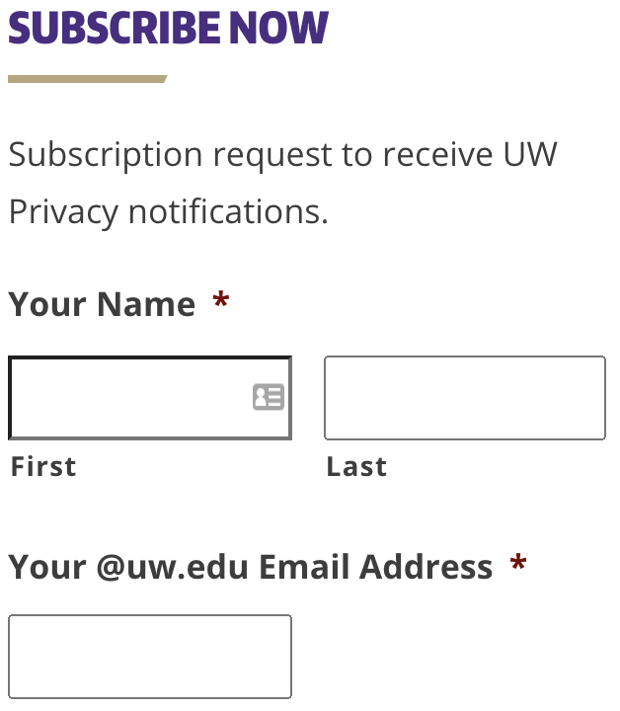
THIRD PARTY DATA PROCESSING NEXT STEPS
Contact uwprivacy@uw.edu with questions
Stay Informed – more changes are coming soon
privacy.uw.edu

Slide 61
Data Privacy & Sponsored Programs
November, 2021 MRAM
Carol Rhodes
Office of Sponsored Programs

Slide 62
When do Standard Contractual Clauses (SCC) come up?
SCC may come up in sponsored program agreements when a sponsor or collaborator is sharing personal data that are subject to EU GDPR with the UW.
SCC involve providing detailed information related to:
the categories of data subjects or data types,
nature of the processing,
who is serving as controller versus processor,
and organizational and technical measures set up by the PI and department to protect personal data.

Slide 63
What does this mean for Sponsored Programs?
When SCC are part of or accompany a sponsored agreement, OSP must place the sponsored agreement on hold while the PI completes the details.
The PI may seek assistance from their IT or department administrator, guidance from the UW Privacy Office, or an outside consultant.

Slide 64
Data Processing Terms
There are a variety of scenarios and types of agreements where a sponsored program could involve the UW sharing personal data with a third-party.
At the earliest point, let OSP know if your sponsored program involves sharing personal data.
Data Registry purposes:
PI/dept can obtain a copy of sponsored agreements from SAGE.

Slide 65
Questions?
Web Resources:
UW Research: Data Privacy & Sponsored Programs
UW Privacy Office:
Glossary
GDPR
European Union SCC

