Slide 1
MRAM UW Privacy Office November 4, 2021

Slide 2
PRIVACY AT UW UNDERSTANDING CURRENT STATE
This material is current as of Nov. 4, 2021
Please be aware that:
Privacy and data protection laws and regulations are rapidly evolving
UW’s approach to privacy is also evolving
For the most recent information see privacy.uw.edu

Slide 3
PRIVACY AT UW UNDERSTANDING CURRENT STATE
CURRENT STATE
UW lacks comprehensive and cohesive information about personal data collection, purpose, and processing activities
Lack of information makes it challenging to universally:
Create transparency with individuals
Decrease duplication of efforts and increase efficiency
Assess and address risk to UW and privacy impact to individuals
Develop cohesive approach to privacy
Identify gaps and needs for policies, templates, tools, and guidance

Slide 4
PEOPLE, PROCESS, AND TECHNOLOGY CHANGE MANAGEMENT
KEY OBJECTIVE
Prepare UW for evolving expectations and requirements
Increase transparency with constituents
Address (where appropriate) New laws/regulations or changes to existing laws/regulations
China – Personal Information Protection Act, effective Nov 1, 2021
Europa - General Data Protection Regulation (GDPR) changes announced June 2021, effective Sept 27, 2021
United Kingdom – Data Protection Act, effective Dec 31, 2020
RCWs
Others

Slide 5
PEOPLE, PROCESS, AND TECHNOLOGY CHANGE MANAGEMENT
KEY OBJECTIVE
Align requirements - TrustArc Privacy Management Platform
UW Policy APS 2.2
UW Policy Misc.
UW Medicine Policy
UW Policy APS 2.6
HIPAA § 45 CFR 164.306(a)
GDPR Article 5.1(f)
Put in place appropriate administrative, physical, and technical safeguards to protect personal information…
HIPAA § 45 CFR 164.530(c)(1)
GDPR Article 32.1
Virginia CDPA §59.1-574.A.3.
UK GDPR Art. 5.1(f)
Virginia CDPA §59.1-578.F.2.
LGPD Chapter I, Article 6.VII
UK GDPR Article 32.1
Singapore PDPA Section 24
New Zealand Privacy Act 2020 - IPP 5
LGPD Chapter VII, Section I, Article 46

Slide 6
PEOPLE, PROCESS, AND TECHNOLOGY CHANGE MANAGEMENT
KEY OBJECTIVES
Inventory, map, and assess personal data processing
Implement TrustArc Privacy Management Platform to help address strategic priorities identified by Privacy Steering Committee
Provide more comprehensive and cohesive guidance
Revise University Privacy Policy
Establish appropriate use standards
Align with industry standards for third party data processing
External agreement templates
Standard Contractual Clauses
Improve internal data sharing practices

Slide 7
PEOPLE, PROCESS, AND TECHNOLOGY CHANGE MANAGEMENT
KEY OBJECTIVE
Enhance engagement with campus
Identify Privacy Partners
Clarify roles and responsibilities
Build support mechanisms
PRIVACY PARTNERS
IN MULTIPLE UW ORGANIZATIONS
PRIVACY OFFICE

Slide 8
THIRD PARTY DATA PROCESSING
RECENT CHANGES
New Template Data Processing Agreement
New Standard Contractual Clauses
New Third Party Data Processing Registry

Slide 9
THIRD PARTY DATA PROCESSING WHY – CLARIFY APPLICABILITY
State or Federal Government
Affiliates
Sponsored Programs
Goods or Services
Data Processing Agreement
IT
Consortiums
Commercialization
Associations
Others?

Slide 10
THIRD PARTY DATA PROCESSING KEY TERMS: THIRD-PARTY
First-party (UW)
Third-party
(not UW)
https://privacy.uw.edu/education/glossary/

Slide 11
THIRD PARTY DATA PROCESSING KEY TERMS: PERSONAL DATA
Personal Data
Any records or information relating to an identified or identifiable natural person
https://privacy.uw.edu/education/glossary/

Slide 12
THIRD PARTY DATA PROCESSING KEY TERMS: DATA PROCESSING
Data Processing
Any operation(s) performed on Personal Data, whether or not by automated means, such as collection, recording, organization, storage, adaptation, alteration, retrieval, consultation, access, use, disclosure by transmission, dissemination, combination, restriction or destruction.
https://privacy.uw.edu/education/glossary/

Slide 13
THIRD PARTY DATA PROCESSING DETERMINE YOUR UNIT’S ROLE
UW Units Responsibilities
(Data) Controller
Determines the purpose and means of processing
(Data) Processor
Performs data processing on behalf of the Controller
https://privacy.uw.edu/education/glossary/

Slide 14
THIRD PARTY DATA PROCESSING DATA PROCESSING AGREEMENT
UW Units' Responsibilities
Inform UW contracting office
Procurement, UW Medicine Supply Chain Management, Office of Sponsored Programs, etc.
Inform third party
Identify UW and third party’s role in data processing
Determine appropriate data processing agreement
Execute and sign agreement
Register third party data processing
https://privacy.uw.edu/design/agreements/dpa

Slide 15
THIRD PARTY DATA PROCESSING TIMING WITH THIRD PARTIES
Include privacy in the design
Recognize there is no grace period for laws and regulations
Introduce data processing agreement
New contracts
Renewal (even automatic)
Plan ahead...it takes time

Slide 16
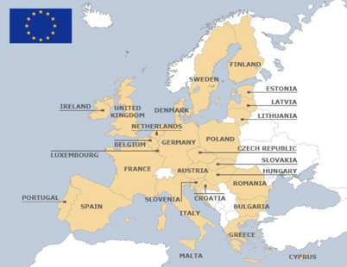
THIRD PARTY DATA PROCESSING STANDARD CONTRACTUAL CLAUSES
TERMS AND CONDITIONS
Mandated and authored by the European Commission
Used when transferring data from European Economic Area (EEA)
Includes specific terms for specific relationships
Cannot be modified except where permitted

Slide 17
THIRD PARTY DATA PROCESSING STANDARD CONTRACTUAL CLAUSES
UW UNITS' RESPONSIBILITIES
Review SCCs
https://privacy.uw.edu/design/agreements/dpa
Determine type of relationship
Review and as needed modify *[text]

Slide 18
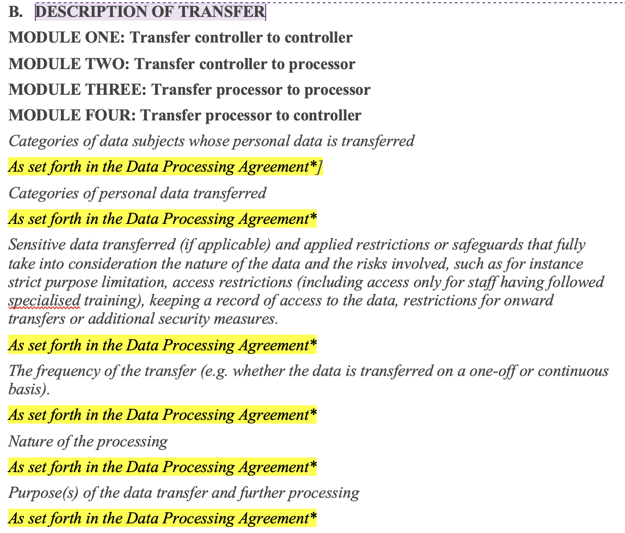
THIRD PARTY DATA PROCESSING STANDARD CONTRACTUAL CLAUSES
UW UNITS' RESPONSIBILITIES
Review and as needed modify the description of transfer

Slide 19
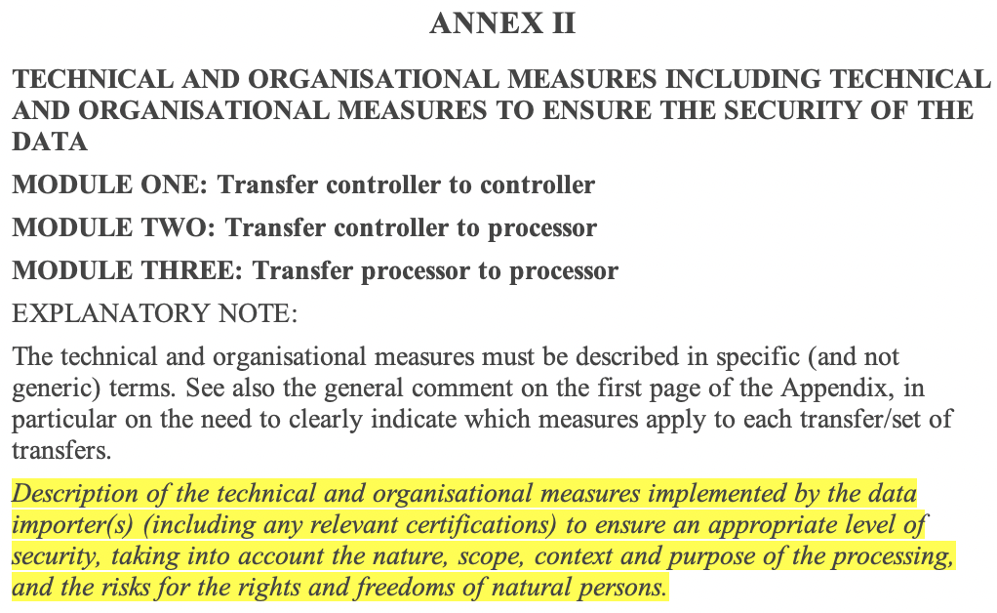
THIRD PARTY DATA PROCESSING STANDARD CONTRACTUAL CLAUSES
UW UNITS' RESPONSIBILITIES
Review and as needed modify the description of controls

Slide 20
THIRD PARTY DATA PROCESSING STANDARD CONTRACTUAL CLAUSES
TIMELINE WHEN SCCS ARE APPLICABLE
Agreements signed before Sept. 27, 2021
Use May 2019 version of SCCs
Update to Sept. 2021 version of SCCs before Dec. 2022
Agreements signed after Sept. 27, 2021
Use Sept. 2021 version of SCCs
https://privacy.uw.edu/education/glossary/

Slide 21
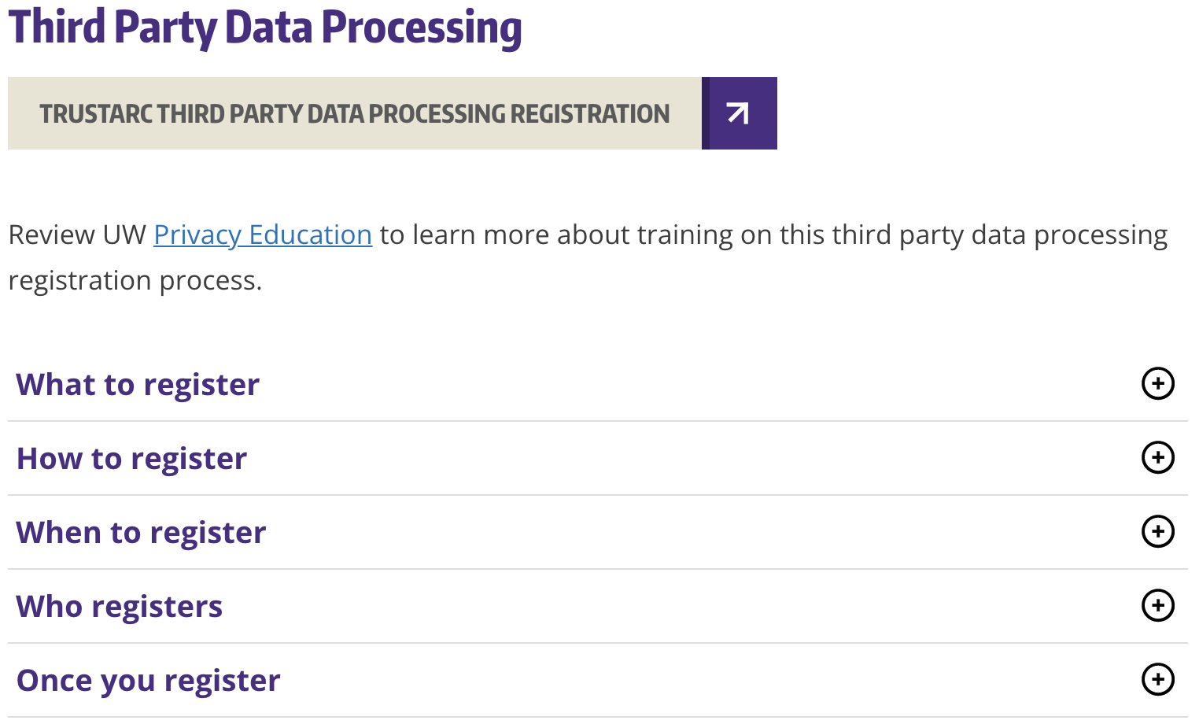
THIRD PARTY DATA PROCESSING REGISTRY
TRUSTARC PRIVACY MANAGEMENT PLATFORM
Privacy.uw.edu/design/trustarc/access

Slide 22
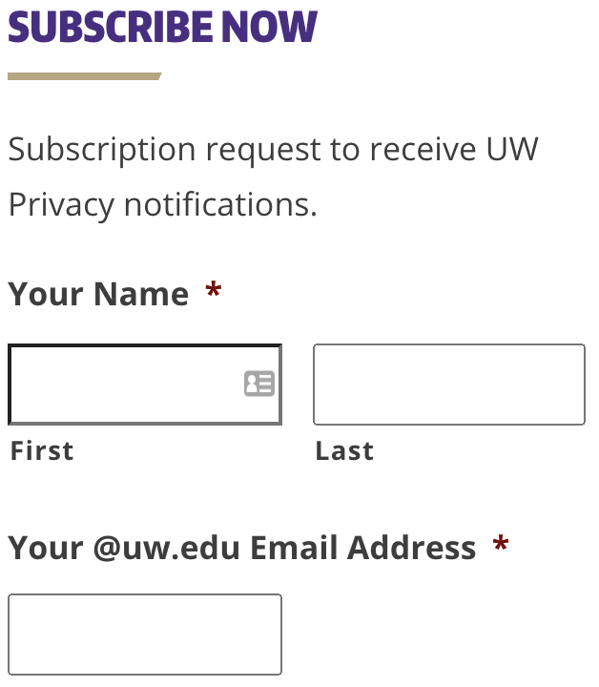
THIRD PARTY DATA PROCESSING NEXT STEPS
Contact uwprivacy@uw.edu with questions
Stay Informed – more changes are coming soon
privacy.uw.edu

