Slide 1
MRAM | Monthly Research Administration Meeting
January 13, 2022 9:00 AM – 10:00 AM HOSTED REMOTELY Join the LIVE Webinar: https://washington.zoom.us/j/346891888
TOPIC | PRESENTER | EMAIL | MIN
Welcome | Kirsten DeFries Research Compliance & Operations | kirsten5@uw.edu | 2
Update on requirements for studies involving minors (APS 10.13) | Caroline Shelton Youth Protection Coordinator | cshelton@uw.edu | 7
State Ethics and Outside Work | Richard Cordova Internal Audit Melissa Petersen Office of Research | rcordova@uw.edu petermm@uw.edu | 10
PAFC Hot Topic: Federal Closeout Requirements | Matt Gardner Post Award Fiscal Compliance | gcafco@uw.edu | 10
Upcoming GCA Closeout Policies | Lily Gebrenegus Grant & Contract Accounting | lgebren@uw.edu | 5
Thank you, Karen Moe | Joe Giffels Office of Research | jgiffels@uw.edu | 5
Foreign Influence & Current Federal Agency Policy Changes | Carol Rhodes Office of Sponsored Programs | carhodes@uw.edu | 15
CORE Update | Laurie Stephan Collaborative On Research Education (CORE) | corehelp@uw.edu | 2
NEXT MEETING February 10, 2022 9:00 AM - 10:00 AM

Slide 2
Live Closed Captioning is now available
Live transcription and closed captions are enabled via the “CC/Transcript” button in your Zoom window.
Recordings of our sessions, with manually edited closed captions, are typically available within a week after the meeting, and a link is emailed with the post-session Q&A.
If you have any issues or questions, please let us know at mramques@uw.edu

Slide 3
Research Compliance & Operations Update
Welcome to the new Assistant Director of PAFC
– Matt Gardner -
Best wishes to Lily Gebrenegus as she moves on to pursue a long standing dream!

Slide 4
UPDATE ON
ADMINISTRATIVE
POLICY STATEMENT 10.13
REQUIREMENTS FOR UNIVERSITY
& THIRD PARTY LED YOUTH PROGRAMS AND RESEARCH
January 13, 2022
Notes:
CAROLINE
Thank you for the opportunity to present again. Today I’ll give a brief refresher of APS 10.13, share current compliance data as it relates to research, and offer options to engage with us to address any questions about these requirements.
Also, one update about our office- our name has changed to the Office of the Youth Protection Coordinator, and we now reside in Compliance Services under the leadership of Jane Yung, Executive Compliance and Risk Officer and Jill Lee, Executive Director of Compliance Services.

Slide 5
Office Operations
Policy Administrator
Primary: EO 56, APS 10.13
Policy partner for: APS 10.9, APS 44.3, EO 31, EO 51, EO 54, EO 55.
University Consultant
Risk mitigation, triage behaviors of concern or incidents involving minors
Policy compliance strategies, general programming best practices
Convener
Coordinate efforts among youth program providers, health, safety and risk SMEs to raise awareness of youth on campus
Youth Safety Champion
Focus on youth safety in adult-oriented University setting
www.uw.edu/youth
Notes:
A brief reminder of our office functions which haven’t changed, we serve as a central resource for questions and concerns regarding the safety of youth who engage with the University.
We are the primary policy administrator for APS 10.13 among other university policies that directly or indirectly address youth safety and well-being.
As this slide outlines, we also consult regularly with departments or individuals and I will make the offer again at the end but we are willing to meet with a research group or department to discuss these requirements in more detail as is helpful.

Slide 6
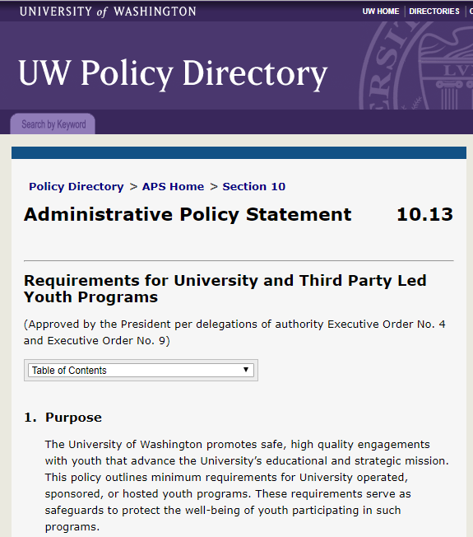
APS 10.13
Establishes minimum standards to safeguard the well-being of youth (persons under age 18) participating in UW led activities, events, programs, or research.
regardless of location
inclusive of virtual interactions
inclusive of some external IRB studies
inclusive of student-led research
Notes:
A very brief refresher on APS 10.13
This policy establishes minimum standards to safeguard youth who come into contact with University programs or research. The vast majority of studies that involve youth do fall within the scope of these requirements.

Slide 7
APS 10.13 Requirements
Registration of study into the UW Youth Program Registration System
Meet background screening, training, and conduct requirements
Report behaviors of concern
Maintain safe environments
Emergency and safety planning and response
Standards for data privacy (Research is exempt from this requirement)
Notes:
The requirements are intended to supplement existing practices and in many cases do require additional steps to be taken by study teams.
For example, specific background screening, training and conduct requirements are in place for personnel who may have unsupervised access to minors. We refer to these individuals as “authorized personnel.”

Slide 8
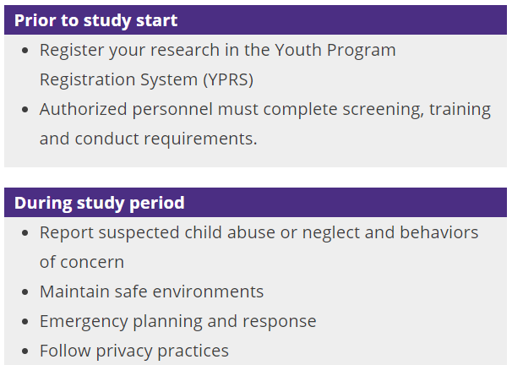
(Compliance metrics in YPRS)
Notes:
Most actions must be taken prior to the start of the study.
First, the study must be registered in the Youth Program Registration System. YPRS automatically initiates a registration form using information from Zipline. Our office reviews Zipline submissions to confirm the study is in-scope of APS 10.13, and then we send e-mail notification to the PI and any other contacts listed in Zipline requesting that they complete the registration process.
Next, any personnel added to the registration will receive requests to complete online trainings and a conduct form. Some will receive notifications about required background checks if there isn’t a current one on file within the last 3 years. All of these steps should be completed prior to the start date of the study.

Slide 9
Registration and compliance trends
Identified via Zipline 187
In-scope, actionable 108
Registration status (n=108)
Incomplete 44
Complete 64
Compliance status (n=64)
Compliant 46
Partially compliant 8
Not compliant 18
For studies submitted
to Zipline
1/1/21-12/31/21
Notes:
We began reviewing Zipline submissions midway through last year, starting with anything newly submitted as of January of 2021.
In 2021 there were 187 new studies that identified involvement with minors.
We determined that 108 studies were in scope of APS 10.13 and requested them to register with YPRS.
Of the 108 studies notified, 64 studies completed their registration forms, and 44 have not yet completed their registration forms.
Of the 64 studies that submitted registration forms, 46 completed all personnel requirements prior to their study start date and are considered compliant with the tracked requirements.
The difference between partial and non-compliance is that we consider a program partially compliant if they complete all requirements after the start date of a study but before its end date. Studies are not compliant have actions by one or more authorized personnel that are not yet complete. A study can move from not compliant to partially compliant.
As mentioned in the previous slide, the key actions that need to be completed prior to start of the study are 1) registration of the study in YPRS and 2) completion of all personnel actions. By that definition, the research community is only at around 43% compliant with APS 10.13 requirements.
Compliance looks a little better for studies that did register with YPRS. 72% completed all required personnel actions in time, which is a good start.
We hope that through continued outreach efforts on our part and support from units we can increase compliance rates of these two key steps.

Slide 10
Compliance challenges and OYPC response
Challenge
Lack of response to OYPC notifications, resulting in incomplete registrations or non-compliance with requirements
Background
E-mails come from
uwminors@uw.edu and/or
mail+1zg8.s79jk@ideal-logic.com
subject line: “Action required: youth-involved research requirements.”
Response
Individualized outreach to PI and proxies (ID’ed in Zipline)
Web-based resources at www.uw.edu/youth
Notes:
I’ll share the most common themes of our current compliance challenges, and thoughts about what strategies can improve compliance, including actions my office is taking.
The most predominant challenge we face is a lack of response by study contacts to notifications from our system. This results in a study registration not being completed, or in registered studies being considered non-compliant.
We send multiple notifications auto-generated from our system but often get no response. For the approximately 70 studies where there is a lack of response to notifications sent by our system, we send individualized e-mails to PI’s and other contacts listed in Zipline.
We also have web-based resources specifically for researchers to answer questions and support taking action.

Slide 11
Compliance challenges and OYPC response
Challenge
Personnel actions not complete by study start date.
Background
Notifications sent to personnel until they are compliant or the study ends.
PI’s receive weekly notifications of any noncompliant authorized personnel.
After start date, escalated notifications go to department heads.
Response
Escalating notifications
Quarterly reports to unit heads and administrators
Notes:
As I mentioned before, authorized personnel must complete their training, conduct and background check steps prior to the study start date. We try to prevent non-compliance with ample notification to PI’s and authorized personnel that escalates in frequency and urgency as they approach their study start date.
We send quarterly reports to study contacts and also unit heads and unit administrators to share compliance statuses for youth programs and research studies.
For studies that are registered, we have what I would consider a good starting place of compliance, at around 70%. I am confident that with greater awareness and attention, this will steadily improve.

Slide 12
Other challenges and OYPC response
Challenge
Student-led research lacks a funding source for background checks. (Background checks are processed through UW HR)
Response
Units need to identify a funding source to pay for background checks, or
Develop a process to pass cost onto student, or
Establish agreement with UW HR that an existing school administered background screening is equivalent
Challenge
Studies outside of Zipline may not know about requirements of APS 10.13, e.g., exempt, evaluations, QI initiatives, etc.
Response
Continued outreach from OYPC to research groups
OYPC can meet with and answer questions for departments and research groups
Notes:
Finally, I’ll share a couple of additional challenges here on this one slide.
We have come across a challenge of student led research that doesn’t have a funding source to pay for background checks. We have worked with different departments to come up with solutions to fill this gap. Our three general recommendations are that units identify a funding source to cover these background checks, or develop a way to pass the cost to students. In some cases when students undergo background checks as part of their enrollment, these can suffice as an alternative, if they are reviewed by UW HR for equivalency.
Zipline provides a way to systematically identify studies but we know that there are studies, evaluations, quality improvement initiatives and the like that may not be aware of university requirements. Ultimately our goal is that any engagement with children by the university is done with safeguards in place. We will continue to do our outreach to departments and are always willing to meet with teams, departments or research groups to explain processes and answer questions.

Slide 13
Contact information
Caroline Shelton cshelton@uw.edu
Laura Harrington laurah13@uw.edu
General inbox uwminors@uw.edu
Notes:
Please don’t hesitate to contact us with any questions or to request a meeting with your research group or department.
Thank you for your time!

Slide 14
WA State Ethics Act Outside Work RCW 42.52
January 13, 2022
Richard Cordova
Internal Audit

Slide 15
RCW 42.52 – Ethics In Public Service
Sections:
.020 Activities Incompatible w/ public duties (Conflict of Interest)
.030 Financial interests in transactions
.040 Assisting in transactions
.050 Confidential information
.070 Special privileges
.080 Employment after public service
.110 Compensation for official duties or nonperformance
.120 Compensation for outside duties
.140 Gifts
.160 Use of State resources
.180 Use of State resources for political campaigns
.220 Universities – Administrative Processes
All of these are re: Conflict of Interest
All of these can relate to O/S Work

Slide 16
Conflicts of Interest
A State employee may not use their position to secure special privileges or exemptions
You cannot get “extra” or outside compensation for your official duties
Conflict of Interest involves the concepts of benefit and bias
Post-State employment restrictions are designed to ensure former employees do not obtain an advantage

Slide 17
Use of Resources
Some limited personal use is allowed if brief and no cost to the agency… De minimis
Zero Tolerance for use of State resources benefitting an o/s business or when used for campaigning
Generally, State resources are to be used only for State purposes, not private benefit or gain
One exception: research employees can make minimal use of University resources in support of commercialization of UW IP

Slide 18
Use of Resources
Research Employees Exception
May use their personally assigned University resources (office, telephone and computers) and e-mail to conduct outside work activities related to their research and technology transfer activities.
CONFLICTS OF INTEREST
GIFTS
USE OF RESOURCES
OUTSIDE EMPLOYMENT

Slide 19
Outside Work
Employees may engage in outside work or part-time employment provided that it does not conflict with or negatively impact employees' ability to fulfill their University employment obligations, and that it does not otherwise negatively impact the University.
Must be pre-approved whether or not work is for compensation.
You may receive pay, honoraria or expense reimbursement.

Slide 20
Outside Work
Legitimate and actually performed
Not part of your regular University work, or under your supervision
Cannot assist others with University transactions under your control
Not for an organization or person from whom the law prohibits receipt of gifts
Does not result in the unauthorized disclosure of confidential information
CONFLICTS OF INTEREST
GIFTS
USE OF RESOURCES
OUTSIDE EMPLOYMENT

Slide 21
Outside Work
Request for Approval of Outside Work – Professional & Classified Staff
Form 1301
Request for Approval of Outside Work for Compensation – Faculty
Form from Provost Office
Faculty – Annually must complete Form 1461
Advance review and approval of outside work or employment is required whenever the activity relates to or could conflict with the employee's University job responsibilities or status as a University employee (when in doubt, disclose)
CONFLICTS OF INTEREST
GIFTS
USE OF RESOURCES
OUTSIDE EMPLOYMENT

Slide 22
Outside Work
Who Approves?
Pro Staff/Classified Staff
Faculty
Immediate supervisor will review and recommend approval/disapproval to the Administrative Unit Head for final review and approval
Dean and Provost must
preapprove
CONFLICTS OF INTEREST
GIFTS
USE OF RESOURCES
OUTSIDE EMPLOYMENT

Slide 23
Outside Work
Conditions for approval
Is not a detriment to University obligations
Does not affect job performance
Not in conflict with discharge of employee’s official duties
Done outside employee’s normal work schedule (or vacation taken)
Must clearly identify that employee is not a representative of the University
Outside work should not be intended to be provided “back” to the University or to University employees
CONFLICTS OF INTEREST
GIFTS
USE OF RESOURCES
OUTSIDE EMPLOYMENT

Slide 24
Outside Work
If the outside work is for another State agency, all the “Outside Work for Pay” rules apply, plus:
It must result from an open competition or receive advance approval from the Ethics Board
A copy of the contract is to be filed with the Ethics Board
CONFLICTS OF INTEREST
GIFTS
USE OF RESOURCES
OUTSIDE EMPLOYMENT

Slide 25
Resources
If you have a question on WA Ethics Act, call Internal Audit – we are a resource to be used by all.
UW Internal Audit
(206) 543-4028
http://f2.washington.edu/audit

Slide 26
Outside Professional Work for Compensation
MRAM
January 2022
Melissa Petersen
Office of Research

Slide 27
Professional and Classified Staff
Policy: Administrative Policy Statement 47.3
Form: Request for Approval of Outside Professional Work for Compensation – Professional and Classified Staff form (may be referred to as the ‘Form 1555’)
MRAM – Melissa Petersen – Office of Research

Slide 28
Professional and Classified Staff
Procedure: In accordance with Unit or School/College policy
Applicant completes form and submits to supervisor* Supervisor reviews and provides a determination to the appropriate Department Chair/Program Director
Department Chair/Program Director provides determination*, may forward to a Unit Administrative Head
School/College may require Dean’s review and approval*
Note: there is no central campus review or approval for staff outside work. Conflicts should be managed locally in accordance with Executive Order No. 32
*Outside work requests may not be evaluated by individuals proposing or performing outside work for the named entity
MRAM – Melissa Petersen – Office of Research

Slide 29
Faculty, Librarians, and other Academic Personnel*
Policy: Executive Order No. 57
Form: Request for Approval of Outside Professional Work for Compensation (Form 1460)
*Academic Personnel is defined in Administrative Policy Statement No. 40.1, Types of University Personnel (and includes Postdoctoral Scholars)
MRAM – Melissa Petersen – Office of Research

Slide 30
Faculty, Librarians, and other Academic Personnel
Procedure:
Applicant completes Form, submits to Department Chair/Dean* (Most Seattle applicants submit to Chairs, most Bothell & Tacoma applicants submit to Deans)
Department Chair/Dean, if Form is approved, forwards to Dean or Vice Chancellor* as appropriate
Dean or Vice Chancellor, if Form is approved, forwards to the Office of Research via work1460@uw.edu
The Office of Research reviews, may impose conditions and restrictions, and issues Form 1460 final approvals
*Form 1460s may not be evaluated by individuals proposing or performing outside work for the named entity, contact the Office of Research
MRAM – Melissa Petersen – Office of Research

Slide 31
Faculty, Librarians, and other Academic Personnel
Form 1460s not receiving approval remain in that office as Personnel Records
Approved Forms are issued and retained in the Office of Research
Records Retention for Professional and Classified Staff Forms
MRAM – Melissa Petersen – Office of Research

Slide 32
Other Related Links & Resources
Office of Research (Form 1460) Informational Page
UW Medicine Outside Work FAQs
Administrative Policy Statement 47.2, Personal Use of University Facilities, Computers, and Equipment by University Employees
Executive Order No. 43, Policy Governing Acceptance of Honoraria
Tax Office Guidance, Donations in Lieu of Honoraria
Ethics Advisory on Textbooks
MRAM – Melissa Petersen – Office of Research

Slide 33
Late Breaking News:
New NIH Grants Policy Statement
Released last week (1/4/2022)
Applicable to all NIH grants and cooperative agreements beginning on or after October 1, 2021.
The update incorporates notices from the past year into the GPS.
Ex: Childcare Allowance for NRSA awards
Link: https://grants.nih.gov/policy/nihgps/index.htm
MRAM – Matt Gardner – PAFC

Slide 34
PAFC HOT TOPIC:
FEDERAL CLOSEOUT REQUIREMENTS
MRAM
January 2022
Matt Gardner
Post Award Fiscal Compliance

Slide 35
Uniform Guidance Requirements
2 CFR 200.344 Closeout
“(a) The recipient must submit, no later than 120 calendar days after the end date of the period of performance, all financial, performance, and other reports as required by the terms and conditions of the Federal award…”
Reports include:
SF425 Financial Report
Progress or technical reports
Invention statements
Any other report required by the sponsor
MRAM – Matt Gardner – PAFC

Slide 36
2 CFR 200.344(a) Closeout
200.344(a) (Continued)
“…A subrecipient must submit to the pass-through entity, no later than 90 calendar days (or an earlier date as agreed upon by the pass-through entity and subrecipient) after the end date of the period of performance, all financial, performance, and other reports as required by the terms and conditions of the Federal award…”
The federal regulations also cover sub closeout.
A sub agreement can state a shorter closeout period (e.g. 60 days).
MRAM – Matt Gardner – PAFC

Slide 37
2 CFR 200.344(a) Closeout
200.344(a) (Continued)
“…The Federal awarding agency or pass-through entity may approve extensions when requested and justified by the non-Federal entity, as applicable.”
The proper way to manage delays in closeout is to request a No-Cost Extension from the sponsor.
If a NCE is not available or not approved, it is up to the recipient to close the Award in compliance with the regulations and the sponsor’s terms and conditions.
MRAM – Matt Gardner – PAFC

Slide 38
Reminders
A federal agency can impose stricter closeout conditions than the Uniform Guidance.
Always read/understand your Notice of Award, along with the applicable agency terms and conditions
All closeout actions must occur for the Award to be considered closed in the eyes of the sponsor.
Reports (financial or technical)
Deliverables
Cost Share
MRAM – Matt Gardner – PAFC

Slide 39
Additional Requirements
200.344(d)
“(d) The non-Federal entity must promptly refund any balances of unobligated cash that the Federal awarding agency or pass-through entity paid in advance or paid and that are not authorized to be retained by the non-Federal entity for use in other projects. See OMB Circular A-129 and see § 200.346, for requirements regarding unreturned amounts that become delinquent debts.”
Notice no time-frame nor de minimis limits with respect to refunding credits to the federal government. Any credit must be promptly refunded, regardless of elapsed time after the end of the Award or the amount of the credit.
MRAM – Matt Gardner – PAFC

Slide 40
Consequences of Non-Compliance
200.344(i)
“(i) If the non-Federal entity does not submit all reports in accordance with this section within one year of the period of performance end date, the Federal awarding agency must report the non-Federal entity's material failure to comply with the terms and conditions of the award with the OMB-designated integrity and performance system (currently FAPIIS). Federal awarding agencies may also pursue other enforcement actions per § 200.339.”
MRAM – Matt Gardner – PAFC

Slide 41
Scenario
An Award has an end date of June 30, 2021. At that time, all research is complete and all funds expended. The PI submits the final technical report on July 31, 2021.
The financial report is due September 30, 2021, but the report is late due to unmet cost share in the UW’s cost share system.
Result: This award is not considered closed because the financial report has not been submitted to the sponsor. Additionally, failure to document cost share is a failure to complete a term and condition of the Award. Cost share is not considered met until all contributions are documented in the UW’s cost share system.
MRAM – Matt Gardner – PAFC

Slide 42
Questions
Post Award Fiscal Compliance (PAFC)
gcafco@uw.edu
https://finance.uw.edu/pafc/
Matt Gardner
mgard4@uw.edu
206-543-2610
Available on both Teams and Zoom
MRAM – Matt Gardner – PAFC

Slide 43
Upcoming GCA Closeout Policies
Lily Gebrenegus, Grant & Contract Accounting
MRAM
January 13, 2022

Slide 44
Topics
NRSA Training Grants
Late Charges
Expired Sub Budgets

Slide 45
NRSA Training Grants
Issues with timely corrections for stipend errors
Difficult to anticipate correct fringe benefit expense amount
Causes issues with timely and accurate FFR submission

Slide 46
NRSA Training Grants
Beginning with training grants expiring December 2021, GCA will use lower of two fringe rates
Any resulting over-expenditure will be transferred to continuation or to a nonfederal budget number
GCA mid-year reconciliation process starts in Feb

Slide 47
Call to Action for Campus
Monitor stipend expenses regularly
Work with the ISC and payroll departments to correct as soon as possible
Notes:
Include a report? Is there something on the training grant webpage?

Slide 48
Late Charges
Issues with timely and accurate posting of late charges
Noncompliant for cost reimbursable awards
Causes UW to have cash on hand
Sponsors are becoming more strict
Common flag for auditors
Received 135 re-open requests in 2021
Notes:
“reasonable” refers to Uniform Guidance; “strict” means hard draw deadlines, refusing to pay late invoices

Slide 49
Late Charges
GCA is working on a policy to enforce timely posting of late charges
Consequences could include refunding cash previously received if issues are not resolved timely
More information coming in the next few months

Slide 50
Call to Action for Campus
Communicate unposted charges and credits to GCA before Final Action Date
Work with vendors or subcontractors to post transactions as soon as possible

Slide 51
Expired Sub Budgets
Difficulty closing sub budgets that have expired
Almost 200 open sub budgets
Will be providing deadlines to let us know if they need to be extended or closed
Balances will be transferred to parent budgets
Deficits will be reviewed and deadlines provided
Notes:
Helps with move to Workday; the 200 includes grants and gifts; expired before 10/1/2021

Slide 52
Resources
Final Action Date webpage
Pending Transactions Form
NIH 120 day policy

Slide 53
Questions
Please contact GCA at gcahelp@uw.edu

Slide 54
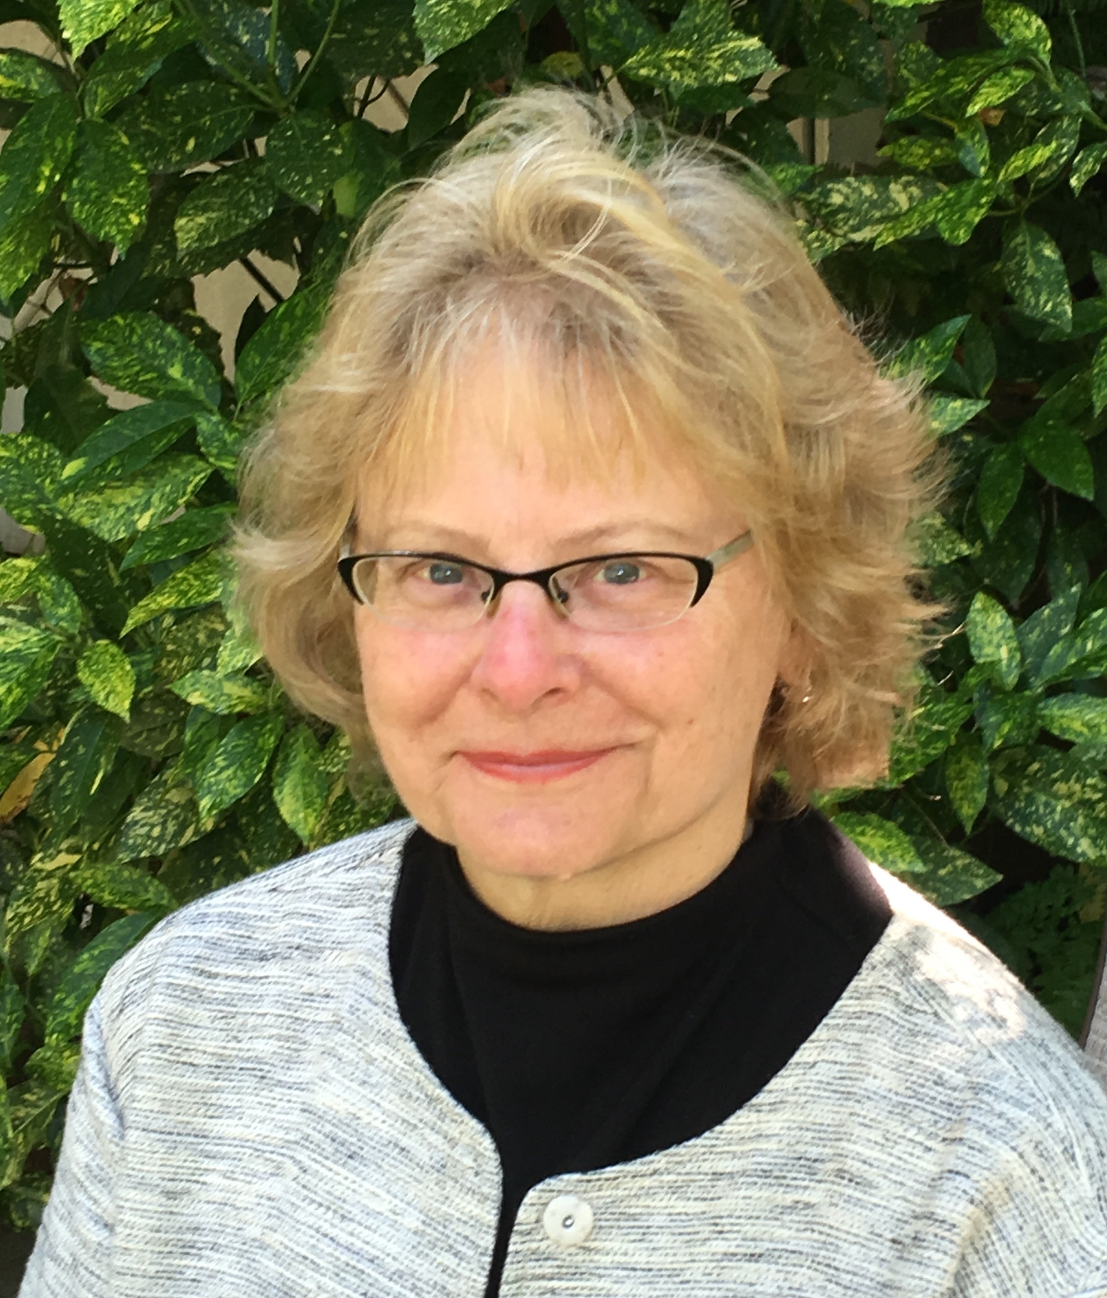
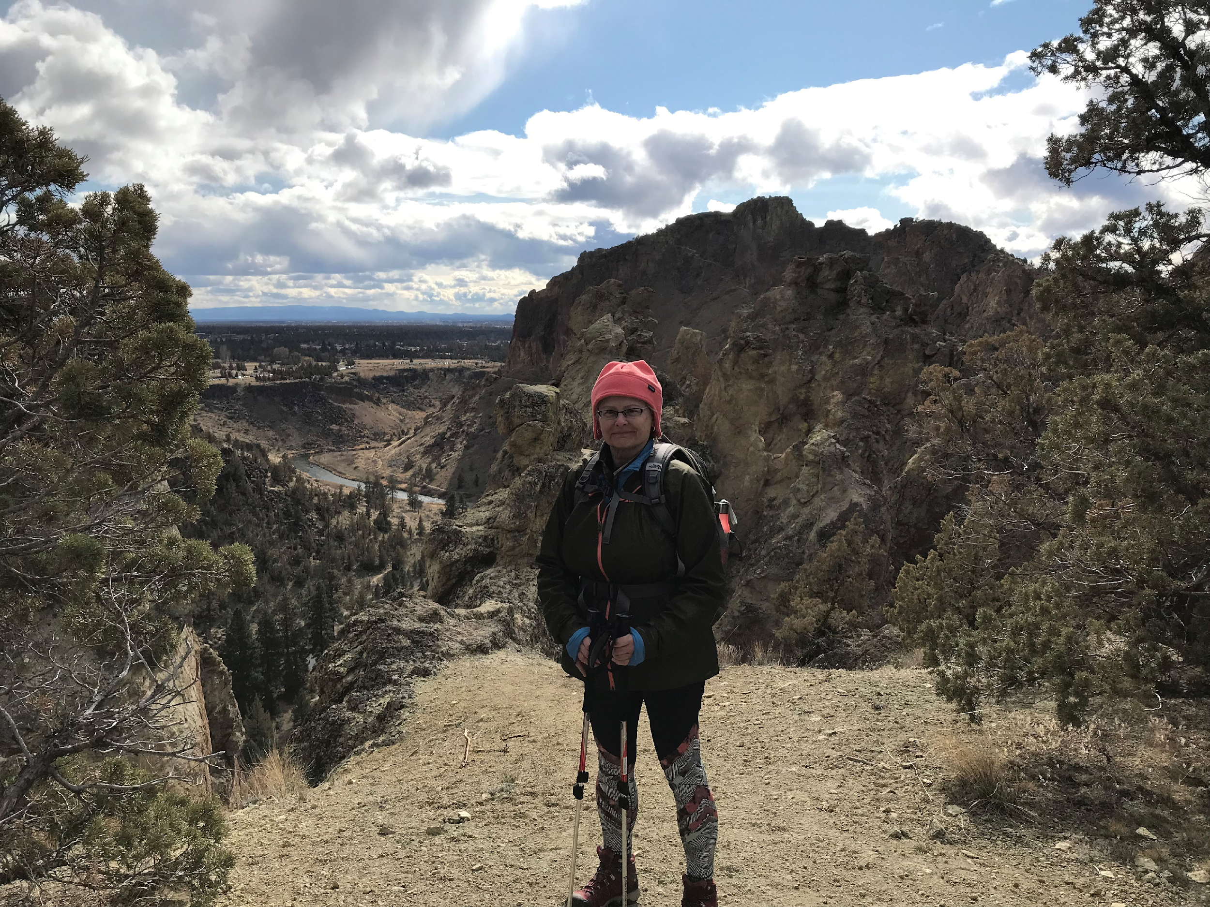
Thank You, Karen – enjoy your retirement!
13 January 2020
MRAM

Slide 55
Foreign Influence & Related Federal Agency Policy Changes
January, 2022 MRAM
Carol Rhodes
Office of Sponsored Programs

Slide 56
Dept. of Energy (DOE): Foreign Government-Sponsored Talent Recruitment Programs (FGTRP)
All contractor personnel are prohibited from participating on a Foreign Government-Sponsored Talent Recruitment Programs (FGTRP)
There are no exceptions to this policy
All contractor personnel are restricted from Other Foreign Government Sponsored or Affiliated Activities of a Foreign Country of Risk
DOE may allow some exemptions - DOE will review requests

Slide 57
What Does This Mean?
When award terms include:
CONTRACTOR REQUIREMENTS DOCUMENT (CRD) “DOE ORDER 486.1A”, FOREIGN GOVERNMENT SPONSORED OR AFFILIATED ACTIVITIES
The PI and all participating personnel need to fill out the UW’s Foreign Government-Sponsored Talent Recruitment Programs (FGTRP) Disclosure Form, sign, and return to OSP via osp@uw.edu
OSP will hold the FA until the forms are returned

Slide 58
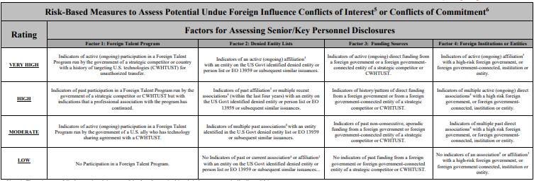
Defense Advanced Research Projects Agency (DARPA) - Foreign Interests Rubric
DARPA has a Risk Rubric they will use to review disclosures from all proposed Senior/Key Personnel. Four criteria factors at four different risk levels from low to very high.
Senior/Key Personnel Foreign Influence Risk Rubric
Countering Foreign Influence Program (DARPA Policy)
Countering Foreign Influence Program (CFIP) Frequently Asked Questions (FAQ)
DARPA for Universities
Notes:
image of risk rubric is small - 4 types of factors with 4 risk rating levels - review on DARPA site for more information

Slide 59
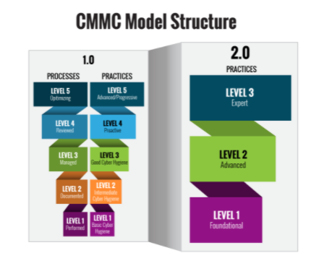
Dept. of Defense (DOD)
Cybersecurity Maturity Model Certification (CMMC) 2.0
Simplifies the CMMC security standards.
https://www.acq.osd.mil/cmmc/about-us.html

Slide 60
CMMC, con’td.
Focuses the most advanced cybersecurity standards and third-party assessment requirements on companies.
Allows all entities at Level 1 and a subset of entities at Level 2 to demonstrate compliance through self-assessments (rather than third -party).

Slide 61
CMMC in Solicitations
DoD will pursue rulemaking with the usual public comment period.
DoD suspended all CMMC Piloting efforts and will not include CMMC requirements in any DoD solicitation until the rulemaking process is completed. (9-24 months from Nov. 2021)

Slide 62
NIH - Other Support Documentation
Updated File Format for the Other Support and Biosketch required for applications on or after 1/25
Flatten these PDFs & retain the signature on file in your department
UW:
Current, Pending, and Other Support
NIH PDF Guidance as of May 2021
Foreign Interests in Sponsored Programs
NIH:
Other Support FAQs
Instructions for How to Flatten a PDF
NOT-OD-21-110

Slide 63
Questions

Slide 64
Updates
2021 Evaluation Results for Zoom courses
(44% rate of return, 1075 Zoom attendees)
CORE Registration:
https://uwresearch.gosignmeup.com/public/course/browse
“I am confident I can apply the knowledge and skills presented in this class to my job.” 95% Strongly Agree/Agree
2. “Presenter(s) delivered an effective and well-organized presentation.” 94% Strongly Agree/Agree
3. “I received high value for my investment of time in this course.” 91% Strongly Agree/Agree
4. “Overall, I rate the quality of this course as very high.” 93% Strongly Agree/Agree
CORE Home: https://www.washington.edu/research/required-training/faculty-grants-management/

Slide 65
Updates
CORE online courses
815 completions in 2021
Updates for 2022
Improved accessibility
Evaluation surveys
FT Impacts on CORE curriculum
Analysis phase
CORE Registration:
https://uwresearch.gosignmeup.com/public/course/browse
CORE Home: https://www.washington.edu/research/required-training/faculty-grants-management/

