Slide 1
UPDATE ON
ADMINISTRATIVE
POLICY STATEMENT 10.13
REQUIREMENTS FOR UNIVERSITY
& THIRD PARTY LED YOUTH PROGRAMS AND RESEARCH
January 13, 2022
Notes:
CAROLINE
Thank you for the opportunity to present again. Today I’ll give a brief refresher of APS 10.13, share current compliance data as it relates to research, and offer options to engage with us to address any questions about these requirements.
Also, one update about our office- our name has changed to the Office of the Youth Protection Coordinator, and we now reside in Compliance Services under the leadership of Jane Yung, Executive Compliance and Risk Officer and Jill Lee, Executive Director of Compliance Services.

Slide 2
Office Operations
Policy Administrator
Primary: EO 56, APS 10.13
Policy partner for: APS 10.9, APS 44.3, EO 31, EO 51, EO 54, EO 55.
University Consultant
Risk mitigation, triage behaviors of concern or incidents involving minors
Policy compliance strategies, general programming best practices
Convener
Coordinate efforts among youth program providers, health, safety and risk SMEs to raise awareness of youth on campus
Youth Safety Champion
Focus on youth safety in adult-oriented University setting
www.uw.edu/youth
Notes:
A brief reminder of our office functions which haven’t changed, we serve as a central resource for questions and concerns regarding the safety of youth who engage with the University.
We are the primary policy administrator for APS 10.13 among other university policies that directly or indirectly address youth safety and well-being.
As this slide outlines, we also consult regularly with departments or individuals and I will make the offer again at the end but we are willing to meet with a research group or department to discuss these requirements in more detail as is helpful.

Slide 3
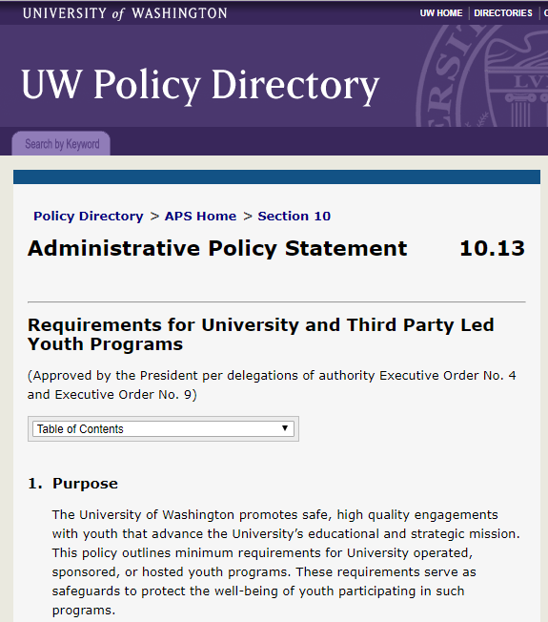
APS 10.13
Establishes minimum standards to safeguard the well-being of youth (persons under age 18) participating in UW led activities, events, programs, or research.
regardless of location
inclusive of virtual interactions
inclusive of some external IRB studies
inclusive of student-led research
Notes:
A very brief refresher on APS 10.13
This policy establishes minimum standards to safeguard youth who come into contact with University programs or research. The vast majority of studies that involve youth do fall within the scope of these requirements.

Slide 4
APS 10.13 Requirements
Registration of study into the UW Youth Program Registration System
Meet background screening, training, and conduct requirements
Report behaviors of concern
Maintain safe environments
Emergency and safety planning and response
Standards for data privacy (Research is exempt from this requirement)
Notes:
The requirements are intended to supplement existing practices and in many cases do require additional steps to be taken by study teams.
For example, specific background screening, training and conduct requirements are in place for personnel who may have unsupervised access to minors. We refer to these individuals as “authorized personnel.”

Slide 5
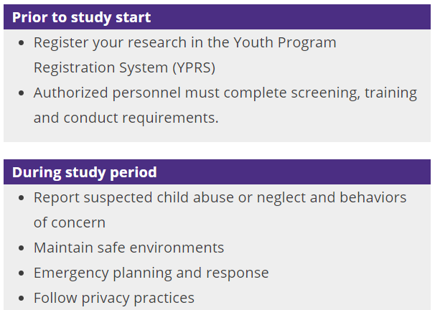
(Compliance metrics in YPRS)
Notes:
Most actions must be taken prior to the start of the study.
First, the study must be registered in the Youth Program Registration System. YPRS automatically initiates a registration form using information from Zipline. Our office reviews Zipline submissions to confirm the study is in-scope of APS 10.13, and then we send e-mail notification to the PI and any other contacts listed in Zipline requesting that they complete the registration process.
Next, any personnel added to the registration will receive requests to complete online trainings and a conduct form. Some will receive notifications about required background checks if there isn’t a current one on file within the last 3 years. All of these steps should be completed prior to the start date of the study.

Slide 6
Registration and compliance trends
Identified via Zipline 187
In-scope, actionable 108
Registration status (n=108)
Incomplete 44
Complete 64
Compliance status (n=64)
Compliant 46
Partially compliant 8
Not compliant 18
For studies submitted
to Zipline
1/1/21-12/31/21
Notes:
We began reviewing Zipline submissions midway through last year, starting with anything newly submitted as of January of 2021.
In 2021 there were 187 new studies that identified involvement with minors.
We determined that 108 studies were in scope of APS 10.13 and requested them to register with YPRS.
Of the 108 studies notified, 64 studies completed their registration forms, and 44 have not yet completed their registration forms.
Of the 64 studies that submitted registration forms, 46 completed all personnel requirements prior to their study start date and are considered compliant with the tracked requirements.
The difference between partial and non-compliance is that we consider a program partially compliant if they complete all requirements after the start date of a study but before its end date. Studies are not compliant have actions by one or more authorized personnel that are not yet complete. A study can move from not compliant to partially compliant.
As mentioned in the previous slide, the key actions that need to be completed prior to start of the study are 1) registration of the study in YPRS and 2) completion of all personnel actions. By that definition, the research community is only at around 43% compliant with APS 10.13 requirements.
Compliance looks a little better for studies that did register with YPRS. 72% completed all required personnel actions in time, which is a good start.
We hope that through continued outreach efforts on our part and support from units we can increase compliance rates of these two key steps.

Slide 7
Compliance challenges and OYPC response
Challenge
Lack of response to OYPC notifications, resulting in incomplete registrations or non-compliance with requirements
Background
E-mails come from
uwminors@uw.edu and/or
mail+1zg8.s79jk@ideal-logic.com
subject line: “Action required: youth-involved research requirements.”
Response
Individualized outreach to PI and proxies (ID’ed in Zipline)
Web-based resources at www.uw.edu/youth
Notes:
I’ll share the most common themes of our current compliance challenges, and thoughts about what strategies can improve compliance, including actions my office is taking.
The most predominant challenge we face is a lack of response by study contacts to notifications from our system. This results in a study registration not being completed, or in registered studies being considered non-compliant.
We send multiple notifications auto-generated from our system but often get no response. For the approximately 70 studies where there is a lack of response to notifications sent by our system, we send individualized e-mails to PI’s and other contacts listed in Zipline.
We also have web-based resources specifically for researchers to answer questions and support taking action.

Slide 8
Compliance challenges and OYPC response
Challenge
Personnel actions not complete by study start date.
Background
Notifications sent to personnel until they are compliant or the study ends.
PI’s receive weekly notifications of any noncompliant authorized personnel.
After start date, escalated notifications go to department heads.
Response
Escalating notifications
Quarterly reports to unit heads and administrators
Notes:
As I mentioned before, authorized personnel must complete their training, conduct and background check steps prior to the study start date. We try to prevent non-compliance with ample notification to PI’s and authorized personnel that escalates in frequency and urgency as they approach their study start date.
We send quarterly reports to study contacts and also unit heads and unit administrators to share compliance statuses for youth programs and research studies.
For studies that are registered, we have what I would consider a good starting place of compliance, at around 70%. I am confident that with greater awareness and attention, this will steadily improve.

Slide 9
Other challenges and OYPC response
Challenge
Student-led research lacks a funding source for background checks. (Background checks are processed through UW HR)
Response
Units need to identify a funding source to pay for background checks, or
Develop a process to pass cost onto student, or
Establish agreement with UW HR that an existing school administered background screening is equivalent
Challenge
Studies outside of Zipline may not know about requirements of APS 10.13, e.g., exempt, evaluations, QI initiatives, etc.
Response
Continued outreach from OYPC to research groups
OYPC can meet with and answer questions for departments and research groups
Notes:
Finally, I’ll share a couple of additional challenges here on this one slide.
We have come across a challenge of student led research that doesn’t have a funding source to pay for background checks. We have worked with different departments to come up with solutions to fill this gap. Our three general recommendations are that units identify a funding source to cover these background checks, or develop a way to pass the cost to students. In some cases when students undergo background checks as part of their enrollment, these can suffice as an alternative, if they are reviewed by UW HR for equivalency.
Zipline provides a way to systematically identify studies but we know that there are studies, evaluations, quality improvement initiatives and the like that may not be aware of university requirements. Ultimately our goal is that any engagement with children by the university is done with safeguards in place. We will continue to do our outreach to departments and are always willing to meet with teams, departments or research groups to explain processes and answer questions.

Slide 10
Contact information
Caroline Shelton cshelton@uw.edu
Laura Harrington laurah13@uw.edu
General inbox uwminors@uw.edu
Notes:
Please don’t hesitate to contact us with any questions or to request a meeting with your research group or department.
Thank you for your time!

